Slide 1
Rationalising denominators (1.6)

Slide 2
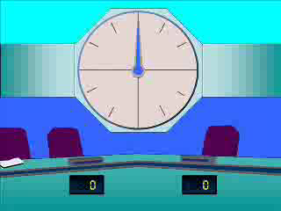
1
Rationalise the denominator:
$$\frac{\sqrt{2}}{\sqrt{11}}$$
a) $\frac{2\sqrt{11}}{11}$
b) $\frac{2\sqrt{11}}{\sqrt{11}}$
c) $\frac{\sqrt{22}}{\sqrt{11}}$
d) $\frac{\sqrt{22}}{11}$

Slide 3
2
Rationalise the denominator:
$$\frac{9}{2\sqrt{10}}$$
a) $\frac{9}{20}$
b) $\frac{9\sqrt{10}}{10}$
c) $\frac{9\sqrt{10}}{20}$
d) $\frac{9}{2}$

Slide 4
3
Rationalise the denominator:
$$\frac{1}{\sqrt{3}+1}$$
a) $\frac{\sqrt{3}−1}{2}$
b) $\frac{\sqrt{3}−1}{4}$
c) $\frac{\sqrt{3}+1}{2}$
d) $\frac{\sqrt{3}+1}{4}$

Slide 5
4
Rationalise the denominator:
$$\frac{9}{1−\sqrt{10}}$$
a) $−\sqrt{10}$
b) $\sqrt{10}$
c) $−1−\sqrt{10}$
d) $−1$

Slide 6
5
Given that $x=2\sqrt{2}, y=\sqrt{18}$
and $z=\sqrt{32}$ , work out $\frac{y}{x+z}$ .
a) $\frac{9}{20}$
b) $\frac{3\sqrt{2}}{12}$
c) $\frac{1}{2}$
d) $\frac{3\sqrt{2}}{16}$

Slide 7
6
What is the value of $x$ if:
$\frac{30\sqrt{x}}{\sqrt{3}}=2\sqrt{3}$ ?
a) $\frac{1}{25}$
b) $\frac{9}{25}$
d) $\sqrt{\frac{6}{30}}$
c) $\frac{1}{5}$

