Slide 1
Surds (1.5)

Slide 2
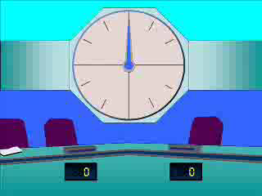
1
Simplify this expression fully:
$$\sqrt{12}+\sqrt{27}$$
a) $3\sqrt{5}$
b) $\sqrt{39}$
c) $5\sqrt{3}$
d) Cannot be simplified

Slide 3
2
Simplify this expression fully:
$$6\sqrt{9}+4\sqrt{3}+3\sqrt{3}+2$$
a) $6\sqrt{9}+7\sqrt{3}+2$
b) $25\sqrt{3}+2$
c) $13\sqrt{3}+2$
d) $7\sqrt{3}+20$

Slide 4
3
Simplify this expression fully:
$$15\sqrt{4}+20\sqrt{2}+3\sqrt{2}+4$$
a) $23\sqrt{2}+34$
b) $38\sqrt{2}+4$
c) $15\sqrt{4}+23\sqrt{2}+4$
d) $53\sqrt{2}+4$

Slide 5
4
Expand and simplify this fully:
$${\left(9+\sqrt{3}\right)}^{2}$$
a) $\sqrt{54}+84$
b) $18\sqrt{3}+84$
c) $12$
d) $84$

