Slide 1
Negative and fractional Indices (1.4)

Slide 2
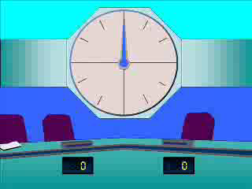
1
Evaluate ${27}^{\frac{2}{3}}$
a) $18$
b) $9$
c) $243$
d) $3$

Slide 3
2
Evaluate ${100}^{−\frac{3}{2}}$
a) $−10$
b) $\frac{1}{1000}$
c) $−\frac{1}{100}$
d) $\frac{1}{10}$

Slide 4
3
Evaluate ${(−27)}^{−\frac{1}{3}}$
a) $\frac{1}{9}$
b) $\frac{1}{3}$
c) $−\frac{1}{3}$
d) Not possible

Slide 5
4
Evaluate ${\left(\frac{8}{27}\right)}^{−\frac{2}{3}}$
a) $−\frac{4}{9}$
b) $−\frac{4}{6}$
c) $\frac{4}{9}$
d) $\frac{9}{4}$

Slide 6
5
Evaluate ${\left(\frac{64}{27}\right)}^{−\frac{2}{3}}$
a) $\frac{8}{6}$
b) $−\frac{16}{9}$
c) $\frac{9}{16}$
d) $\frac{16}{9}$

Slide 7
6
Simplify $\frac{5^{\frac{1}{2}}×\sqrt[3]{5}}{{\left(\sqrt[3]{5}\right)}^{4}÷\sqrt{5}}$
a) $\sqrt{5}$
b) $\sqrt{2^{9}}$
c) ${\left(\sqrt[12]{5}\right)}^{7}$
d) $1$

