Slide 1
Expanding brackets (2.2)

Slide 2
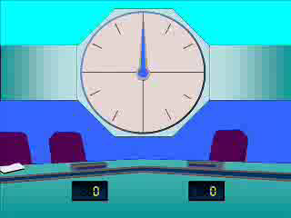
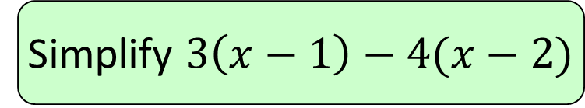




1
Simplify $3\left(x−1\right)−4(x−2)$
a) $−x+5$
b) $−x+1$
c) $−x−1$
d) $−x−5$

Slide 3
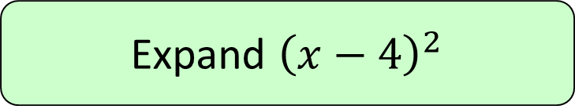

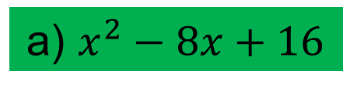
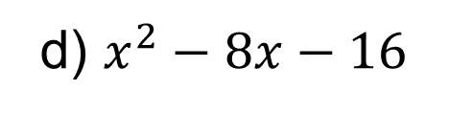

2
Expand ${\left(x−4\right)}^{2}$
a) $x^{2}−8x+16$
b) $x^{2}+16$
c) $x^{2}−16$
d) $x^{2}−8x−16$

Slide 4
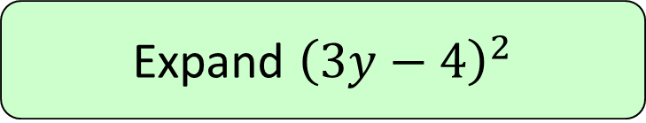
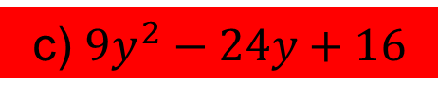
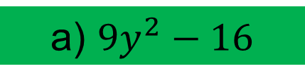
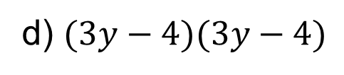

3
Expand ${\left(3y−4\right)}^{2}$
a) $9y^{2}−16$
b) $9y^{2}+16$
c) $9y^{2}−24y+16$
d) $(3y−4)(3y−4)$

Slide 5
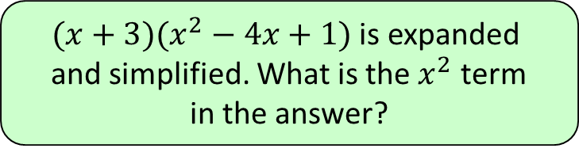




4
$(x+3)(x^{2}−4x+1)$ is expanded
and simplified. What is the $x^{2}$ term
in the answer?
a) $3x^{2}$
b) $−4x^{2}$
c) $x^{2}$
d) $−x^{2}$

Slide 6
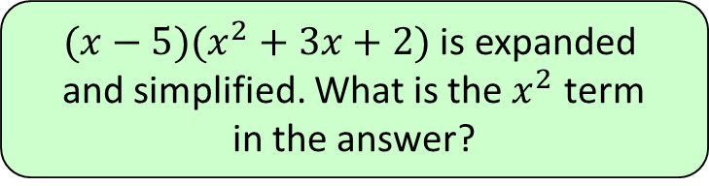



5
$(x−5)(x^{2}+3x+2)$ is expanded
and simplified. What is the $x^{2}$ term
in the answer?
a) $3x^{2}$
b) $−5x^{2}$
c) $−2x^{2}$
d) $2x^{2}$

Slide 7
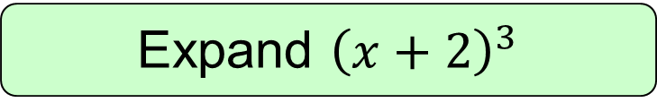

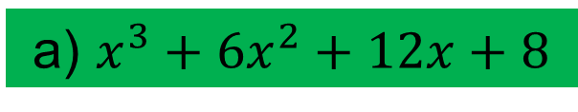
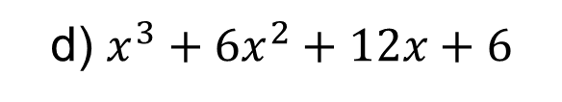
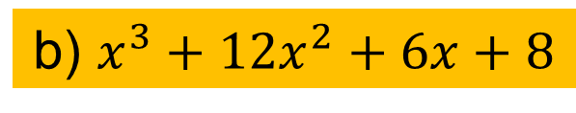
6
Expand ${\left(x+2\right)}^{3}$
a) $x^{3}+6x^{2}+12x+8$
b) $x^{3}+12x^{2}+6x+8$
c) $x^{3}+8$
d) $x^{3}+6x^{2}+12x+6$

Slide 8
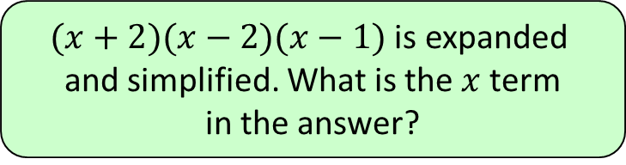




7
$(x+2)(x−2)(x−1)$ is expanded
and simplified. What is the $x$ term
in the answer?
a) $5x$
b) $4x$
c) $−4x$
d) $−5x$

