Slide 1
Old Spec Q’s
Differentiation
First Principles
Practice A
SAM
(ii)
Practice B
SAM
(iii)
Practice C (i)
SAM
(iv)
Practice C (ii)
2018 (i)
Practice D (i)
2018 (ii)
Practice D (ii)
2018 (iii)
SAM
(i)

Slide 2
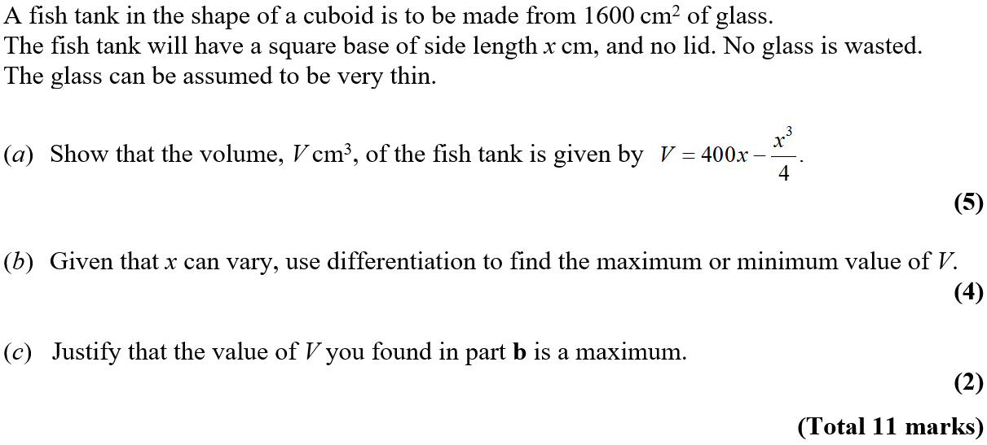
Practice A

Slide 3
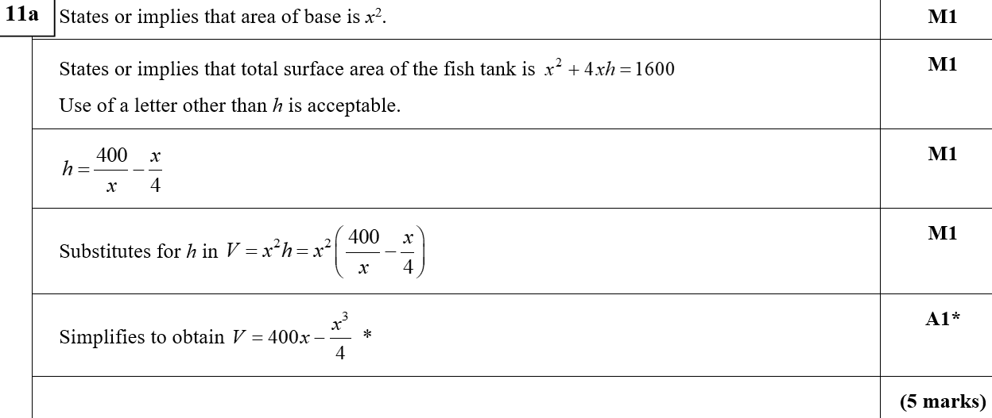
Practice A
A
A notes

Slide 4
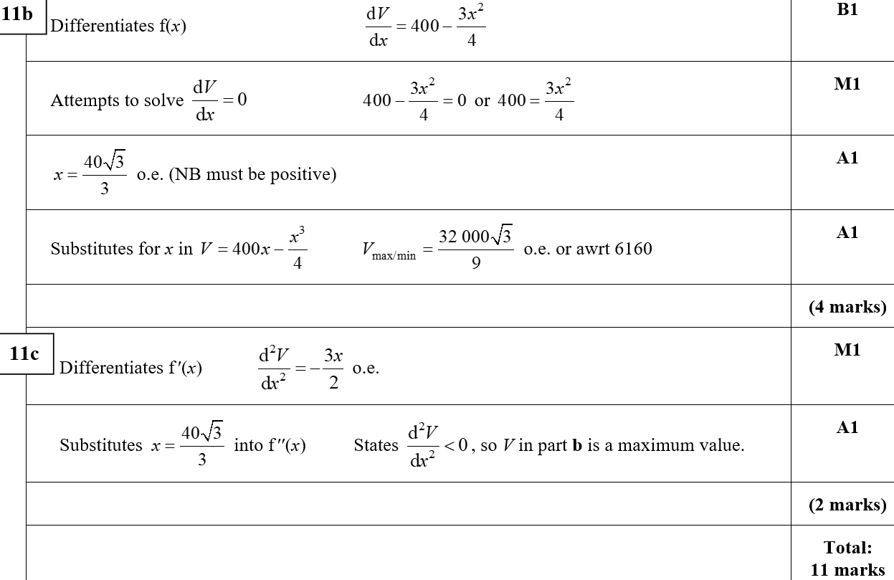
Practice A
B
C
C notes

Slide 5
Practice B

Slide 6
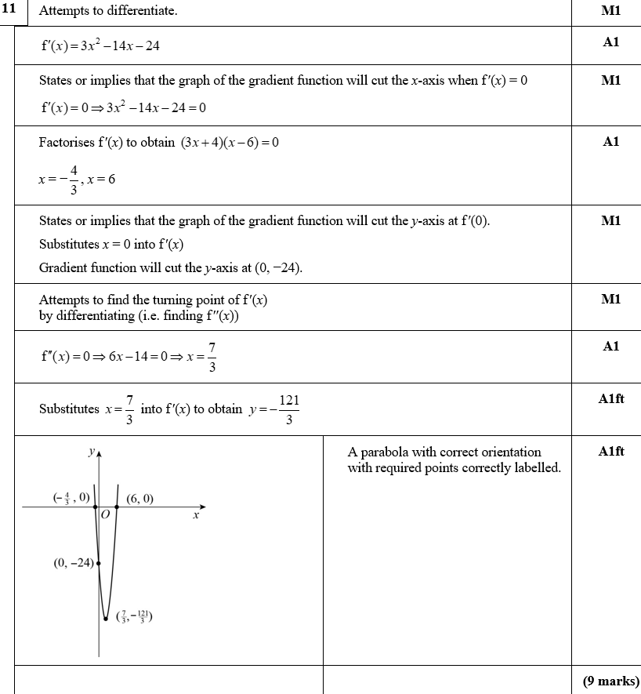
Practice B
A

Slide 7
Practice B
A notes

Slide 8
Practice C

Slide 9
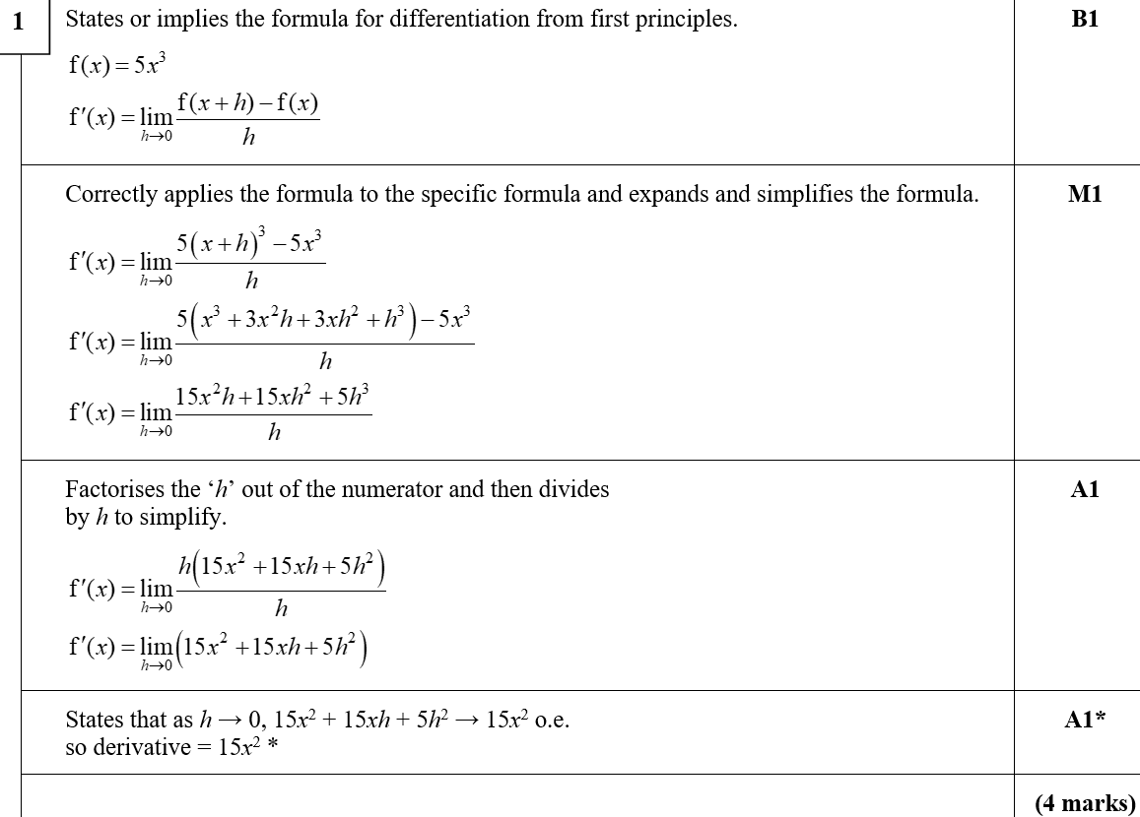
Practice C
A
A notes

Slide 10
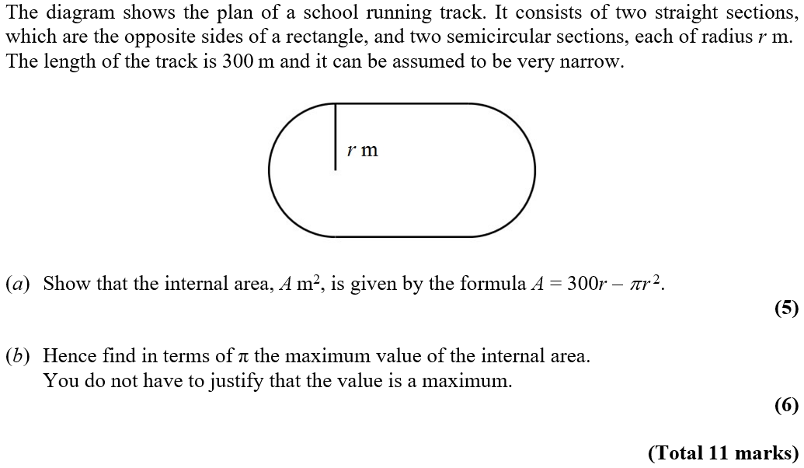
Practice C

Slide 11
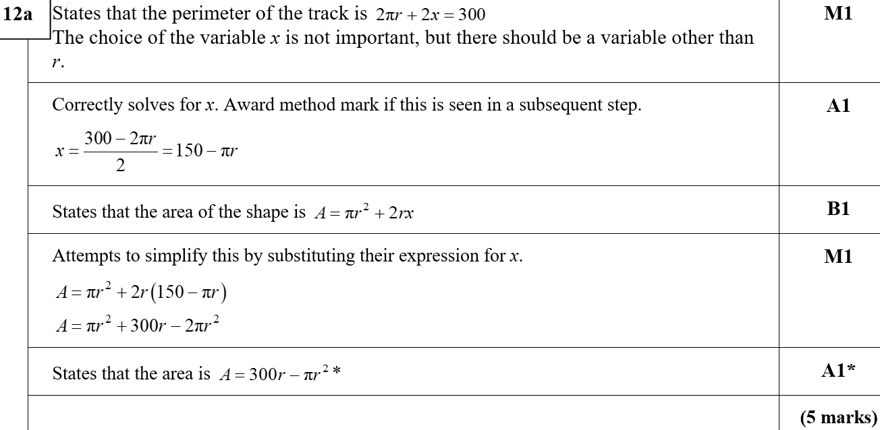
Practice C
A

Slide 12
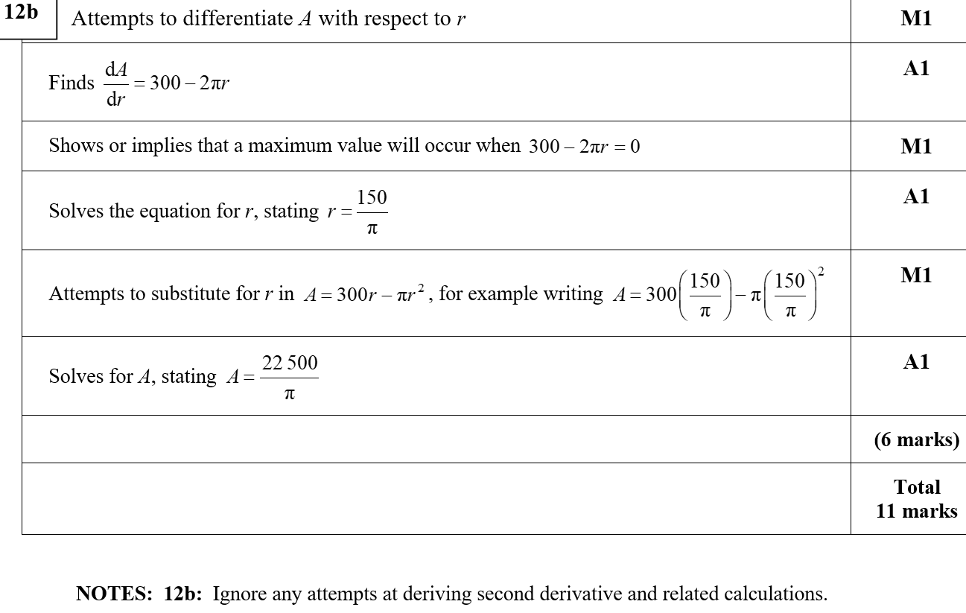
Practice C
B
B notes

Slide 13
Practice D

Slide 14
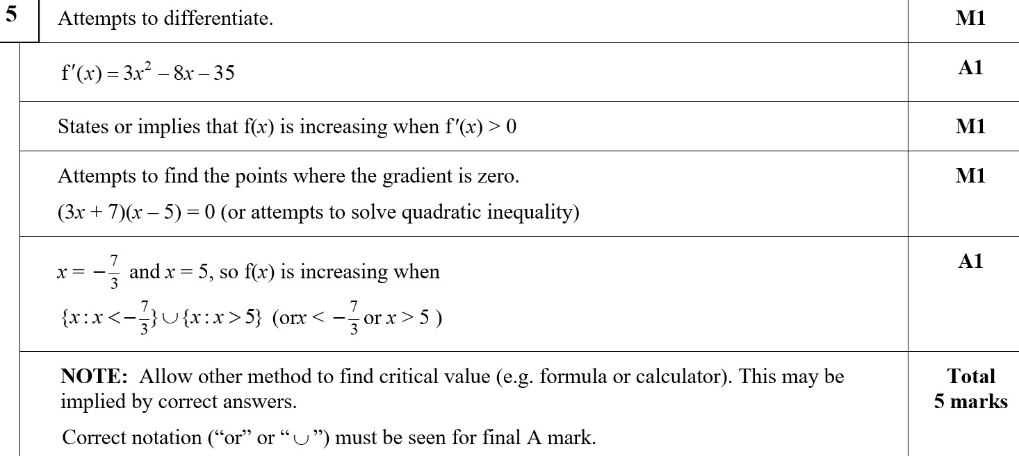
Practice D
A

Slide 15
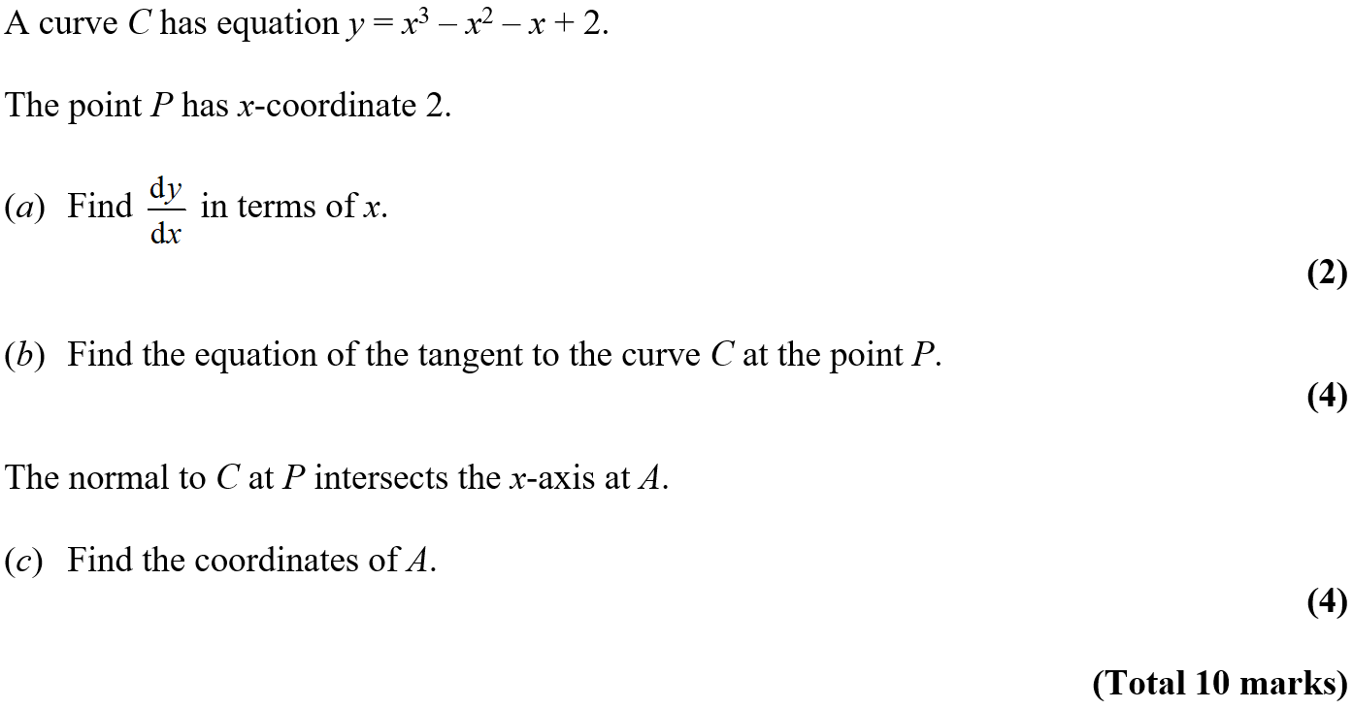
Practice D

Slide 16
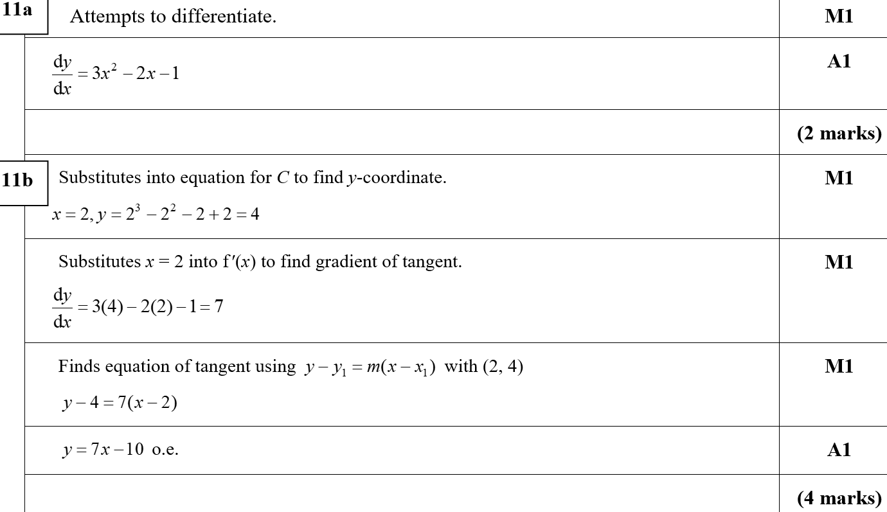
Practice D
A
B

Slide 17
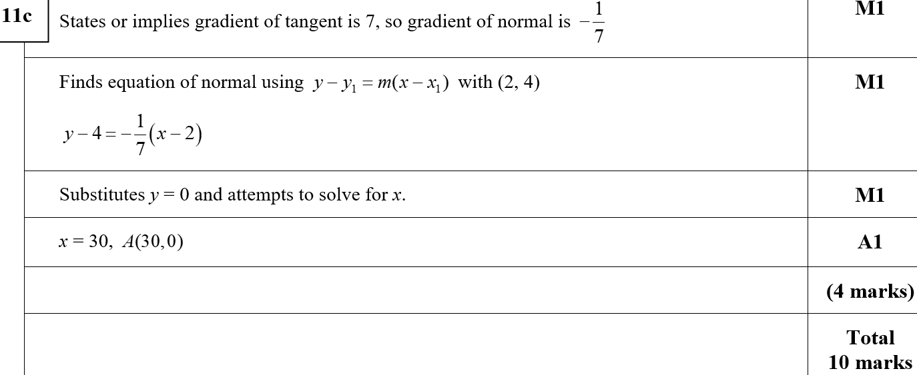
Practice D
C
B notes
C notes

Slide 18
SAM

Slide 19
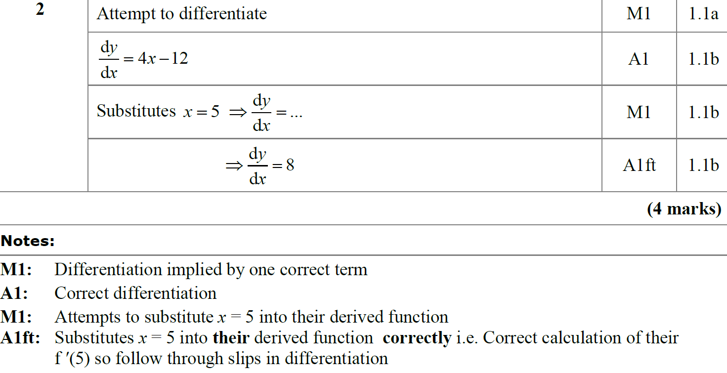
SAM
A
A notes

Slide 20
SAM

Slide 21
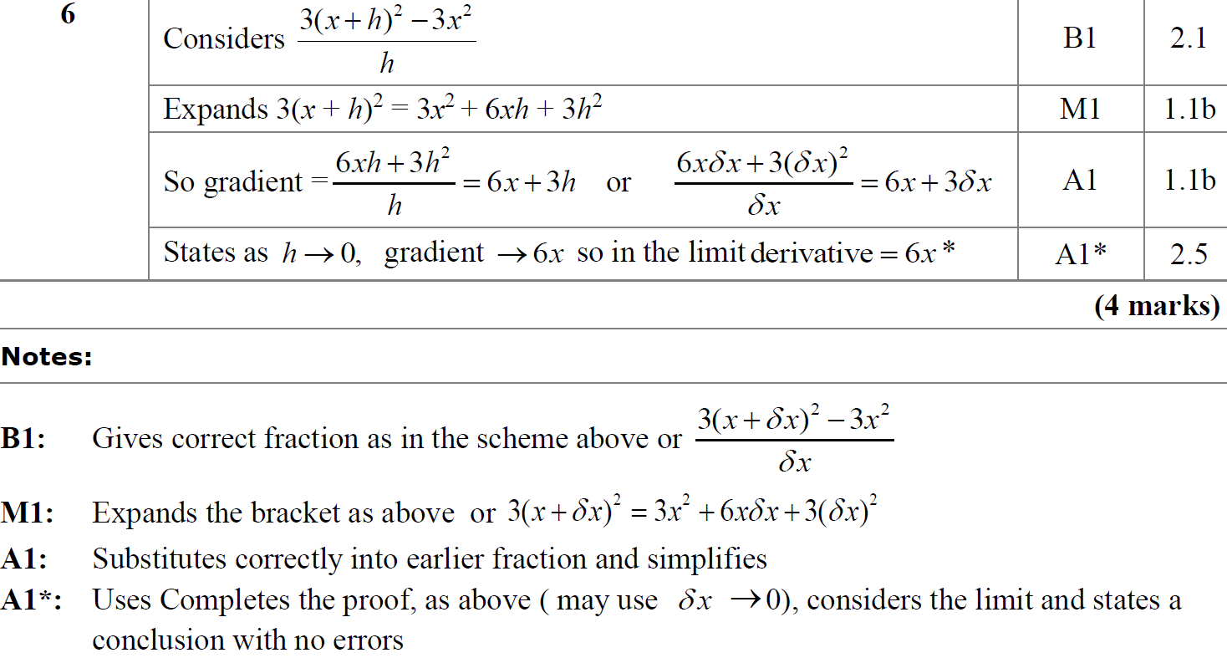
SAM
A
A notes

Slide 22
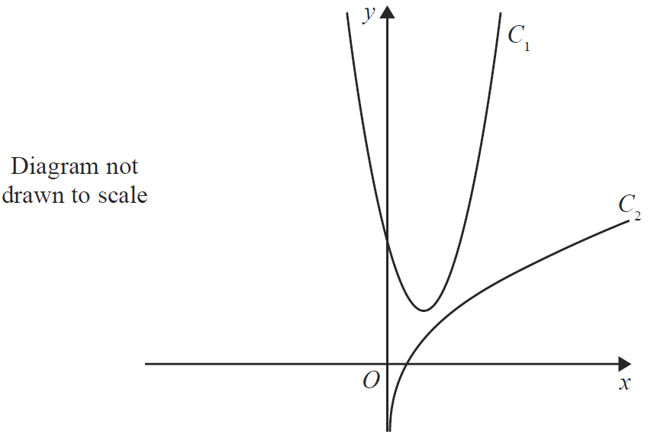
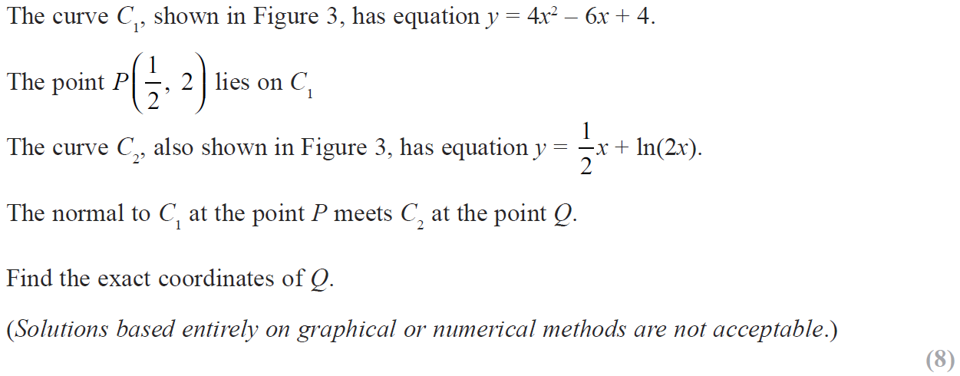
SAM

Slide 23
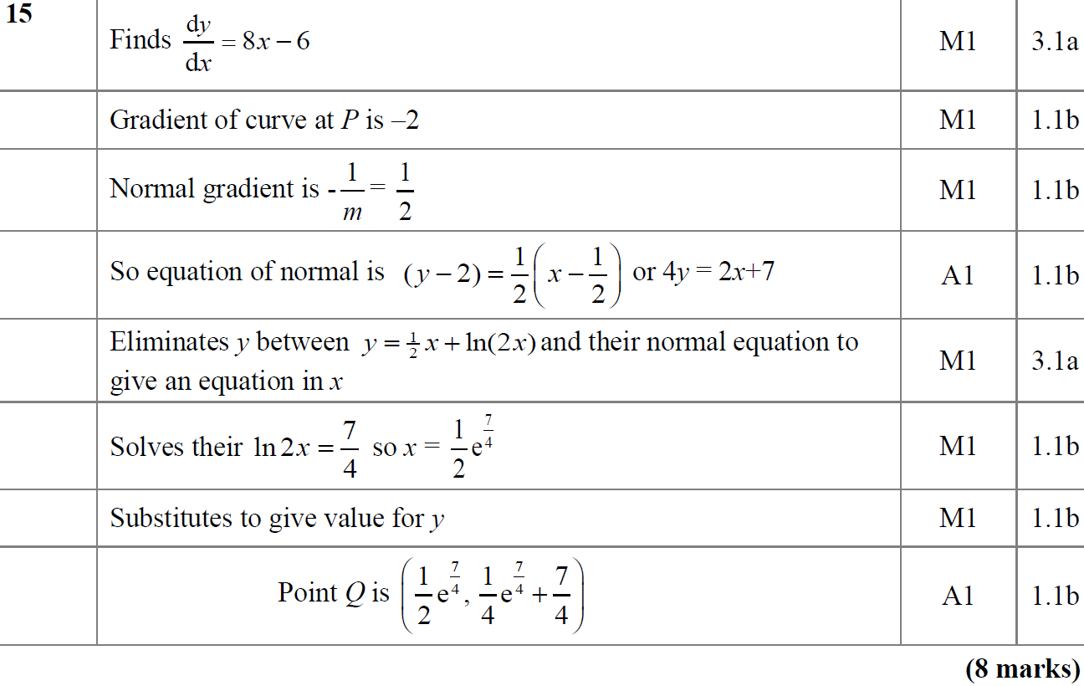
SAM
A

Slide 24
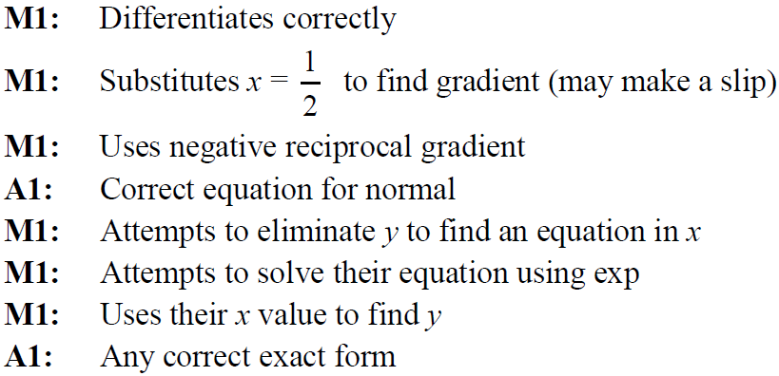
SAM
A notes

Slide 25
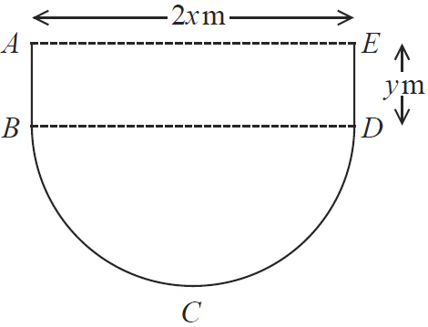
SAM

Slide 26
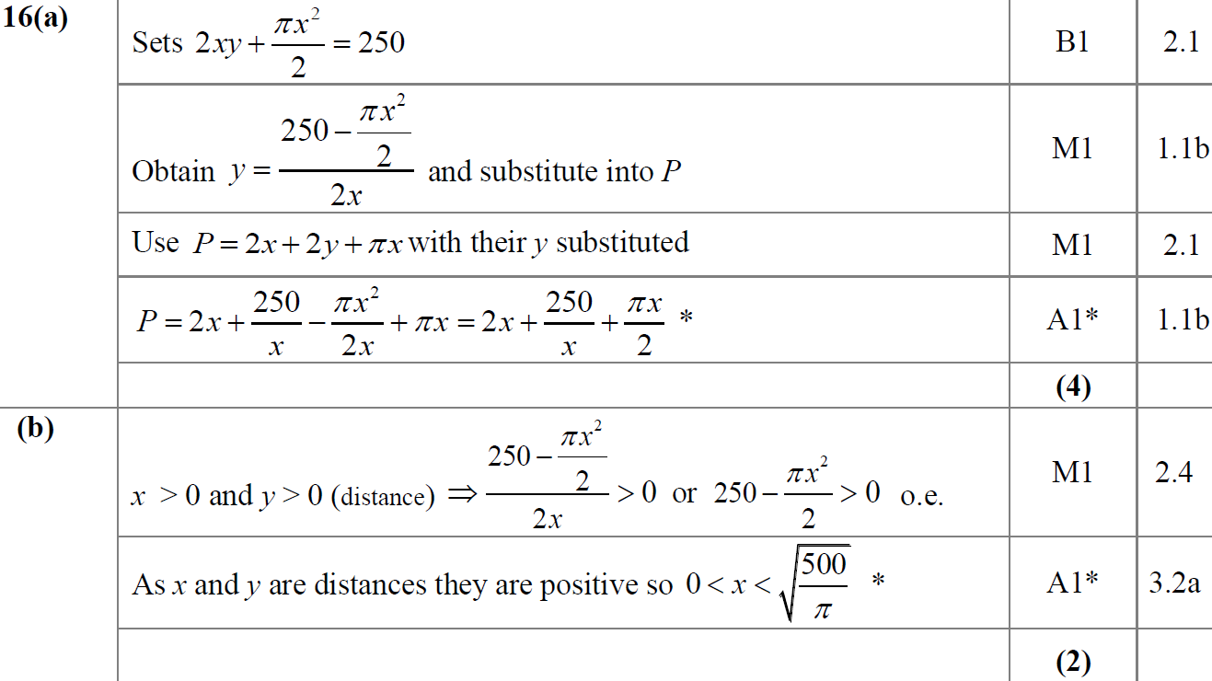
SAM
A
B

Slide 27
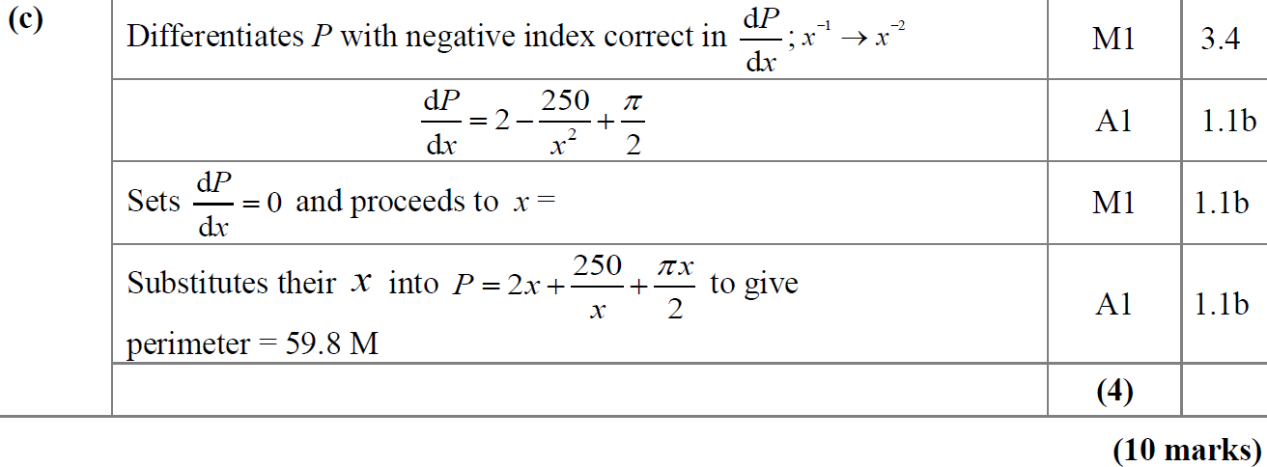
SAM
C

Slide 28
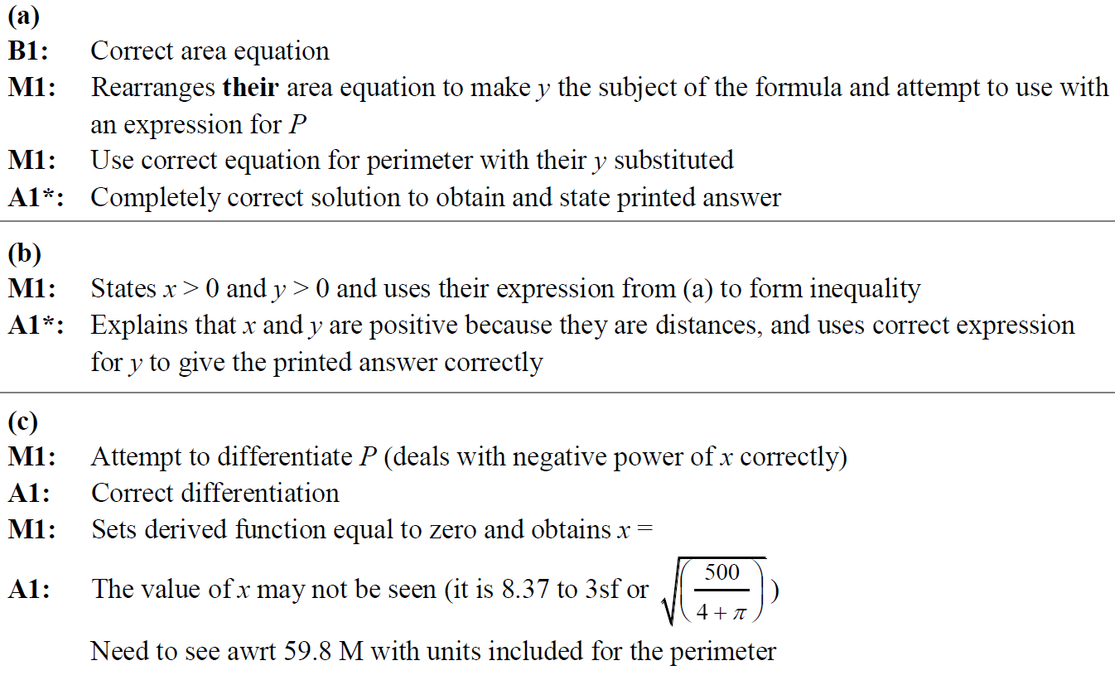
SAM
A notes
B notes
C notes

Slide 29
2018

Slide 30
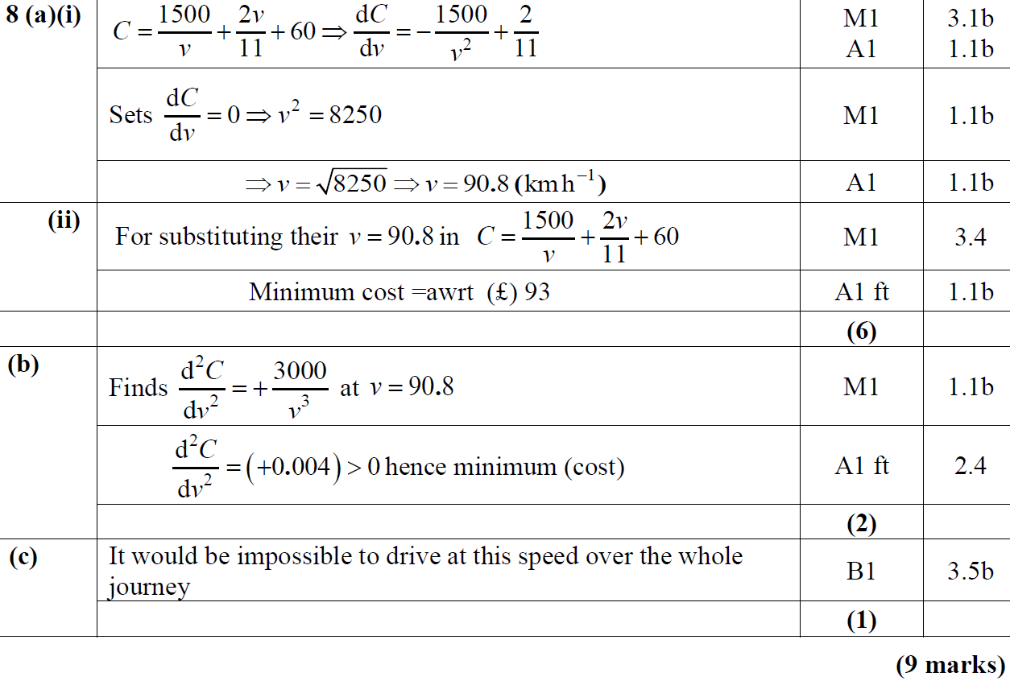
2018
A (i)
A (ii)
B
C

Slide 31
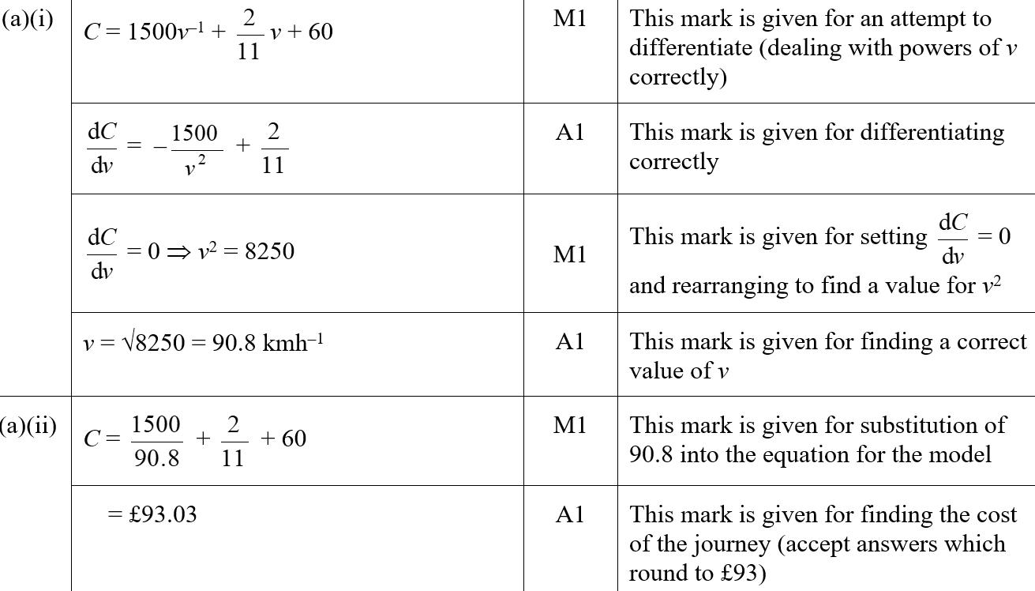
2018
A (i) (SF)
A (ii) (SF)

Slide 32
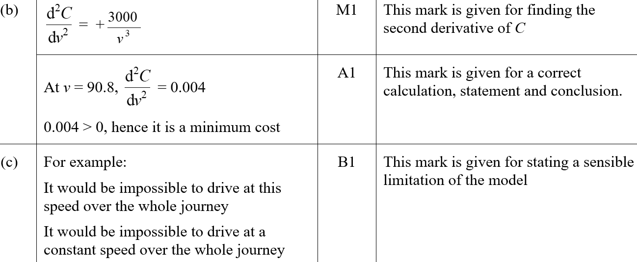
2018
B (SF)
C (SF)

Slide 33
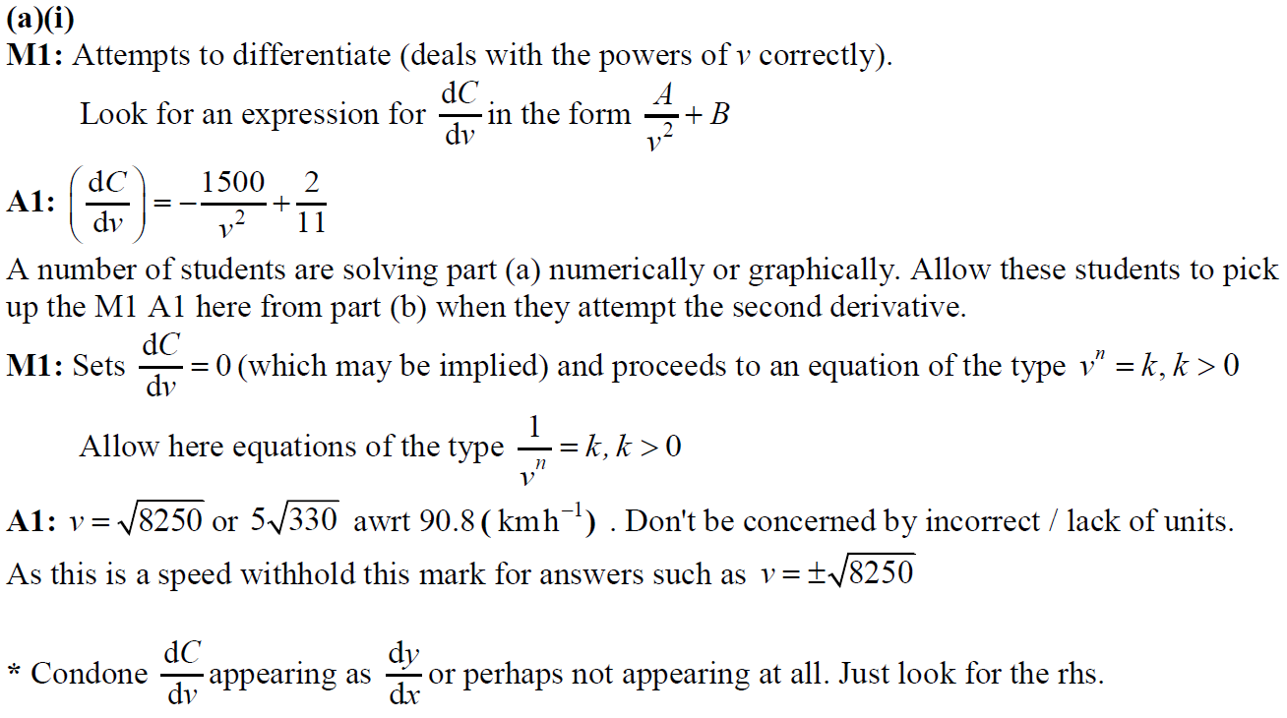
2018
A (i) notes

Slide 34
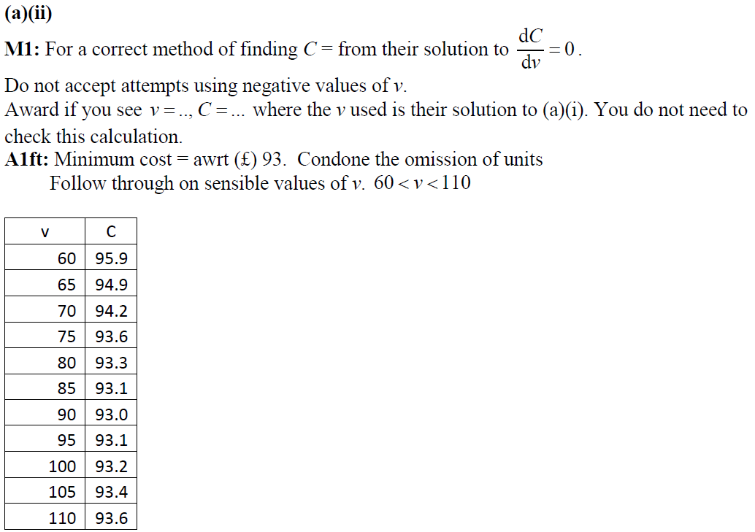
2018
A (ii) notes

Slide 35
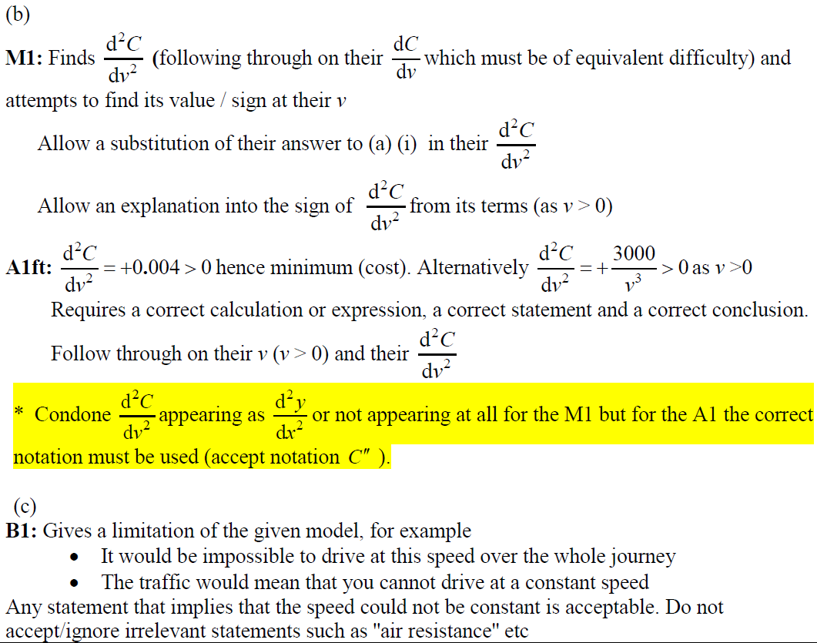
2018
B notes
C notes

Slide 36
2018

Slide 37
2018
A

Slide 38
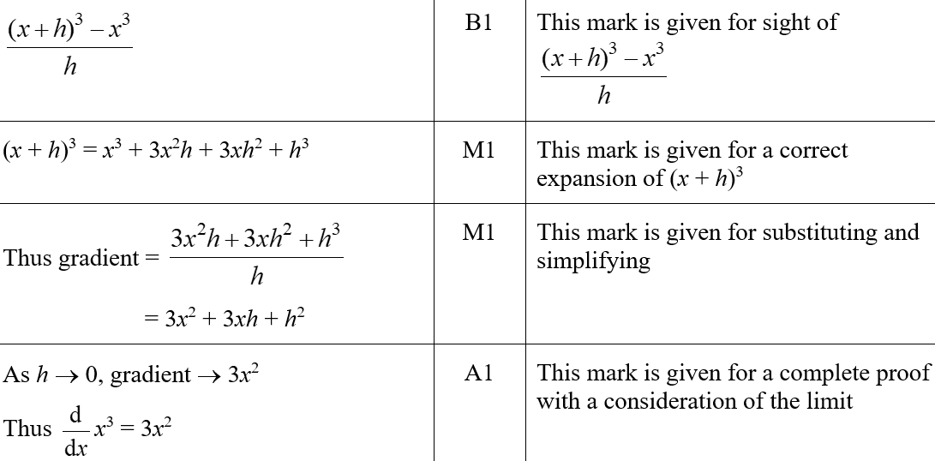
2018
A (SF)

Slide 39
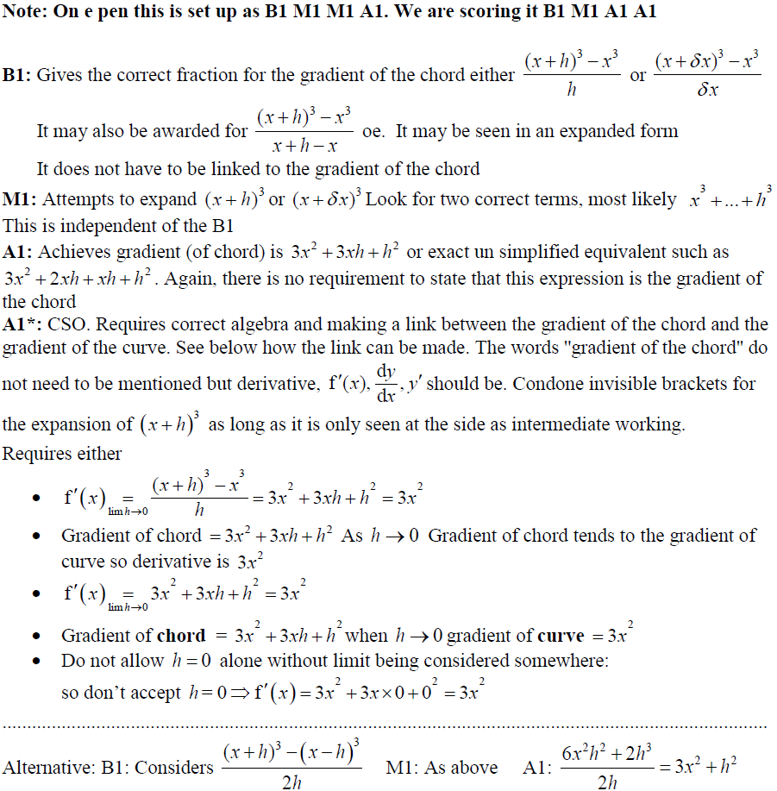
2018
A notes

Slide 40
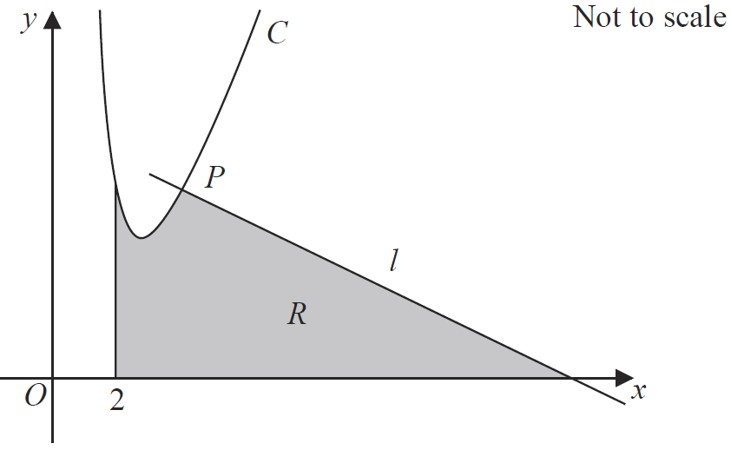
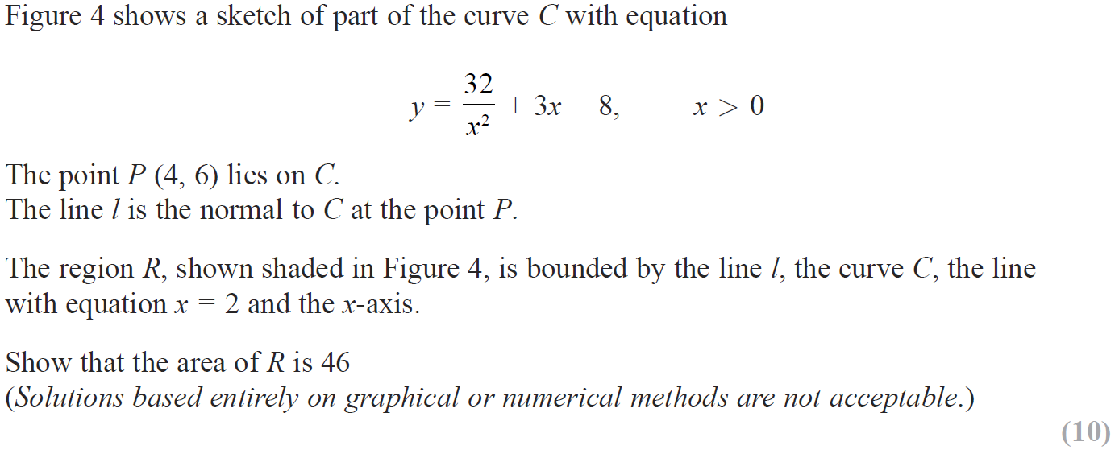
2018

Slide 41
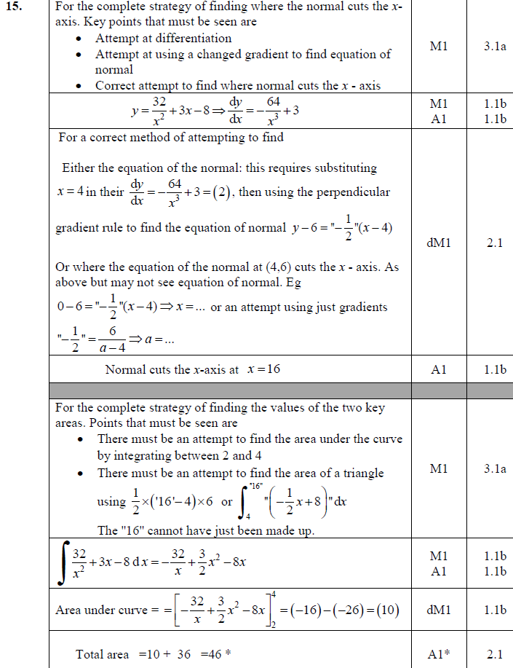
2018
A

Slide 42
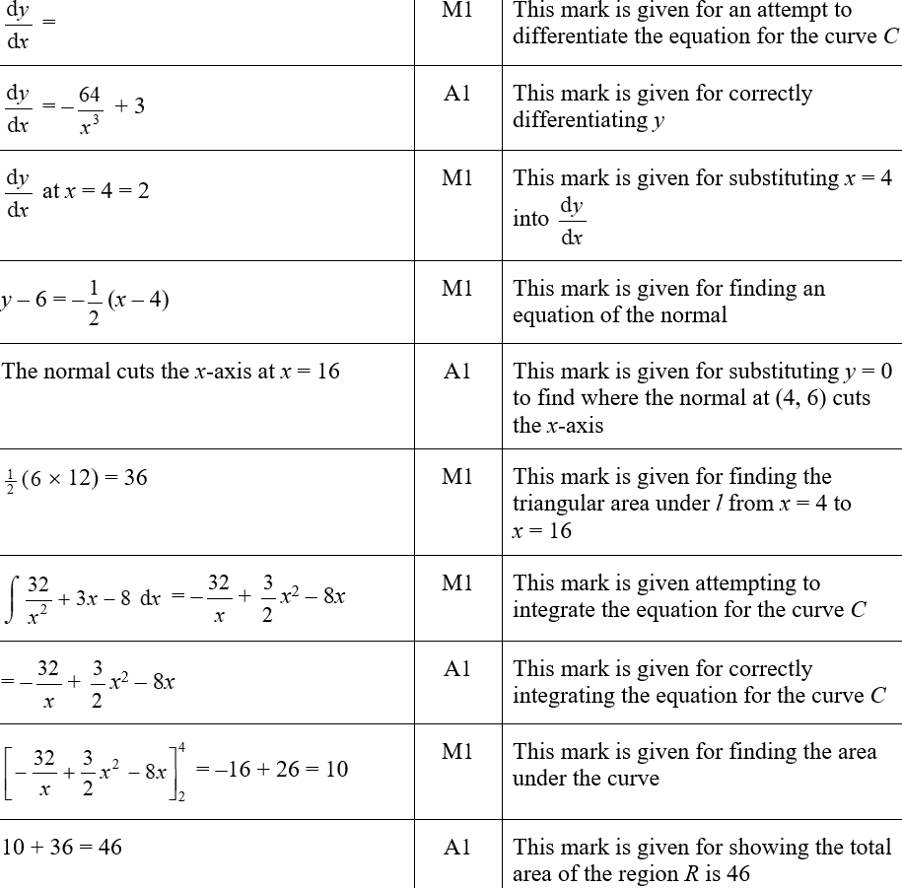
2018
A (SF)

Slide 43
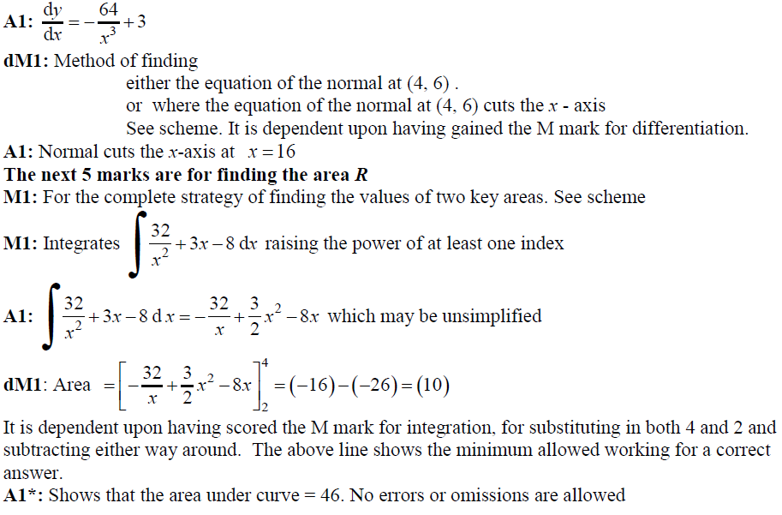
2018
A notes part 1

Slide 44
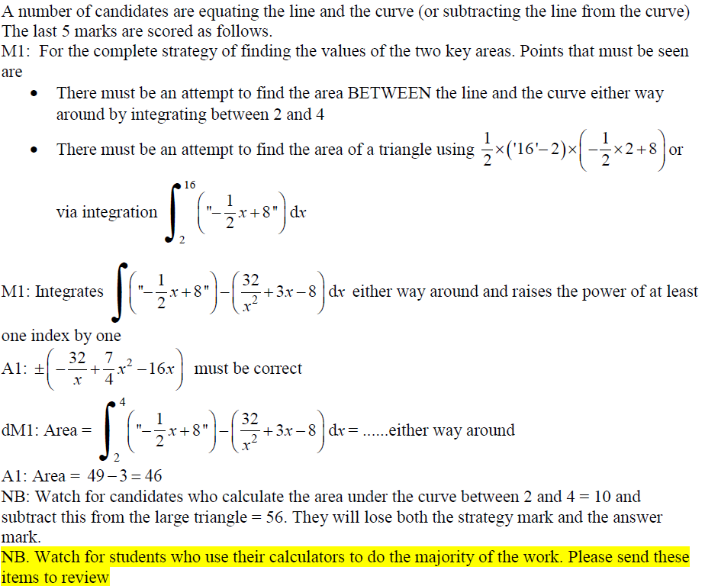
2018
A notes part 2

Slide 45
New Spec Q’s
Old Spec Differentiation
Jan 2006
June 2009
Jan 2013
May 2006
Jan 2010
May 2013
Jan 2007 (i)
June 2010 (i)
May 2014
Jan 2007 (ii)
June 2010 (ii)
May 2015
May 2007
Jan 2011
May 2016
Jan 2008
May 2011
May 2017
June 2008
Jan 2012
May 2018
Jan 2009
May 2012

Slide 46
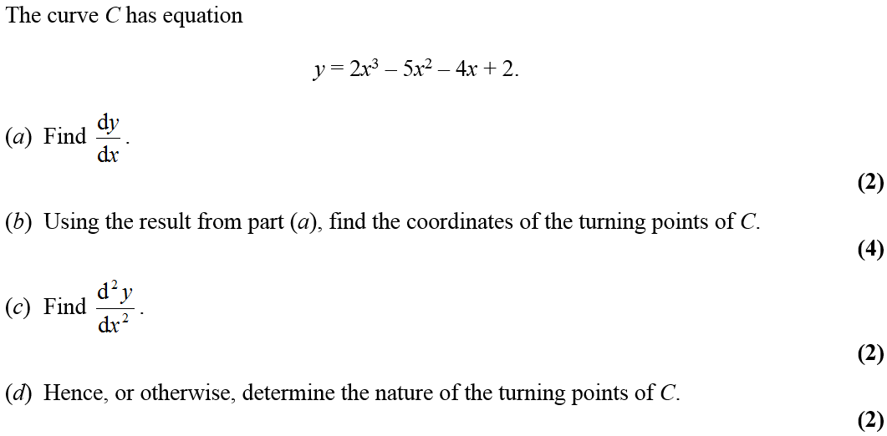
Jan 2006

Slide 47
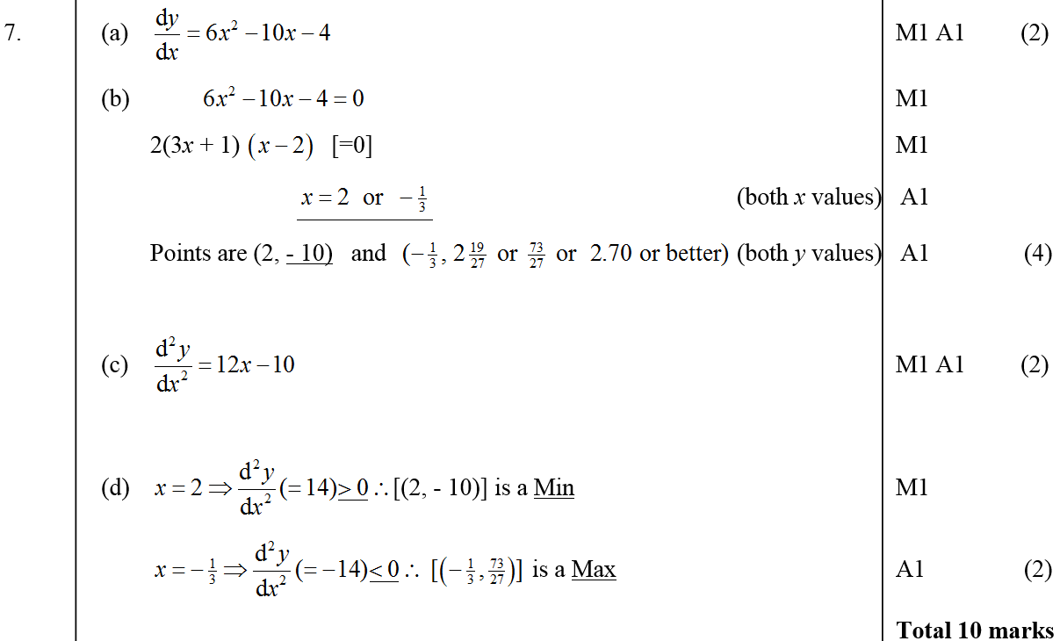
Jan 2006
A
B
C
D

Slide 48
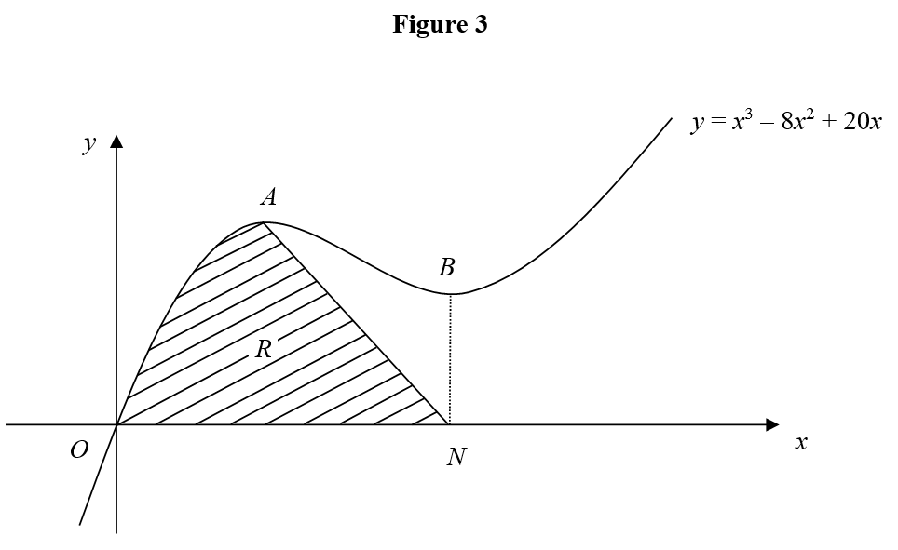
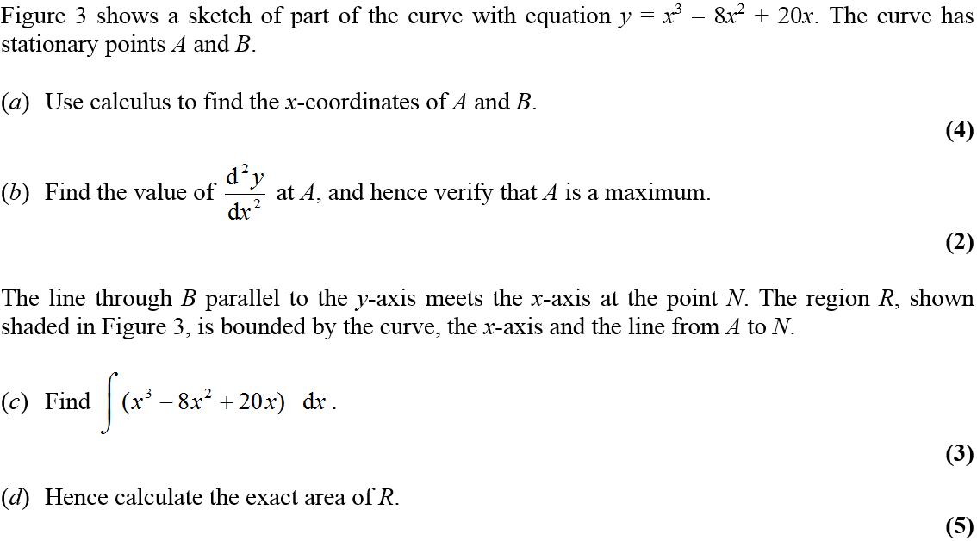
May 2006

Slide 49
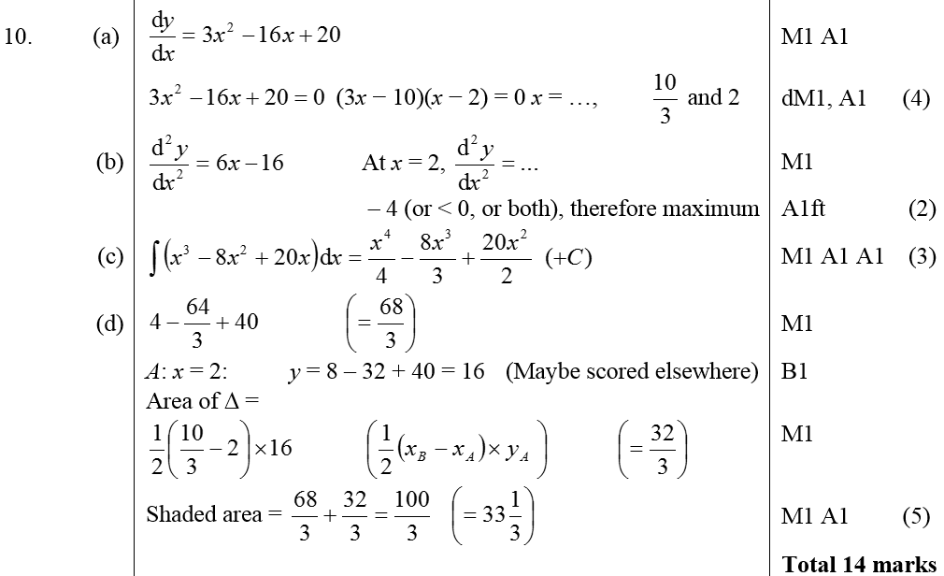
May 2006
A
B
C
D

Slide 50
Jan 2007

Slide 51
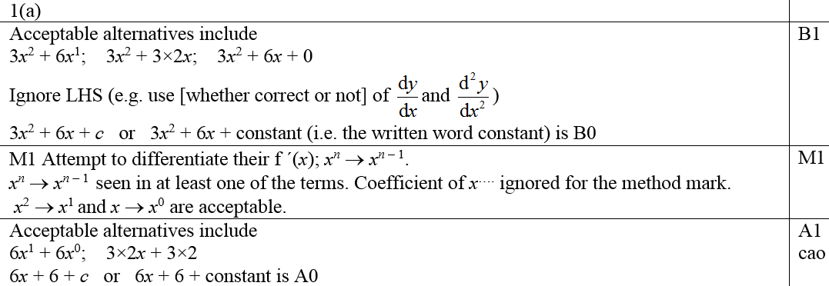
Jan 2007
A
B
A notes

Slide 52
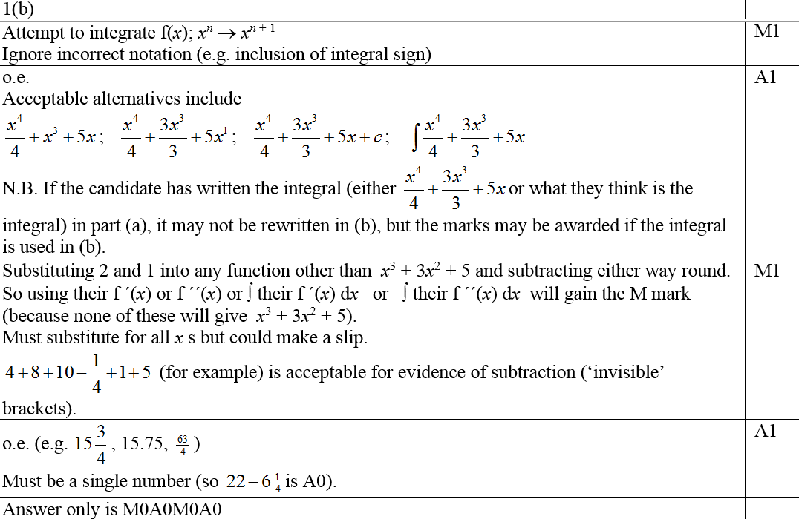
Jan 2007
B notes

Slide 53
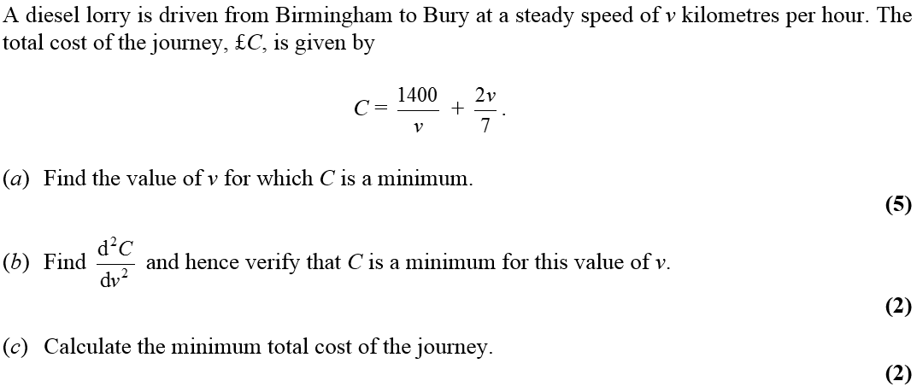
Jan 2007

Slide 54
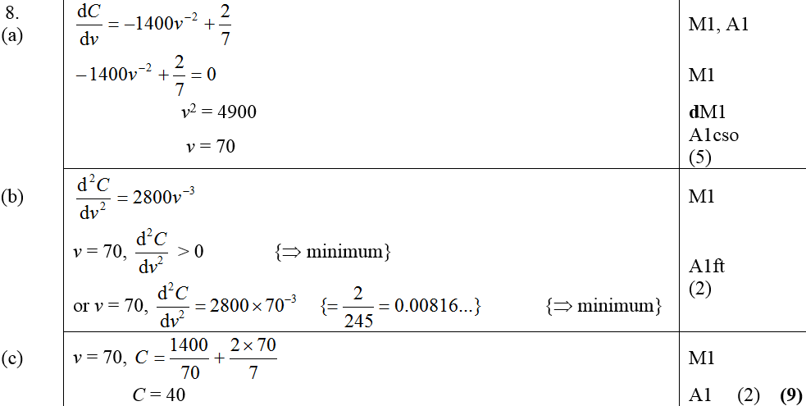
Jan 2007
A
B
C

Slide 55
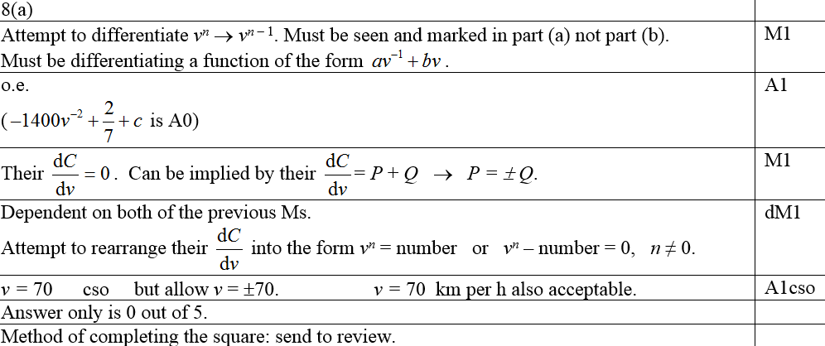
Jan 2007
A notes
A trial and improvement
A graph

Slide 56
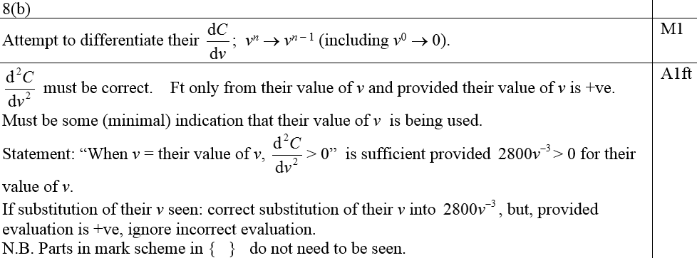
Jan 2007
B notes
C notes

Slide 57
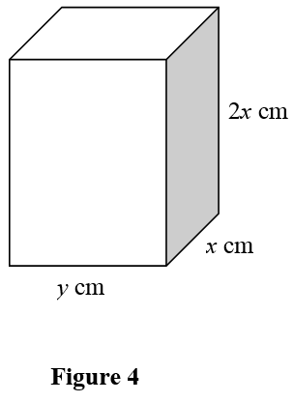
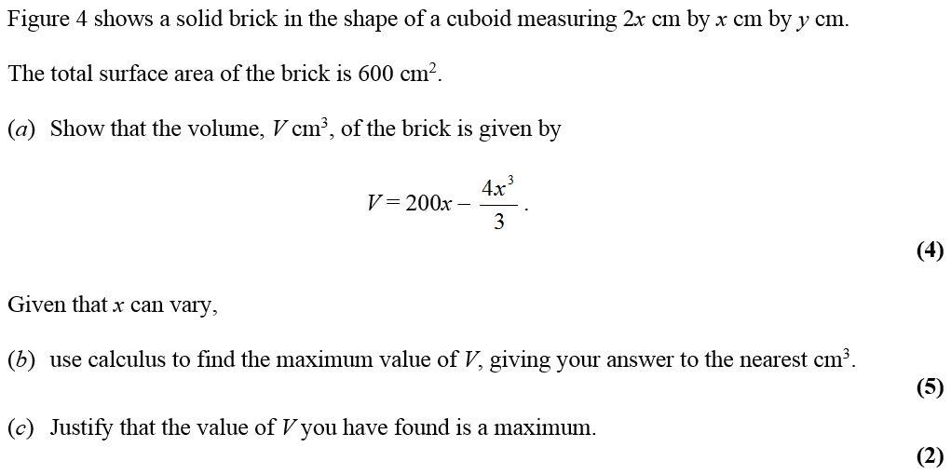
May 2007

Slide 58
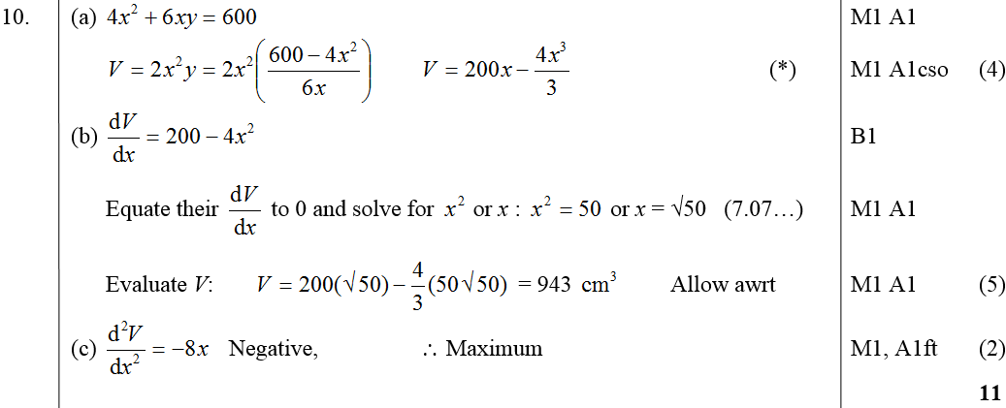
May 2007
A
B
C
A notes

Slide 59
May 2007
B notes
C notes

Slide 60
Jan 2008

Slide 61
Jan 2008
A
B
C
D

Slide 62
Jan 2008
A
B
C

Slide 63
June 2008

Slide 64
June 2008
A
B

Slide 65
Jan 2009

Slide 66
Jan 2009
A
B
C
Other methods for C

Slide 67
Jan 2009
Alternative A
A notes
B notes
C notes

Slide 68
June 2009

Slide 69
June 2009
A
B
C
D

Slide 70
Jan 2010

Slide 71
Jan 2010
A
B
C

Slide 72
Jan 2010
A
B
C

Slide 73
June 2010

Slide 74
June 2010
A
B

Slide 75
June 2010

Slide 76
June 2010
A
B

Slide 77
Jan 2011

Slide 78
Jan 2011
A
B
C

Slide 79
Jan 2011
A
B
C

Slide 80
May 2011

Slide 81
May 2011
A
B
C

Slide 82
May 2011
A
B
C

Slide 83
Jan 2012

Slide 84
A
Jan 2012
B
C
D

Slide 85
Jan 2012
A
B
C
D

Slide 86
May 2012

Slide 87
A
May 2012
B
C
D
E

Slide 88
May 2012
A
B
C
D
E

Slide 89
Jan 2013

Slide 90
Jan 2013
A
B
C
D

Slide 91
May 2013

Slide 92
May 2013
A
B

Slide 93
May 2014

Slide 94
May 2014
A

Slide 95
May 2014
B

Slide 96
May 2014
C

Slide 97
May 2014
D

Slide 98
May 2015

Slide 99
May 2015
A
B
C

Slide 100
May 2015
A notes

Slide 101
May 2015
B notes

Slide 102
May 2015
C notes

Slide 103
May 2016

Slide 104
May 2016
A
B
C

Slide 105
May 2016
D
E

Slide 106
May 2016
A notes
B notes
C notes

Slide 107
May 2016
D notes
E notes

Slide 108
May 2017

Slide 109
May 2017
A
B

Slide 110
May 2017
B Alternative

Slide 111
May 2017
B Special case

Slide 112
May 2017
A notes
B notes

Slide 113
May 2017
B Alternative notes

Slide 114
May 2018

Slide 115
May 2018
A
B
B Alternative

Slide 116
May 2018
C
C Alternative

Slide 117
May 2018
A notes
B notes
B Alternative notes

Slide 118
May 2018
C notes
C Alternative notes

