Slide 1
Teachings for
Exercise 9E

Slide 2
Trigonometric Ratios
B
b
You need to be able to solve problems involving several of these rules, and in practical contexts
The diagram shows the locations of four mobile phone masts in a field. $BC=75m$, $CD=80m$, angle $BCD=55^{°}$ and angle $ADC={140}^{°}$
The masts must be at least 70m apart so that they do not interfere with each other. Given that A is the minimum distance from D, find the distance AB.
75m
a
A
$$71.7$$
55˚
C
A
70m
140˚
80m
D
c
Label the length AD which is indicated in the question
You will usually need to split quadrilaterals into 2 triangles
We can use triangle BDC to find length BD, and angle BDC
$$a^{2}=b^{2}+c^{2}−2bcCosA$$
Sub in values (it is often easier to use your own labelling)
$$a^{2}={(75)}^{2}+{(80)}^{2}−2(75)(80)Cos55$$
Calculate
$$a^{2}=5142.08…$$
Square root
$$a=71.708…$$
You should store this value in your calculator (you will see how to do this in a moment!)
9E

Slide 3
Trigonometric Ratios
B
b
You need to be able to solve problems involving several of these rules, and in practical contexts
The diagram shows the locations of four mobile phone masts in a field. $BC=75m$, $CD=80m$, angle $BCD=55^{°}$ and angle $ADC={140}^{°}$
The masts must be at least 70m apart so that they do not interfere with each other. Given that A is the minimum distance from D, find the distance AB.
75m
a
A
$$71.7$$
$$81.0^{°}$$
55˚
C
A
70m
140˚
$$59.0^{°}$$
80m
B
D
c
Now we need to find out an angle in triangle BDA
We can do this by subtracting angle BDC from 140˚
$$\frac{SinB}{b}=\frac{SinA}{a}$$
Sub in values (remember to use the exact value of side a)
$$\frac{SinB}{75}=\frac{Sin55}{71.7}$$
Calculate to find SinB
$$SinB=0.85675…$$
Inverse sine
$$B=58.954…$$
Subtract from 140
$$=81.045$$
9E

Slide 4
Trigonometric Ratios
B
b
You need to be able to solve problems involving several of these rules, and in practical contexts
The diagram shows the locations of four mobile phone masts in a field. $BC=75m$, $CD=80m$, angle $BCD=55^{°}$ and angle $ADC={140}^{°}$
The masts must be at least 70m apart so that they do not interfere with each other. Given that A is the minimum distance from D, find the distance AB.
a
75m
a
c
A
$$71.7$$
$$81.0^{°}$$
55˚
C
A
70m
140˚
$$59.0^{°}$$
b
80m
D
c
B
A
Now we can use the cosine rule again in triangle ABD to find length AB…
$$a^{2}=b^{2}+c^{2}−2bcCosA$$
Sub in exact values
$$a^{2}={(70)}^{2}+{(71.7)}^{2}−2\left(70\right)\left(71.7\right)Cos81.0$$
Calculate
$$a^{2}=8479.55…$$
Square root
$$a=92.1m$$
9E

Slide 5
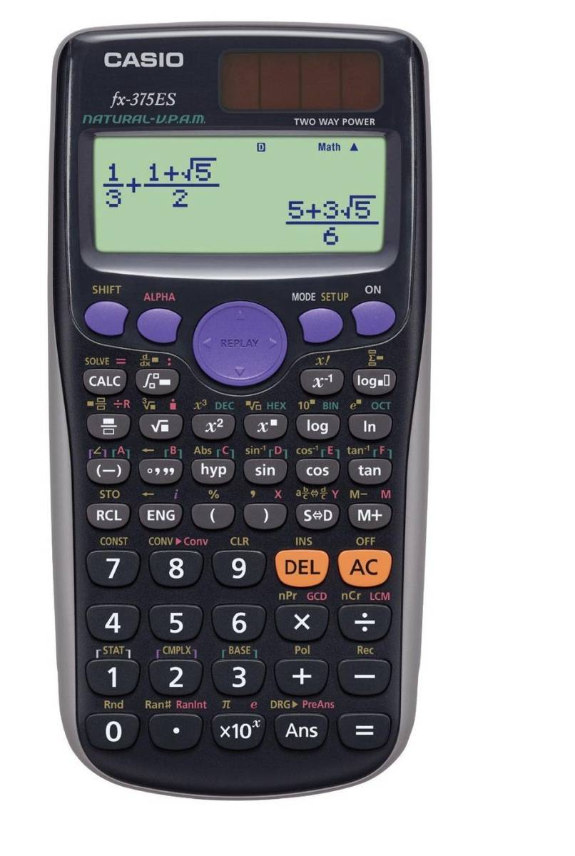
Trigonometric Ratios
You need to be able to solve problems involving several of these rules, and in practical contexts
How to store answers on a calculator:
When the number you want to store is on the screen, press shift + RCL
Then press the button with the red letter that you want to use (eg – A). You do not need to press the alpha button for this. The number will then be stored as that letter
3) Now when you do a calculation, if you want to use the stored number, press alpha and the corresponding button, and that number will be used
9E

