Slide 1
Trigonometric
Ratios
Twitter: @Owen134866
www.mathsfreeresourcelibrary.com

Slide 2
Prior Knowledge Check
1) Find the unknown values indicated:
a)
b)
c)
d)
2) $f\left(x\right)=x^{2}+3x$. Sketch the graphs of:
a) $y=f(x)$
b) $y=f(x+2)$
c) $y=f\left(x\right)−3$
d) $y=f\left(\frac{1}{2}x\right)$
3.1cm
x
$$−3$$
$$0$$
23˚
7.3cm
x
70˚
9.05cm
$$−5$$
$$−2$$
8.5cm
x
25.8˚
2.7cm
$$−3$$
6.2cm
x
5cm
77.2˚
$$−6$$
$$0$$
22cm

Slide 3
Teachings for
Exercise 9A

Slide 4
Trigonometric Ratios
C
You need to know and be able to use the Cosine rule to find an unknown side or angle
We will see where this rule comes from first!
Consider the triangle to the right, labelled using A, B and C, and a, b and c as you are familiar with
Let us draw on the perpendicular height and call it h, down to a point X
This splits side c into two sections
One we will call ‘x’, meaning the other section is ‘c – x’
b
a
h
A
x
c - x
B
X
c
Using Pythagoras’ Theorem in the left triangle, to find length h
Replace with the letters used on the diagram
Using Pythagoras’ Theorem in the right triangle, to find length h
Replace with the letters used on the diagram
→We now have two expressions for h². These expressions must be the same and can therefore be set equal to each other!
9A

Slide 5
Trigonometric Ratios
C
A
Hyp
You need to know and be able to use the Cosine rule to find an unknown side or angle
As with the Sine rule, we will see where this rule comes from first!
Consider the triangle to the right, labelled using A, B and C, and a, b and c as you are familiar with
Let us draw on the perpendicular height and call it h, down to a point X
This splits side c into two sections
One we will call ‘x’, meaning the other section is ‘c – x’
C
H
b
a
h
A
x
c - x
B
X
Adj
c
Square the bracket
‘Multiply it out’ – careful with negatives!
Add x² to both sides
Rearrange
You can replace x with an equivalent expression by using GCSE Trigonometry…
Simplify
9A

Slide 6
Trigonometric Ratios
a
b
You need to know and be able to use the Cosine rule to find an unknown side or angle
A triangle has sides of 4cm, 5cm and 6cm respectively. Find the size of the smallest angle
The smallest angle will always be opposite the smallest side
Call this angle ‘A’
Proceed as before, but you will have to do a little more rearranging…
4cm
5cm
6cm
A
c
Sub in appropriate values for a, b and c
Calculate some terms
Subtract 61
Divide by -60
Use inverse Cos
9A

Slide 7
Trigonometric Ratios
You need to know and be able to use the Cosine rule to find an unknown side or angle
Coastguard station B is 8km on a bearing of 060˚ from coastguard station A. A ship C is 4.8km, on a bearing of 018˚, away from A.
Calculate the distance from C to B
Start with a diagram (this will help a lot!)
Label the side you are finding ‘a’ (in this case the letters work out nicely, but with different letters it is sometimes easier to ignore them and use a, b and c)
N
C
a
b
B
4.8km
18˚
42˚
8km
60˚
c
A
Replace a, b and c as appropriate
Calculate the right-hand side
Square root the answer
9A

Slide 8
Trigonometric Ratios
P
c
a
You need to know and be able to use the Cosine rule to find an unknown side or angle
In the triangle to the right, PQ = xcm, QR = (x + 2)cm, RP = 5cm and angle PQR = 60˚. Find the value of x.
x cm
5cm
60˚
Q
R
A
(x + 2) cm
b
Sub in appropriate values for a, b and c
Sub in a, b and c…
Expand brackets
→ Cos60 = 0.5
Calculate
Simplify
Rearrange into a solvable form
Work out answers
There is also a negative solution but this would not make sense in context so we do not need it (it would be good workings to show it though!)
a = 1
b = 2
c = -21
We can use the Quadratic formula!
9A

Slide 9
Teachings for
Exercise 9B

Slide 10
Trigonometric Ratios
B
Consider the triangle labelled to the right, remembering GCSE trigonometry:
Right hand triangle:
Left hand triangle:
The opposite sides are the same so:
hyp
hyp
c
a
opp
A
C
adj
b
adj
O
S
H
Divide by c and a
9B

Slide 11
Trigonometric Ratios
Calculate the labelled side in the triangle to the right:
Have the unknown as the numerator!
8mm
Substitute numbers in
82°
x
Multiply by Sin82
34°
Work out the fraction
9B

Slide 12
Trigonometric Ratios
Calculate the labelled angle in the triangle to the right:
Have the unknown as the numerator!
θ
15cm
Substitute numbers in
32°
12cm
Multiply by 12
Work out the fraction
Use Inverse Sine
9B

Slide 13
Teachings for
Exercise 9C

Slide 14
Trigonometric Ratios
There are sometimes 2 solutions for a missing angle:
The Sine graph is symmetrical (you will see this later this chapter) so the value of Sin 30 is the same as Sin 150.
Generally:
y = Sinθ
90
180
270
360
Sin30 = Sin150
9C

Slide 15
Trigonometric Ratios
B
In triangle ABC, AB = 4cm, BC = 3cm and angle BAC = 44°. Work out the possible values of ACB.
4cm
3cm
3cm
44°
A
C
C
Substitute
Multiply by 4
Work out the fraction
Inverse Sine
Work out the other possible value
9C

Slide 16
Teachings for
Exercise 9D

Slide 17
Trigonometric Ratios
A
Hyp
You need to be able to calculate the area of a triangle using Sine
Again, we will start by seeing where this formula comes from…
In the triangle to the right, the area will be given by ¹/₂ base x height
The base is ‘a’ and the height is ‘h’
But we can work out an expression for h by using GCSE Trigonometry in the right hand triangle
This allows us to replace h in the formula, with bSinC instead
(The point of this is to allow us to find the area of a triangle by using an angle and 2 sides, without needing the perpendicular height!)
O
S
H
c
b
Opp
h
B
C
a
Replace h with bSinC
Remove the bracket
→ To use this you are looking to know 2 sides as well as the angle between them
9D

Slide 18
Trigonometric Ratios
A
b
You need to be able to calculate the area of a triangle using Sine
Calculate the area of the triangle shown to the right…
c
4.2cm
B
75˚
6.8cm
C
a
Sub in values
Calculate
9D

Slide 19
Trigonometric Ratios
C
a
x
30°
You need to be able to calculate the area of a triangle using Sine
The area of the triangle to the right is 60cm².
→ Show that x² – 3x - 240 = 0
B
x - 3
c
b
Sub in values
A
Multiply by 2 to cancel out the ¹/₂
Sin30 = 0.5
Multiply by 2 again to cancel out the 0.5
Expand the bracket
Subtract 240
9D

Slide 20
Teachings for
Exercise 9E

Slide 21
Trigonometric Ratios
B
b
You need to be able to solve problems involving several of these rules, and in practical contexts
The diagram shows the locations of four mobile phone masts in a field. $BC=75m$, $CD=80m$, angle $BCD=55^{°}$ and angle $ADC={140}^{°}$
The masts must be at least 70m apart so that they do not interfere with each other. Given that A is the minimum distance from D, find the distance AB.
75m
a
A
$$71.7$$
55˚
C
A
70m
140˚
80m
D
c
Label the length AD which is indicated in the question
You will usually need to split quadrilaterals into 2 triangles
We can use triangle BDC to find length BD, and angle BDC
$$a^{2}=b^{2}+c^{2}−2bcCosA$$
Sub in values (it is often easier to use your own labelling)
$$a^{2}={(75)}^{2}+{(80)}^{2}−2(75)(80)Cos55$$
Calculate
$$a^{2}=5142.08…$$
Square root
$$a=71.708…$$
You should store this value in your calculator (you will see how to do this in a moment!)
9E

Slide 22
Trigonometric Ratios
B
b
You need to be able to solve problems involving several of these rules, and in practical contexts
The diagram shows the locations of four mobile phone masts in a field. $BC=75m$, $CD=80m$, angle $BCD=55^{°}$ and angle $ADC={140}^{°}$
The masts must be at least 70m apart so that they do not interfere with each other. Given that A is the minimum distance from D, find the distance AB.
75m
a
A
$$71.7$$
$$81.0^{°}$$
55˚
C
A
70m
140˚
$$59.0^{°}$$
80m
B
D
c
Now we need to find out an angle in triangle BDA
We can do this by subtracting angle BDC from 140˚
$$\frac{SinB}{b}=\frac{SinA}{a}$$
Sub in values (remember to use the exact value of side a)
$$\frac{SinB}{75}=\frac{Sin55}{71.7}$$
Calculate to find SinB
$$SinB=0.85675…$$
Inverse sine
$$B=58.954…$$
Subtract from 140
$$=81.045$$
9E

Slide 23
Trigonometric Ratios
B
b
You need to be able to solve problems involving several of these rules, and in practical contexts
The diagram shows the locations of four mobile phone masts in a field. $BC=75m$, $CD=80m$, angle $BCD=55^{°}$ and angle $ADC={140}^{°}$
The masts must be at least 70m apart so that they do not interfere with each other. Given that A is the minimum distance from D, find the distance AB.
a
75m
a
c
A
$$71.7$$
$$81.0^{°}$$
55˚
C
A
70m
140˚
$$59.0^{°}$$
b
80m
D
c
B
A
Now we can use the cosine rule again in triangle ABD to find length AB…
$$a^{2}=b^{2}+c^{2}−2bcCosA$$
Sub in exact values
$$a^{2}={(70)}^{2}+{(71.7)}^{2}−2\left(70\right)\left(71.7\right)Cos81.0$$
Calculate
$$a^{2}=8479.55…$$
Square root
$$a=92.1m$$
9E

Slide 24
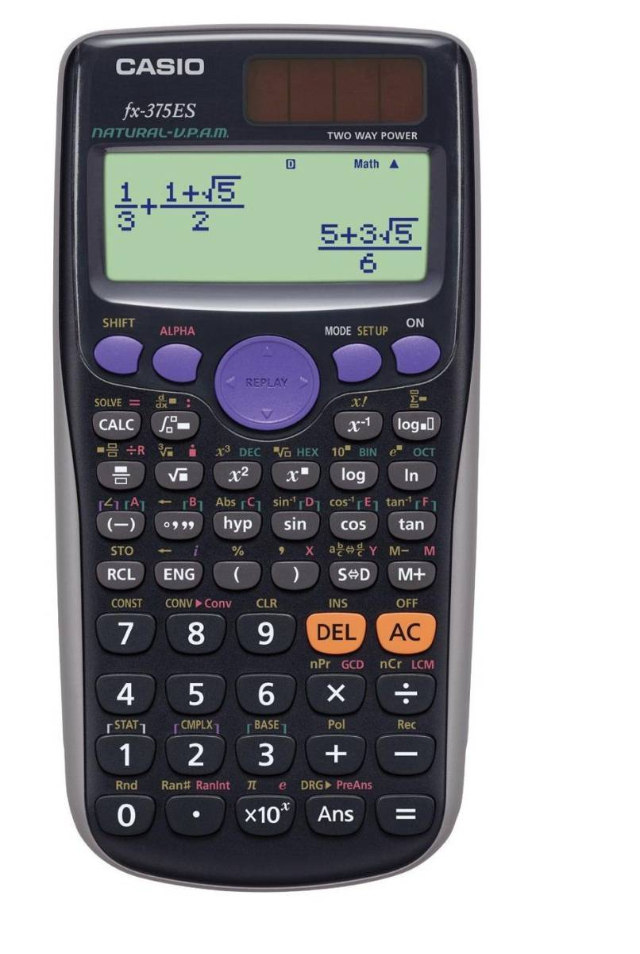
Trigonometric Ratios
You need to be able to solve problems involving several of these rules, and in practical contexts
How to store answers on a calculator:
When the number you want to store is on the screen, press shift + RCL
Then press the button with the red letter that you want to use (eg – A). You do not need to press the alpha button for this. The number will then be stored as that letter
3) Now when you do a calculation, if you want to use the stored number, press alpha and the corresponding button, and that number will be used
9E

Slide 25
Teachings for
Exercise 9F

Slide 26
Trigonometric Ratios
y
y = sinθ
You need to be able to recognise the graphs of sinθ, cosθ and tanθ
You will have seen all these graphs on your GCSE
The key points to remember are the peaks/troughs of each, and the points of intersection
The Cos graph is the same as the Sin graph, but shifted along (it starts at 1 instead of 0)
The Tan graph has lines called asymptotes. These are points the graph approaches but never reaches (90º, 270º etc…)
1
0
θ
-360º
-270º
-180º
-90º
90º
180º
270º
360º
-1
y
y = cosθ
1
0
θ
-360º
-270º
-180º
-90º
90º
180º
270º
360º
-1
y = tanθ
1
0
θ
-360º
-270º
-180º
-90º
90º
180º
270º
360º
Period (length of wave) = 360º for Sin and Cos, and 180º for Tan
-1
9F

Slide 27
Teachings for
Exercise 9G

Slide 28
Trigonometric Ratios
y
y = sinθ
You need to be able to recognise transformations of graphs, and sketch them
Transformation type 1
This stretches the graph vertically by a factor ‘a’.
1
0
θ
90º
180º
270º
360º
-1
y
y = -sinθ
1
0
θ
90º
180º
270º
360º
Reflection in the x axis
-1
(all the y values will ‘swap sign’)
y
y = sin(-θ)
Reflection in the y axis
1
0
θ
90º
180º
270º
360º
(You get the same y values for the reversed x value. -90 gives the result 90 would have)
-1
9G

Slide 29
Trigonometric Ratios
y
y = cosθ
You need to be able to recognise transformations of graphs, and sketch them
Transformation type 1
This stretches the graph vertically by a factor ‘a’.
1
0
θ
90º
180º
270º
360º
-1
y
y = -cosθ
1
0
θ
90º
180º
270º
360º
Reflection in the x axis
-1
y
y = cos(-θ)
Reflection in the y axis
1
0
θ
90º
180º
270º
360º
-1
9G

Slide 30
Trigonometric Ratios
y
y = sinθ
You need to be able to recognise transformations of graphs, and sketch them
Transformation type 2
This shifts the graph vertically ‘a’ units.
→ It is important to note that the ‘a’ is added on AFTER doing ‘sinθ’
“Adding an amount onto sinθ is a vertical shift”
1
0
θ
90º
180º
270º
360º
-1
y
y = sinθ + 1
1
0
θ
90º
180º
270º
360º
y values all increase by 1
-1
y
y = -2 + sinθ
y values all decrease by 2
-1
-2
θ
-3
9G

Slide 31
Trigonometric Ratios
y
y = sinθ
You need to be able to recognise
transformations of graphs, and sketch them
Transformation type 3
This shifts the graph horizontally ‘-a’ units.
NOTE: The ‘a’ is added to θ before we work out the sine value…
“Adding/Subtracting an amount from the bracket is a horizontal shift”
1
0
θ
90º
180º
270º
360º
-1
y
90
y = sin(θ + 90)
1
y takes the same set of values, for values of θ that are 90 less than before
0
θ
90º
180º
270º
360º
-1
y takes the same set of values, for values of θ that are 30 more than before
y
30
y = sin(θ – 30)
1
0
θ
90º
180º
270º
360º
-1
9G

Slide 32
Trigonometric Ratios
y
y = sinθ
You need to be able to recognise transformations of graphs, and sketch them
Transformation type 4
This stretches the graph horizontally by a factor ‘¹/_{a}’
“Multiplying or dividing θ in the bracket is a horizontal stretch/squash”
1
0
θ
90º
180º
270º
360º
-1
y
y = sin2θ
1
Same set of y values, for half the θ values
0
θ
90º
180º
270º
360º
-1
Same set of y values, for triple the θ values
y
y = sin(^{θ}/₃)
1
0
θ
270º
540º
810º
1080º
-1
9G

Slide 33
Trigonometric Ratios
y
(90, 1.5)
y = sinθ + k
You need to be able to answer questions with unknowns in
The graph shows the Function:
f(x) = Sinθ + k
a) Write down the value of k
→ 0.5 (Graph 0.5 units higher)
b) What is the smallest positive value of θ that gives a minimum point?
→ 270˚
c) What is the value of Sinθ at this point?
→ -0.5
1
0
θ
90º
180º
270º
360º
-1
9G

Slide 34
Trigonometric Ratios
y
y = cos(θ+k)
You need to be able to answer questions with unknowns in
The graph shows the Function:
f(x) = Cos(θ + k)
a) Write down the value of k
→ 20 (Graph moved 20 units left)
→ f(x) = Cos(θ + 20)
b) What is the value of θ at x?
→ x = 250˚
c) What are the coordinates of the minimum?
→ (160, -1)
d) What is the value of Cosθ at y?
1
y
70º
250º
0
xº
θ
-1
f(x) = Cos(θ + k)
We know k
f(x) = Cos(θ + 20)
On the y axis, θ = 0.
f(x) = Cos(20)
Work out the answer!
f(x) = 0.94 (2dp)
9G

