Slide 1
Teachings for
Exercise 8E

Slide 2

















The Binomial Expansion
You can use the Binomial Expansion to find approximations for complicated functions.
The key part to understanding this is that if values of x are small, it can be possible to ignore larger powers…
A couple of sections previously, we had this expansion…
$$={(3)}^{5}$$
$$+\left(\begin{matrix}5 \\ 1\end{matrix}\right){\left(3\right)}^{4}\left(−2x\right)$$
$$+\left(\begin{matrix}5 \\ 2\end{matrix}\right){\left(3\right)}^{3}{\left(−2x\right)}^{2}$$
$$+\left(\begin{matrix}5 \\ 3\end{matrix}\right){\left(3\right)}^{2}{\left(−2x\right)}^{3}$$
$$+\left(\begin{matrix}5 \\ 4\end{matrix}\right)(3){\left(−2x\right)}^{4}$$
$$+ {\left(−2x\right)}^{5}$$
$$=243$$
$$− 810x$$
$$+ 1080x^{2}$$
$$−{ 720x}^{3}$$
$$+ {240x}^{4}$$
$$− {32x}^{5}$$
Imagine x was 0.2. Let’s look at the value of each term…
$$=243$$
$$− 162$$
$$+ 43.2$$
$$− 5.76$$
$$+ 0.384$$
$$− 0.01024$$
The values get progressively smaller – why is this?
→ If we are approximating a calculation, we can ignore later terms since they will have less of an effect on it
8E

Slide 3

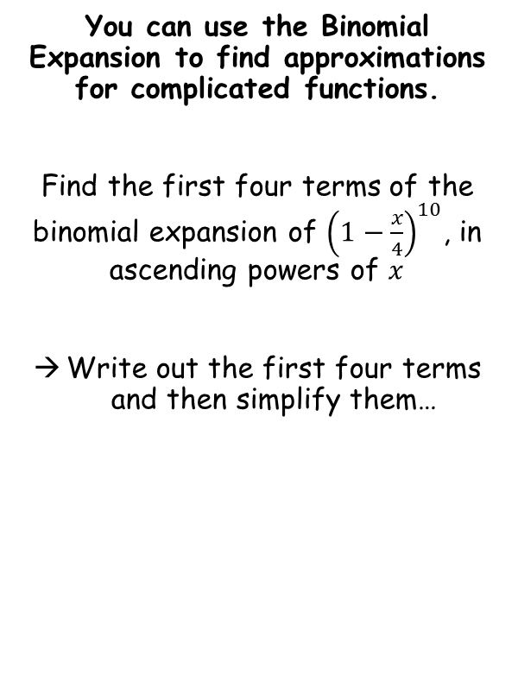



The Binomial Expansion
You can use the Binomial Expansion to find approximations for complicated functions.
Find the first four terms of the binomial expansion of ${\left(1−\frac{x}{4}\right)}^{10}$, in ascending powers of $x$
Write out the first four terms and then simplify them…
$$={(1)}^{10}$$
$$+\left(\begin{matrix}10 \\ 1\end{matrix}\right){\left(1\right)}^{9}\left(−\frac{x}{4}\right)$$
$$+\left(\begin{matrix}10 \\ 2\end{matrix}\right){\left(1\right)}^{8}{\left(−\frac{x}{4}\right)}^{2}$$
$$+\left(\begin{matrix}10 \\ 3\end{matrix}\right){\left(1\right)}^{7}{\left(−\frac{x}{4}\right)}^{3}$$
$$=1−2.5x+2.8125x^{2}−1.875x^{3}$$
$$=1−2.5x+2.8125x^{2}−1.875x^{3}$$
8E

Slide 4


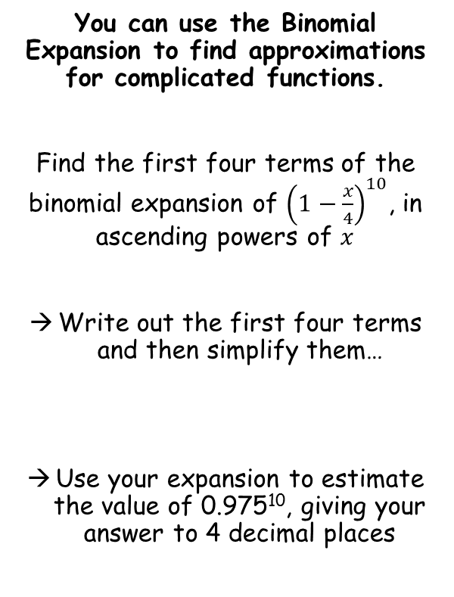




The Binomial Expansion
Compare the expansion with what we are being asked…
You can use the Binomial Expansion to find approximations for complicated functions.
Find the first four terms of the binomial expansion of ${\left(1−\frac{x}{4}\right)}^{10}$, in ascending powers of $x$
Write out the first four terms and then simplify them…
Use your expansion to estimate the value of 0.975¹⁰, giving your answer to 4 decimal places
$${\left(1−\frac{x}{4}\right)}^{10}$$
$${0.975}^{10}$$
Therefore…
$$1−\frac{x}{4}=0.975$$
Rearrange
$$0.025=\frac{x}{4}$$
Multiply by 4
$$0.1=x$$
$$=1−2.5x+2.8125x^{2}−1.875x^{3}$$
This means that if we substitute x = 0.1 into the expansion, we will get an approximation for 0.975¹⁰
$$=1−2.5x+2.8125x^{2}−1.875x^{3}$$
$$=1−2.5(0.1)+2.8125{(0.1)}^{2}−1.875{(0.1)}^{3}$$
If you check 0.975¹⁰ on a calculator, you get 0.776329…
→ So the answer is correct to 4dp!
$$=0.77625$$
8E

