Slide 1
Teachings for
Exercise 8D

Slide 2


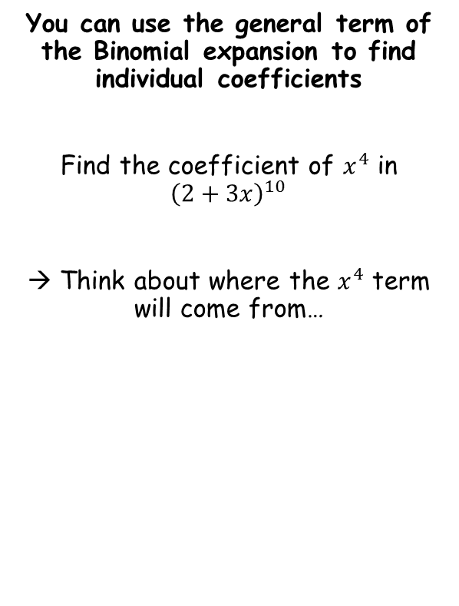


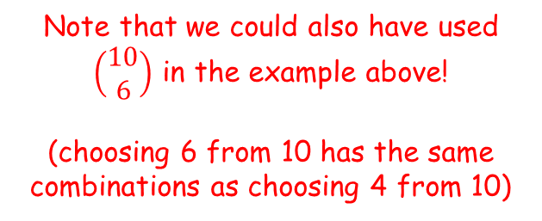

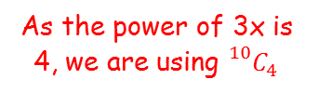
The Binomial Expansion
$${(a+b)}^{n}=a^{n}+\left(\begin{matrix}n \\ 1\end{matrix}\right)a^{n−1}b+\left(\begin{matrix}n \\ 2\end{matrix}\right)a^{n−2}b^{2}+…+\left(\begin{matrix}n \\ r\end{matrix}\right)a^{n−r}b^{r}+…+b^{n}$$
As the power of 3x is 4, we are using ${}_{}^{10}{C_{4}}$
You can use the general term of the Binomial expansion to find individual coefficients
Find the coefficient of $x^{4}$ in ${\left(2+3x\right)}^{10}$
→ Think about where the $x^{4}$ term will come from…
$$\left(\begin{matrix}10 \\ 4\end{matrix}\right)$$
$${\left(2\right)}^{6}$$
$${\left(3x\right)}^{4}$$
$$=1,088,640x^{4}$$
The coefficient is just the number!
This term will need to be raised to a power 4
$$=1,088,640$$
Which means that this one will be raised to a power 6 (4 + 6 = 10)
Note that we could also have used $\left(\begin{matrix}10 \\ 6\end{matrix}\right)$ in the example above!
(choosing 6 from 10 has the same combinations as choosing 4 from 10)
8D

Slide 3
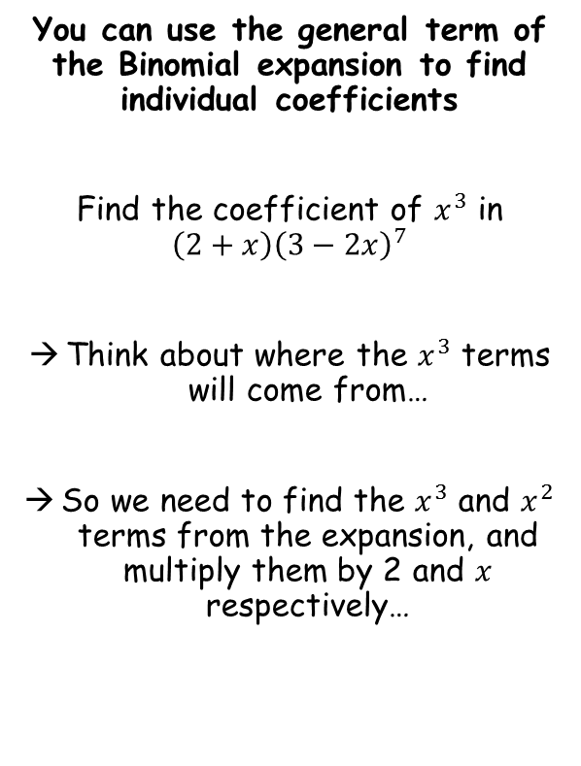
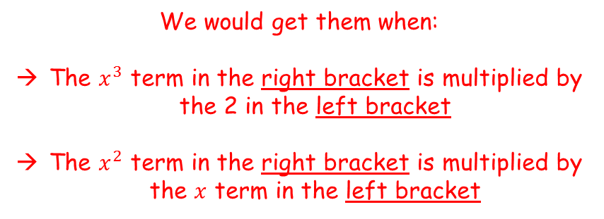


The Binomial Expansion
$${(a+b)}^{n}=a^{n}+\left(\begin{matrix}n \\ 1\end{matrix}\right)a^{n−1}b+\left(\begin{matrix}n \\ 2\end{matrix}\right)a^{n−2}b^{2}+…+\left(\begin{matrix}n \\ r\end{matrix}\right)a^{n−r}b^{r}+…+b^{n}$$
You can use the general term of the Binomial expansion to find individual coefficients
Find the coefficient of $x^{3}$ in ${\left(2+x\right)\left(3−2x\right)}^{7}$
Think about where the $x^{3}$ terms will come from…
So we need to find the $x^{3}$ and $x^{2}$ terms from the expansion, and multiply them by 2 and $x$ respectively…
Every term in the binomial expansion bracket will get multiplied by the 2 terms in the first bracket
→ How could we get $x^{3}$ terms?
$${\left(2+x\right)\left(3−2x\right)}^{7}$$
We would get them when:
The $x^{3}$ term in the right bracket is multiplied by the 2 in the left bracket
The $x^{2}$ term in the right bracket is multiplied by the $x$ term in the left bracket
8D

Slide 4

















The Binomial Expansion
$${(a+b)}^{n}=a^{n}+\left(\begin{matrix}n \\ 1\end{matrix}\right)a^{n−1}b+\left(\begin{matrix}n \\ 2\end{matrix}\right)a^{n−2}b^{2}+…+\left(\begin{matrix}n \\ r\end{matrix}\right)a^{n−r}b^{r}+…+b^{n}$$
$${\left(2+x\right)\left(3−2x\right)}^{7}$$
You can use the general term of the Binomial expansion to find individual coefficients
Find the coefficient of $x^{3}$ in ${\left(2+x\right)\left(3−2x\right)}^{7}$
Think about where the $x^{3}$ terms will come from…
So we need to find the $x^{3}$ and $x^{2}$ terms from the expansion, and multiply them by 2 and $x$ respectively…
$x^{3}$ term
$x^{2}$ term
$$\left(\begin{matrix}7 \\ 3\end{matrix}\right)$$
$${\left(3\right)}^{4}$$
$${\left(−2x\right)}^{3}$$
$$\left(\begin{matrix}7 \\ 2\end{matrix}\right)$$
$${\left(3\right)}^{5}$$
$${\left(−2x\right)}^{2}$$
$$=−22,680x^{3}$$
$$=20,412x^{2}$$
$$×2$$
$$×x$$
$$=−45,360x^{3}$$
$$=20,412x^{3}$$
Adding these together gives $−24,948x^{3}$
So the coefficient of $x^{3}$ in the expansion of ${\left(2+x\right)\left(3−2x\right)}^{7}$ is -24,948
8D

Slide 5



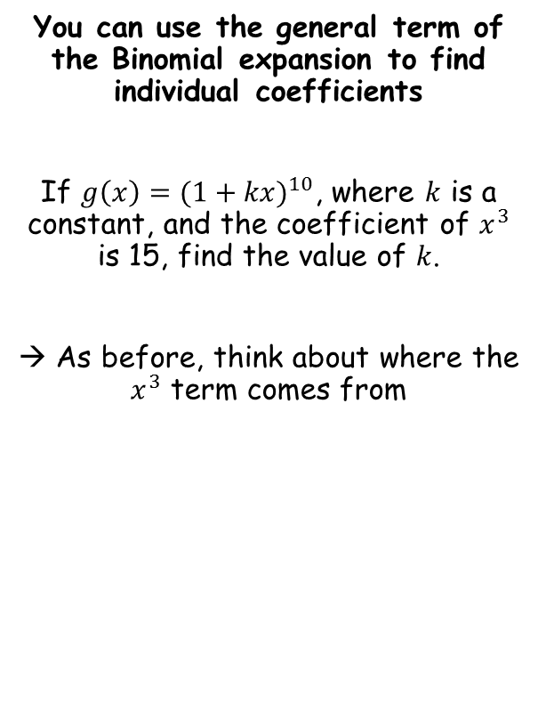





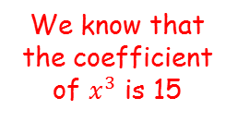
The Binomial Expansion
$${(a+b)}^{n}=a^{n}+\left(\begin{matrix}n \\ 1\end{matrix}\right)a^{n−1}b+\left(\begin{matrix}n \\ 2\end{matrix}\right)a^{n−2}b^{2}+…+\left(\begin{matrix}n \\ r\end{matrix}\right)a^{n−r}b^{r}+…+b^{n}$$
You can use the general term of the Binomial expansion to find individual coefficients
If $g\left(x\right)={(1+kx)}^{10}$, where $k$ is a constant, and the coefficient of $x^{3}$ is 15, find the value of $k$.
→ As before, think about where the $x^{3}$ term comes from
$${(1+kx)}^{10}$$
Write out the parts of the term we need
$$\left(\begin{matrix}10 \\ 3\end{matrix}\right)$$
$${\left(1\right)}^{7}$$
$${\left(kx\right)}^{3}$$
Simplify / calculate
$$=120k^{3}x^{3}$$
We know that the coefficient of $x^{3}$ is 15
$$120k^{3}=15$$
Divide by 120
$$k^{3}=\frac{1}{8}$$
Cube root
$$k=\frac{1}{2}$$
8D

Slide 6









The Binomial Expansion
$${(a+b)}^{n}=a^{n}+\left(\begin{matrix}n \\ 1\end{matrix}\right)a^{n−1}b+\left(\begin{matrix}n \\ 2\end{matrix}\right)a^{n−2}b^{2}+…+\left(\begin{matrix}n \\ r\end{matrix}\right)a^{n−r}b^{r}+…+b^{n}$$
You can use the general term of the Binomial expansion to find individual coefficients
Write down the first three terms, in ascending powers of $x$, of the binomial expansion of ${(1+qx)}^{8}$, where $q$ is a non-zero constant.
$${(1+qx)}^{8}$$
Write out the expansion using the rule above
$$={(1)}^{8}$$
$$+\left(\begin{matrix}8 \\ 1\end{matrix}\right){\left(1\right)}^{7}\left(qx\right)$$
$$+\left(\begin{matrix}8 \\ 2\end{matrix}\right){\left(1\right)}^{6}{\left(qx\right)}^{2}$$
Simplify
$$=1$$
$$+ 8qx$$
$$+ 28q^{2}x^{2}$$
$$=1+8qx+ 28q^{2}x^{2}$$
8D

Slide 7






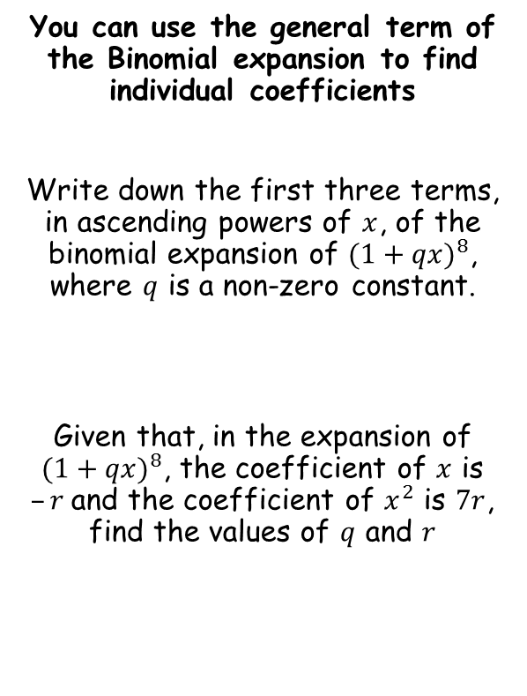









The Binomial Expansion
$${(a+b)}^{n}=a^{n}+\left(\begin{matrix}n \\ 1\end{matrix}\right)a^{n−1}b+\left(\begin{matrix}n \\ 2\end{matrix}\right)a^{n−2}b^{2}+…+\left(\begin{matrix}n \\ r\end{matrix}\right)a^{n−r}b^{r}+…+b^{n}$$
You can use the general term of the Binomial expansion to find individual coefficients
Write down the first three terms, in ascending powers of $x$, of the binomial expansion of ${(1+qx)}^{8}$, where $q$ is a non-zero constant.
Given that, in the expansion of ${(1+qx)}^{8}$, the coefficient of $x$ is $–r$and the coefficient of $x^{2}$ is $7r$, find the values of $q$ and $r$
$$8q=−r$$
$$28q^{2}=7r$$
Multiply by -1
$$−8q=r$$
$$28q^{2}=7r$$
Sub in $−8q$
$$28q^{2}=7(−8q)$$
$$=1+8qx+ 28q^{2}x^{2}$$
Multiply the bracket
$$28q^{2}=−56q$$
Add $56q$
$$28q^{2}+56q=0$$
Divide by 28
$$q^{2}+2q=0$$
Factorise
$$q(q+2)=0$$
Remember that $q$ is a ‘non-zero constant’
$$q=−2$$
We can now find $r$
$$r=16$$
8D

