Slide 1
Teachings for
Exercise 8B

Slide 2
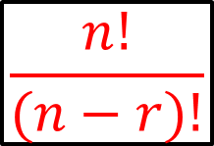
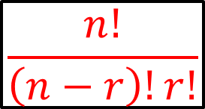
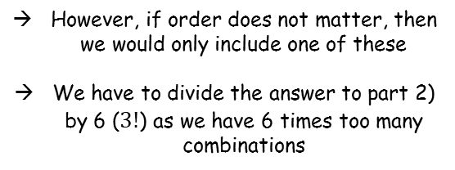
The Binomial Expansion
If we are going to choose $r$ objects from a set of $n$ objects…
Number of ways of choosing r items from a group of n items $= \frac{n!}{\left(n−r\right)!r!}$
$${}_{}^{n}{C_{r}}= \frac{n!}{\left(n−r\right)!r!}$$
$$A B C D E$$
1) How many ways can we choose all 5, where order matters?
2) How many ways can we choose 3 out of the 5, where order matters?
3) How many ways can we choose 3 out of the 5, where order does not matter?
5 choices for the first letter, 4 choices then for the second… down to one choice for the last one…
5 choices for the first letter, 4 choices then for the second, and 3 choices for the third…
If we are choosing 3 letters, and the order matters (as in example 2)), we would include the following:
→ $5×4×3$ways
$ABC$
$ACB$
$BAC$
→ $5×4×3×2×1$ways
$BCA$
$CAB$
$CBA$
→
$$\frac{5×4×3×2×1}{2×1}$$
However, if order does not matter, then we would only include one of these
We have to divide the answer to part 2) by 6 ($3!$) as we have 6 times too many combinations
→ $5!$
→
$$\frac{5!}{2!}$$
$$n!$$
$$\frac{n!}{(n−r)!}$$
→
$$\frac{5!}{2!3!}$$
$$\frac{n!}{\left(n−r\right)!r!}$$
8B

Slide 3
The Binomial Expansion
Number of ways of choosing r items from a group of n items $= \frac{n!}{\left(n−r\right)!r!}$
$${}_{}^{n}{C_{r}}= \frac{n!}{\left(n−r\right)!r!}$$
Factorial notation will be useful in the binomial expansion, and your calculator can be used to help!
1) Calculate $6!$
$$=720$$
2) Calculate ${}_{}^{8}{C_{3}}$
(The number of ways to choose 3 objects from a set of 8)
$$=56$$
8B

Slide 4
The Binomial Expansion
Number of ways of choosing r items from a group of n items $= \frac{n!}{\left(n−r\right)!r!}$
$${}_{}^{n}{C_{r}}= \frac{n!}{\left(n−r\right)!r!}$$
Factorial notation will be useful in the binomial expansion, and your calculator can be used to help!
Calculate ${}_{}^{9}{C_{3}}$ and ${}_{}^{9}{C_{6}}$, and comment on your answers
They are both 84
Whenever you choose 3 from 9, you are essentially also choosing 6 from 9!
8B

