Slide 1
The Binomial Expansion
Twitter: @Owen134866
www.mathsfreeresourcelibrary.com

Slide 2





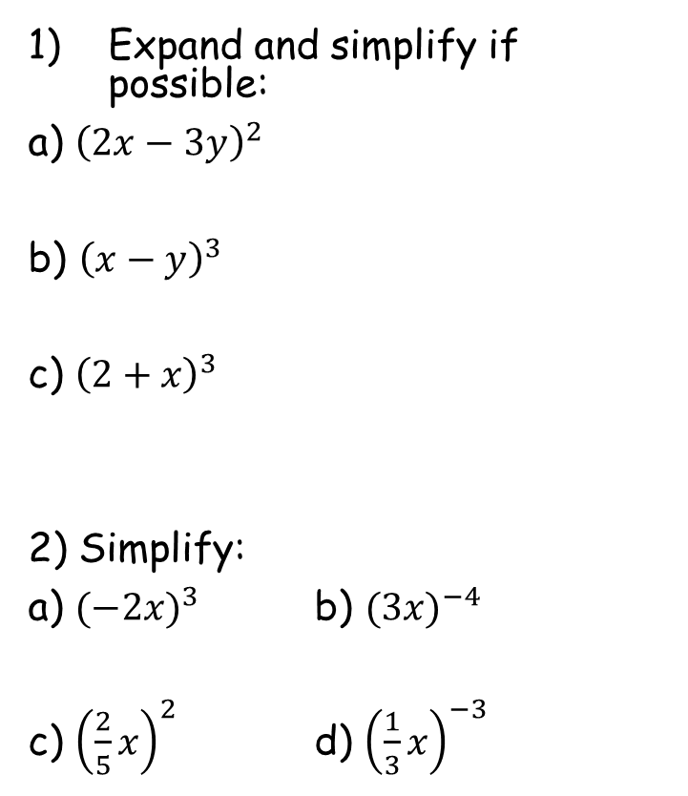







Prior Knowledge Check
Expand and simplify if possible:
a) ${\left(2x−3y\right)}^{2}$
b) ${\left(x−y\right)}^{3}$
c) ${\left(2+x\right)}^{3}$
2) Simplify:
a) ${(−2x)}^{3}$ b) ${(3x)}^{−4}$
c) ${\left(\frac{2}{5}x\right)}^{2}$ d) ${\left(\frac{1}{3}x\right)}^{−3}$
3) Expand and simplify if possible:
a) ${(25x)}^{\frac{1}{2}}$ b) ${(64x)}^{−\frac{2}{3}}$
c) ${\left(\frac{9}{100}x\right)}^{−\frac{1}{2}}$ d) ${\left(\frac{8}{27}x\right)}^{\frac{4}{3}}$
$$\frac{1}{16\sqrt[3]{x^{2}}}$$
$${=4x}^{2}−12xy+{9y}^{2}$$
$$5\sqrt{x}$$
$${=x}^{3}−3x^{2}y+{3xy}^{2}−y^{3}$$
$$=8+12x+{6x}^{2}+x^{3}$$
$$\frac{10}{3\sqrt{x}}$$
$$\frac{16}{81}\sqrt[3]{x^{4}}$$
$$\frac{1}{{81x}^{4}}$$
$$−{8x}^{3}$$
$$\frac{4}{25}x^{2}$$
$$\frac{27}{x^{3}}$$

Slide 3
Teachings for
Exercise 8A

Slide 4
The Binomial Expansion
Work out each of these:
There is a pattern in the coefficients (the numbers at the front of each term)
8A

Slide 5
The Binomial Expansion
The coefficients make a pattern known as Pascal’s triangle
1
You work out each number by adding the 2 above it.
Number 1s always go down the edges
1
1
1
2
1
1
3
3
1
1
4
6
4
1
1
5
10
10
5
1
8A

Slide 6
The Binomial Expansion
For (a + b)^{n}
Find the expansion of (x + 2y)³
n = 0
n = 1
n = 3, so use the relevant row
n = 2
n = 3
Sub in for a and b
n = 4
Simplify
Careful, (2y)² = 4y²
Now fully simplify
8A

Slide 7
The Binomial Expansion
For (a + b)^{n}
Find the expansion of (2x - 5)⁴
n = 4, so use the relevant row
Work out each part carefully
Careful with negatives!
Simplify as much as you can
8A

Slide 8
The Binomial Expansion
For (a + b)^{n}
The coefficient of x² in the expansion of (2 - cx)³ is 294. Find the value of c.
Using n = 3
The ‘x’ will be substituted in for b, so we want the term which has b²
Sub in for a and b
Careful with negatives!
6c² is the coefficient of x², so must be equal to 294
Divide by 6
2 possible answers
8A

