Slide 1
Teachings for
Exercise 7D

Slide 2






Algebraic Methods
A proof is a logical and structured argument to show that a mathematical statement is always true (or not true)
A proof will follow this general pattern:
You need to be able to prove mathematical statements clearly
→ One way is by deduction
Statement: Prove that the product of two odd numbers is odd”
Demonstration: 5 x 7 = 35, which is odd
Proof:
$p$ and $q$ are integers, so $2p+1$ and $2q+1$ are odd numbers
Known facts/ theorems
$$(2p+1)(2q+1)$$
Multiply out
$$=4pq+2p+2q+1$$
Factorise partially
Clearly shown logical steps
$$=2(2pq+p+q)+1$$
→ Since p and q are integers, $2pq+p+q$ is also an integer.
Statement of proof
→ Therefore, $2(2pq+p+q)+1$ is once more than an even number
→ Consequently, the product of two numbers is an odd number
7D

Slide 3




Algebraic Methods
Prove that:
A proof is a logical and structured argument to show that a mathematical statement is always true (or not true)
You might have to prove identities
An identity has a ‘triple’ equal sign, and means that both sides are always equal (for any value of x)
Do not try to solve it like an equation. Instead, start with one side and show it is equal to the other
$$\left(3x+2\right)\left(x−5\right)\left(x+7\right)≡{3x}^{3}+{8x}^{2}−101x−70$$
Start with the left hand side (LHS)
$$\left(3x+2\right)\left(x−5\right)\left(x+7\right)$$
Expand one bracket
$$=\left(3x+2\right)(x^{2}+2x−35)$$
Expand again
$$={3x}^{3}+{6x}^{2}−105x+2x^{2}+4x−70$$
Group like terms
$$={3x}^{3}+{8x}^{2}−101x−70$$
This equals the right hand side
$$=RHS$$
7D

Slide 4









Algebraic Methods
A proof is a logical and structured argument to show that a mathematical statement is always true (or not true)
Prove that if $(x−p)$ is a factor of $f(x)$ then $f\left(p\right)=0$
If $(x−p)$ is a factor of $f(x)$ then:
Think about what $(x−p)$being a factor means…
$$f\left(x\right)=(x−p)×g(x)$$
We want to show what happens with $f(p)$ → Let $x=p$
$$f\left(p\right)=(p−p)×g(p)$$
$$(p−p)=0$$
$$f\left(p\right)=0×g(p)$$
This equals 0
$$f\left(p\right)=0$$
7D

Slide 5





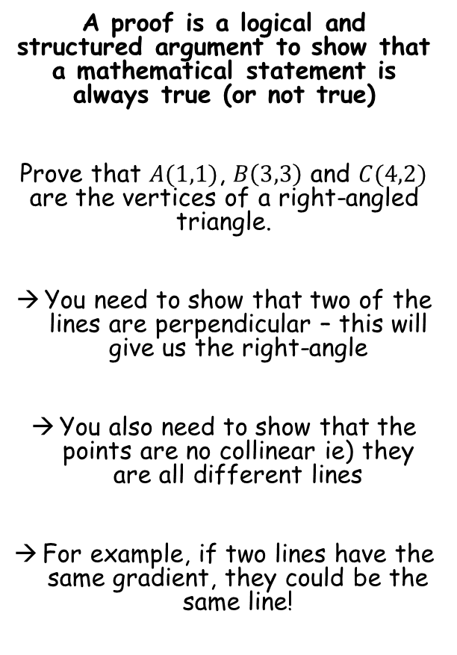






Algebraic Methods
A proof is a logical and structured argument to show that a mathematical statement is always true (or not true)
Prove that $A(1,1)$, $B\left(3,3\right)$ and $C(4,2)$ are the vertices of a right-angled triangle.
You need to show that two of the lines are perpendicular – this will give us the right-angle
You also need to show that the points are no collinear ie) they are all different lines
For example, if two lines have the same gradient, they could be the same line!
$$B(3,3)$$
$$C(4,2)$$
$$A(1,1)$$
Gradient of Line AB
Gradient of Line AC
Gradient of Line BC
$$\frac{y_{2}−y_{1}}{x_{2}−x_{1}}$$
$$\frac{y_{2}−y_{1}}{x_{2}−x_{1}}$$
$$\frac{y_{2}−y_{1}}{x_{2}−x_{1}}$$
$$\frac{3−1}{3−1}$$
$$\frac{2−1}{4−1}$$
$$\frac{3−2}{3−4}$$
$$=1$$
$$=\frac{1}{3}$$
$$=−1$$
Gradient of AB x Gradient of BC = -1 so they are perpendicular
→ All gradients are different so the lines are not collinear
7D

Slide 6

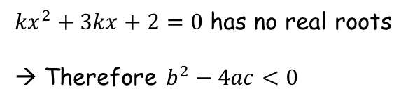

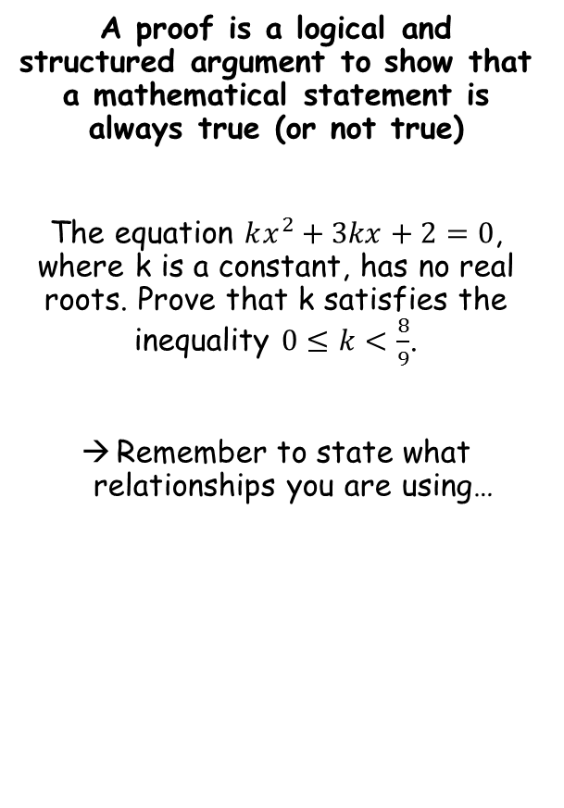






Algebraic Methods
A proof is a logical and structured argument to show that a mathematical statement is always true (or not true)
The equation $kx^{2}+3kx+2=0$, where k is a constant, has no real roots. Prove that k satisfies the inequality $0≤k<\frac{8}{9}$.
Remember to state what relationships you are using…
${kx}^{2}+3kx+2=0$ has no real roots
→ Therefore $b^{2}−4ac<0$
$$b^{2}−4ac<0$$
Sub in values
$${(3k)}^{2}−4(k)(2)<0$$
Simplify
$${9k}^{2}−8k<0$$
Factorise
$$k(9k−8)<0$$
$$y={9k}^{2}−8k$$
At this point a sketch can help show the answer!
→ We want the part below the x-axis, therefore:
$$0$$
$$\frac{8}{9}$$
$$0<k<\frac{8}{9}$$
7D

Slide 7




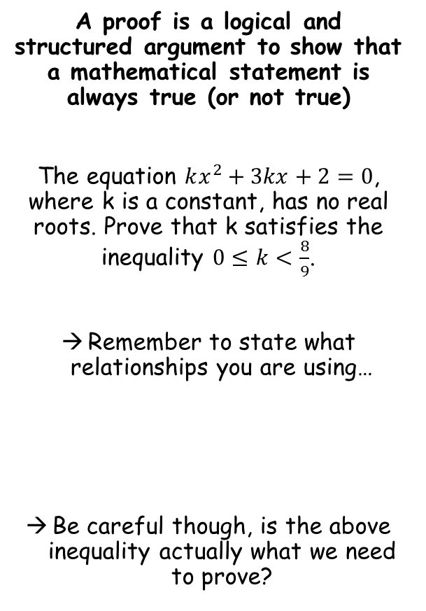




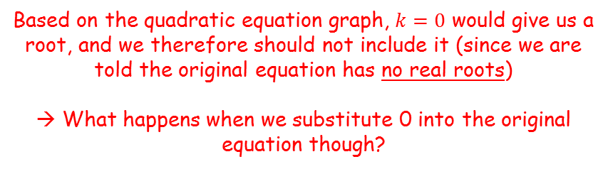

Algebraic Methods
$$y={9k}^{2}−8k$$
A proof is a logical and structured argument to show that a mathematical statement is always true (or not true)
The equation $kx^{2}+3kx+2=0$, where k is a constant, has no real roots. Prove that k satisfies the inequality $0≤k<\frac{8}{9}$.
Remember to state what relationships you are using…
Be careful though, is the above inequality actually what we need to prove?
$$0$$
$$\frac{8}{9}$$
Based on the quadratic equation graph, $k=0$ would give us a root, and we therefore should not include it (since we are told the original equation has no real roots)
→ What happens when we substitute 0 into the original equation though?
$$0<k<\frac{8}{9}$$
$$0≤k<\frac{8}{9}$$
$$kx^{2}+3kx+2=0$$
$$(0)x^{2}+3(0)x+2=0$$
$$2=0$$
So we do not get a root for $k=0$, and therefore it should be included in our answer
7D

