Slide 1
Teachings for
Exercise 7C

Slide 2





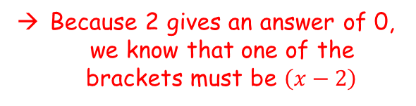




Algebraic Methods
The factor theorem is a quick way of finding simple linear factors of a polynomial
Factorise and solve the following:
$$x^{2}−9x+20=0$$
$$x^{2}−9x+20=0$$
Factorise
$$(x−4)(x−5)=0$$
Solve
$x=4$ or $x=5$
→ Remember that what we are doing is finding the values that make the original equation equal 0
Another (less reliable) way to factorise is to try subbing in values
If a value gives an answer 0, you then know one of the brackets
$$x^{2}+6x−16=0$$
Sub in 1
Sub in 2
$${(1)}^{2}+6(1)−16=0$$
$${(2)}^{2}+6(2)−16=0$$
$$−9=0$$
$$0=0$$
Because 2 gives an answer of 0, we know that one of the brackets must be $\left(x−2\right)$
7C

Slide 3
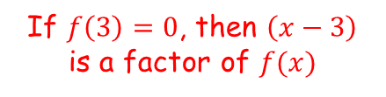
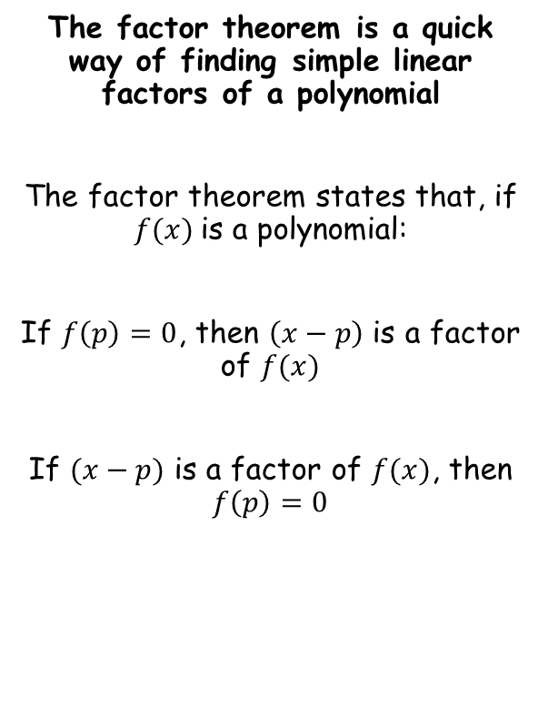
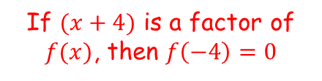
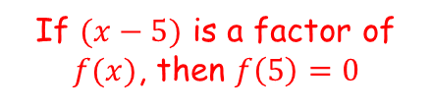
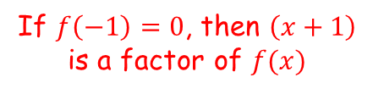
Algebraic Methods
The factor theorem is a quick way of finding simple linear factors of a polynomial
The factor theorem states that, if $f(x)$is a polynomial:
If $f\left(p\right)=0$, then $\left(x−p\right)$ is a factor of $f(x)$
If $(x−p)$ is a factor of $f(x)$, then $f\left(p\right)=0$
If $f\left(3\right)=0$, then $\left(x−3\right)$ is a factor of $f(x)$
If $f\left(−1\right)=0$, then $\left(x+1\right)$ is a factor of $f(x)$
If $(x−5)$ is a factor of $f(x)$, then $f\left(5\right)=0$
If $(x+4)$ is a factor of $f(x)$, then $f\left(−4\right)=0$
7C

Slide 4

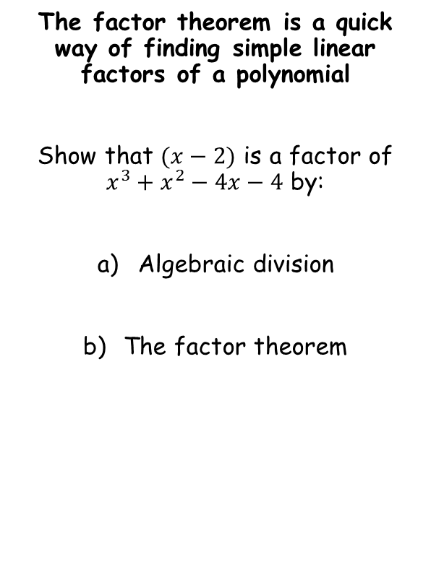
Algebraic Methods
The factor theorem is a quick way of finding simple linear factors of a polynomial
Show that $(x−2)$ is a factor of $x^{3}+x^{2}−4x−4$ by:
Algebraic division
The factor theorem
x²
+
3x
+
2
x - 2
x³ + x² – 4x - 4
x³ – 2x²
3x² - 4x - 4
3x² - 6x
2x - 4
2x - 4
0
The remainder is 0, so $(x−2)$ is a factor!
7C

Slide 5




Algebraic Methods
The factor theorem is a quick way of finding simple linear factors of a polynomial
Show that $(x−2)$ is a factor of $x^{3}+x^{2}−4x−4$ by:
Algebraic division
The factor theorem
$$x^{3}+x^{2}−4x−4$$
Sub in x = 2
$${(2)}^{3}+{(2)}^{2}−4(2)−4$$
Calculate
$$=0$$
The answer is 0, so $(x−2)$ is a factor!
7C

Slide 6

Algebraic Methods
The factor theorem is a quick way of finding simple linear factors of a polynomial
a) Fully factorise ${2x}^{3}+x^{2}−18x−9$
b) Hence, sketch the graph of $y={2x}^{3}+x^{2}−18x−9$
2x³ + x² – 18x - 9
Substitute in values of x to find a factor
x = 1
2 + 1 – 18 - 9
= -24
x = 2
16 + 4 – 36 - 9
= -25
x = 3
54 + 9 – 54 - 9
= 0
So (x – 3) is a factor
7C

Slide 7
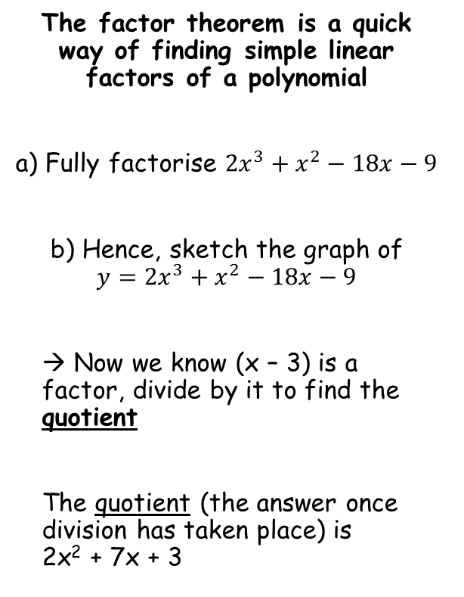
Algebraic Methods
The factor theorem is a quick way of finding simple linear factors of a polynomial
a) Fully factorise ${2x}^{3}+x^{2}−18x−9$
b) Hence, sketch the graph of $y={2x}^{3}+x^{2}−18x−9$
→ Now we know (x – 3) is a factor, divide by it to find the quotient
The quotient (the answer once division has taken place) is 2x² + 7x + 3
2x²
+
7x
+
3
x - 3
2x³ + x² – 18x - 9
2x³ – 6x²
7x² – 18x - 9
7x² – 21x
3x - 9
3x - 9
0
7C

Slide 8

Algebraic Methods
The factor theorem is a quick way of finding simple linear factors of a polynomial
a) Fully factorise ${2x}^{3}+x^{2}−18x−9$
b) Hence, sketch the graph of $y={2x}^{3}+x^{2}−18x−9$
(x – 3)(2x² + 7x + 3)
You can also factorise the quotient
$$=(x−3)(2x+1)(x+3)$$
2 numbers that multiply to give +3, and add to give +7 when one has doubled…
(x – 3)(2x + 1)(x + 3)
This is now fully factorised!
7C

Slide 9


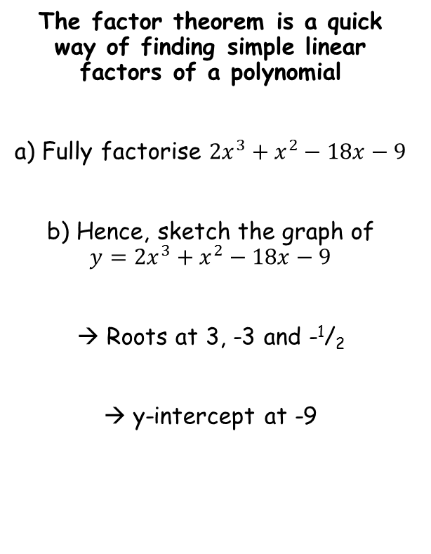



Algebraic Methods
The factor theorem is a quick way of finding simple linear factors of a polynomial
a) Fully factorise ${2x}^{3}+x^{2}−18x−9$
b) Hence, sketch the graph of $y={2x}^{3}+x^{2}−18x−9$
→ Roots at 3, -3 and -¹/₂
→ y-intercept at -9
$$−\frac{1}{2}$$
$$=(x−3)(2x+1)(x+3)$$
$$−3$$
$$3$$
$$−9$$
$$y=(x−3)(2x+1)(x+3)$$
7C

Slide 10
Algebraic Methods
The factor theorem is a quick way of finding simple linear factors of a polynomial
Given that (x + 1) is a factor of 4x⁴ – 3x² + a, find the value of a.
4x⁴ – 3x² + a
If (x + 1) is a factor, then subbing -1 will make the equation = 0
0 =
4(-1 ) ⁴ – 3(-1)² + a
Work out each term
0 =
4 – 3 + a
Solve the equation to find the value of a
0 =
1 + a
-1 =
a
7C

