Slide 1
Teachings for
Exercise 7B

Slide 2
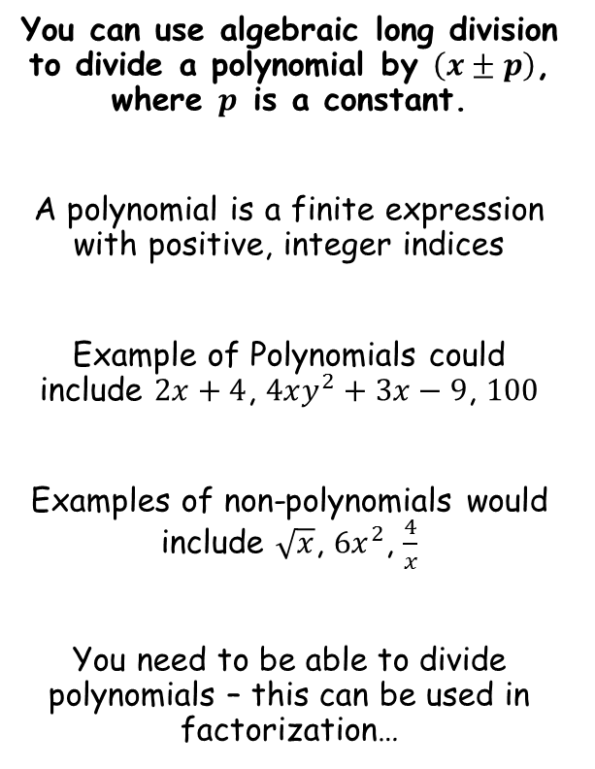
Algebraic Methods
You can use algebraic long division to divide a polynomial by $\left(x±p\right)$, where $p$ is a constant.
A polynomial is a finite expression with positive, integer indices
Example of Polynomials could include $2x+4$, $4xy^{2}+3x−9$, $100$
Examples of non-polynomials would include $\sqrt{x}$, $6x^{2}$, $\frac{4}{x}$
You need to be able to divide polynomials – this can be used in factorization…
7B

Slide 3
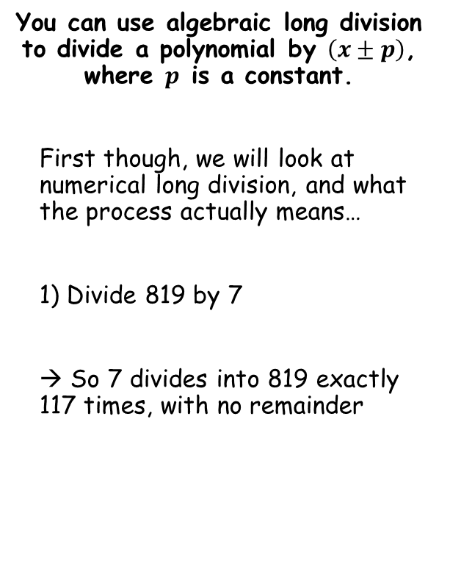
Algebraic Methods
You can use algebraic long division to divide a polynomial by $\left(x±p\right)$, where $p$ is a constant.
First though, we will look at numerical long division, and what the process actually means…
1) Divide 819 by 7
→ So 7 divides into 819 exactly 117 times, with no remainder
1
1
7
First, ‘How many 700s in 800’
1
We now take away ‘1 x 700’ from what we started with
Second, ‘How many 70s in 119’
1
We now take away ‘1 x 70’ from what we had (119)
Finally, ‘How many 7s in 49’
7
We now take away ‘7 x 7’ from what we had (49)
7
8
1
9
7
0
0
1
1
9
7
0
4
9
4
9
0
7B

Slide 4
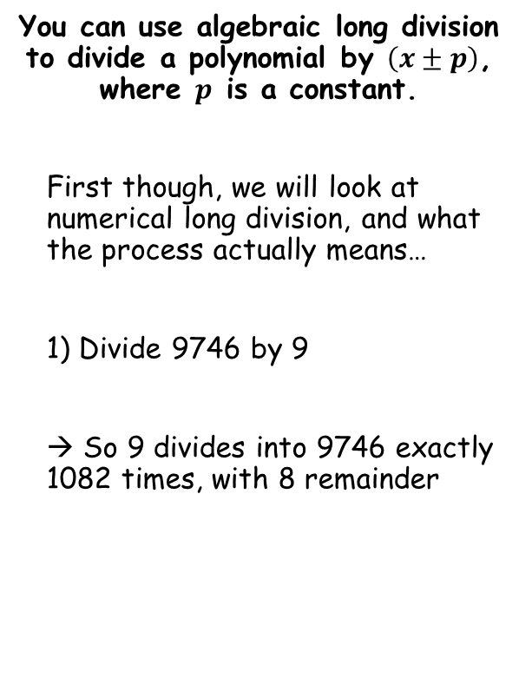
Algebraic Methods
1
0
8
2
You can use algebraic long division to divide a polynomial by $\left(x±p\right)$, where $p$ is a constant.
First though, we will look at numerical long division, and what the process actually means…
1) Divide 9746 by 9
→ So 9 divides into 9746 exactly 1082 times, with 8 remainder
9
9
7
4
6
9
0
0
0
7
4
6
Finally, ‘How many 9s in 26’
2
We now take away ‘2 x 9’ from what we had left (26)
First, ‘How many 9000s in 9000’
1
We now take away ‘1 x 9000’ from what we started with
Second, ‘How many 900s in 746’
0
We now take away ‘0 x 900’ from what we had left (746)
Third, ‘How many 90s in 746’
8
We now take away ‘8 x 90’ from what we had left (746)
0
7
4
6
7
2
0
2
6
1
8
8
7B

Slide 5
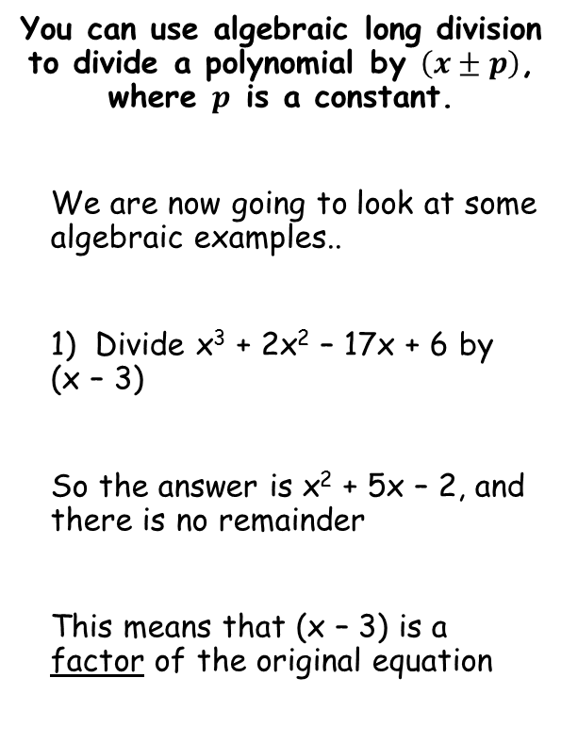
Algebraic Methods
You can use algebraic long division to divide a polynomial by $\left(x±p\right)$, where $p$ is a constant.
We are now going to look at some algebraic examples..
1) Divide x³ + 2x² – 17x + 6 by (x – 3)
So the answer is x² + 5x – 2, and there is no remainder
This means that (x – 3) is a factor of the original equation
x²
+
5x
-
2
x - 3
x³ + 2x² – 17x + 6
x³ – 3x²
5x² - 17x + 6
5x² - 15x
Third, Divide -2x by x
-2
We then subtract -2(x – 3) from what we have left
First, Divide x³ by x
x²
We then subtract x²(x – 3) from what we started with
Second, Divide 5x² by x
5x
We then subtract 5x(x – 3) from what we have left
- 2x + 6
- 2x + 6
0
Therefore:
$$\left(x−3\right)\left(x^{2}+5x−2\right)=x^{3}+2x^{2}−17x+6$$
7B

Slide 6

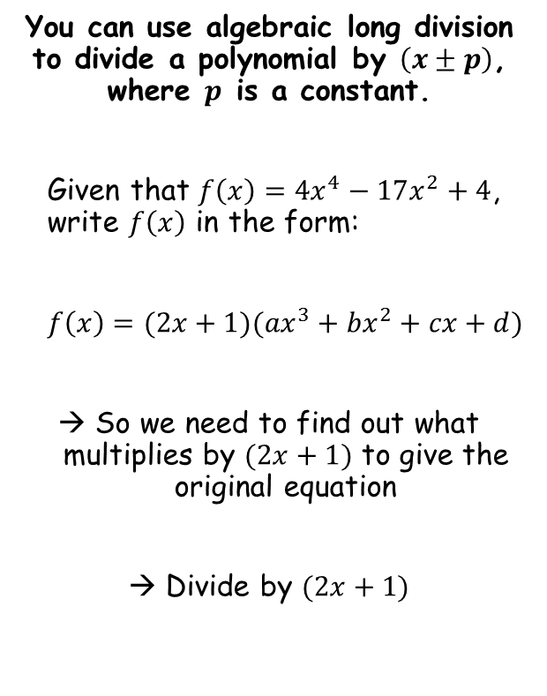
Algebraic Methods
2x³
-
x²
You can use algebraic long division to divide a polynomial by $\left(x±p\right)$, where $p$ is a constant.
Given that $f\left(x\right)={4x}^{4}−17x^{2}+4$, write $f\left(x\right)$ in the form:
$f\left(x\right)=(2x+1)({ax}^{3}+{bx}^{2}+cx+d)$
→ So we need to find out what multiplies by $(2x+1)$ to give the original equation
→ Divide by $(2x+1)$
-
8x
+ 4
2x + 1
4x⁴ + 0x³ - 17x² + 0x + 4
4x⁴ + 2x³
-2x³ - 17x² + 0x + 4
Follow the same processes as previously!
→ You must include terms with a 0 coefficient as well!
-2x³ - x²
- 16x² + 0x + 4
- 16x² - 8x
8x + 4
8x + 4
0
$$f\left(x\right)=(2x+1)({2x}^{3}−x^{2}−8x+4)$$
7B

Slide 7

Algebraic Methods
You can use algebraic long division to divide a polynomial by $\left(x±p\right)$, where $p$ is a constant.
Find the remainder when ${2x}^{3}−{5x}^{2}−16x+10$ is divided by $(x−4)$
2x²
+
3x
-
4
x - 4
2x³ - 5x² – 16x + 10
2x³ – 8x²
3x² – 16x + 10
First, divide 2x³ by x
= 2x²
Then, work out 2x²(x – 4) and subtract from what you started with
Second, divide 3x² by x
= 3x
Then, work out 3x(x – 4) and subtract from what you have left
Third, divide -4x by x
= -4
Then, work out -4(x – 4) and subtract from what you have left
3x² – 12x
-4x + 10
-4x + 16
-6
7B

