Slide 1
Algebraic Methods
Twitter: @Owen134866
www.mathsfreeresourcelibrary.com

Slide 2


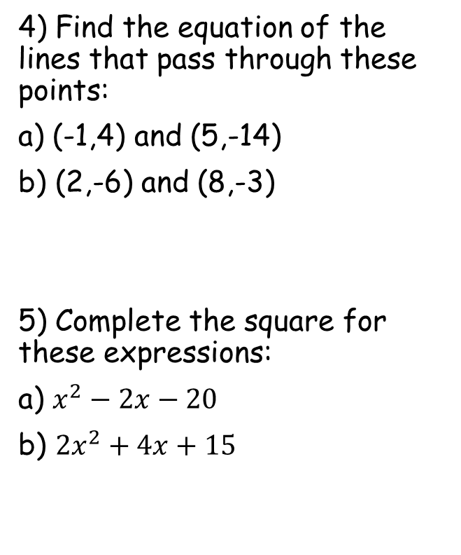


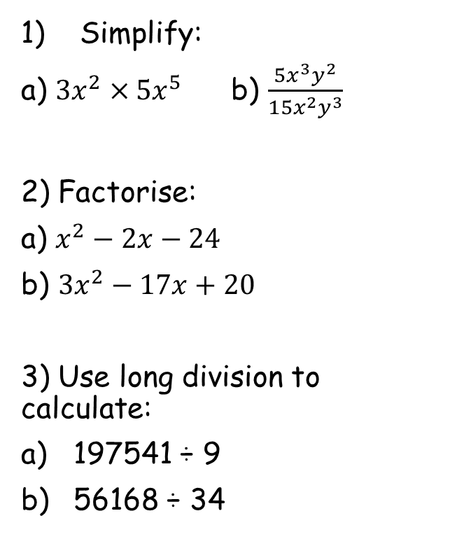






Prior Knowledge Check
Simplify:
a) ${3x}^{2}×{5x}^{5}$ b) $\frac{5x^{3}y^{2}}{{15x}^{2}y^{3}}$
2) Factorise:
a) $x^{2}−2x−24$
b) ${3x}^{2}−17x+20$
3) Use long division to calculate:
197541 ÷ 9
56168 ÷ 34
4) Find the equation of the lines that pass through these points:
a) (-1,4) and (5,-14)
b) (2,-6) and (8,-3)
5) Complete the square for these expressions:
a) $x^{2}−2x−20$
b) ${2x}^{2}+4x+15$
$$\frac{x}{3y}$$
$${15x}^{7}$$
$$y=1−3x$$
$$y=\frac{1}{2}x−7$$
$$(x−6)(x+4)$$
$$(3x−5)(x−4)$$
$${\left(x−1\right)}^{2}−21$$
$$21949$$
$${2\left(x+1\right)}^{2}+13$$
$$1652$$

Slide 3
Teachings for
Exercise 7A

Slide 4
Algebraic Methods
You can simplify algebraic fractions by using division
Sometimes you need to look for common factors to each term
→ In this case, every term, top and bottom, contains an x
→ You can therefore ‘cancel’ an x from each part
Divide all by x
Don’t need to divide by 1!
7A

Slide 5
Algebraic Methods
You can simplify algebraic fractions by using division
→ This equation has been put into brackets
→ You can cancel out brackets which are on the top and bottom
Divide by (2x – 1)
Don’t need to divide by 1!
7A

Slide 6
Algebraic Methods
You can simplify algebraic fractions by using division
→ Sometimes you will have to factorise one of the equations first
→ Once this is done, you can cancel out brackets as before
Two numbers that multiply to give +12 and add to give +7
Cancel the (x + 3)s
7A

Slide 7
Algebraic Methods
You can simplify algebraic fractions by using division
→ Sometimes you will have to factorise both of the equations first
→ Once this is done, you can cancel out brackets as before
Two numbers that multiply to give +5 and add to give +6
Two numbers that multiply to give -10 and add to give +3
Divide by (x + 5)
7A

Slide 8
Algebraic Methods
You can simplify algebraic fractions by using division
→ Sometimes you will have to factorise one of the equations first
→ Once this is done, you can cancel out brackets as before
Two numbers that multiply to give +12 and add to give +11, when one is doubled
Divide by the (x + 4)
7A

