Slide 1
Teachings for
Exercise 7D

Slide 2
Algebraic Methods
A proof is a logical and structured argument to show that a mathematical statement is always true (or not true)
A proof will follow this general pattern:
You need to be able to prove mathematical statements clearly
→ One way is by deduction
Statement: Prove that the product of two odd numbers is odd”
Demonstration: 5 x 7 = 35, which is odd
Proof:
$p$ and $q$ are integers, so $2p+1$ and $2q+1$ are odd numbers
Known facts/ theorems
$$(2p+1)(2q+1)$$
Multiply out
$$=4pq+2p+2q+1$$
Factorise partially
Clearly shown logical steps
$$=2(2pq+p+q)+1$$
→ Since p and q are integers, $2pq+p+q$ is also an integer.
Statement of proof
→ Therefore, $2(2pq+p+q)+1$ is once more than an even number
→ Consequently, the product of two numbers is an odd number
7D

Slide 3
Algebraic Methods
Prove that:
A proof is a logical and structured argument to show that a mathematical statement is always true (or not true)
You might have to prove identities
An identity has a ‘triple’ equal sign, and means that both sides are always equal (for any value of x)
Do not try to solve it like an equation. Instead, start with one side and show it is equal to the other
$$\left(3x+2\right)\left(x−5\right)\left(x+7\right)≡{3x}^{3}+{8x}^{2}−101x−70$$
Start with the left hand side (LHS)
$$\left(3x+2\right)\left(x−5\right)\left(x+7\right)$$
Expand one bracket
$$=\left(3x+2\right)(x^{2}+2x−35)$$
Expand again
$$={3x}^{3}+{6x}^{2}−105x+2x^{2}+4x−70$$
Group like terms
$$={3x}^{3}+{8x}^{2}−101x−70$$
This equals the right hand side
$$=RHS$$
7D

Slide 4
Algebraic Methods
A proof is a logical and structured argument to show that a mathematical statement is always true (or not true)
Prove that if $(x−p)$ is a factor of $f(x)$ then $f\left(p\right)=0$
If $(x−p)$ is a factor of $f(x)$ then:
Think about what $(x−p)$being a factor means…
$$f\left(x\right)=(x−p)×g(x)$$
We want to show what happens with $f(p)$ → Let $x=p$
$$f\left(p\right)=(p−p)×g(p)$$
$$(p−p)=0$$
$$f\left(p\right)=0×g(p)$$
This equals 0
$$f\left(p\right)=0$$
7D

Slide 5
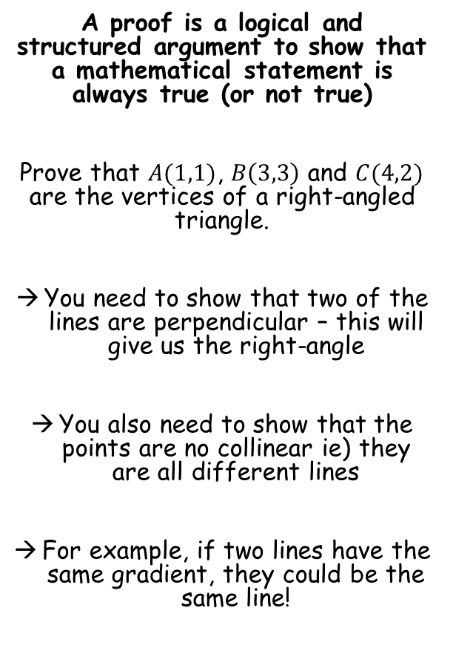
Algebraic Methods
A proof is a logical and structured argument to show that a mathematical statement is always true (or not true)
Prove that $A(1,1)$, $B\left(3,3\right)$ and $C(4,2)$ are the vertices of a right-angled triangle.
You need to show that two of the lines are perpendicular – this will give us the right-angle
You also need to show that the points are no collinear ie) they are all different lines
For example, if two lines have the same gradient, they could be the same line!
$$B(3,3)$$
$$C(4,2)$$
$$A(1,1)$$
Gradient of Line AB
Gradient of Line AC
Gradient of Line BC
$$\frac{y_{2}−y_{1}}{x_{2}−x_{1}}$$
$$\frac{y_{2}−y_{1}}{x_{2}−x_{1}}$$
$$\frac{y_{2}−y_{1}}{x_{2}−x_{1}}$$
$$\frac{3−1}{3−1}$$
$$\frac{2−1}{4−1}$$
$$\frac{3−2}{3−4}$$
$$=1$$
$$=\frac{1}{3}$$
$$=−1$$
Gradient of AB x Gradient of BC = -1 so they are perpendicular
→ All gradients are different so the lines are not collinear
7D

Slide 6
Algebraic Methods
A proof is a logical and structured argument to show that a mathematical statement is always true (or not true)
The equation $kx^{2}+3kx+2=0$, where k is a constant, has no real roots. Prove that k satisfies the inequality $0≤k<\frac{8}{9}$.
Remember to state what relationships you are using…
${kx}^{2}+3kx+2=0$ has no real roots
→ Therefore $b^{2}−4ac<0$
$$b^{2}−4ac<0$$
Sub in values
$${(3k)}^{2}−4(k)(2)<0$$
Simplify
$${9k}^{2}−8k<0$$
Factorise
$$k(9k−8)<0$$
$$y={9k}^{2}−8k$$
At this point a sketch can help show the answer!
→ We want the part below the x-axis, therefore:
$$0$$
$$\frac{8}{9}$$
$$0<k<\frac{8}{9}$$
7D

Slide 7
Algebraic Methods
$$y={9k}^{2}−8k$$
A proof is a logical and structured argument to show that a mathematical statement is always true (or not true)
The equation $kx^{2}+3kx+2=0$, where k is a constant, has no real roots. Prove that k satisfies the inequality $0≤k<\frac{8}{9}$.
Remember to state what relationships you are using…
Be careful though, is the above inequality actually what we need to prove?
$$0$$
$$\frac{8}{9}$$
Based on the quadratic equation graph, $k=0$ would give us a root, and we therefore should not include it (since we are told the original equation has no real roots)
→ What happens when we substitute 0 into the original equation though?
$$0<k<\frac{8}{9}$$
$$0≤k<\frac{8}{9}$$
$$kx^{2}+3kx+2=0$$
$$(0)x^{2}+3(0)x+2=0$$
$$2=0$$
So we do not get a root for $k=0$, and therefore it should be included in our answer
7D

Slide 8
Teachings for
Exercise 7E

Slide 9
Algebraic Methods
For odd numbers → $2p+1$
A mathematical statement can be proved via exhaustion.
The method of exhaustion involves breaking a situation down into smaller cases, and then proving each of them separately
This method is better when there are a limited number of cases
“Prove that all square numbers are either a multiple of 4, or 1 more than a multiple of 4”
→ A square number is generated by either multiplying an odd number by itself, or an even number by itself…
$${\left(2p+1\right)}^{2}$$
Squared means the bracket times itself…
$$=(2p+1)(2p+1)$$
Multiply out
$$={4p}^{2}+4p+1$$
Factorise 4 out for part of it
$$={4(p}^{2}+p)+1$$
So a square number generated from an odd number will always be one more than a multiple of 4
For even numbers → $2p$
$${\left(2p\right)}^{2}$$
Multiply by itself
$$=(2p)(2p)$$
Calculate
$$={4p}^{2}$$
Factorise the 4 out
$$={4(p}^{2})$$
So a square number generated from an even number will always be a multiple of 4
→ Since all integers are odd or even, the statement has been proved for all cases
7E

Slide 10
Algebraic Methods
A mathematical statement can be proved via exhaustion.
Prove that the following statement is not true:
“The sum of two consecutive prime numbers is always even”
You can prove a statement is not true by ‘counter-example’. In that case, you find a single example where the statement does not work
2 + 3 = 5 would be a counter-example here…
7E

Slide 11
Algebraic Methods
A mathematical statement can be proved via exhaustion.
Prove that for all positive values of x and y:
$$\frac{x}{y}+\frac{y}{x}≥2$$
Remember that a proof like this needs to start from known facts, not from what you are proving itself
Sometimes you should do some ‘jottings’ or workings first, and then write up the proof properly afterwards…
‘Jottings’
$$\frac{x}{y}+\frac{y}{x}≥2$$
Convert fractions so the denominators are equal
$$\frac{x^{2}}{xy}+\frac{y^{2}}{xy}≥2$$
Multiply by xy (we know this is positive so the inequality sign will not flip)
$$x^{2}+y^{2}≥2xy$$
Subtract 2xy
$$x^{2}+y^{2}−2xy≥0$$
This can be factorized (doing lots of practice questions helps spot this kind of pattern!)
$${\left(x−y\right)}^{2}≥0$$
We know this statement to be true since any value squared will be equal to or greater than 0
→ To do our proof, we should start from this known statement
7E

Slide 12
Algebraic Methods
A mathematical statement can be proved via exhaustion.
Prove that for all positive values of x and y:
$$\frac{x}{y}+\frac{y}{x}≥2$$
Remember that a proof like this needs to start from known facts, not from what you are proving itself
Sometimes you should do some ‘jottings’ or workings first, and then write up the proof properly afterwards…
Proof
Consider ${\left(x−y\right)}^{2}$
We know the statement will give an answer greater than or equal to 0
$${\left(x−y\right)}^{2}≥0$$
Expand the bracket
$$x^{2}+y^{2}−2xy≥0$$
Divide both sides by xy (this is valid as we know they are both positive)
$$\frac{x^{2}+y^{2}−2xy}{xy}≥0$$
Simplify
$$\frac{x}{y}+\frac{y}{x}−2≥0$$
Add 2
$$\frac{x}{y}+\frac{y}{x}≥2$$
We have therefore proved the statement, starting from a known fact!
7E

