Slide 1
Algebraic Methods
Twitter: @Owen134866
www.mathsfreeresourcelibrary.com

Slide 2


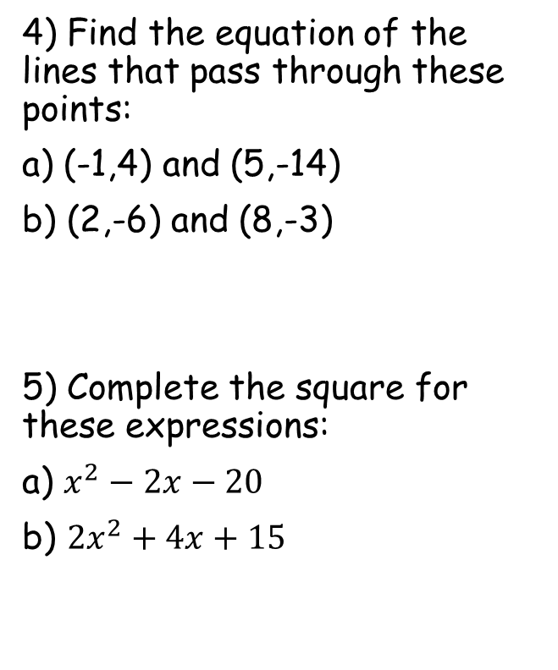


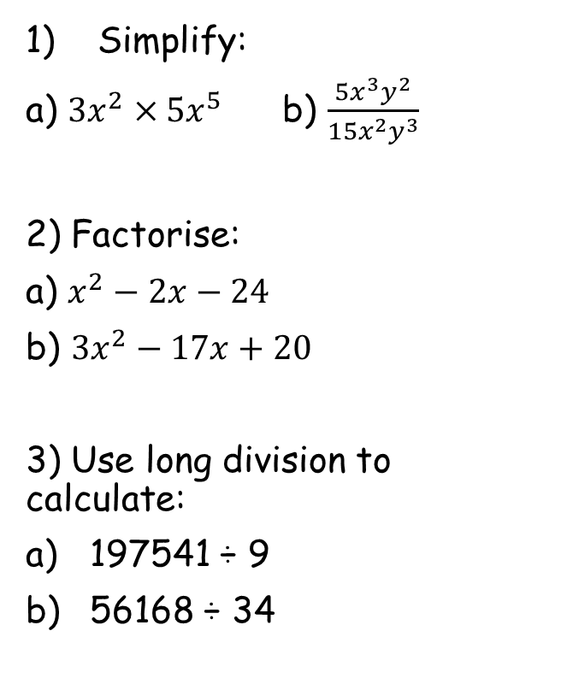






Prior Knowledge Check
Simplify:
a) ${3x}^{2}×{5x}^{5}$ b) $\frac{5x^{3}y^{2}}{{15x}^{2}y^{3}}$
2) Factorise:
a) $x^{2}−2x−24$
b) ${3x}^{2}−17x+20$
3) Use long division to calculate:
197541 ÷ 9
56168 ÷ 34
4) Find the equation of the lines that pass through these points:
a) (-1,4) and (5,-14)
b) (2,-6) and (8,-3)
5) Complete the square for these expressions:
a) $x^{2}−2x−20$
b) ${2x}^{2}+4x+15$
$$\frac{x}{3y}$$
$${15x}^{7}$$
$$y=1−3x$$
$$y=\frac{1}{2}x−7$$
$$(x−6)(x+4)$$
$$(3x−5)(x−4)$$
$${\left(x−1\right)}^{2}−21$$
$$21949$$
$${2\left(x+1\right)}^{2}+13$$
$$1652$$

Slide 3
Teachings for
Exercise 7A

Slide 4
Algebraic Methods
You can simplify algebraic fractions by using division
Sometimes you need to look for common factors to each term
→ In this case, every term, top and bottom, contains an x
→ You can therefore ‘cancel’ an x from each part
Divide all by x
Don’t need to divide by 1!
7A

Slide 5
Algebraic Methods
You can simplify algebraic fractions by using division
→ This equation has been put into brackets
→ You can cancel out brackets which are on the top and bottom
Divide by (2x – 1)
Don’t need to divide by 1!
7A

Slide 6
Algebraic Methods
You can simplify algebraic fractions by using division
→ Sometimes you will have to factorise one of the equations first
→ Once this is done, you can cancel out brackets as before
Two numbers that multiply to give +12 and add to give +7
Cancel the (x + 3)s
7A

Slide 7
Algebraic Methods
You can simplify algebraic fractions by using division
→ Sometimes you will have to factorise both of the equations first
→ Once this is done, you can cancel out brackets as before
Two numbers that multiply to give +5 and add to give +6
Two numbers that multiply to give -10 and add to give +3
Divide by (x + 5)
7A

Slide 8
Algebraic Methods
You can simplify algebraic fractions by using division
→ Sometimes you will have to factorise one of the equations first
→ Once this is done, you can cancel out brackets as before
Two numbers that multiply to give +12 and add to give +11, when one is doubled
Divide by the (x + 4)
7A

Slide 9
Teachings for
Exercise 7B

Slide 10
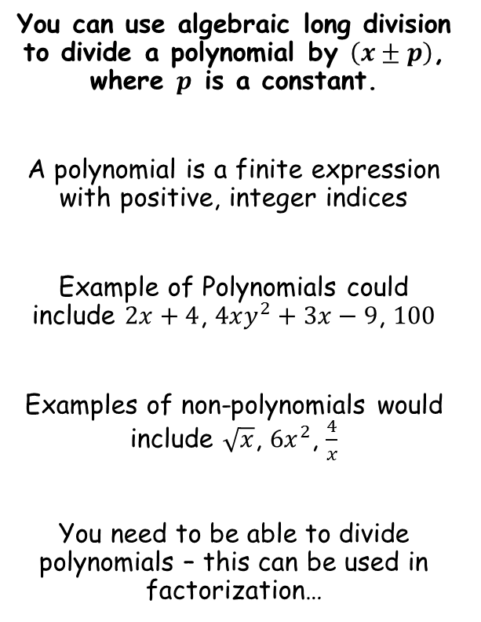
Algebraic Methods
You can use algebraic long division to divide a polynomial by $\left(x±p\right)$, where $p$ is a constant.
A polynomial is a finite expression with positive, integer indices
Example of Polynomials could include $2x+4$, $4xy^{2}+3x−9$, $100$
Examples of non-polynomials would include $\sqrt{x}$, $6x^{2}$, $\frac{4}{x}$
You need to be able to divide polynomials – this can be used in factorization…
7B

Slide 11
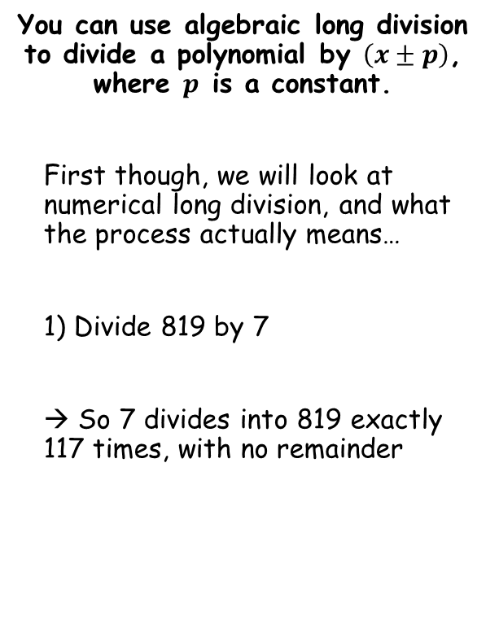
Algebraic Methods
You can use algebraic long division to divide a polynomial by $\left(x±p\right)$, where $p$ is a constant.
First though, we will look at numerical long division, and what the process actually means…
1) Divide 819 by 7
→ So 7 divides into 819 exactly 117 times, with no remainder
1
1
7
First, ‘How many 700s in 800’
1
We now take away ‘1 x 700’ from what we started with
Second, ‘How many 70s in 119’
1
We now take away ‘1 x 70’ from what we had (119)
Finally, ‘How many 7s in 49’
7
We now take away ‘7 x 7’ from what we had (49)
7
8
1
9
7
0
0
1
1
9
7
0
4
9
4
9
0
7B

Slide 12
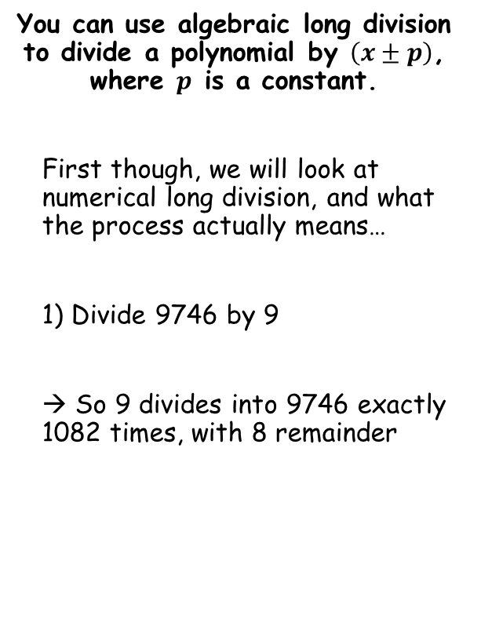
Algebraic Methods
1
0
8
2
You can use algebraic long division to divide a polynomial by $\left(x±p\right)$, where $p$ is a constant.
First though, we will look at numerical long division, and what the process actually means…
1) Divide 9746 by 9
→ So 9 divides into 9746 exactly 1082 times, with 8 remainder
9
9
7
4
6
9
0
0
0
7
4
6
Finally, ‘How many 9s in 26’
2
We now take away ‘2 x 9’ from what we had left (26)
First, ‘How many 9000s in 9000’
1
We now take away ‘1 x 9000’ from what we started with
Second, ‘How many 900s in 746’
0
We now take away ‘0 x 900’ from what we had left (746)
Third, ‘How many 90s in 746’
8
We now take away ‘8 x 90’ from what we had left (746)
0
7
4
6
7
2
0
2
6
1
8
8
7B

Slide 13
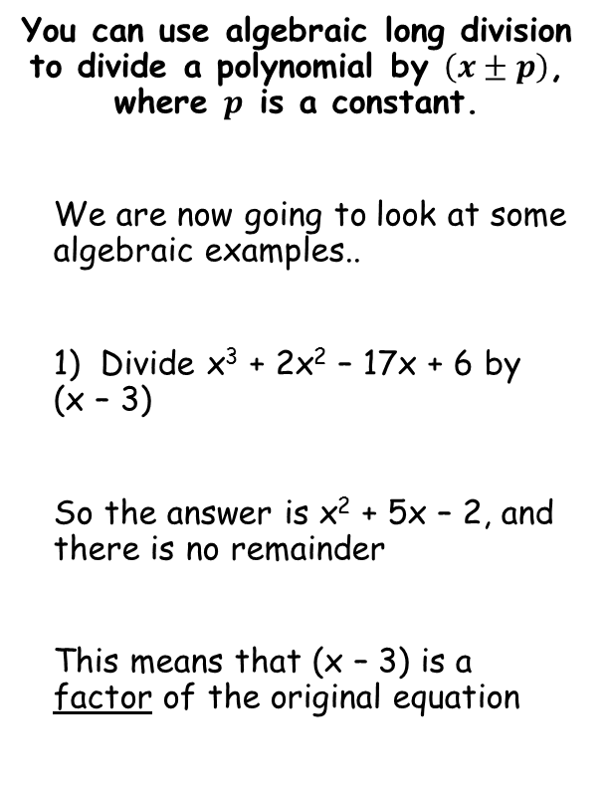
Algebraic Methods
You can use algebraic long division to divide a polynomial by $\left(x±p\right)$, where $p$ is a constant.
We are now going to look at some algebraic examples..
1) Divide x³ + 2x² – 17x + 6 by (x – 3)
So the answer is x² + 5x – 2, and there is no remainder
This means that (x – 3) is a factor of the original equation
x²
+
5x
-
2
x - 3
x³ + 2x² – 17x + 6
x³ – 3x²
5x² - 17x + 6
5x² - 15x
Third, Divide -2x by x
-2
We then subtract -2(x – 3) from what we have left
First, Divide x³ by x
x²
We then subtract x²(x – 3) from what we started with
Second, Divide 5x² by x
5x
We then subtract 5x(x – 3) from what we have left
- 2x + 6
- 2x + 6
0
Therefore:
$$\left(x−3\right)\left(x^{2}+5x−2\right)=x^{3}+2x^{2}−17x+6$$
7B

Slide 14

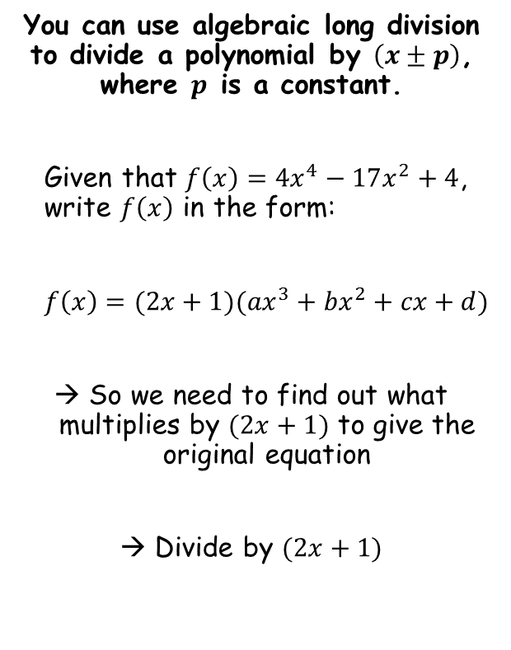
Algebraic Methods
2x³
-
x²
You can use algebraic long division to divide a polynomial by $\left(x±p\right)$, where $p$ is a constant.
Given that $f\left(x\right)={4x}^{4}−17x^{2}+4$, write $f\left(x\right)$ in the form:
$f\left(x\right)=(2x+1)({ax}^{3}+{bx}^{2}+cx+d)$
→ So we need to find out what multiplies by $(2x+1)$ to give the original equation
→ Divide by $(2x+1)$
-
8x
+ 4
2x + 1
4x⁴ + 0x³ - 17x² + 0x + 4
4x⁴ + 2x³
-2x³ - 17x² + 0x + 4
Follow the same processes as previously!
→ You must include terms with a 0 coefficient as well!
-2x³ - x²
- 16x² + 0x + 4
- 16x² - 8x
8x + 4
8x + 4
0
$$f\left(x\right)=(2x+1)({2x}^{3}−x^{2}−8x+4)$$
7B

Slide 15

Algebraic Methods
You can use algebraic long division to divide a polynomial by $\left(x±p\right)$, where $p$ is a constant.
Find the remainder when ${2x}^{3}−{5x}^{2}−16x+10$ is divided by $(x−4)$
2x²
+
3x
-
4
x - 4
2x³ - 5x² – 16x + 10
2x³ – 8x²
3x² – 16x + 10
First, divide 2x³ by x
= 2x²
Then, work out 2x²(x – 4) and subtract from what you started with
Second, divide 3x² by x
= 3x
Then, work out 3x(x – 4) and subtract from what you have left
Third, divide -4x by x
= -4
Then, work out -4(x – 4) and subtract from what you have left
3x² – 12x
-4x + 10
-4x + 16
-6
7B

Slide 16
Teachings for
Exercise 7C

Slide 17





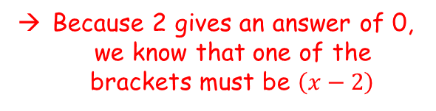




Algebraic Methods
The factor theorem is a quick way of finding simple linear factors of a polynomial
Factorise and solve the following:
$$x^{2}−9x+20=0$$
$$x^{2}−9x+20=0$$
Factorise
$$(x−4)(x−5)=0$$
Solve
$x=4$ or $x=5$
→ Remember that what we are doing is finding the values that make the original equation equal 0
Another (less reliable) way to factorise is to try subbing in values
If a value gives an answer 0, you then know one of the brackets
$$x^{2}+6x−16=0$$
Sub in 1
Sub in 2
$${(1)}^{2}+6(1)−16=0$$
$${(2)}^{2}+6(2)−16=0$$
$$−9=0$$
$$0=0$$
Because 2 gives an answer of 0, we know that one of the brackets must be $\left(x−2\right)$
7C

Slide 18
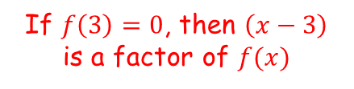
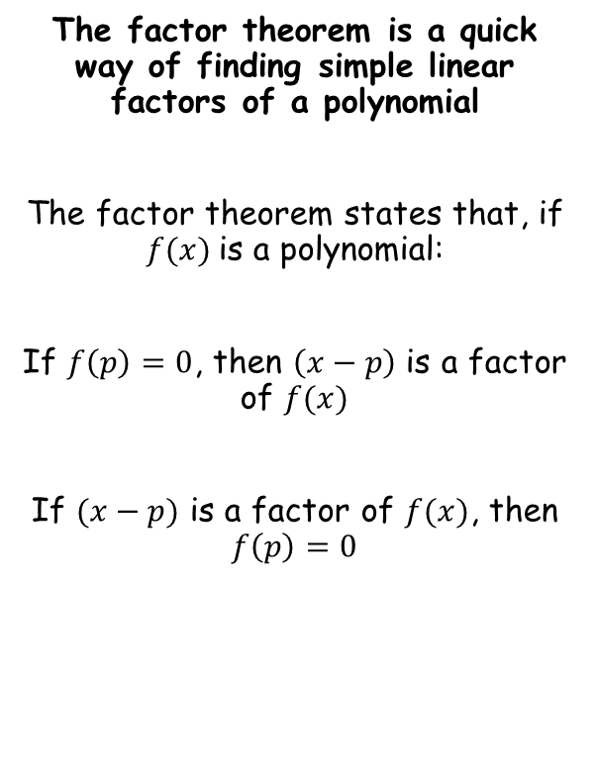
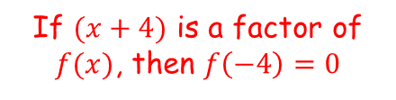
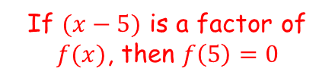
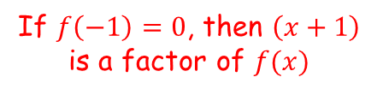
Algebraic Methods
The factor theorem is a quick way of finding simple linear factors of a polynomial
The factor theorem states that, if $f(x)$is a polynomial:
If $f\left(p\right)=0$, then $\left(x−p\right)$ is a factor of $f(x)$
If $(x−p)$ is a factor of $f(x)$, then $f\left(p\right)=0$
If $f\left(3\right)=0$, then $\left(x−3\right)$ is a factor of $f(x)$
If $f\left(−1\right)=0$, then $\left(x+1\right)$ is a factor of $f(x)$
If $(x−5)$ is a factor of $f(x)$, then $f\left(5\right)=0$
If $(x+4)$ is a factor of $f(x)$, then $f\left(−4\right)=0$
7C

Slide 19

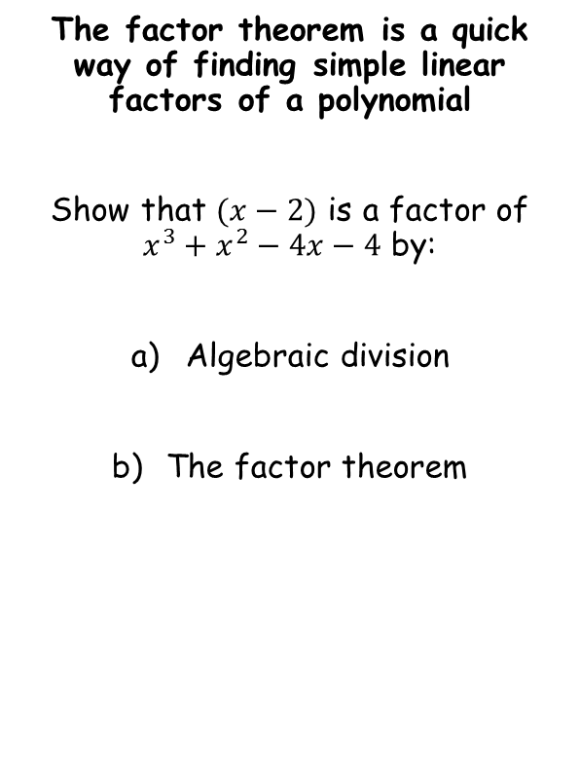
Algebraic Methods
The factor theorem is a quick way of finding simple linear factors of a polynomial
Show that $(x−2)$ is a factor of $x^{3}+x^{2}−4x−4$ by:
Algebraic division
The factor theorem
x²
+
3x
+
2
x - 2
x³ + x² – 4x - 4
x³ – 2x²
3x² - 4x - 4
3x² - 6x
2x - 4
2x - 4
0
The remainder is 0, so $(x−2)$ is a factor!
7C

Slide 20




Algebraic Methods
The factor theorem is a quick way of finding simple linear factors of a polynomial
Show that $(x−2)$ is a factor of $x^{3}+x^{2}−4x−4$ by:
Algebraic division
The factor theorem
$$x^{3}+x^{2}−4x−4$$
Sub in x = 2
$${(2)}^{3}+{(2)}^{2}−4(2)−4$$
Calculate
$$=0$$
The answer is 0, so $(x−2)$ is a factor!
7C

Slide 21

Algebraic Methods
The factor theorem is a quick way of finding simple linear factors of a polynomial
a) Fully factorise ${2x}^{3}+x^{2}−18x−9$
b) Hence, sketch the graph of $y={2x}^{3}+x^{2}−18x−9$
2x³ + x² – 18x - 9
Substitute in values of x to find a factor
x = 1
2 + 1 – 18 - 9
= -24
x = 2
16 + 4 – 36 - 9
= -25
x = 3
54 + 9 – 54 - 9
= 0
So (x – 3) is a factor
7C

Slide 22
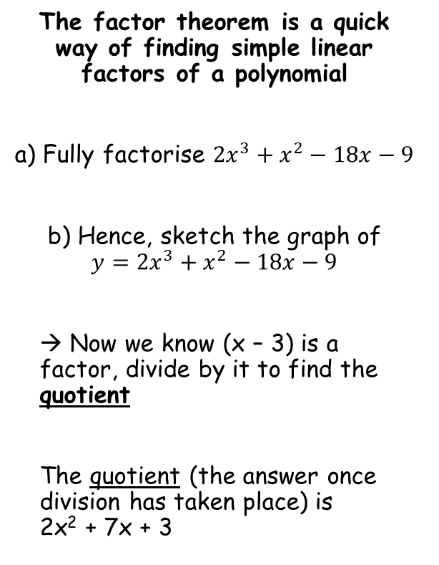
Algebraic Methods
The factor theorem is a quick way of finding simple linear factors of a polynomial
a) Fully factorise ${2x}^{3}+x^{2}−18x−9$
b) Hence, sketch the graph of $y={2x}^{3}+x^{2}−18x−9$
→ Now we know (x – 3) is a factor, divide by it to find the quotient
The quotient (the answer once division has taken place) is 2x² + 7x + 3
2x²
+
7x
+
3
x - 3
2x³ + x² – 18x - 9
2x³ – 6x²
7x² – 18x - 9
7x² – 21x
3x - 9
3x - 9
0
7C

Slide 23

Algebraic Methods
The factor theorem is a quick way of finding simple linear factors of a polynomial
a) Fully factorise ${2x}^{3}+x^{2}−18x−9$
b) Hence, sketch the graph of $y={2x}^{3}+x^{2}−18x−9$
(x – 3)(2x² + 7x + 3)
You can also factorise the quotient
$$=(x−3)(2x+1)(x+3)$$
2 numbers that multiply to give +3, and add to give +7 when one has doubled…
(x – 3)(2x + 1)(x + 3)
This is now fully factorised!
7C

Slide 24


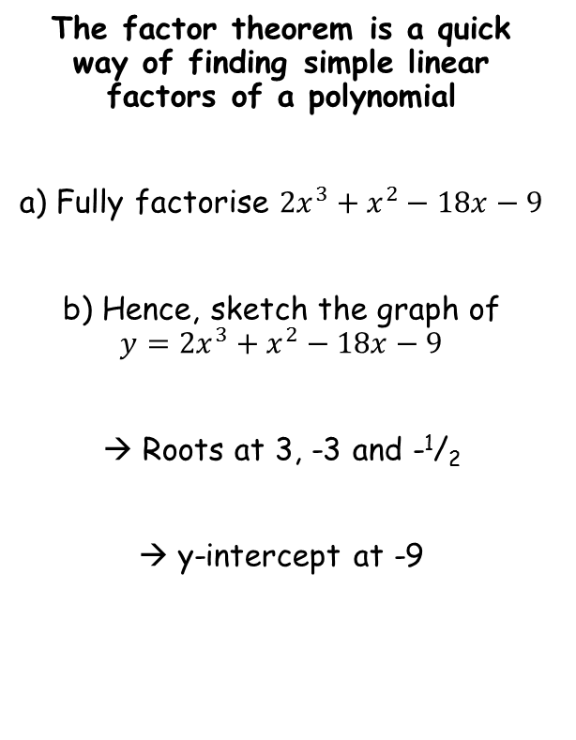



Algebraic Methods
The factor theorem is a quick way of finding simple linear factors of a polynomial
a) Fully factorise ${2x}^{3}+x^{2}−18x−9$
b) Hence, sketch the graph of $y={2x}^{3}+x^{2}−18x−9$
→ Roots at 3, -3 and -¹/₂
→ y-intercept at -9
$$−\frac{1}{2}$$
$$=(x−3)(2x+1)(x+3)$$
$$−3$$
$$3$$
$$−9$$
$$y=(x−3)(2x+1)(x+3)$$
7C

Slide 25
Algebraic Methods
The factor theorem is a quick way of finding simple linear factors of a polynomial
Given that (x + 1) is a factor of 4x⁴ – 3x² + a, find the value of a.
4x⁴ – 3x² + a
If (x + 1) is a factor, then subbing -1 will make the equation = 0
0 =
4(-1 ) ⁴ – 3(-1)² + a
Work out each term
0 =
4 – 3 + a
Solve the equation to find the value of a
0 =
1 + a
-1 =
a
7C

