Slide 1
Teachings for
Exercise 6F

Slide 2
Circles
You need to be able to solve problems involving circles and triangles.
Draw any triangle in the centre of a piece of paper (not too big, not too small)
Construct, using a pair of compasses, the perpendicular bisector of each side
Show where they meet. How does this relate to circles?
6F

Slide 3
Circles
You need to be able to solve problems involving circles and triangles.
You need to bisect each side separately
The 3 bisectors should all cross at one point
You can draw a circle which has this point as its centre. The circle will got through all 3 corners of the triangle!
This is called the ‘circumcentre’ of the triangle
6F

Slide 4
Circles
You need to be able to solve problems involving circles and triangles.
Diameter
For any chord, the perpendicular bisector goes through the centre
Any triangle can have a circle drawn through the corners
→ Each side is a chord of the circle
If one side of the triangle is the diameter, the angle in the semi-circle is 90˚
6F

Slide 5
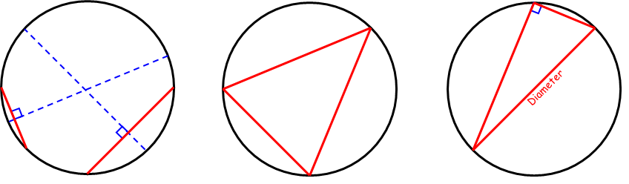










Circles
C(-4,9)
You need to be able to solve problems involving circles and triangles.
The points A(-8,1), B(4,5) and C(-4,9) lie on the circle, as shown in the diagram.
Show that AB is a diameter of the circle.
Find an equation of the circle
If AB is the diameter of the circle, then it will be the hypotenuse in a right-angled triangle
We therefore should aim to show that the triangle is right-angled
B(4,5)
A(-8,1)
We can use Pythagoras’ Theorem to find the distances between each pair of coordinates
$$\sqrt{{(x_{1}−x_{2})}^{2}+{(y_{1}−y_{2})}^{2}}$$
$$AC=\sqrt{4^{2}+8^{2}}$$
$$BC=\sqrt{8^{2}+4^{2}}$$
$$AB=\sqrt{{12}^{2}+4^{2}}$$
$$=\sqrt{80}$$
$$=\sqrt{80}$$
$$=\sqrt{160}$$
Sub these distances into Pythagoras’ Theorem and see if it works!
$$a^{2}+b^{2}=c^{2}$$
$${\left(\sqrt{80}\right)}^{2}+{\left(\sqrt{80}\right)}^{2}={\left(\sqrt{160}\right)}^{2}$$
$$80+80=160$$
6F

Slide 6






Circles
C(-4,9)
You need to be able to solve problems involving circles and triangles.
The points A(-8,1), B(4,5) and C(-4,9) lie on the circle, as shown in the diagram.
Show that AB is a diameter of the circle.
Find an equation of the circle
To find the equation of the circle, we need its centre and its radius.
We just found the length of the diameter, so the radius will be half of that
B(4,5)
A(-8,1)
$$\sqrt{160}$$
The centre will be the midpoint of AB
$$\left(\frac{x_{1}+x_{2}}{2},\frac{y_{1}+y_{2}}{2}\right)$$
Sub in values
$$\left(\frac{−8+4}{2},\frac{1+5}{2}\right)$$
Calculate
$$\left(−2,3 \right)$$
$$Radius=\frac{\sqrt{160}}{2}$$
$$Centre=(−2,3)$$
6F

Slide 7

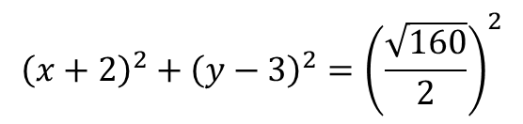

Circles
C(-4,9)
You need to be able to solve problems involving circles and triangles.
The points A(-8,1), B(4,5) and C(-4,9) lie on the circle, as shown in the diagram.
Show that AB is a diameter of the circle.
Find an equation of the circle
To find the equation of the circle, we need its centre and its radius.
We just found the length of the diameter, so the radius will be half of that
B(4,5)
A(-8,1)
$$\sqrt{160}$$
$${\left(x−a\right)}^{2}+{\left(y−b\right)}^{2}=r^{2}$$
$${\left(x+2\right)}^{2}+{\left(y−3\right)}^{2}={\left(\frac{\sqrt{160}}{2}\right)}^{2}$$
Sub in values
Simplify
$${\left(x+2\right)}^{2}+{\left(y−3\right)}^{2}=40$$
$$Radius=\frac{\sqrt{160}}{2}$$
$$Centre=(−2,3)$$
6F

Slide 8


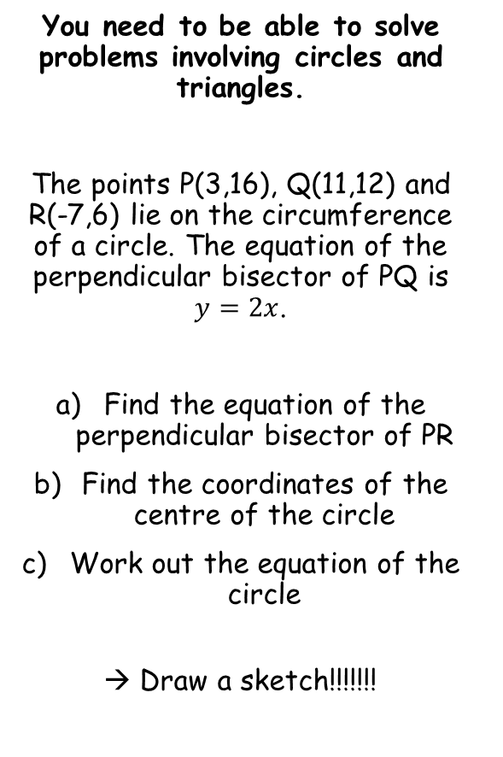






Circles
P(3,16)
Q(11,12)
You need to be able to solve problems involving circles and triangles.
The points P(3,16), Q(11,12) and R(-7,6) lie on the circumference of a circle. The equation of the perpendicular bisector of PQ is $y=2x$.
Find the equation of the perpendicular bisector of PR
Find the coordinates of the centre of the circle
Work out the equation of the circle
→ Draw a sketch!!!!!!!
R(-7,6)
$$y=2x$$
To find the equation of the perpendicular bisector of PR, we need its gradient, and a coordinate on it
Midpoint of PR
Gradient of PR
$$\left(\frac{x_{1}+x_{2}}{2},\frac{y_{1}+y_{2}}{2}\right)$$
$$\frac{y_{1}−y_{2}}{x_{1}−x_{2}}$$
Sub in values
Sub in values
$$\left(\frac{−7+3}{2},\frac{6+16}{2}\right)$$
$$\frac{16−6}{3−(−7)}$$
Coordinate (-2,11)
Gradient -1
Calculate
Calculate
$$\left(−2,11 \right)$$
$$=1$$
Gradient of P.Bisector
$$=−1$$
6F

Slide 9





Circles
P(3,16)
Q(11,12)
You need to be able to solve problems involving circles and triangles.
The points P(3,16), Q(11,12) and R(-7,6) lie on the circumference of a circle. The equation of the perpendicular bisector of PQ is $y=2x$.
Find the equation of the perpendicular bisector of PR
Find the coordinates of the centre of the circle
Work out the equation of the circle
→ Draw a sketch!!!!!!!
R(-7,6)
$$y=−x+9$$
$$y=2x$$
$$y−y_{1}=m(x−x_{1})$$
Sub in values
$$y−\left(11\right)=−1(x−(−2))$$
Simplify
$$y−11=−1(x+2)$$
Rearrange
$$y=−x+9$$
Coordinate (-2,11)
Gradient -1
6F

Slide 10


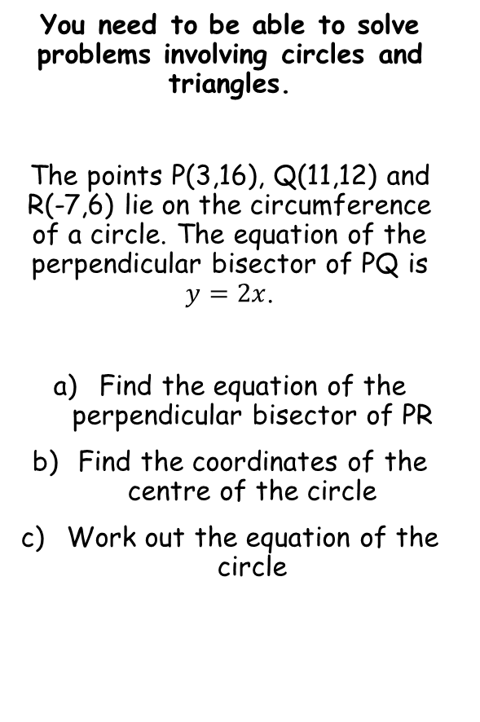



Circles
P(3,16)
Q(11,12)
You need to be able to solve problems involving circles and triangles.
The points P(3,16), Q(11,12) and R(-7,6) lie on the circumference of a circle. The equation of the perpendicular bisector of PQ is $y=2x$.
Find the equation of the perpendicular bisector of PR
Find the coordinates of the centre of the circle
Work out the equation of the circle
R(-7,6)
$$(3,6)$$
$$y=−x+9$$
$$y=2x$$
The Perpendicular Bisectors will meet at the centre of the circle
→ Set them equal to each other and solve the equation
$$2x=−x+9$$
Add x
$$3x=9$$
Divide by 3
$$x=3$$
Use x to find y
$$y=6$$
6F

Slide 11




Circles
P(3,16)
Q(11,12)
You need to be able to solve problems involving circles and triangles.
The points P(3,16), Q(11,12) and R(-7,6) lie on the circumference of a circle. The equation of the perpendicular bisector of PQ is $y=2x$.
Find the equation of the perpendicular bisector of PR
Find the coordinates of the centre of the circle
Work out the equation of the circle
R(-7,6)
$$(3,6)$$
$$y=−x+9$$
$$y=2x$$
We already have the centre of the circle, so now we need the radius
→ Find the distance between (3,6) and any of the other coordinates!
$$\sqrt{{(x_{1}−x_{2})}^{2}+{(y_{1}−y_{2})}^{2}}$$
Using (3,6) and (11,12)
$$=\sqrt{{(3−11)}^{2}+{(6−12)}^{2}}$$
$$Radius=10$$
Calculate
$$=10$$
6F

Slide 12



Circles
P(3,16)
Q(11,12)
You need to be able to solve problems involving circles and triangles.
The points P(3,16), Q(11,12) and R(-7,6) lie on the circumference of a circle. The equation of the perpendicular bisector of PQ is $y=2x$.
Find the equation of the perpendicular bisector of PR
Find the coordinates of the centre of the circle
Work out the equation of the circle
R(-7,6)
$$(3,6)$$
$$y=−x+9$$
$$y=2x$$
$${\left(x−a\right)}^{2}+{\left(y−b\right)}^{2}=r^{2}$$
Sub in values
$${\left(x−3\right)}^{2}+{\left(y−6\right)}^{2}={\left(10\right)}^{2}$$
Simplify
$${\left(x−3\right)}^{2}+{\left(y−6\right)}^{2}=100$$
$$Radius=10$$
6F

Slide 13
Circles
P(3,16)
Q(11,12)
You need to be able to solve problems involving circles and triangles.
The points P(3,16), Q(11,12) and R(-7,6) lie on the circumference of a circle. The equation of the perpendicular bisector of PQ is $y=2x$.
Find the equation of the perpendicular bisector of PR
Find the coordinates of the centre of the circle
Work out the equation of the circle
R(-7,6)
$$(3,6)$$
$$y=−x+9$$
$$y=2x$$
Notice that the sketch actually wasn’t completely accurate!
→ This is fine, the whole point is to help you visualize the question and identify what information you have, and need to work out
$$Radius=10$$
6F

