Slide 1
Teachings for
Exercise 6E

Slide 2



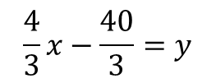
Circles
You can use the properties of tangents and chords within circles to solve geometric problems.
The line 4x – 3y – 40 = 0 is a tangent to the circle (x – 2)² + (y – 6)² = 100 at P = (10,0). Show that the radius at P is perpendicular to this line.
To solve this problem, you need to find the gradient of the straight line and compare it to the gradient of the radius at (10,0)
→ Find the gradient of the straight line by writing it in terms of y
$$4x−3y−40=0$$
Add 3y
(x – 2)² + (y – 6)² = 100
4x – 3y – 40 = 0
$$4x−40=3y$$
Divide by 3
$$\frac{4}{3}x−\frac{40}{3}=y$$
(2,6)
So the gradient of the straight line is ⁴/₃
(10,0)
$$Gradient of straight line= \frac{4}{3}$$
6E

Slide 3




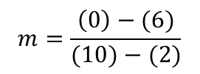
Circles
You can use the properties of tangents and chords within circles to solve geometric problems.
The line 4x – 3y – 40 = 0 is a tangent to the circle (x – 2)² + (y – 6)² = 100 at P = (10,0). Show that the radius at P is perpendicular to this line.
Now find the gradient of the radius at (10,0)
You can do this by finding the gradient of the line segment shown in green…
You can use a formula from C1!
$$m=\frac{y_{2}−y_{1}}{x_{2}−x_{1}}$$
Sub in values (make sure you put them the same way round!)
$$m=\frac{\left(0\right)−(6)}{(10)−(2)}$$
(x – 2)² + (y – 6)² = 100
4x – 3y – 40 = 0
Calculate
$$m=\frac{−6}{8}$$
(2,6)
Simplify
$$m=−\frac{3}{4}$$
(10,0)
$$Gradient of straight line= \frac{4}{3}$$
So this is the gradient of the radius at (10,0)
$$Gradient of radius=− \frac{3}{4}$$
6E

Slide 4


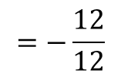
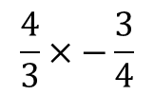
Circles
You can use the properties of tangents and chords within circles to solve geometric problems.
The line 4x – 3y – 40 = 0 is a tangent to the circle (x – 2)² + (y – 6)² = 100 at P = (10,0). Show that the radius at P is perpendicular to this line.
$$Gradient of straight line= \frac{4}{3}$$
$$Gradient of radius=− \frac{3}{4}$$
Multiply the gradients together…
$$\frac{4}{3}×−\frac{3}{4}$$
$$=−\frac{12}{12}$$
(x – 2)² + (y – 6)² = 100
4x – 3y – 40 = 0
$$=−1$$
(2,6)
If two gradients multiply to make -1, they are perpendicular
(this is another way of defining it!)
(10,0)
6E

Slide 5

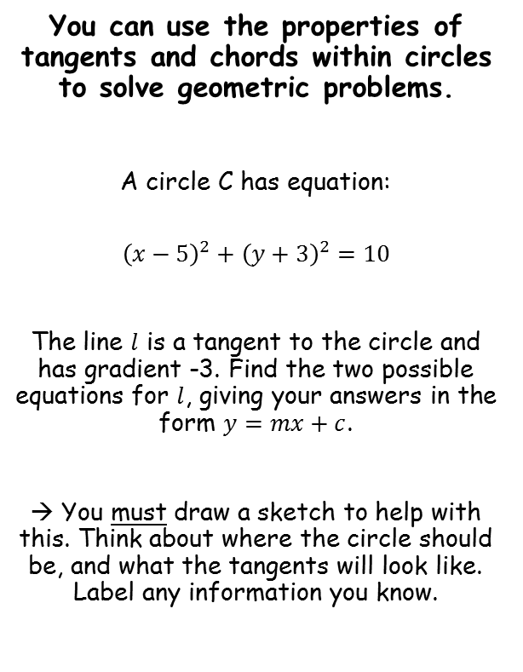
Circles
The tangents will be downward sloping, since their gradient is -3
You can use the properties of tangents and chords within circles to solve geometric problems.
A circle C has equation:
$${\left(x−5\right)}^{2}+{\left(y+3\right)}^{2}=10$$
The line $l$ is a tangent to the circle and has gradient -3. Find the two possible equations for $l$, giving your answers in the form $y=mx+c$.
→ You must draw a sketch to help with this. Think about where the circle should be, and what the tangents will look like. Label any information you know.
(5,-3)
Centre (5,-3)
Radius $\sqrt{10}$
We can also mark on the diameter (this is often needed in these questions)
To find the equation of the tangents, we need their gradients, and the coordinate where they meet the circle.
We already know their gradients are -3
We can find the coordinates by finding where the diameter (in green) meets the circle
To do this, we first need the equation of the diameter
Gradient = -3
6E

Slide 6




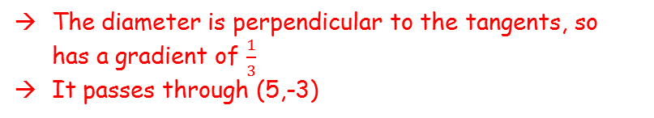
Circles
You can use the properties of tangents and chords within circles to solve geometric problems.
A circle C has equation:
$${\left(x−5\right)}^{2}+{\left(y+3\right)}^{2}=10$$
The line $l$ is a tangent to the circle and has gradient -3. Find the two possible equations for $l$, giving your answers in the form $y=mx+c$.
→ You must draw a sketch to help with this. Think about where the circle should be, and what the tangents will look like. Label any information you know.
$$y=\frac{1}{3}x−\frac{14}{3}$$
(5,-3)
Centre (5,-3)
Radius $\sqrt{10}$
The diameter is perpendicular to the tangents, so has a gradient of $\frac{1}{3}$
It passes through (5,-3)
Gradient = -3
$$y−y_{1}=m(x−x_{1})$$
$$y−(−3)=\frac{1}{3}(x−5)$$
Sub in values
$$y=\frac{1}{3}x−\frac{14}{3}$$
Rearrange
6E

Slide 7





Circles
You can use the properties of tangents and chords within circles to solve geometric problems.
A circle C has equation:
$${\left(x−5\right)}^{2}+{\left(y+3\right)}^{2}=10$$
The line $l$ is a tangent to the circle and has gradient -3. Find the two possible equations for $l$, giving your answers in the form $y=mx+c$.
→ You must draw a sketch to help with this. Think about where the circle should be, and what the tangents will look like. Label any information you know.
$$y=\frac{1}{3}x−\frac{14}{3}$$
(5,-3)
Centre (5,-3)
Radius $\sqrt{10}$
$${\left(x−5\right)}^{2}+{\left(y+3\right)}^{2}=10$$
Replace y with the expression in x
Gradient = -3
$${\left(x−5\right)}^{2}+{\left(\frac{1}{3}x−\frac{14}{3}+3\right)}^{2}=10$$
Simplify the bracket
$${\left(x−5\right)}^{2}+{\left(\frac{1}{3}x−\frac{5}{3}\right)}^{2}=10$$
Square both brackets
$$x^{2}−10x+25+\frac{1}{9}x^{2}−\frac{10}{9}x+\frac{25}{9}=10$$
Group like terms
$${\frac{10}{9}x}^{2}−\frac{100}{9}x+\frac{250}{9}=10$$
6E

Slide 8







Circles
You can use the properties of tangents and chords within circles to solve geometric problems.
A circle C has equation:
$${\left(x−5\right)}^{2}+{\left(y+3\right)}^{2}=10$$
The line $l$ is a tangent to the circle and has gradient -3. Find the two possible equations for $l$, giving your answers in the form $y=mx+c$.
→ You must draw a sketch to help with this. Think about where the circle should be, and what the tangents will look like. Label any information you know.
$$y=\frac{1}{3}x−\frac{14}{3}$$
(5,-3)
Centre (5,-3)
Radius $\sqrt{10}$
$${\frac{10}{9}x}^{2}−\frac{100}{9}x+\frac{250}{9}=10$$
Multiply by 9
Gradient = -3
$${10x}^{2}−100x+250=90$$
Subtract 90
$${10x}^{2}−100x+160=0$$
Divide by 10
$$x^{2}−10x+16=0$$
Factorise
$$x=2 or 8$$
$$\left(x−8\right)\left(x−2\right)=0$$
Solve
$$x=2 or 8$$
6E

Slide 9





Circles
You can use the properties of tangents and chords within circles to solve geometric problems.
A circle C has equation:
$${\left(x−5\right)}^{2}+{\left(y+3\right)}^{2}=10$$
The line $l$ is a tangent to the circle and has gradient -3. Find the two possible equations for $l$, giving your answers in the form $y=mx+c$.
→ You must draw a sketch to help with this. Think about where the circle should be, and what the tangents will look like. Label any information you know.
$$y=\frac{1}{3}x−\frac{14}{3}$$
(5,-3)
Centre (5,-3)
Radius $\sqrt{10}$
We can use these values of x to find the full coordinates of intersection
Gradient = -3
$$y=\frac{1}{3}x−\frac{14}{3}$$
x = 2
x = 8
$$Intersections are at \left(2,−4\right) and (8,−2)$$
$$y=\frac{1}{3}(2)−\frac{14}{3}$$
$$y=\frac{1}{3}(8)−\frac{14}{3}$$
$$x=2 or 8$$
$$y=−4$$
$$y=−2$$
6E

Slide 10





Circles
You can use the properties of tangents and chords within circles to solve geometric problems.
A circle C has equation:
$${\left(x−5\right)}^{2}+{\left(y+3\right)}^{2}=10$$
The line $l$ is a tangent to the circle and has gradient -3. Find the two possible equations for $l$, giving your answers in the form $y=mx+c$.
→ You must draw a sketch to help with this. Think about where the circle should be, and what the tangents will look like. Label any information you know.
$$y=−3x+2$$
$$y=\frac{1}{3}x−\frac{14}{3}$$
(5,-3)
(8,-2)
Centre (5,-3)
(2,-4)
Radius $\sqrt{10}$
Finally, we can find the equation of these tangents by using their gradient and the coordinates on them
Gradient = -3
$$y−y_{1}=m(x−x_{1})$$
Sub in the first coordinate, and the gradient
$$y−\left(−4\right)=−3(x−2)$$
Expand/simplify
$$Intersections are at \left(2,−4\right) and (8,−2)$$
$$y+4=−3x+6$$
Subtract 4
$$y=−3x+2$$
6E

Slide 11




Circles
$$y=−3x+22$$
You can use the properties of tangents and chords within circles to solve geometric problems.
A circle C has equation:
$${\left(x−5\right)}^{2}+{\left(y+3\right)}^{2}=10$$
The line $l$ is a tangent to the circle and has gradient -3. Find the two possible equations for $l$, giving your answers in the form $y=mx+c$.
→ You must draw a sketch to help with this. Think about where the circle should be, and what the tangents will look like. Label any information you know.
$$y=−3x+2$$
$$y=\frac{1}{3}x−\frac{14}{3}$$
(5,-3)
(8,-2)
Centre (5,-3)
(2,-4)
Radius $\sqrt{10}$
Finally, we can find the equation of these tangents by using their gradient and the coordinates on them
Gradient = -3
$$y−y_{1}=m(x−x_{1})$$
Sub in the second coordinate, and the gradient
$$y−\left(−2\right)=−3(x−8)$$
Expand/simplify
$$Intersections are at \left(2,−4\right) and (8,−2)$$
$$y+2=−3x+24$$
Subtract 2
$$y=−3x+22$$
6E

Slide 12
Circles
$$y=−3x+22$$
You can use the properties of tangents and chords within circles to solve geometric problems.
A circle C has equation:
$${\left(x−5\right)}^{2}+{\left(y+3\right)}^{2}=10$$
The line $l$ is a tangent to the circle and has gradient -3. Find the two possible equations for $l$, giving your answers in the form $y=mx+c$.
→ You must draw a sketch to help with this. Think about where the circle should be, and what the tangents will look like. Label any information you know.
$$y=−3x+2$$
$$y=\frac{1}{3}x−\frac{14}{3}$$
(5,-3)
(8,-2)
Centre (5,-3)
(2,-4)
Radius $\sqrt{10}$
Gradient = -3
Notice that the sketch actually wasn’t completely accurate!
→ This is fine, the whole point is to help you visualize the question and identify what information you have, and need to work out
$$Intersections are at \left(2,−4\right) and (8,−2)$$
6E

