Slide 1
Teachings for
Exercise 6C

Slide 2
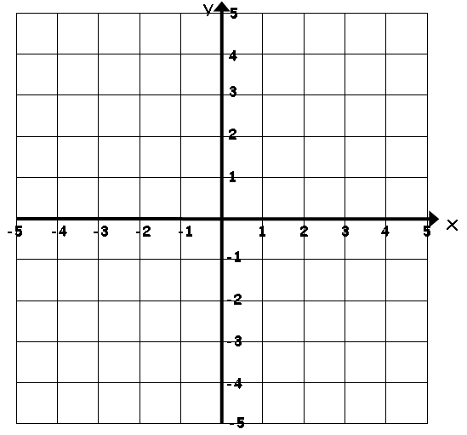
Circles
Plot the graph of the equation x² + y² = 25 for values of x from -5 to 5
6C

Slide 3
Circles
You can model circles through equations
(x – a)² + (y – b)² = r²
Where (a,b) is the centre of the circle and r is its radius.
Write down the equation of the circle with centre (5,7) and radius 4
(5,7)
This is a translation 5 units to the left
This is a translation 7 units up
A circle with this equation would have centre at (0,0)
6C

Slide 4
Circles
$${\left(x−a\right)}^{2}+{\left(y−b\right)}^{2}=r^{2}$$
$$Centre=(a,b)$$
$$Radius=r$$
You can model circles through equations
Find the coordinates of the centre, and the radius of, the circle with the following equation:
$${\left(x+3\right)}^{2}+{\left(y−1\right)}^{2}=4^{2}$$
Remember the coordinates have the opposite sign to what is in the brackets!
$$Centre=(−3,1)$$
$$Radius=4$$
If the equation is written as above, the radius is obvious!
6C

Slide 5

Circles
$${\left(x−a\right)}^{2}+{\left(y−b\right)}^{2}=r^{2}$$
$$Centre=(a,b)$$
$$Radius=r$$
You can model circles through equations
Find the coordinates of the centre, and the radius of, the circle with the following equation:
$${\left(x−\frac{5}{2}\right)}^{2}+{\left(y+4\right)}^{2}=32$$
$$Centre=\left(\frac{5}{2},−4\right)$$
Remember the coordinates have the opposite sign to what is in the brackets!
$$Radius=\sqrt{32}$$
If the equation is written as above, square root the number
$$=4\sqrt{2}$$
6C

Slide 6
Circles
$${\left(x−a\right)}^{2}+{\left(y−b\right)}^{2}=r^{2}$$
$$Centre=(a,b)$$
$$Radius=r$$
You can model circles through equations
Show that the circle:
Passes through (5,-8)
$${\left(x−3\right)}^{2}+{\left(y+4\right)}^{2}=20$$
Sub in values
$${\left(5−3\right)}^{2}+{\left(−8+4\right)}^{2}=20$$
Calculate inside the brackets
$${\left(x−3\right)}^{2}+{\left(y+4\right)}^{2}=20$$
$${\left(2\right)}^{2}+{\left(−4\right)}^{2}=20$$
Square both
$$4+16=20$$
As the statement is true, the circle curve will pass through (5,-8)
6C

Slide 7
Circles
$${\left(x−a\right)}^{2}+{\left(y−b\right)}^{2}=r^{2}$$
$$Centre=(a,b)$$
$$Radius=r$$
You can model circles through equations
The line AB is the diameter of a circle, where A and B are (4,7) and (-8,3) respectively. Find the equation of the circle.
→ To do this we need to find the centre of the circle, and its radius…
Finding the midpoint
$$\left(\frac{x_{1}+x_{2}}{2},\frac{y_{1}+y_{2}}{2}\right)$$
Sub in the coordinate values
$$\left(\frac{−8+4}{2},\frac{3+7}{2}\right)$$
Calculate
$$\left(−2,5\right)$$
(4,7)
(-2,5)
(-8,3)
$$Centre=\left(−2,5\right)$$
6C

Slide 8
Circles
$${\left(x−a\right)}^{2}+{\left(y−b\right)}^{2}=r^{2}$$
$$Centre=(a,b)$$
$$Radius=r$$
You can model circles through equations
The line AB is the diameter of a circle, where A and B are (4,7) and (-8,3) respectively. Find the equation of the circle.
→ To do this we need to find the centre of the circle, and its radius…
Finding the radius
The radius will be the distance from the centre to the edge, so you can use 2 coordinates and Pythagoras’ Theorem for this!
Using (-2,5) and (4,7)
$$\sqrt{{\left(x_{2}−x_{1}\right)}^{2}+{\left(y_{2}−y_{1}\right)}^{2}}$$
Sub in values…
$$\sqrt{{\left(4−(−2)\right)}^{2}+{\left(7−5\right)}^{2}}$$
Careful with negatives!
(4,7)
(-2,5)
$$\sqrt{{\left(6\right)}^{2}+{\left(2\right)}^{2}}$$
Calculate
(-8,3)
$$\sqrt{40}$$
Simplify
$$=2\sqrt{10}$$
$$Centre=\left(−2,5\right)$$
$$Radius=2\sqrt{10}$$
6C

Slide 9
Circles
$${\left(x−a\right)}^{2}+{\left(y−b\right)}^{2}=r^{2}$$
$$Centre=(a,b)$$
$$Radius=r$$
You can model circles through equations
The line AB is the diameter of a circle, where A and B are (4,7) and (-8,3) respectively. Find the equation of the circle.
→ To do this we need to find the centre of the circle, and its radius…
$${\left(x−a\right)}^{2}+{\left(y−b\right)}^{2}=r^{2}$$
Replace values
$${\left(x+2\right)}^{2}+{\left(y−5\right)}^{2}={(2\sqrt{10})}^{2}$$
Other form
$${\left(x+2\right)}^{2}+{\left(y−5\right)}^{2}=40$$
(4,7)
(-2,5)
(-8,3)
$$Centre=\left(−2,5\right)$$
$$Radius=2\sqrt{10}$$
6C

Slide 10
Circles
$${\left(x−a\right)}^{2}+{\left(y−b\right)}^{2}=r^{2}$$
$$Centre=(a,b)$$
$$Radius=r$$
You can model circles through equations
Find the centre and radius of the circle with equation:
$$x^{2}+y^{2}−14x+16y−12=0$$
→ You can use completing the square to change the form…
$$x^{2}+y^{2}−14x+16y−12=0$$
Rearrange to have the x and y terms together
$$x^{2}−14x+y^{2}+16y−12=0$$
Complete the square for the x and y terms separately
$${(x−7)}^{2}−(49)$$
$${+ (y+8)}^{2}−(64)$$
$$−12=0$$
Group the like terms
$${(x−7)}^{2}{+ (y+8)}^{2}−125=0$$
Add 125
$${(x−7)}^{2}{+ (y+8)}^{2} =125$$
$$Centre=(7,−8)$$
$$Radius=\sqrt{125}=5\sqrt{5}$$
6C

