Slide 1
Teachings for
Exercise 5E

Slide 2


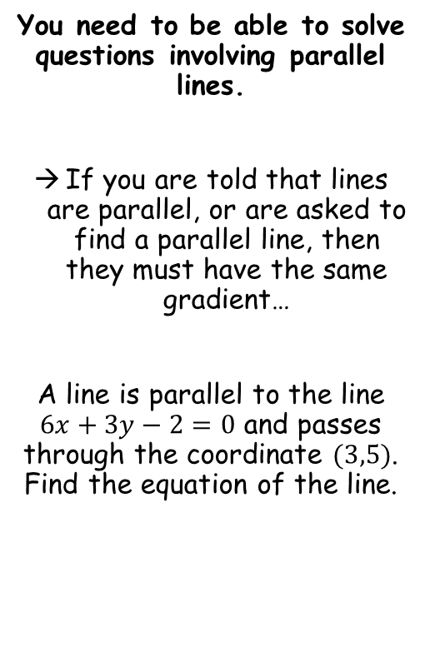



Straight-line graphs
$$m=\frac{y_{2}−y_{1}}{x_{2}−x_{1}}$$
$$y−y_{1}=m\left(x−x_{1}\right)$$
You need to be able to solve questions involving parallel lines.
If you are told that lines are parallel, or are asked to find a parallel line, then they must have the same gradient…
A line is parallel to the line $6x+3y−2=0$ and passes through the coordinate $(3,5)$. Find the equation of the line.
Find the gradient of the line we are given
$$6x+3y−2=0$$
Add 2, Subtract 6x
$$3y=2−6x$$
$$y=\frac{2}{3}−2x$$
Divide by 3
So the gradient needs to be -2
m = -2
(x₁,y₁) = (3,5)
5E

Slide 3




Straight-line graphs
$$m=\frac{y_{2}−y_{1}}{x_{2}−x_{1}}$$
$$y−y_{1}=m\left(x−x_{1}\right)$$
You need to be able to solve questions involving parallel lines.
If you are told that lines are parallel, or are asked to find a parallel line, then they must have the same gradient…
A line is parallel to the line $6x+3y−2=0$ and passes through the coordinate $(3,5)$. Find the equation of the line.
$$y−y_{1}=m\left(x−x_{1}\right)$$
Sub in values
$$y−5=−2\left(x−3\right)$$
Expand the bracket
$$y−5=−2x+6$$
Add 5
$$y=−2x+11$$
m = -2
(x₁,y₁) = (3,5)
5E

