Slide 1
Straight-line
graphs
Twitter: @Owen134866
www.mathsfreeresourcelibrary.com

Slide 2




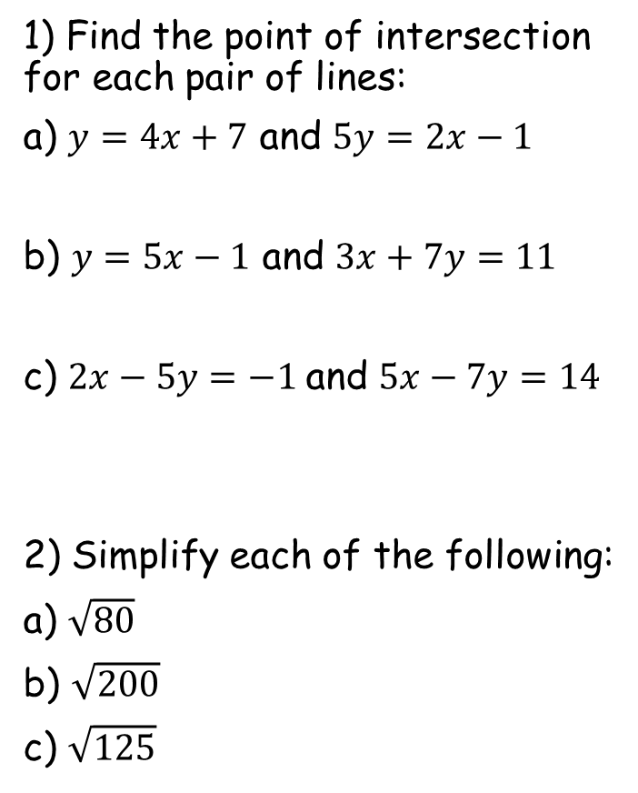






Prior Knowledge Check
1) Find the point of intersection for each pair of lines:
a) $y=4x+7$ and $5y=2x−1$
b) $y=5x−1$ and $3x+7y=11$
c) $2x−5y=−1$and $5x−7y=14$
2) Simplify each of the following:
a) $\sqrt{80}$
b) $\sqrt{200}$
c) $\sqrt{125}$
3) Make y the subject of each equation:
a) $6x+3y−15=0$
b) $2x−5y−9=0$
c) $3x−7y+12=0$
$$(−2,−1)$$
$$y=5−2x$$
$$\left(\frac{9}{19},\frac{26}{19}\right)$$
$$y=\frac{2}{5}x−\frac{9}{5}$$
$$(7,3)$$
$$y=\frac{3}{7}x+\frac{12}{7}$$
$$4\sqrt{5}$$
$$10\sqrt{2}$$
$$5\sqrt{5}$$

Slide 3
Teachings for
Exercise 5A and 5B

Slide 4
Straight-line graphs
You can find the gradient of a straight line joining two points by considering the vertical and horizontal distance between them. It can also be found from the equation of the graph.
y
(x₂,y₂)
(x₁,y₁)
y₂ - y₁
You can work out the gradient of a line if you know 2 points on it.
Let the first point be (x₁,y₁) and the second be (x₂,y₂). The following formula gives the gradient:
‘The change in the y values, divided by the change in the x values’
x₂ - x₁
x
5A/B

Slide 5
Straight-line graphs
You can find the gradient of a straight line joining two points by considering the vertical and horizontal distance between them. It can also be found from the equation of the graph.
Calculate the gradient of the line which passes through (-2,7) and (4,5)
(x₁, y₁)
= (-2, 7)
(x₂, y₂)
= (4, 5)
You can work out the gradient of a line if you know 2 points on it.
Let the first point be (x₁,y₁) and the second be (x₂,y₂). The following formula gives the gradient:
‘The change in the y values, divided by the change in the x values’
Substitute numbers in
Work out or leave as a fraction
Simplify if possible
5A/B

Slide 6
Straight-line graphs
You can find the gradient of a straight line joining two points by considering the vertical and horizontal distance between them. It can also be found from the equation of the graph.
The line joining (2, -5) to (4, a) has a gradient of -1. Calculate the value of a.
(x₁, y₁)
= (2, -5)
(x₂, y₂)
= (4, a)
You can work out the gradient of a line if you know 2 points on it.
Let the first point be (x₁,y₁) and the second be (x₂,y₂). The following formula gives the gradient:
‘The change in the y values, divided by the change in the x values’
Substitute numbers in
Simplify
Multiply by 2
Subtract 5
5A/B

