Slide 1
Teachings for
Exercise 4G

Slide 2
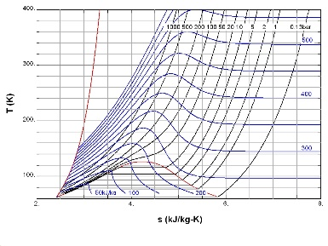
Graphs and Transformations
y
$$f(x)$$
You can apply transformations to unfamiliar functions by considering how specific points and features will be affected.
The diagram to the right shows a sketch of the curve $f(x)$ which passes through the origin. The points $A(1,4)$ and $B(3,1)$ also lie on the curve.
a) Sketch the graph of $y=f(x+1)$
Graph translates one unit left
x coordinates decrease by 1
(1,4)
(3,1)
x
y
$$f(x+1)$$
(0,4)
(2,1)
x
(-1,0)
4G

Slide 3
Graphs and Transformations
y
$$f(x)$$
You can apply transformations to unfamiliar functions by considering how specific points and features will be affected.
The diagram to the right shows a sketch of the curve $f(x)$ which passes through the origin. The points $A(1,4)$ and $B(3,1)$ also lie on the curve.
b) Sketch the graph of $y=f(x−1)$
Graph translates one unit right
x coordinates increase by 1
(1,4)
(3,1)
x
y
$$f(x−1)$$
(2,4)
(4,1)
x
(1,0)
4G

Slide 4
Graphs and Transformations
y
$$f(x)$$
You can apply transformations to unfamiliar functions by considering how specific points and features will be affected.
The diagram to the right shows a sketch of the curve $f(x)$ which passes through the origin. The points $A(1,4)$ and $B(3,1)$ also lie on the curve.
c) Sketch the graph of $y=f\left(x\right)−4$
Graph translates four units down
y coordinates decrease by 4
(1,4)
(3,1)
x
y
$$f\left(x\right)−4$$
(1,0)
x
(3,-3)
(0,-4)
4G

Slide 5
Graphs and Transformations
y
$$f(x)$$
You can apply transformations to unfamiliar functions by considering how specific points and features will be affected.
The diagram to the right shows a sketch of the curve $f(x)$ which passes through the origin. The points $A(1,4)$ and $B(3,1)$ also lie on the curve.
d) Sketch the graph of $2y=f(x)$
Therefore $y=\frac{1}{2}f(x)$
Graph ‘stretched’ vertically by ½
y coordinates halve
(1,4)
(3,1)
x
y
$$\frac{1}{2}f(x)$$
(1,2)
(3,0.5)
x
4G

