Slide 1
Teachings for
Exercise 4F

Slide 2
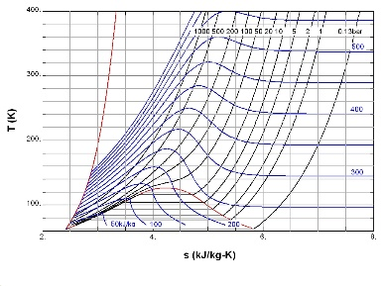
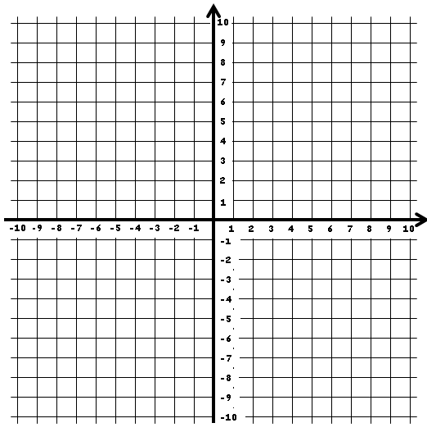
Graphs and Transformations
You can transform the graph of a function by altering the function itself. The second type is stretching a graph.
Let’s compare two functions by plotting their graphs:
$$y=x^{2}+2x$$
$$y=2(x^{2}+2x)$$
$$y=2(x^{2}+2x)$$
$$y=x^{2}+2x$$
y
$$x$$
$$−3$$
$$−2$$
$$−1$$
$$0$$
$$1$$
$$2$$
$$3$$
x
$$y$$
$$3$$
$$0$$
$$−1$$
$$0$$
$$3$$
$$8$$
$$15$$
$$x$$
$$−3$$
$$−2$$
$$−1$$
$$0$$
$$1$$
$$2$$
$$3$$
$$y$$
$$6$$
$$0$$
$$−2$$
$$0$$
$$6$$
$$16$$
$$30$$
You can see that multiplying the whole equation by two has stretched it vertically by a factor 2
We get the same original set of values for $y$, but they have all doubled
4F

Slide 3
Graphs and Transformations
You can transform the graph of a function by altering the function itself. The second type is stretching a graph.
Let’s compare two functions by plotting their graphs:
$$y=x^{2}+2x$$
$$y={(2x)}^{2}+2(2x)$$
$$y=x^{2}+2x$$
y
$$y={(2x)}^{2}+2(2x)$$
$$x$$
$$−3$$
$$−2$$
$$−1$$
$$0$$
$$1$$
$$2$$
$$3$$
x
$$y$$
$$3$$
$$0$$
$$−1$$
$$0$$
$$3$$
$$8$$
$$15$$
$$x$$
$$−3$$
$$−2$$
$$−1$$
$$0$$
$$1$$
$$2$$
$$3$$
$$y$$
$$24$$
$$8$$
$$0$$
$$0$$
$$8$$
$$24$$
$$48$$
You can see that replacing $x$ with $2x$ has squashed the graph horizontally by a factor 2
We get the same set of values for $y$, but for $x$ values that are half what they were before!
4F

Slide 4
Graphs and Transformations
You can transform the graph of a function by altering the function itself. The second type is stretching a graph.
As a general rule:
The graph of $y=af\left(x\right)$ is an stretch of the graph $y=f(x)$ by a scale factor $a$ in the vertical direction
The graph of $y=f\left(ax\right)$ is a stretch of the graph $y=f(x)$ by a scale factor $\frac{1}{a}$ in the horizontal direction
Note the difference here
In the first one, we are just multiplying the whole equation by a value, so the answers for y (vertical) all change
In the second one, we are multiplying x by a value before calculating. So for example if we multiply by 2, we will get the same y-values as before, but for x-vales that are halved
4E

Slide 5
Graphs and Transformations
y
You can transform the graph of a function by altering the function itself. The second type is stretching a graph.
Given that $f\left(x\right)=9−x^{2}$, sketch the curves with equations:
a) $y=f(2x)$
b) $y=2f(x)$
Start by sketching $y=f(x)$
$$f\left(x\right)=9−x^{2}$$
$$f\left(x\right)=(3−x)(3+x)$$
$$9$$
$$y=f(x)$$
$$−3$$
$$3$$
x
(The x coordinates halve)
(The y coordinates double)
$$y=f(2x)$$
$$y=2f(x)$$
y
y
$$9$$
$$18$$
$$−1.5$$
$$1.5$$
x
$$−3$$
$$3$$
x
Note that if the sketches are on separate axes, you do not need to ‘stretch’ them – just label key points correctly
4F

Slide 6
Graphs and Transformations
y
You can transform the graph of a function by altering the function itself. The second type is stretching a graph.
a) Sketch the curve with equation $y=x(x−2)(x+1)$
b) Hence, sketch the curve $y=2x(2x−2)(2x+1)$
c) Based on your sketch in a), also sketch the curve $y=−x(x−2)(x+1)$
$$y=f(x)$$
$$−1$$
$$2$$
x
Notice that all the ‘x’ values have become ‘2x’.
→ Therefore, we must draw the graph of $y=f(2x)$
(The y coordinates are multiplied by -1)
(The x coordinates halve)
$$y=f(2x)$$
$$y=−f(x)$$
y
y
$$y=f(2x)$$
$$−0.5$$
$$1$$
x
$$−1$$
$$2$$
x
$$y=−f(x)$$
Notice that the negative sign will cause all values of y to be multiplied by -1
→ This is therefore the graph of $y=−f(x)$, a reflection in the x-axis
4F

Slide 7
Graphs and Transformations
$$y=f(x)$$
$$y=f(−x)$$
You can transform the graph of a function by altering the function itself. The second type is stretching a graph.
On the same set of axes, draw the graphs of $y=f(x)$, $y=f(−x)$ and
$y=−f(x)$ where $f\left(x\right)=x(x+2)$
y
x
$$−2$$
$$0$$
$$2$$
$$y=f(−x)$$
We get the same y values, but after the x values have been multiplied by -1
→ Reflection in the y-axis
$$y=−f(x)$$
All the y-values we get are multiplied by -1
→ Reflection in the x-axis
$$y=−f(x)$$
4F

