Slide 1
Teachings for
Exercise 4E

Slide 2
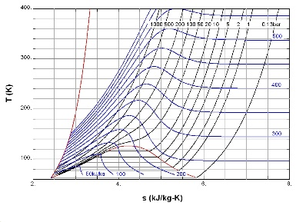
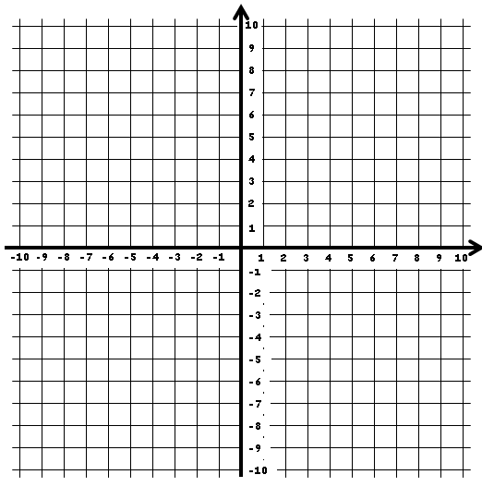
Graphs and Transformations
You can transform the graph of a function by altering the function itself. The first type is the translation of a graph.
Let’s compare two functions by plotting their graphs:
$$y=x^{2}+2x$$
$$y=x^{2}+2x+1$$
$$y=x^{2}+2x+1$$
$$y=x^{2}+2x$$
y
$$x$$
$$−3$$
$$−2$$
$$−1$$
$$0$$
$$1$$
$$2$$
$$3$$
x
$$y$$
$$3$$
$$0$$
$$−1$$
$$0$$
$$3$$
$$8$$
$$15$$
$$x$$
$$−3$$
$$−2$$
$$−1$$
$$0$$
$$1$$
$$2$$
$$3$$
$$y$$
$$4$$
$$1$$
$$0$$
$$1$$
$$4$$
$$9$$
$$16$$
You can see that adding 1 to the whole equation has translated the graph up by 1!
We get the same original set of values for $y$, but they have all increased by an extra 1
4E

Slide 3
Graphs and Transformations
You can transform the graph of a function by altering the function itself. The first type is the translation of a graph.
Let’s compare two functions by plotting their graphs:
$$y=x^{2}+2x$$
$$y={(x−1)}^{2}+2(x−1)$$
$$y=x^{2}+2x$$
y
$$y={(x−1)}^{2}+2(x−1)$$
$$x$$
$$−3$$
$$−2$$
$$−1$$
$$0$$
$$1$$
$$2$$
$$3$$
x
$$y$$
$$3$$
$$0$$
$$−1$$
$$0$$
$$3$$
$$8$$
$$15$$
$$x$$
$$−3$$
$$−2$$
$$−1$$
$$0$$
$$1$$
$$2$$
$$3$$
$$y$$
$$8$$
$$3$$
$$0$$
$$−1$$
$$0$$
$$3$$
$$8$$
You can see that replacing x with $x−1$ has translated the graph 1 units to the right!
We get the same set of values for $y$, but we need $x$ values that are one higher to do so!
4E

Slide 4
Graphs and Transformations
You can transform the graph of a function by altering the function itself. The first type is the translation of a graph.
As a general rule:
The graph of $y=f\left(x\right)+a$ is a translation of the graph $y=f\left(x\right)$ by the vector $\left(\begin{matrix}0 \\ a\end{matrix}\right)$
The graph of $y=f\left(x+a\right)$ is a translation of the graph $y=f(x)$ by the vector $\left(\begin{matrix}−a \\ 0\end{matrix}\right)$
Note the difference here
In the first one, we are just adding/subtracting a value to the equation, which moves it up and down
In the second one, we are adding/subtracting a value to x before any calculations are done, which moves the graph sideways
4E

Slide 5
Graphs and Transformations
You can transform the graph of a function by altering the function itself. The first type is the translation of a graph.
As a general rule:
The graph of $y=f\left(x\right)+a$ is a translation of the graph $y=f\left(x\right)$ by the vector $\left(\begin{matrix}0 \\ a\end{matrix}\right)$
The graph of $y=f\left(x+a\right)$ is a translation of the graph $y=f(x)$ by the vector $\left(\begin{matrix}−a \\ 0\end{matrix}\right)$
Sketch the following graphs:
a) $y=x^{2}$
b) $y={(x−2)}^{2}$
c) $y=x^{2}+2$
Translates 2 units right
Translates 2 units up
y
$$y=x^{2}+2$$
$$y=x^{2}$$
$$y={(x−2)}^{2}$$
$$4$$
$$2$$
$$0$$
$$2$$
x
4E

Slide 6
Graphs and Transformations
Given that $f\left(x\right)=x^{3}$ and $g\left(x\right)=x\left(x−2\right)$, sketch the graphs of $y=f\left(x+1\right)$ and $y=g(x+1)$
You can transform the graph of a function by altering the function itself. The first type is the translation of a graph.
As a general rule:
The graph of $y=f\left(x\right)+a$ is a translation of the graph $y=f\left(x\right)$ by the vector $\left(\begin{matrix}0 \\ a\end{matrix}\right)$
The graph of $y=f\left(x+a\right)$ is a translation of the graph $y=f(x)$ by the vector $\left(\begin{matrix}−a \\ 0\end{matrix}\right)$
→ So both will be translated 1 unit left
y
y
$$y=f(x)$$
$$y=f(x+1)$$
$$1$$
$$0$$
x
$$−1$$
x
y
$$y=g(x)$$
y
$$y=g(x+1)$$
$$0$$
$$2$$
x
$$−1$$
$$1$$
x
$$−1$$
4E

Slide 7
Graphs and Transformations
You can transform the graph of a function by altering the function itself. The first type is the translation of a graph.
As a general rule:
The graph of $y=f\left(x\right)+a$ is a translation of the graph $y=f\left(x\right)$ by the vector $\left(\begin{matrix}0 \\ a\end{matrix}\right)$
The graph of $y=f\left(x+a\right)$ is a translation of the graph $y=f(x)$ by the vector $\left(\begin{matrix}−a \\ 0\end{matrix}\right)$
Given that $h\left(x\right)=\frac{1}{x}$, sketch the curve with equation $y=h\left(x\right)+1$, stating the equations of any asymptotes and intersections with the axes
$$x=0$$
y
$$y=1$$
x
Remember to include the asymptotes and their equations
You can calculate the value of x at the intersection. Consider the actual equation of the blue line…
$$y=\frac{1}{x}+1$$
$$y=h(x)$$
$$y=h\left(x\right)+1$$
4E

Slide 8
Graphs and Transformations
You can transform the graph of a function by altering the function itself. The first type is the translation of a graph.
As a general rule:
The graph of $y=f\left(x\right)+a$ is a translation of the graph $y=f\left(x\right)$ by the vector $\left(\begin{matrix}0 \\ a\end{matrix}\right)$
The graph of $y=f\left(x+a\right)$ is a translation of the graph $y=f(x)$ by the vector $\left(\begin{matrix}−a \\ 0\end{matrix}\right)$
Given that $h\left(x\right)=\frac{1}{x}$, sketch the curve with equation $y=h\left(x\right)+1$, stating the equations of any asymptotes and intersections with the axes
$$x=0$$
y
$$y=1$$
x
$$−1$$
$$0=\frac{1}{x}+1$$
Subtract 1
$$−1=\frac{1}{x}$$
Solve
$$y=\frac{1}{x}+1$$
$$x=−1$$
4E

