Slide 1
Teachings for
Exercise 4C

Slide 2
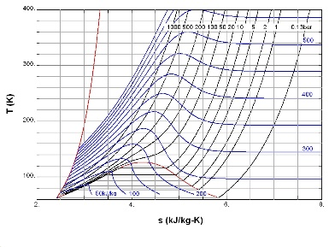
Graphs and Transformations
You can sketch graphs of reciprocal functions such as $y=\frac{1}{x}$, $y=\frac{1}{x^{2}}$ and $y=−\frac{2}{x}$by considering their asymptotes.
In the example to the right, the asymptotes are the x and y axes, as the graph tends towards these but does not reach them
Their equations would be $x=0$ and $y=0$
Example
Sketch the graph of the function
x
-1
-0.5
-0.25
0.25
0.5
1
y
y
-1
-2
-4
4
2
1
You cannot divide by 0, so you get no coordinate when x takes this value
y = ¹/_{x}
x
4C

Slide 3
Graphs and Transformations
You can sketch graphs of reciprocal functions such as $y=\frac{1}{x}$, $y=\frac{1}{x^{2}}$ and $y=−\frac{2}{x}$by considering their asymptotes.
Example
Sketch the graph of the function
y
y = ³/_{x}
The curve will be the same as the previous one, but further out…
y = ¹/_{x}
x
4C

Slide 4
Graphs and Transformations
You can sketch graphs of reciprocal functions such as $y=\frac{1}{x}$, $y=\frac{1}{x^{2}}$ and $y=−\frac{2}{x}$by considering their asymptotes.
Example
Sketch the graph of the function
y
y = -¹/_{x}
The curve will be the same, but reflected in the x-axis
y = ¹/_{x}
x
4C

Slide 5
Graphs and Transformations
You can sketch graphs of reciprocal functions such as $y=\frac{1}{x}$, $y=\frac{1}{x^{2}}$ and $y=−\frac{2}{x}$by considering their asymptotes.
If the equation contains an $x^{2}$, this will mean that all the values will be positive (assuming there are no other parts to the equation)
→ Think about what the graph will look like…
Example
Sketch the graph of the function
$$y=\frac{1}{x^{2}}$$
y
$$y=\frac{1}{x^{2}}$$
x
x
-1
-0.5
-0.25
0.25
0.5
1
y
1
4
16
16
4
1
4C

