Slide 1
Teachings for
Exercise 4B

Slide 2
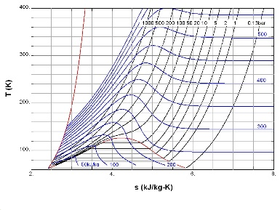
Graphs and Transformations
$$y$$
$$a>0$$
Quartic graphs are of the form $f\left(x\right)=ax^{4}+bx^{3}+cx^{2}+dx+e=0$, where $a$, $b$, $c$, $d$ and $e$ are real numbers and $a≠0$.
A quartic equation can take a number of different forms depending on its exact nature
It can have up to 4 roots, and up to 3 turning points…
$$x$$
$$y$$
$$a>0$$
$$y$$
$$a<0$$
$$x$$
$$x$$
‘repeated root’
4B

Slide 3
Graphs and Transformations
Quartic graphs are of the form $f\left(x\right)=ax^{4}+bx^{3}+cx^{2}+dx+e=0$, where $a$, $b$, $c$, $d$ and $e$ are real numbers and $a≠0$.
Sketch the curve:
$$y=\left(x+1\right)\left(x+2\right)\left(x−1\right)\left(x−2\right)$$
There will be roots where x = -1, -2, 1 and 2
If $x=0$, then $y=4$
$$y=\left(x+1\right)\left(x+2\right)\left(x−1\right)\left(x−2\right)$$
$$y$$
4
$$x$$
-2
-1
1
2
4B

Slide 4
Graphs and Transformations
Quartic graphs are of the form $f\left(x\right)=ax^{4}+bx^{3}+cx^{2}+dx+e=0$, where $a$, $b$, $c$, $d$ and $e$ are real numbers and $a≠0$.
Sketch the curve:
$$y=x{\left(x+2\right)}^{2}(3−x)$$
There will be roots where x = 0, -2, and 3
The root at -2 will be repeated
If $x=0$, then $y=0$
$$y$$
$$x$$
-2
0
3
$$y=x{\left(x+2\right)}^{2}(3−x)$$
4B

Slide 5
Graphs and Transformations
Quartic graphs are of the form $f\left(x\right)=ax^{4}+bx^{3}+cx^{2}+dx+e=0$, where $a$, $b$, $c$, $d$ and $e$ are real numbers and $a≠0$.
Sketch the curve:
$$y={\left(x−1\right)}^{2}{\left(x−3\right)}^{2}$$
There will be repeated roots at both 1 and 3
If $x=0$, then $y=9$
$$y={\left(x−1\right)}^{2}{\left(x−3\right)}^{2}$$
$$y$$
9
$$x$$
1
3
4B

