Slide 1
Teachings for
Exercise 3G

Slide 2
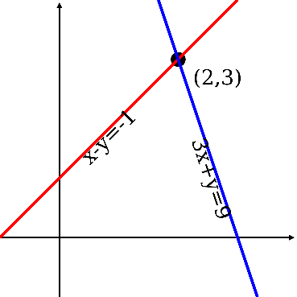
Equations and Inequalities
You can use shading on graphs to identify regions that satisfy linear and quadratic inequalities.
On this diagram, the shaded region represents all the coordinates where $y>f(x)$
y
$$f(x)$$
On this diagram, the unshaded region represents all the coordinates where $y<f(x)$
x
→ A dotted line would mean the line itself is not included $(>or<)$
→ A solid line would mean the line is included $(≥or≤)$
3G

Slide 3
Equations and Inequalities
y
$$x=5$$
You can use shading on graphs to identify regions that satisfy linear and quadratic inequalities.
On graph paper, show the region that satisfies the following inequalities:
$$y≥−2$$
$$x<5$$
$$y≤3x+2$$
$$x>0$$
Start by drawing each of these as if they were an equation…
→ Use solid or dotted lines depending on the inequality…
x
$$y=−2$$
$$y=3x+2$$
$$x=0$$
3G

Slide 4
Equations and Inequalities
y
$$y=x^{2}−3x−4$$
You can use shading on graphs to identify regions that satisfy linear and quadratic inequalities.
On graph paper, show the region that satisfies the following inequalities:
$$2y+x<14$$
$$y>x^{2}−3x−4$$
Start by drawing each of these as if they were an equation, based on the skills you already have
→ Use solid or dotted lines depending on the inequality…
$$2y+x=14$$
x
3G

