Slide 1
Teachings for
Exercise 3F

Slide 2
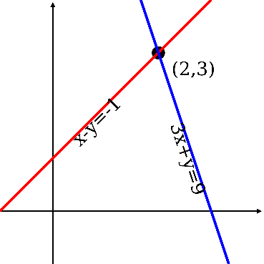
Equations and Inequalities
You could be asked to interpret the solutions to inequalities by considering their graphs.
$L_{1}$ has equation $y=12+4x$
$L_{2}$ has equation $y=x^{2}$
The diagram below shows a sketch of $L_{1}$ and $L_{2}$ on the same axes.
Find the coordinates of the points of intersection
Hence write down the solution to the inequality $12+4x>x^{2}$
Find the coordinates of intersection by setting the equations equal and solving them
$$12+4x=x^{2}$$
Rearrange
$$0=x^{2}−4x−12$$
Factorise
$$0=\left(x−6\right)(x+2)$$
y
Solve
$$L_{2}$$
$$L_{1}$$
$$x=−2 or 6$$
Use either equation to find the corresponding y-coordinates
$$y=4 or 36$$
x
So the coordinates of intersection are (-2,4) and (6,36)
3F

Slide 3
Equations and Inequalities
You could be asked to interpret the solutions to inequalities by considering their graphs.
$L_{1}$ has equation $y=12+4x$
$L_{2}$ has equation $y=x^{2}$
The diagram below shows a sketch of $L_{1}$ and $L_{2}$ on the same axes.
Find the coordinates of the points of intersection
Hence write down the solution to the inequality $12+4x>x^{2}$
Hence write down the solution to the inequality $12+4x>x^{2}$
Look at the graphs. You want the region where $L_{1}>L_{2}$
This is found between the intersections, so between $x=−2$and $x=6$
$$L_{2}$$
y
$$L_{1}$$
(6,36)
The solution is therefore:
$$−2<x<6$$
(-2,4)
x
3F

