Slide 1
Teachings for
Exercise 3E

Slide 2
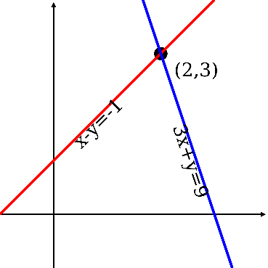
Equations and Inequalities
You need to be able to solve quadratic inequalities and correctly identify the range(s) of solutions.
To solve a Quadratic Inequality, you need to:
1) Solve the Quadratic Equation
2) Sketch a graph of the Equation
3) Decide which is the required set of values
→ Remember that the solutions are where the graph crosses the x-axis
→ The graph will be u-shaped. Where it crosses the y-axis does not matter for this topic
→ Then think about which part satisfies the original inequality
Example
Find the set of values of x for which:
Factorise
y
x
-1
5
We want values below 0
3E

Slide 3
Equations and Inequalities
You need to be able to solve quadratic inequalities and correctly identify the range(s) of solutions.
To solve a Quadratic Inequality, you need to:
1) Solve the Quadratic Equation
2) Sketch a graph of the Equation
3) Decide which is the required set of values
→ Remember that the solutions are where the graph crosses the x-axis
→ The graph will be u-shaped. Where it crosses the y-axis does not matter for this topic
→ Then think about which part satisfies the original inequality
Example
Find the set of values of x for which:
Multiply by -1
Factorise
y
x
-3
0.5
We want values below 0
3E

Slide 4
Equations and Inequalities
You need to be able to solve quadratic inequalities and correctly identify the range(s) of solutions.
Find the values of k for which the equation:
has two real roots.
→ Remember that ‘two real roots’ implies that:
$$b^{2}−4ac>0$$
Sub in a, b and c
$${(6)}^{2}−4(k+3)(k−5)>0$$
Expand the double bracket
$$36−4(k^{2}−2k−15)>0$$
Multiply the bracket by 4, and subtract (be careful!)
$$−4k^{2}+8k+96>0$$
$$\left(k+3\right)x^{2}+6x+k−5=0$$
Divide all by 4
$$−k^{2}+2k+24>0$$
Write as ‘=‘ instead
$$−k^{2}+2k+24=0$$
Multiply by -1
$$b^{2}−4ac>0$$
$$k^{2}−2k−24=0$$
Factorise and solve
y
$$\left(k−6\right)\left(k+4\right)=0$$
$$k=6 or −4$$
Think back to the equation. It was a negative x², and we now know the roots, so sketch it appropriately
→ We want the values to be bigger than 0…
k
-4
6
$$−4<k<6$$
3E

Slide 5
Equations and Inequalities
You need to be able to solve quadratic inequalities and correctly identify the range(s) of solutions.
Find the set of values for which:
$$\frac{6}{x}>2$$
Multiply by $x$
$$6>2x$$
Divide by 2
$$3>x$$
$$\frac{6}{x}>2, x≠0$$
Is this correct though…?
So x can be any value less than 3?
So would a value of -1 work in the original equation?
What went wrong???
3E

Slide 6
Equations and Inequalities
You need to be able to solve quadratic inequalities and correctly identify the range(s) of solutions.
Find the set of values for which:
→ If this was an equation, you would multiply by x
→ However, remember that if x is negative, we would need to switch the sign around…
→ The problem is, we cannot know that at this stage…
$$\frac{6}{x}>2$$
Multiply by $x^{2}$ (since we know it will be positive)
$$6x>{2x}^{2}$$
Subtract $2x^{2}$
$$6x−{2x}^{2}>0$$
$$\frac{6}{x}>2, x≠0$$
Factorise
$$2x(3−x)>0$$
y
We want values above 0
0
3
x
$$0<x<3$$
3E

