Slide 1
Teachings for
Exercise 3B

Slide 2
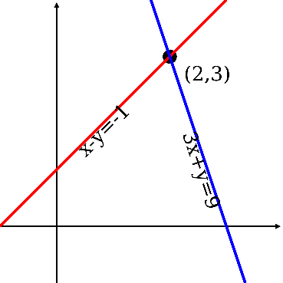
Equations and Inequalities
You need to be able to solve simultaneous equations where one is linear and the other is quadratic. They can have up to two pairs of solutions.
If one of the equations is a quadratic then you will almost certainly have to use the substitution method, to form a new quadratic…
Don’t be surprised if you have to deal with fractions!
At this point we are not finished, we still have to find the x-values. Forgetting this part is a common mistake!
Example
Solve the following Simultaneous Equations
Re-arrange
1
2
Replace the ‘x’ in equation 2, with ‘3 – 2y’
2
Expand Brackets
Simplify
Multiply by -1
Factorise
Solve
3B

Slide 3
Equations and Inequalities
You need to be able to solve simultaneous equations where one is linear and the other is quadratic. They can have up to two pairs of solutions.
If one of the equations is a quadratic then you will almost certainly have to use the substitution method, to form a new quadratic…
Don’t be surprised if you have to deal with fractions!
Example
Solve the following Simultaneous Equations
1
2
Sub each value for y into one of the equations
y = -¹/₂
y = -1
x = 4, y = -¹/₂
x = 5, y = -1
3B

