Slide 1
Equations and
Inequalities
Twitter: @Owen134866
www.mathsfreeresourcelibrary.com

Slide 2
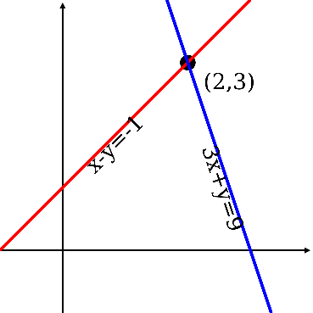
Prior Knowledge Check
1)This question concerns only the numbers from 1-13
$$A=\left\{factors of 12\right\}$$
$B=\left\{factors of 20\right\}$
Write down the values in these sets:
a) $A∩B$ b) ${\left(A∪B\right)}^{′}$
3) Match the equations with the correct graphs (not to scale), and label all intersections with the axes, as well as any turning points
a) $y=9−x^{2}$
b) $y={\left(x−2\right)}^{2}+4$
c) $y=(x−7)(2x+5)$
$$b)$$
$$c)$$
$$9$$
$$A∩B=\left\{1, 2, 4\right\}$$
$${\left(A∪B\right)}^{′}=\left\{7, 9, 11,13\right\}$$
$$8$$
$$(2,4)$$
2) Simplify these expressions:
a) $\sqrt{75}$ b) $\frac{2\sqrt{45}+3\sqrt{32}}{6}$
$$−2.5$$
$$7$$
$$−3$$
$$3$$
$$−35$$
$$(4.75,−32.625)$$
$$a)$$
$$5\sqrt{3}$$
$$\sqrt{5}+2\sqrt{2}$$

Slide 3
Teachings for
Exercise 3A

Slide 4
Equations and Inequalities
Linear simultaneous equations in two unknowns have one set of values that will make both equations true at the same time.
They can be solved in various ways, such as by elimination or by substitution.
Elimination involves finding a way to cancel a variable when the equations are added or subtracted
Example
Solve the following Simultaneous Equations by Elimination
1
x3
2
Add
Substitute x in to ‘2’
2
3A

Slide 5
Equations and Inequalities
Linear simultaneous equations in two unknowns have one set of values that will make both equations true at the same time.
They can be solved in various ways, such as by elimination or by substitution.
Substitution involves rearrange one equation in terms of a single variable, and then substituting it into the second equation
Example
Solve the following Simultaneous Equations by Substitution
Rearrange
1
2
Replace the ‘y’ in equation 2, with ‘2x – 1’
2
Replace y
Expand
Sub into 1 or 2
3A

