Slide 1
Teachings for Exercise 2F

Slide 2
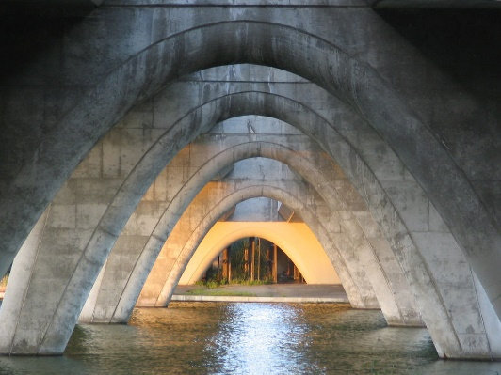
Quadratics
$$y$$
Graphs of the function $f\left(x\right)=ax^{2}+bx+c$ have a curved shape known as a parabola. They can be sketched by identifying key features.
If the value of a is positive, the graph will be a ‘u’ shape
If the value of a is negative, the graph will be an ‘n’ shape
$$x$$
1
2
3
4
1 and 2 – The roots, found when $f\left(x\right)=0$
3 – The y intercept, found when $x=0$
4 – The minimum point, found by completing the square, or by the fact it will be half-way between the roots
→ An ‘n’ shape would have a maximum point instead
2F

Slide 3
Quadratics
$$y$$
Graphs of the function $f\left(x\right)=ax^{2}+bx+c$ have a curved shape known as a parabola. They can be sketched by identifying key features.
Sketch the graph of the function $y=x^{2}−5x+4$, and find the coordinates of its turning point.
1) Find the y-intercept by setting $x=0$
4
$$x$$
$$y=x^{2}−5x+4$$
$$y={(0)}^{2}−5(0)+4$$
$$y=4$$
2F

Slide 4
Quadratics
$$y$$
Graphs of the function $f\left(x\right)=ax^{2}+bx+c$ have a curved shape known as a parabola. They can be sketched by identifying key features.
Sketch the graph of the function $y=x^{2}−5x+4$, and find the coordinates of its turning point.
2) Find the roots by setting the function equal to 0
4
$$x$$
1
4
$$0=x^{2}−5x+4$$
$$0=(x−4)(x−1)$$
$$x=1 or 4$$
2F

Slide 5
Quadratics
$$y$$
Graphs of the function $f\left(x\right)=ax^{2}+bx+c$ have a curved shape known as a parabola. They can be sketched by identifying key features.
Sketch the graph of the function $y=x^{2}−5x+4$, and find the coordinates of its turning point.
3) The minimum point’s x-coordinate is half-way between the roots, so sub in this x-value
4
$$x$$
1
4
(2.5,-2.25)
$$y=x^{2}−5x+4$$
$$y={(2.5)}^{2}−5(2.5)+4$$
$$y=−2.25$$
2F

Slide 6
Quadratics
$$y$$
Graphs of the function $f\left(x\right)=ax^{2}+bx+c$ have a curved shape known as a parabola. They can be sketched by identifying key features.
Sketch the graph of the function $y=4x−2x^{2}−3$, and find the coordinates of its turning point.
1) Find the y-intercept by setting $x=0$
$$x$$
-3
$$y=4x−2x^{2}−3$$
$$y=4(0)−2{(0)}^{2}−3$$
$$y=−3$$
2F

Slide 7
Quadratics
$$y$$
Graphs of the function $f\left(x\right)=ax^{2}+bx+c$ have a curved shape known as a parabola. They can be sketched by identifying key features.
Sketch the graph of the function $y=4x−2x^{2}−3$, and find the coordinates of its turning point.
2) Find the roots by setting the function equal to 0
$$x$$
-3
Using the quadratic formula…
$$a=−2$$
$$b=4$$
$$c=−3$$
$$x=\frac{−b±\sqrt{b^{2}−4ac}}{2a}$$
Sub in values
$$x=\frac{−4±\sqrt{{(4)}^{2}−4(−2)(−3)}}{2(−2)}$$
$$0=4x−2x^{2}−3$$
Simplify
$$x=\frac{−4±\sqrt{−8}}{−4}$$
This equation cannot be solved though…
→ This means the graph does not cross the x-axis
2F

Slide 8
Quadratics
$$y$$
Graphs of the function $f\left(x\right)=ax^{2}+bx+c$ have a curved shape known as a parabola. They can be sketched by identifying key features.
Sketch the graph of the function $y=4x−2x^{2}−3$, and find the coordinates of its turning point.
3) We will need to use completing the square to find the maximum point
(1,-1)
$$x$$
-3
$$−2x^{2}+4x−3$$
Take -2 out as a factor of the first 2 terms
$$−2\left(x^{2}−2x\right)−3$$
Complete the square for just the bracketed part
$$−2\left[{\left(x−1\right)}^{2}−1\right]−3$$
Multiply out the squared bracket
The maximum point will be at (1,-1)
$$−2{\left(x−1\right)}^{2}+2−3$$
Simplify
$$−2{\left(x−1\right)}^{2}−1$$
2F

