Slide 1
Teachings for
Exercise 2C and 2D

Slide 2
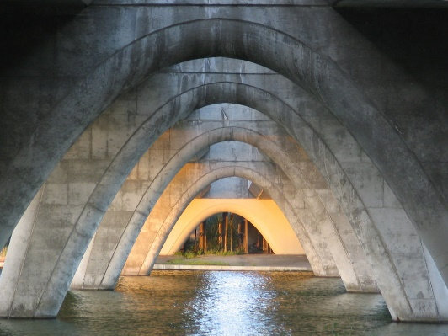
Quadratics
It is often useful to rewrite quadratic expressions by completing the square.
Example
Complete the square for the following expression…
a)
If we check by expanding our answer…
‘So ^{b}/₂ is half of the coefficient of x’
2C/D

Slide 3
Quadratics
It is often useful to rewrite quadratic expressions by completing the square.
$$x^{2}−4x$$
Write using a squared bracket
Half
$${\left(x−2\right)}^{2}$$
$$− (4)$$
Square
$$x^{2}+12x$$
Write using a squared bracket
Half
‘So ^{b}/₂ is half of the coefficient of x’
$${\left(x+6\right)}^{2}$$
$$− (36)$$
Square
In both cases, the first and second expressions are equal!
2C/D

Slide 4
Quadratics
It is often useful to rewrite quadratic expressions by completing the square.
$$x^{2}+8x$$
Write using a squared bracket
Half
$${\left(x+4\right)}^{2}$$
$$− (16)$$
Square
$$x^{2}−2x$$
Write using a squared bracket
Half
‘So ^{b}/₂ is half of the coefficient of x’
$${\left(x−1\right)}^{2}$$
$$− (1)$$
Square
In both cases, the first and second expressions are equal!
2C/D

Slide 5
Quadratics
It is often useful to rewrite quadratic expressions by completing the square.
$${2x}^{2}+16x$$
Take out 2 as a factor
$$2\left(x^{2}+8x\right)$$
Complete the square for the inner part
Half
$$2\left({\left(x+4\right)}^{2}−(16)\right)$$
Multiply both of the inner parts by the 2
Square
$$2{\left(x+4\right)}^{2}−32$$
‘So ^{b}/₂ is half of the coefficient of x’
2C/D

Slide 6
Quadratics
It is often useful to rewrite quadratic expressions by completing the square.
$$x^{2}+4x−3=0$$
Half
Complete the square for the first 2 terms
$${\left(x+2\right)}^{2}$$
$$− (4)$$
$$− 3$$
$$=0$$
Collect like terms
Square
$${\left(x+2\right)}^{2}−7$$
$$=0$$
Add 7 to both sides
$${\left(x+2\right)}^{2}=7$$
Square root both sides
$$x+2=±\sqrt{7}$$
Subtract 2 from both sides
$$x=−2±\sqrt{7}$$
‘So ^{b}/₂ is half of the coefficient of x’
Finally, you can calculate the answers (or in some cases you can just leave them like this!)!
$$=0.65 or −4.65$$
2C/D

Slide 7
Quadratics
It is often useful to rewrite quadratic expressions by completing the square.
$$x^{2}−6x+4=0$$
Half
Complete the square for the first 2 terms
$${\left(x−3\right)}^{2}$$
$$− (9)$$
$$+ 4$$
$$=0$$
Collect like terms
Square
$${\left(x−3\right)}^{2}−5$$
$$=0$$
Add 5 to both sides
$${\left(x−3\right)}^{2}=5$$
Square root both sides
$$x−3=±\sqrt{5}$$
Add 3 to both sides
$$x=3±\sqrt{5}$$
‘So ^{b}/₂ is half of the coefficient of x’
Finally, you can calculate the answers (or in some cases you can just leave them like this!)!
$$=5.24 or 0.76$$
2C/D

Slide 8
Quadratics
$$2x^{2}+12x−10=0$$
$$ax^{2}+bx+c=0$$
Divide by 2
Divide by a
$$x^{2}+\frac{b}{a}x+\frac{c}{a}=0$$
$$x^{2}+6x−5=0$$
Complete the square
Half
Half
Complete the square
$${\left(x+\frac{b}{2a}\right)}^{2}$$
$$−\frac{b^{2}}{{4a}^{2}}$$
$$+ \frac{c}{a}$$
$${\left(x+3\right)}^{2}$$
$$− 9$$
$$− 5$$
$$=0$$
$$=0$$
Add $\frac{b^{2}}{4a^{2}}$ and subtract $\frac{c}{a}$
Add 9 and add 5
Square
$${\left(x+\frac{b}{2a}\right)}^{2}=\frac{b^{2}}{{4a}^{2}}−\frac{c}{a}$$
Square
$${\left(x+3\right)}^{2}=9+5$$
Group terms
Group terms
$${\left(x+\frac{b}{2a}\right)}^{2}=\frac{b^{2}−4ac}{{4a}^{2}}$$
$${\left(x+3\right)}^{2}=14$$
Square root
$$\frac{b^{2}}{{4a}^{2}}−\frac{c}{a}$$
Square root
$$x+\frac{b}{2a}=$$
$$±\frac{\sqrt{b^{2}−4ac}}{}$$
$$x+3=±\sqrt{14}$$
Multiply by 4a to make the denominators equal
$$\sqrt{4a^{2}}$$
$$2a$$
Subtract $\frac{b}{2a}$
Subtract 3
$$\frac{b^{2}}{{4a}^{2}}−\frac{4ac}{{4a}^{2}}$$
$$−\frac{b}{2a}±\frac{\sqrt{b^{2}−4ac}}{2a}$$
$$x=−3±\sqrt{14}$$
$$x=$$
Group together
Group together
$$\frac{b^{2}−4ac}{{4a}^{2}}$$
$$x=\frac{−b±\sqrt{b^{2}−4ac}}{2a}$$

