Slide 1
Teachings for Exercise 1F

Slide 2
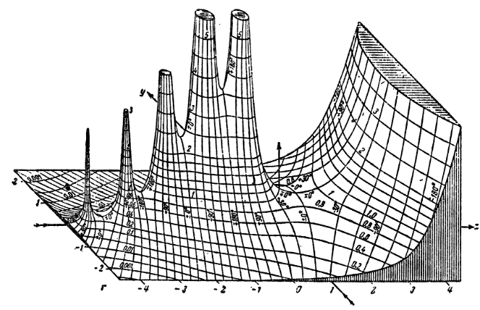
Algebraic Expressions
If a fraction has a surd in the denominator, then it can be useful to rearrange it so that the denominator is a rational number. This is called rationalising the denominator.
For fractions of the form $\frac{1}{\sqrt{a}}$, multiply the numerator and denominator by $\sqrt{a}$
For fractions of the form $\frac{1}{a+\sqrt{b}}$, multiply the numerator and denominator by $a−\sqrt{b}$
For fractions of the form $\frac{1}{a−\sqrt{b}}$, multiply the numerator and denominator by $a+\sqrt{b}$
Rationalise
$$× \frac{\sqrt{3}}{\sqrt{3}}$$
Multiply so that the surd is removed from the denominator
a) $\frac{1}{\sqrt{3}}$
$$\frac{1}{\sqrt{3}}$$
$$= \frac{\sqrt{3}}{3}$$
b) $\frac{1}{3+\sqrt{2}}$
$$\frac{1}{3+\sqrt{2}}$$
$$× \frac{3−\sqrt{2}}{3−\sqrt{2}}$$
Multiply both numerator and denominator
$$= \frac{3−\sqrt{2}}{\left(3+\sqrt{2}\right)\left(3−\sqrt{2}\right)}$$
Multiply out the brackets
$$= \frac{3−\sqrt{2}}{9+3\sqrt{2}−3\sqrt{2}−2}$$
$$= \frac{3−\sqrt{2}}{7}$$
Simplify
1F

Slide 3
Algebraic Expressions
If a fraction has a surd in the denominator, then it can be useful to rearrange it so that the denominator is a rational number. This is called rationalising the denominator.
For fractions of the form $\frac{1}{\sqrt{a}}$, multiply the numerator and denominator by $\sqrt{a}$
For fractions of the form $\frac{1}{a+\sqrt{b}}$, multiply the numerator and denominator by $a−\sqrt{b}$
For fractions of the form $\frac{1}{a−\sqrt{b}}$, multiply the numerator and denominator by $a+\sqrt{b}$
Rationalise
c) $\frac{\sqrt{5}+\sqrt{2}}{\sqrt{5}−\sqrt{2}}$
$$\frac{\sqrt{5}+\sqrt{2}}{\sqrt{5}−\sqrt{2}}$$
$$× \frac{\sqrt{5}+\sqrt{2}}{\sqrt{5}+\sqrt{2}}$$
Multiply both numerator and denominator
$$= \frac{\left(\sqrt{5}+\sqrt{2}\right)\left(\sqrt{5}+\sqrt{2}\right)}{\left(\sqrt{5}−\sqrt{2}\right)\left(\sqrt{5}+\sqrt{2}\right)}$$
Multiply out the brackets
$$= \frac{5+\sqrt{10}+\sqrt{10}+2}{5+\sqrt{10}−\sqrt{10}−2}$$
Simplify
$$= \frac{7+2\sqrt{10}}{3}$$
1F

Slide 4
Algebraic Expressions
If a fraction has a surd in the denominator, then it can be useful to rearrange it so that the denominator is a rational number. This is called rationalising the denominator.
For fractions of the form $\frac{1}{\sqrt{a}}$, multiply the numerator and denominator by $\sqrt{a}$
For fractions of the form $\frac{1}{a+\sqrt{b}}$, multiply the numerator and denominator by $a−\sqrt{b}$
For fractions of the form $\frac{1}{a−\sqrt{b}}$, multiply the numerator and denominator by $a+\sqrt{b}$
Rationalise
d) $\frac{1}{{\left(1−\sqrt{3}\right)}^{2}}$
$$= \frac{1}{\left(1−\sqrt{3}\right)\left(1−\sqrt{3}\right)}$$
Multiply out the brackets first
$$= \frac{1}{4−2\sqrt{3}}$$
Multiply to cancel the surds
$$= \frac{1}{4−2\sqrt{3}}$$
$$× \frac{4+2\sqrt{3}}{4+2\sqrt{3}}$$
$$= \frac{4+2\sqrt{3}}{(4−2\sqrt{3})\left(4+2\sqrt{3}\right)}$$
Multiply out the brackets
$$= \frac{4+2\sqrt{3}}{16+8\sqrt{3}−8\sqrt{3}−4\sqrt{9}}$$
Simplify
$$= \frac{4+2\sqrt{3}}{4}$$
Divide all by 2
$$= \frac{2+\sqrt{3}}{2}$$
1F

