Slide 1
Teachings for Exercise 1E

Slide 2
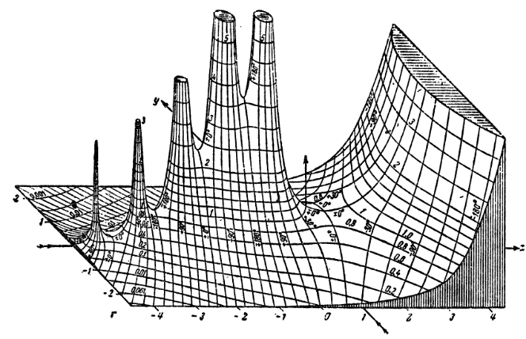
Algebraic Expressions
In $n$ is an integer that is not a square number, then $\sqrt{n}$ is a surd. It is an example of an irrational number.
Surds can be used to leave answers exact without rounding errors, and can be manipulated by using the following rules:
$$\sqrt{ab}=\sqrt{a}×\sqrt{b}$$
$$\sqrt{\frac{a}{b}}=\frac{\sqrt{a}}{\sqrt{b}}$$
Simplify
a) $\sqrt{18}$
$$=\sqrt{9}×\sqrt{2}$$
Find a factor which is a square number, which you can then square root
$$=3\sqrt{2}$$
Make sure that what you write is clear…
→ $3\sqrt{2}$ and $\sqrt[3]{2}$ are different!
b) $\frac{\sqrt{20}}{2}$
$$=\frac{\sqrt{4}×\sqrt{5}}{2}$$
Simplify the numerator
$$=\frac{2\sqrt{5}}{2}$$
Simplify the whole fraction
$$=\sqrt{5}$$
1E

Slide 3
Algebraic Expressions
In $n$ is an integer that is not a square number, then $\sqrt{n}$ is a surd. It is an example of an irrational number.
Surds can be used to leave answers exact without rounding errors, and can be manipulated by using the following rules:
$$\sqrt{ab}=\sqrt{a}×\sqrt{b}$$
$$\sqrt{\frac{a}{b}}=\frac{\sqrt{a}}{\sqrt{b}}$$
Simplify
c) $5\sqrt{6}−2\sqrt{24}+\sqrt{294}$
Try to find a common factor
$$=5\sqrt{6}−2\sqrt{4}\sqrt{6}+\sqrt{49}\sqrt{6}$$
Square roots can be worked out
$$=5\sqrt{6}−4\sqrt{6}+7\sqrt{6}$$
Simplify
$$=8\sqrt{6}$$
1E

Slide 4
Algebraic Expressions
In $n$ is an integer that is not a square number, then $\sqrt{n}$ is a surd. It is an example of an irrational number.
Surds can be used to leave answers exact without rounding errors, and can be manipulated by using the following rules:
$$\sqrt{ab}=\sqrt{a}×\sqrt{b}$$
$$\sqrt{\frac{a}{b}}=\frac{\sqrt{a}}{\sqrt{b}}$$
Expand and simplify if possible
a) $\sqrt{2}\left(5−\sqrt{3}\right)$
Multiply out
$$=5\sqrt{2}−\sqrt{6}$$
b) $\left(2−\sqrt{3}\right)\left(5+\sqrt{3}\right)$
Multiply out
$$=10+2\sqrt{3}−5\sqrt{3}−\sqrt{9}$$
Group together like terms. Calculate root 9
$$=10−3\sqrt{3}−3$$
Simplify
$$=7−3\sqrt{3}$$
1E

