Slide 1
Teachings for Exercise 1D

Slide 2
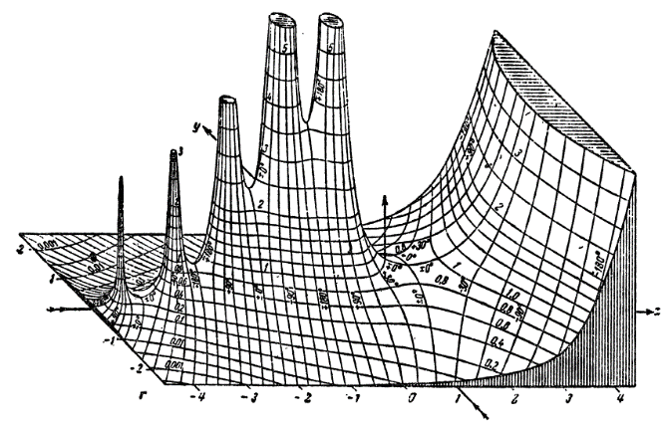

Algebraic Expressions
Indices can be negative numbers or fractions
$$a^{\frac{1}{m}}=\sqrt[m]{a}$$
$$a^{\frac{n}{m}}={\left(\sqrt[m]{a}\right)}^{n}$$
$$a^{−m}=\frac{1}{a^{m}}$$
$$a^{0}=1$$
Simplify
a) $\frac{x^{3}}{x^{−3}}$
$$=x^{6}$$
b) $x^{\frac{1}{2}}×x^{\frac{3}{2}}$
$$=x^{2}$$
c) ${\left(x^{3}\right)}^{\frac{2}{3}}$
$$=x^{2}$$
d) $\sqrt[3]{125x^{6}}$
$$={\left(125x^{6}\right)}^{\frac{1}{3}}$$
$$={(125)}^{\frac{1}{3}}{\left(x^{6}\right)}^{\frac{1}{3}}$$
$$=5x^{2}$$
1D

Slide 3
Algebraic Expressions
Indices can be negative numbers or fractions
$$a^{\frac{1}{m}}=\sqrt[m]{a}$$
$$a^{\frac{n}{m}}={\left(\sqrt[m]{a}\right)}^{n}$$
$$a^{−m}=\frac{1}{a^{m}}$$
$$a^{0}=1$$
Simplify
e) $\frac{2x^{2}−x}{x^{5}}$
$$=\frac{2x^{2}}{x^{5}}−\frac{x}{x^{5}}$$
Simplify separately
$$=\frac{2}{x^{3}}−\frac{1}{x^{4}}$$
Rewrite
$$=2x^{−3}−x^{−4}$$
Either of these forms is correct – check if the question asks for a specific one!
1D

Slide 4
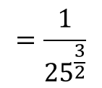
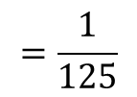
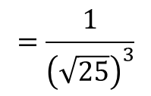
Algebraic Expressions
Indices can be negative numbers or fractions
$$a^{\frac{1}{m}}=\sqrt[m]{a}$$
$$a^{\frac{n}{m}}={\left(\sqrt[m]{a}\right)}^{n}$$
$$a^{−m}=\frac{1}{a^{m}}$$
$$a^{0}=1$$
Evaluate (work out the value of)
a) $9^{\frac{1}{2}}$
$$=\sqrt{9}$$
$$=3$$
b) ${64}^{\frac{1}{3}}$
You can use a calculator for these, but you still need to be able to show the process, especially for algebraic versions
$$=\sqrt[3]{64}$$
$$=4$$
c) ${49}^{\frac{3}{2}}$
$$={\left(\sqrt{49}\right)}^{3}$$
$$=343$$
d) ${25}^{−\frac{3}{2}}$
$$=\frac{1}{{25}^{\frac{3}{2}}}$$
$$=\frac{1}{{\left(\sqrt{25}\right)}^{3}}$$
$$=\frac{1}{125}$$
1D

Slide 5
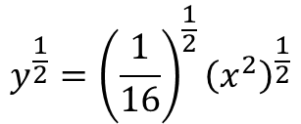
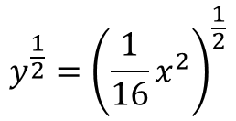
Algebraic Expressions
Indices can be negative numbers or fractions
$$a^{\frac{1}{m}}=\sqrt[m]{a}$$
$$a^{\frac{n}{m}}={\left(\sqrt[m]{a}\right)}^{n}$$
$$a^{−m}=\frac{1}{a^{m}}$$
$$a^{0}=1$$
Given that $y=\frac{1}{16}x^{2}$, express $y^{\frac{1}{2}}$ in the form ${kx}^{n}$ where $k$ and $n$ are constants
$$y=\frac{1}{16}x^{2}$$
Rewrite based on the question
$$y^{\frac{1}{2}}={\left(\frac{1}{16}x^{2}\right)}^{\frac{1}{2}}$$
Each part is raised to a power ½
$$y^{\frac{1}{2}}={\left(\frac{1}{16}\right)}^{\frac{1}{2}}{\left(x^{2}\right)}^{\frac{1}{2}}$$
Simplify
$$y^{\frac{1}{2}}=\frac{1}{4}x$$
1D

Slide 6
Algebraic Expressions
Indices can be negative numbers or fractions
$$a^{\frac{1}{m}}=\sqrt[m]{a}$$
$$a^{\frac{n}{m}}={\left(\sqrt[m]{a}\right)}^{n}$$
$$a^{−m}=\frac{1}{a^{m}}$$
$$a^{0}=1$$
Given that $y=\frac{1}{16}x^{2}$, express ${4y}^{−1}$ in the form ${kx}^{n}$ where $k$ and $n$ are constants
$$y=\frac{1}{16}x^{2}$$
Rewrite based on the question
$${4y}^{−1}=4{\left(\frac{1}{16}x^{2}\right)}^{−1}$$
Each part is raised to a power -1, and will then be multiplied by 4
$${4y}^{−1}={4\left(\frac{1}{16}\right)}^{−1}{\left(x^{2}\right)}^{−1}$$
Simplify
$${4y}^{−1}=4(16)(x^{−2})$$
Simplify more
$${4y}^{−1}=64x^{−2}$$
1D

