Slide 1
Teachings for Exercise 1C

Slide 2
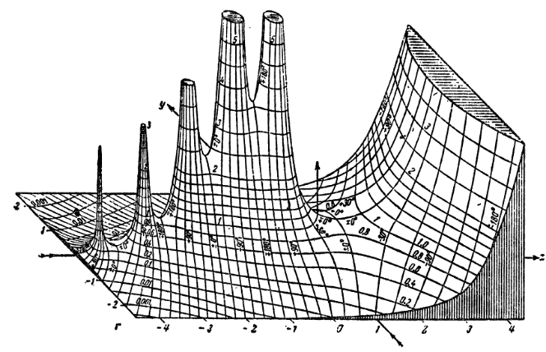
Algebraic Expressions
You can write expressions as products of their factors. This is known as factorising.
If the terms have a common factor (or several), then the expression can be factorized into a single bracket
Common Factor
a)
3
b)
x
c)
4x
d)
3xy
e)
3x
1C

Slide 3
Algebraic Expressions
(x + 2)(x + 1)
x²
+
3x
+
2
You get the middle number by adding the 2 numbers in the brackets
You get the last number in a Quadratic Equation by multiplying the 2 numbers in the brackets

Slide 4
Algebraic Expressions
(x - 5)(x + 3)
x²
-
2x
-
15
You get the middle number by adding the 2 numbers in the brackets
You get the last number in a Quadratic Equation by multiplying the 2 numbers in the brackets

Slide 5
Algebraic Expressions
x² - 7x + 12
Numbers that multiply to give + 12
Which pair adds to give -7?
+3 +4
-3 -4
+12 +1
-12 -1
+6 +2
-6 -2
So the brackets were originally…
(x - 3)(x - 4)

Slide 6
Algebraic Expressions
x² + 10x + 16
Numbers that multiply to give + 16
Which pair adds to give +10?
+1 +16
-1 -16
+2 +8
-2 -8
+4 +4
-4 -4
So the brackets were originally…
(x + 2)(x + 8)

Slide 7
Algebraic Expressions
x² - x - 20
Numbers that multiply to give - 20
Which pair adds to give - 1?
+1 -20
-1 +20
+2 -10
-2 +10
+4 -5
-4 +5
So the brackets were originally…
(x + 4)(x - 5)

Slide 8
Algebraic Expressions
Factorising Quadratics
A Quadratic Equation has the form;
ax² + bx + c
Where a, b and c are constants and a ≠ 0.
You can also Factorise these equations.
REMEMBER
→ An equation with an ‘x²’ in does not necessarily go into 2 brackets. You use 2 brackets when there are NO ‘Common Factors’
Examples
a)
The 2 numbers in brackets must:
Multiply to give ‘c’
Add to give ‘b’
1E

Slide 9
Algebraic Expressions
Factorising Quadratics
A Quadratic Equation has the form;
ax² + bx + c
Where a, b and c are constants and a ≠ 0.
You can also Factorise these equations.
Examples
b)
The 2 numbers in brackets must:
Multiply to give ‘c’
Add to give ‘b’
1E

Slide 10
Algebraic Expressions
Factorising Quadratics
A Quadratic Equation has the form;
ax² + bx + c
Where a, b and c are constants and a ≠ 0.
You can also Factorise these equations.
Examples
c)
The 2 numbers in brackets must:
Multiply to give ‘c’
Add to give ‘b’
(In this case, b = 0)
This is known as ‘the difference of two squares’
→ x² – y² = (x + y)(x – y)
1E

Slide 11
Algebraic Expressions
Factorising Quadratics
A Quadratic Equation has the form;
ax² + bx + c
Where a, b and c are constants and a ≠ 0.
You can also Factorise these equations.
Examples
d)
The 2 numbers in brackets must:
Multiply to give ‘c’
Add to give ‘b’
1E

Slide 12
Algebraic Expressions
Factorising Quadratics
A Quadratic Equation has the form;
ax² + bx + c
Where a, b and c are constants and a ≠ 0.
You can also Factorise these equations.
Examples
d)
The 2 numbers in brackets must:
Multiply to give ‘c’
Add to give ‘b’
Sometimes, you need to remove a ‘common factor’ first…
1E

Slide 13
Algebraic Expressions
Expand the following pairs of brackets
(x + 3)(x + 4)
→ x² + 3x + 4x + 12
→ x² + 7x + 12
(2x + 3)(x + 4)
→ 2x² + 3x + 8x + 12
→ 2x² + 11x + 12
x
+ 3
x
x²
+ 3x
When an x term has a ‘2’ coefficient, the rules are different…
+ 4
+ 4x
+ 12
2 of the terms are doubled
→ So, the numbers in the brackets add to give the x term, WHEN ONE HAS BEEN DOUBLED FIRST
2x
+ 3
x
2x²
+ 3x
+ 4
+ 8x
+ 12

Slide 14
Algebraic Expressions
2x² - 5x - 3
Numbers that multiply to give - 3
One of the values to the left will be doubled when the brackets are expanded
-3 +1
+3 -1
-6 +1
-3 +2
So the brackets were originally…
(2x + 1)(x - 3)
+6 -1
+3 -2
The -3 doubles so it must be on the opposite side to the ‘2x’

Slide 15
Algebraic Expressions
2x² + 13x + 11
Numbers that multiply to give + 11
One of the values to the left will be doubled when the brackets are expanded
+11 +1
-11 -1
+22 +1
+11 +2
So the brackets were originally…
(2x + 11)(x + 1)
-22 -1
-11 -2
The +1 doubles so it must be on the opposite side to the ‘2x’

Slide 16
Algebraic Expressions
3x² - 11x - 4
Numbers that multiply to give - 4
One of the values to the left will be tripled when the brackets are expanded
+2 -2
-4 +1
+4 -1
+6 -2
+2 -6
So the brackets were originally…
-12 +1
-4 +3
(3x + 1)(x - 4)
The -4 triples so it must be on the opposite side to the ‘3x’
+12 -1
+4 -3

