Slide 1
Teachings for Exercise 1B

Slide 2
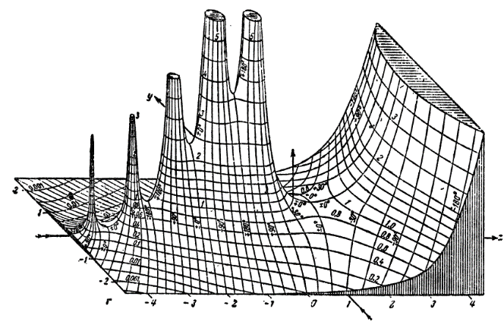
Algebraic Expressions
To find the product of two expressions you multiply each term in one expression by each term in the other expression
There are various methods for doing this, all are ok!
(x + 4)(x + 7)
→ x² + 4x + 7x + 28
→ x² + 11x + 28
(2x + 3)(x – 8)
→ 2x² + 3x – 16x – 24
→ 2x² – 13x - 24
x
+ 4
x
x²
+ 4x
+ 7
+ 7x
+ 28
2x
+ 3
x
2x²
+ 3x
- 8
- 16x
- 24
1B

Slide 3
Algebraic Expressions
To find the product of two expressions you multiply each term in one expression by each term in the other expression
If you have more than two brackets, just multiply any 2 first, and then multiply the answer by the next one
Expand $\left(x+4\right)\left(2x−1\right)\left(x+3\right)$
$$\left(x+4\right)\left(2x−1\right)\left(x+3\right)$$
Multiply the first pair of brackets
$$=({2x}^{2}+7x−4)$$
$$(x+3)$$
Multiply this new pair
$$={2x}^{3}+{6x}^{2}$$
$$+ 7x^{2}+21x$$
$$− 4x−12$$
Simplify
$$={2x}^{3}+13x^{2}+17x−12$$
1B

