Slide 1
Algebraic Expressions
Twitter: @Owen134866
www.mathsfreeresourcelibrary.com

Slide 2
Prior Knowledge Check
Simplify:
a) $4m^{2}n+5mn^{2}−2m^{2}n+mn^{2}−{3mn}^{2}$
b) ${3x}^{2}−5x+2+{3x}^{2}−7x−12$
2) Write as a single power of 2
a) $2^{5}×2^{3}$ b) $2^{6}÷2^{2}$
c) ${\left(2^{3}\right)}^{2}$
3) Expand:
a) $3(x+4)$ b) $5(2−3x)$
c) $6(2x−5y)$
$$2m^{2}n+{3mn}^{2}$$
4) Write down the highest common factor of:
24 and 16 b) $6x$ and ${8x}^{2}$
c) ${4xy}^{2}$ and $3xy$
5) Simplify:
a) $\frac{10x}{5}$ b) $\frac{20x}{2}$
c) $\frac{40x}{24}$
$$8$$
$$2x$$
$$6x^{2}−12x−10$$
$$xy$$
$$2^{8}$$
$$2^{4}$$
$$2x$$
$$10x$$
$$2^{6}$$
$$\frac{5x}{3}$$
$$3x+12$$
$$12x−30y$$
$$10−15x$$

Slide 3
Teachings for Exercise 1A

Slide 4
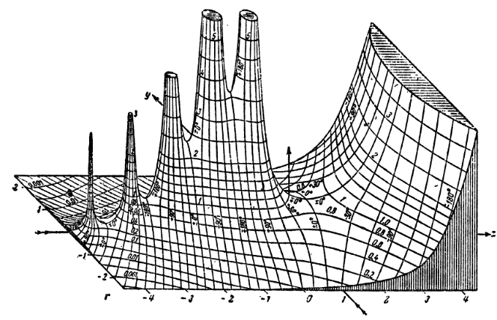
Algebraic Expressions
You can use the laws of indices to simplify powers of the same base
$$a^{m}×a^{n}=a^{m+n}$$
$$a^{m}÷a^{n}=a^{m−n}$$
$${\left(a^{m}\right)}^{n}=a^{mn}$$
$${\left(ab\right)}^{n}=a^{n}b^{n}$$
a) $x^{2}×x^{5}$
$$=x^{7}$$
b) ${2r}^{2}×{3r}^{3}$
$$={6r}^{5}$$
c) $\frac{b^{7}}{b^{4}}$
$$=b^{3}$$
d) ${6x}^{5}÷{3x}^{3}$
$$={2x}^{2}$$
e) ${\left(a^{3}\right)}^{2}×2a^{2}$
$$=a^{6}×2a^{2}$$
$$=2a^{8}$$
f) ${\left({3x}^{2}\right)}^{3}÷x^{4}$
$$=27x^{6}÷x^{4}$$
$$=2{7x}^{2}$$
1A

Slide 5
Algebraic Expressions
You can use the laws of indices to simplify powers of the same base
$$a^{m}×a^{n}=a^{m+n}$$
$$a^{m}÷a^{n}=a^{m−n}$$
$${\left(a^{m}\right)}^{n}=a^{mn}$$
$${\left(ab\right)}^{n}=a^{n}b^{n}$$
Expand and simplify if possible
a) $−3x(7x−4)$
$$=−21x^{2}+12x$$
b) $y^{2}(3−2y^{3})$
$$=3y^{2}−2y^{5}$$
c) $4x(3x−{2x}^{2}+{5x}^{3})$
$$=12x^{2}−8x^{3}+20x^{4}$$
d) $2x\left(5x+3\right)−5(2x+3)$
$$=10x^{2}+6x−10x−15$$
$$=10x^{2}−4x−15$$
1A

Slide 6
Algebraic Expressions
You can use the laws of indices to simplify powers of the same base
$$a^{m}×a^{n}=a^{m+n}$$
$$a^{m}÷a^{n}=a^{m−n}$$
$${\left(a^{m}\right)}^{n}=a^{mn}$$
$${\left(ab\right)}^{n}=a^{n}b^{n}$$
Simplify
If you have a single term as the denominator, you can simplify the numerator terms separately…
a) $\frac{x^{7}+x^{4}}{x^{3}}$
$$=\frac{x^{7}}{x^{3}}+\frac{x^{4}}{x^{3}}$$
$$=x^{4}+x$$
b) $\frac{3x^{2}−{6x}^{5}}{2x}$
$$=\frac{{3x}^{2}}{2x}−\frac{{6x}^{5}}{2x}$$
$$=\frac{3x}{2}$$
$$− 3x^{4}$$
c) $\frac{20x^{7}+{15x}^{3}}{5x^{2}}$
$$=\frac{20x^{7}}{5x^{2}}+\frac{{15x}^{3}}{5x^{2}}$$
$$=4x^{5}$$
$$+ 3x$$
1A

