Slide 1
Teachings for
Exercise 12K

Slide 2
Differentiation
You can use derivatives to model many real-life relationships.
Remember that you can think of $\frac{dy}{dx}$ as $\frac{small change in y}{small change in x}$
The differential therefore represents the rate of change of $y$, with respect to $x$
It is possible to replace $y$ and $x$ with real-life quantities that are changing, in order to model the situation mathematically
12K

Slide 3
Differentiation
You can use derivatives to model many real-life relationships.
To the right is a water tank, and the volume is constantly changing over time
If $V$ represents the volume of water in litres, and $t$ represents the time in seconds, then the Volume is a function of time. $V=f(t)$
$$V=f(t)$$
If the volume is a function of time, then the differential will represent the rate at which the volume is changing over time..
$$\frac{dV}{dt}=f′(t)$$
12K

Slide 4
Differentiation
You can use derivatives to model many real-life relationships.
Given that the volume, $V {cm}^{3}$, of an expanding sphere is related to its radius, $r cm$, by the formula $V=\frac{4}{3}πr^{3}$, find the rate of change of volume with respect to radius at the instant when the radius is 5cm.
$$V=\frac{4}{3}πr^{3}$$
Differentiate to find the rate of change of Volume with respect to the radius
$$\frac{dV}{dr}=4πr^{2}$$
Sub in the value of r = 5
$$=4π{\left(5\right)}^{2}$$
Calculate
$$=314 {cm}^{3}$$
So at the moment when the radius of the expanding sphere is 5cm, the Volume is increasing at 314cm³ per cm.
12K

Slide 5
Differentiation
You can use derivatives to model many real-life relationships.
x
x
A large tank (shown) is to be made from 54m² of sheet metal. It has no top.
a) Show that the Volume of the tank will be given by:
y
$$SA={2x}^{2}+3xy$$
The Surface Area is 54
$$V=18x−\frac{2}{3}x^{3}$$
$$54={2x}^{2}+3xy$$
Subtract 2x²
With the information you have, you can set up equations for the Volume and Surface Area of the tank…
We want a formula for the Volume in terms of x only, so we will need to eliminate y
This can be done using the SA equation…
$$54−{2x}^{2}=3xy$$
Divide by 3x
$$V=x^{2}y$$
$$SA={2x}^{2}+3xy$$
$$\frac{54−{2x}^{2}}{3x}=y$$
12K

Slide 6
Differentiation
You can use derivatives to model many real-life relationships.
x
$$y=\frac{54−{2x}^{2}}{3x}$$
x
A large tank (shown) is to be made from 54m² of sheet metal. It has no top.
a) Show that the Volume of the tank will be given by:
y
$$V=x^{2}y$$
Replace y with the expression above
$$V=18x−\frac{2}{3}x^{3}$$
$$V=x^{2}\left(\frac{54−{2x}^{2}}{3x}\right)$$
Multiply the fraction by x²
With the information you have, you can set up equations for the Volume and Surface Area of the tank…
We want a formula for the Volume in terms of x only, so we will need to eliminate y
This can be done using the SA equation…
3
$$V=\frac{54x^{2}−{2x}^{4}}{3x}$$
Divide all terms by x
$$V=x^{2}y$$
$$SA={2x}^{2}+3xy$$
$$V=\frac{54x−{2x}^{3}}{3}$$
Write as 2 separate terms
$$V=18x−\frac{2}{3}x^{3}$$
12K

Slide 7
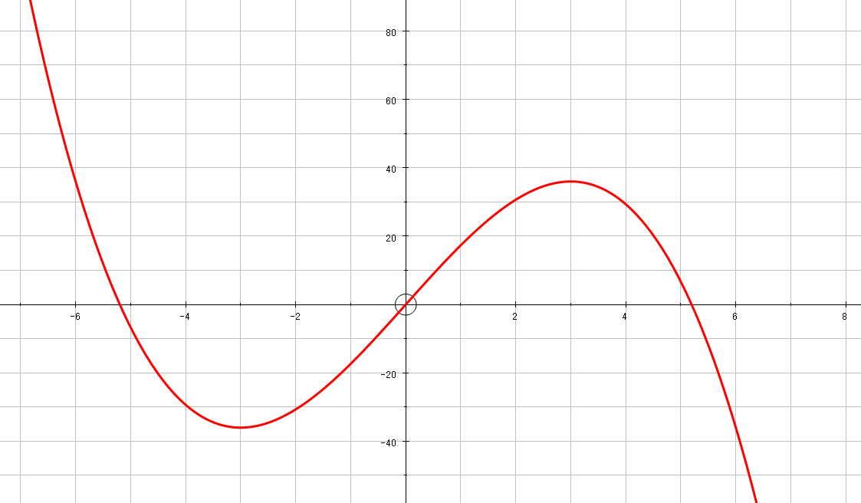
Differentiation
You can use derivatives to model many real-life relationships.
x
x
A large tank (shown) is to be made from 54m² of sheet metal. It has no top.
a) Show that the Volume of the tank will be given by:
b) Find the Maximum volume of the tank
So we want to find the value of x for which the Volume is a maximum
The graph to the right shows the equation for the volume…
Differentiate the function and set it equal to 0…
y
The Volume will be maximised here (x has to be greater than 0)
$$V=18x−\frac{2}{3}x^{3}$$
V
$$V=18x−\frac{2}{3}x^{3}$$
x
The maximum Volume is at the stationary point
→ Hence, the gradient will equal 0
12K

Slide 8
Differentiation
You can use derivatives to model many real-life relationships.
x
x
A large tank (shown) is to be made from 54m² of sheet metal. It has no top.
a) Show that the Volume of the tank will be given by:
b) Find the Maximum volume of the tank
Differentiate the function and set it equal to 0…
So the greatest Volume will occur when x = 3…
y
$$V=18x−\frac{2}{3}x^{3}$$
Differentiate
$$V=18x−\frac{2}{3}x^{3}$$
$$\frac{dV}{dx}=18−2x^{2}$$
Set the gradient function equal to 0
$$0=18−2x^{2}$$
Add 2x²
$${2x}^{2}=18$$
Divide by 2
$$x^{2}=9$$
Square root
$$x=±3$$
x must be positive
$$x=3$$
12K

Slide 9
Differentiation
You can use derivatives to model many real-life relationships.
x
x
A large tank (shown) is to be made from 54m² of sheet metal. It has no top.
a) Show that the Volume of the tank will be given by:
b) Find the Maximum volume of the tank
Differentiate the function and set it equal to 0…
So the greatest Volume will occur when x = 3…
y
$$V=18x−\frac{2}{3}x^{3}$$
Let x = 3
$$V=18x−\frac{2}{3}x^{3}$$
$$V=18(3)−\frac{2}{3}{(3)}^{3}$$
Calculate V
$$V=36m^{3}$$
12K

