Slide 1
Teachings for
Exercise 12J

Slide 2




Differentiation
Gradient is positive, increases, then decreases
Gradient is negative, decreases, then increases
$$y$$
Function
You can use the features of a function to sketch its corresponding gradient function.
You need to consider the gradient at various sections of the graph…
Dividing the graph up helps, and plot any stationary points first
After that, consider the way the gradient changes…
Gradient is positive, but decreasing
Gradient is negative, and decreasing
$$x$$
$$y$$
Gradient Function
Gradient is zero at each of these points
$$x$$
12J

Slide 3


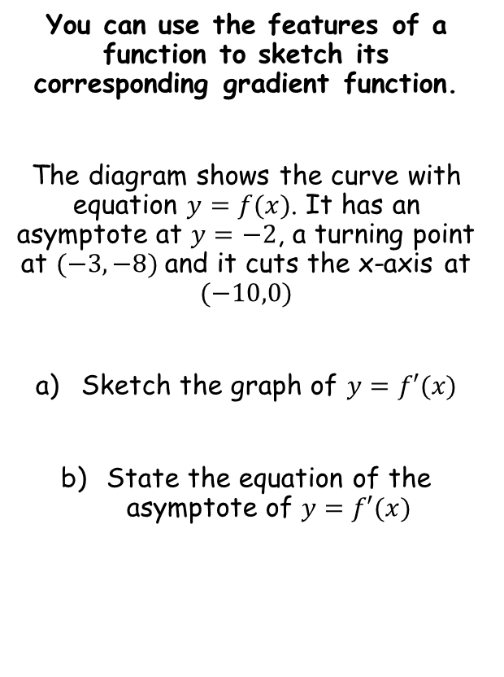





Differentiation
$$y$$
Function
You can use the features of a function to sketch its corresponding gradient function.
The diagram shows the curve with equation $y=f(x)$. It has an asymptote at $y=−2$, a turning point at $(−3,−8)$and it cuts the x-axis at $(−10,0)$
Sketch the graph of $y=f′(x)$
State the equation of the asymptote of $y=f′(x)$
Gradient is negative, but increasing
$$(−10,0)$$
$$x$$
$$y=−2$$
Gradient is positive, increases briefly, but then decreases towards 0
$$(−3,−8)$$
$$y$$
Gradient Function
$$−3$$
$$y=0$$
$$x$$
Gradient is zero at this point
12J

