Slide 1
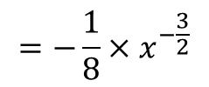
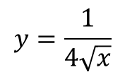
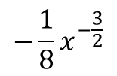

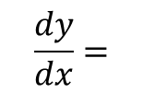
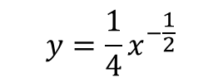

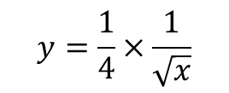
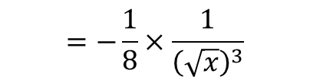
Differentiation
Find $\frac{dy}{dx}$ when $y=\frac{1}{4\sqrt{x}}$
You can differentiate a function with several terms by differentiating each term separately.
If you have several terms, differentiate them all separately.
→ You should do any re-writing you need to before differentiating anything…
$$y=\frac{1}{4\sqrt{x}}$$
We need to rewrite this first – you can think of it as being 2 fractions multiplied together
$$y=\frac{1}{4}×\frac{1}{\sqrt{x}}$$
Group together
$$y=\frac{1}{4}x^{−\frac{1}{2}}$$
$$\frac{dy}{dx}=$$
Differentiate
$$−\frac{1}{8}x^{−\frac{3}{2}}$$
Think of them as 2 terms multiplied
$$=−\frac{1}{8}×x^{−\frac{3}{2}}$$
Rewrite the second
$$=−\frac{1}{8}×\frac{1}{{\left(\sqrt{x}\right)}^{3}}$$
Group together again
$$=−\frac{1}{8{\left(\sqrt{x}\right)}^{3}}$$
12D/E

Slide 2



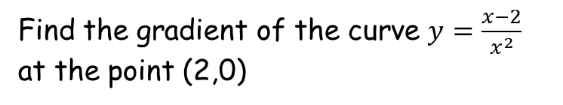






Differentiation
Find the gradient of the curve $y=\frac{x−2}{x^{2}}$ at the point (2,0)
You can differentiate a function with several terms by differentiating each term separately.
If you have several terms, differentiate them all separately.
→ You should do any re-writing you need to before differentiating anything…
$$y=\frac{x−2}{x^{2}}$$
This can be written as 2 separate fractions with the same denominator
$$y=\frac{x}{x^{2}}−\frac{2}{x^{2}}$$
Rewrite for differentiation
$$y=x^{−1}−{2x}^{−2}$$
Differentiate to find the gradient function
$$\frac{dy}{dx}=$$
$$−x^{−2}$$
$$+ 4x^{−3}$$
Sub in x = 2
$$=−{(2)}^{−2}$$
$$+ 4{(2)}^{−3}$$
$$=\frac{1}{4}$$
Calculate
12D/E

