Slide 1
Teachings for
Exercise 12D and 12E

Slide 2

Differentiation
Find $\frac{dy}{dx}$ when $y=x^{2}−6x−4$
You can differentiate a function with several terms by differentiating each term separately.
If you have several terms, differentiate them all separately.
→ You should do any re-writing you need to before differentiating anything…
Differentiate each term separately.
A number on its own disappears
12D/E

Slide 3





Differentiation
Find $\frac{dy}{dx}$ when $y=x^{2}−6x−4$
You can differentiate a function with several terms by differentiating each term separately.
If you have several terms, differentiate them all separately.
→ You should do any re-writing you need to before differentiating anything…
$$=−6x^{1}$$
Multiply by power, reduce power by 1
$$=−4x^{0}$$
Multiply by power, reduce power by 1
$$=−6x^{0}$$
$$=0$$
x⁰ = 1
$$=−6$$
So terms that are just a number will cancel out!
12D/E

Slide 4



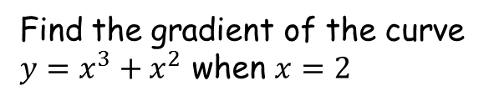


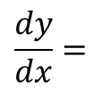

Differentiation
You can differentiate a function with several terms by differentiating each term separately.
If you have several terms, differentiate them all separately.
→ You should do any re-writing you need to before differentiating anything…
Find the gradient of the curve $y=x^{3}+x^{2}$ when $x=2$
$$y=x^{3}+x^{2}$$
Differentiate each term to find the gradient function
$$\frac{dy}{dx}=$$
$${3x}^{2}$$
$$+ 2x$$
Sub in x = 2
$${=3(2)}^{2}$$
$$+ 2(2)$$
Calculate
$$=16$$
12D/E

Slide 5
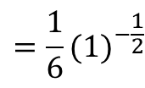
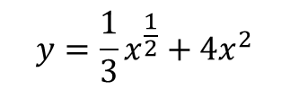
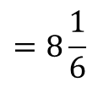
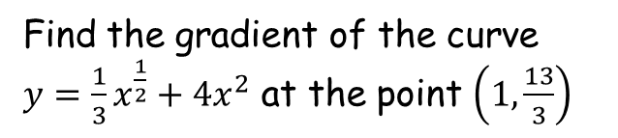

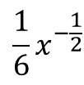
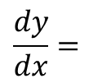

Differentiation
Find the gradient of the curve $y={\frac{1}{3}x}^{\frac{1}{2}}+4x^{2}$ at the point $\left(1,\frac{13}{3}\right)$
You can differentiate a function with several terms by differentiating each term separately.
If you have several terms, differentiate them all separately.
→ You should do any re-writing you need to before differentiating anything…
$$y={\frac{1}{3}x}^{\frac{1}{2}}+4x^{2}$$
Differentiate each term to find the gradient function
$$\frac{dy}{dx}=$$
$${\frac{1}{6}x}^{−\frac{1}{2}}$$
$$+ 8x$$
$${=\frac{1}{6}(1)}^{−\frac{1}{2}}$$
Sub in x = 1
$$+ 8(1)$$
Calculate
$$=8\frac{1}{6}$$
12D/E

