Slide 1
Differentiation
Twitter: @Owen134866
www.mathsfreeresourcelibrary.com

Slide 2

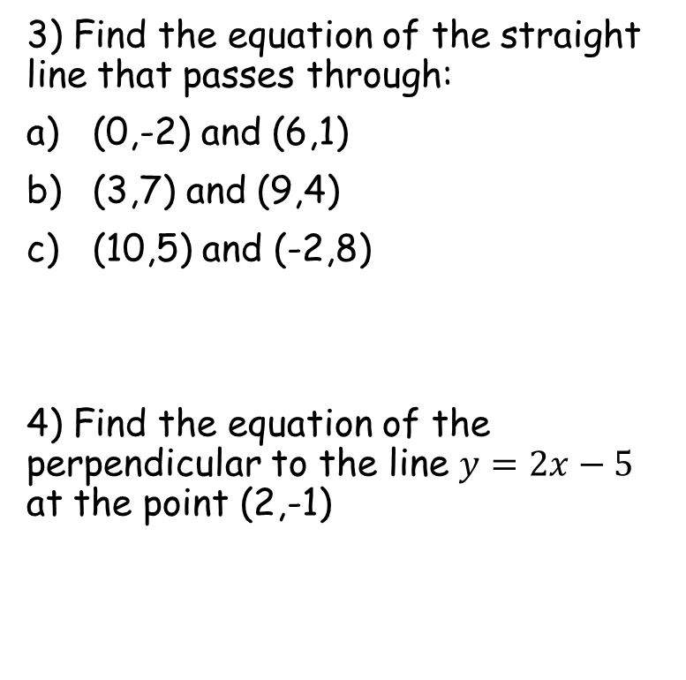

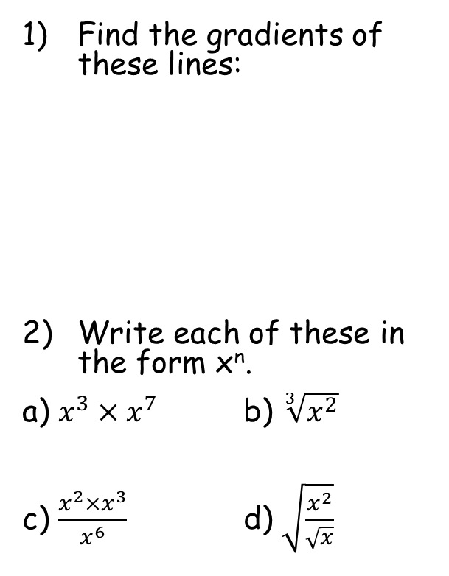






Prior Knowledge Check
Find the gradients of these lines:
Write each of these in the form x^{n}.
a) $x^{3}×x^{7}$ b) $\sqrt[3]{x^{2}}$
c) $\frac{x^{2}×x^{3}}{x^{6}}$ d) $\sqrt{\frac{x^{2}}{\sqrt{x}}}$
3) Find the equation of the straight line that passes through:
(0,-2) and (6,1)
(3,7) and (9,4)
(10,5) and (-2,8)
4) Find the equation of the perpendicular to the line $y=2x−5$ at the point (2,-1)
(6,6)
$$y=\frac{1}{2}x−2$$
4
4
$$y=−\frac{1}{2}x+\frac{17}{2}$$
-5
1
6
$$y=−\frac{1}{4}x+\frac{15}{2}$$
5
-²/₃
¹/₃
$$x^{\frac{2}{3}}$$
$$x^{10}$$
$$y=−\frac{1}{2}x$$
$$x^{\frac{3}{4}}$$
$$x^{−1}$$

Slide 3
Teachings for
Exercise 12B

Slide 4

Differentiation
What can you say about the gradient of the graph to the right?
How would you work out the gradient at a specific point?
As the gradient changes, there must be a formula to calculate the gradient, based on the position on the curve…
$$y=f(x)$$

Slide 5
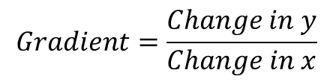

Differentiation
y
To the right is a part of a graph.
Imagine we want to estimate the gradient between any 2 points on the graph
Way too many words here – lets use algebra!
$$y=f(x)$$
Change in y
$$Gradient=\frac{Change in y}{Change in x}$$
Change in x
x

Slide 6


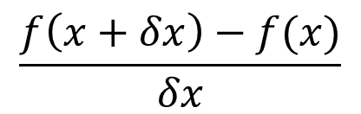





Differentiation
y
Algebraic version
$$y=f(x)$$
Original coordinate
New coordinate
$$x+δx, f\left(x+δx\right)$$
$$(x,f\left(x\right))$$
$$(x+δx,f\left(x+δx\right))$$
$$\frac{δy}{δx}=$$
$$\frac{f\left(x+δx\right)−f(x)}{δx}$$
$$f\left(x+δx\right)−f(x)$$
$$x,f\left(x\right)$$
$$δx$$
This means the change in y divided by the change in x
x

Slide 7
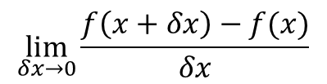
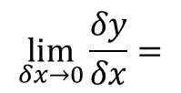
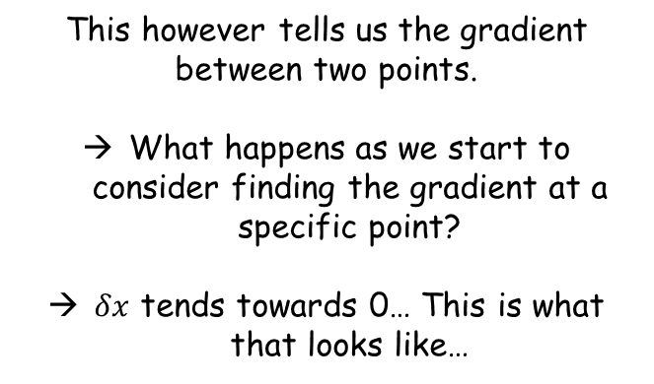
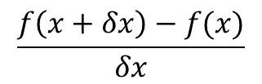
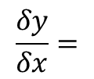

Differentiation
y
$$\frac{δy}{δx}=$$
$$\frac{f\left(x+δx\right)−f(x)}{δx}$$
$$y=f(x)$$
This however tells us the gradient between two points.
What happens as we start to consider finding the gradient at a specific point?
$δx$ tends towards 0… This is what that looks like…
$$x+δx, f\left(x+δx\right)$$
$$f\left(x+δx\right)−f(x)$$
$$\lim_{δx→0}{\frac{δy}{δx}}=$$
$$\lim_{δx→0}{\frac{f\left(x+δx\right)−f(x)}{δx}}$$
$$x,f\left(x\right)$$
$$δx$$
The limit as $δx$ tends towards 0
x

Slide 8
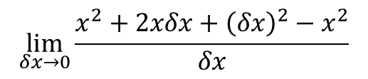

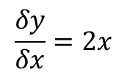

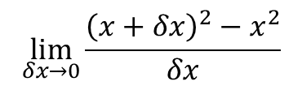

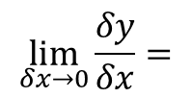


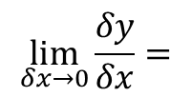

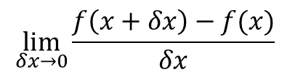
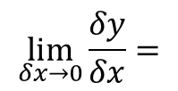


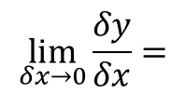
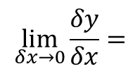
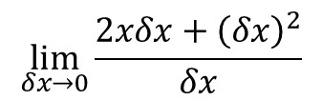
Differentiation
y
$$\lim_{δx→0}{\frac{δy}{δx}}=$$
$$\lim_{δx→0}{\frac{f\left(x+δx\right)−f(x)}{δx}}$$
$$y=x^{2}$$
Replace the functions
$$x+δx, {\left(x+δx\right)}^{2}$$
$$\lim_{δx→0}{\frac{δy}{δx}}=$$
$$\lim_{δx→0}{\frac{{\left(x+δx\right)}^{2}−x^{2}}{δx}}$$
Expand the bracket
$$\lim_{δx→0}{\frac{δy}{δx}}=$$
$$\lim_{δx→0}{\frac{x^{2}+2xδx+{\left(δx\right)}^{2}−x^{2}}{δx}}$$
$${\left(x+δx\right)}^{2}−x^{2}$$
The x² terms cancel each other
$$\lim_{δx→0}{\frac{δy}{δx}}=$$
$$\lim_{δx→0}{\frac{2xδx+{\left(δx\right)}^{2}}{δx}}$$
$$x,x^{2}$$
$$δx$$
Divide all by $δx$
$$\lim_{δx→0}{\frac{δy}{δx}}=$$
x
$$\lim_{δx→0}{2x+δx}$$
What happens as we approach a single point instead of 2 separate ones?
$$δx → 0$$
$$\frac{δy}{δx}=2x$$

Slide 9
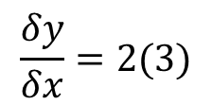
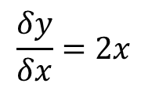
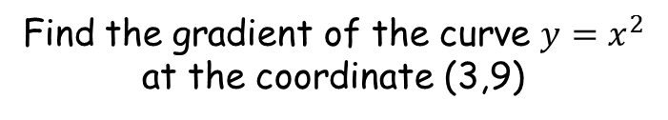
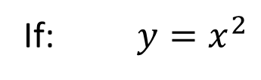



Differentiation
y
If: $y=x^{2}$
The function
$$y=x^{2}$$
The gradient function (formula for the gradient, in terms of x)
Then: $\frac{δy}{δx}=2x$
Find the gradient of the curve $y=x^{2}$ at the coordinate (3,9)
The gradient at this exact point is 6
$$\frac{δy}{δx}=2x$$
The x-coordinate at this point is 4
$$\frac{δy}{δx}=2(3)$$
x
$$3$$
Calculate it!
$$=6$$

Slide 10
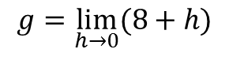
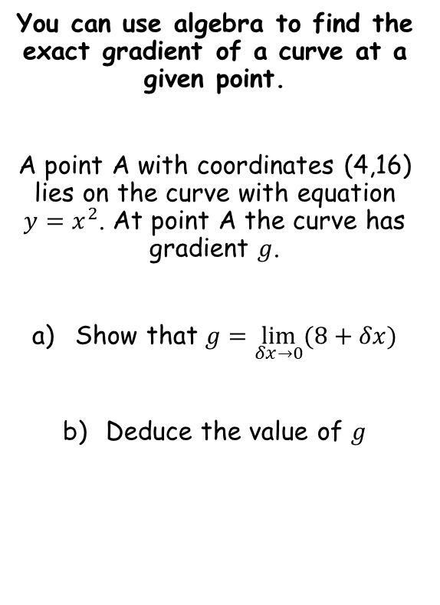
Differentiation
You can use algebra to find the exact gradient of a curve at a given point.
A point A with coordinates (4,16) lies on the curve with equation $y=x^{2}$. At point A the curve has gradient $g$.
Show that $g=\lim_{δx→0}(8+δx)$
Deduce the value of $g$
$$g=\lim_{h→0}(8+h)$$
Be aware that sometimes the letter h is used to represent the change in x
12B

Slide 11







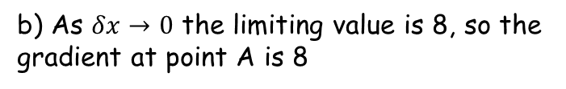
Differentiation
$$\lim_{δx→0}{\frac{δy}{δx}}=\lim_{δx→0}{\frac{f\left(x+δx\right)−f(x)}{δx}}$$
We can use g to represent the gradient here
You can use algebra to find the exact gradient of a curve at a given point.
A point A with coordinates (4,16) lies on the curve with equation $y=x^{2}$. At point A the curve has gradient $g$.
Show that $g=\lim_{δx→0}(8+δx)$
Deduce the value of $g$
$$g=\lim_{δx→0}{\frac{f\left(x+δx\right)−f(x)}{δx}}$$
Replace the value of x, and use the function given in the question
$$g=\lim_{δx→0}{\frac{{\left(4+δx\right)}^{2}−{(4)}^{2}}{δx}}$$
Expand brackets
$$g=\lim_{δx→0}{\frac{16+8δx+{(δx)}^{2}−16}{δx}}$$
Group like terms
$$g=\lim_{δx→0}{\frac{8δx+{(δx)}^{2}}{δx}}$$
Divide all by $δx$
$$g=\lim_{δx→0}{(8+δx)}$$
b) As $δx→0$ the limiting value is 8, so the gradient at point A is 8
12B

Slide 12

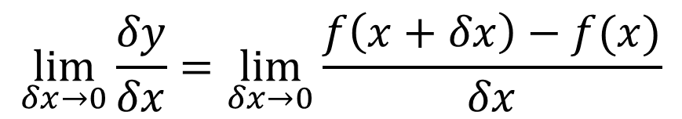




Differentiation
$$\lim_{δx→0}{\frac{δy}{δx}}=\lim_{δx→0}{\frac{f\left(x+δx\right)−f(x)}{δx}}$$
Can you find a formula for the gradient for each of these curves using the method shown? Use it to find the gradient where x = 2 for each!
a) $y=x^{3}$
b) $y=x^{2}+4$
c) $y=x^{2}+4x$
d) $y={2x}^{3}$
e) $y=x^{4}$

