Slide 1
Differentiation
Twitter: @Owen134866
www.mathsfreeresourcelibrary.com

Slide 2

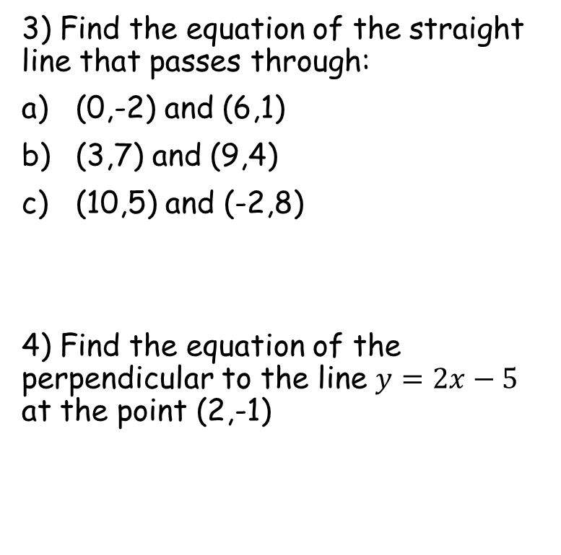

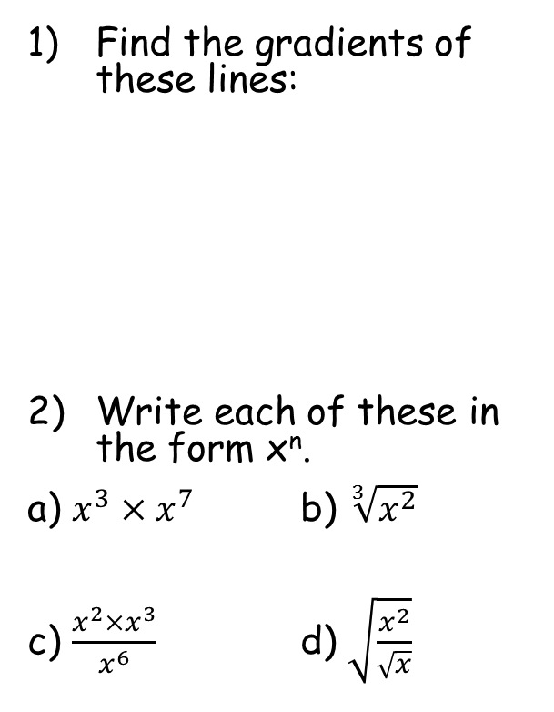






Prior Knowledge Check
Find the gradients of these lines:
Write each of these in the form x^{n}.
a) $x^{3}×x^{7}$ b) $\sqrt[3]{x^{2}}$
c) $\frac{x^{2}×x^{3}}{x^{6}}$ d) $\sqrt{\frac{x^{2}}{\sqrt{x}}}$
3) Find the equation of the straight line that passes through:
(0,-2) and (6,1)
(3,7) and (9,4)
(10,5) and (-2,8)
4) Find the equation of the perpendicular to the line $y=2x−5$ at the point (2,-1)
(6,6)
$$y=\frac{1}{2}x−2$$
4
4
$$y=−\frac{1}{2}x+\frac{17}{2}$$
-5
1
6
$$y=−\frac{1}{4}x+\frac{15}{2}$$
5
-²/₃
¹/₃
$$x^{\frac{2}{3}}$$
$$x^{10}$$
$$y=−\frac{1}{2}x$$
$$x^{\frac{3}{4}}$$
$$x^{−1}$$

Slide 3
Teachings for
Exercise 12B

Slide 4

Differentiation
What can you say about the gradient of the graph to the right?
How would you work out the gradient at a specific point?
As the gradient changes, there must be a formula to calculate the gradient, based on the position on the curve…
$$y=f(x)$$

Slide 5
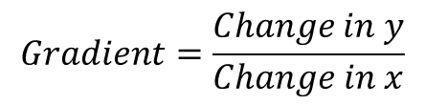

Differentiation
y
To the right is a part of a graph.
Imagine we want to estimate the gradient between any 2 points on the graph
Way too many words here – lets use algebra!
$$y=f(x)$$
Change in y
$$Gradient=\frac{Change in y}{Change in x}$$
Change in x
x

Slide 6


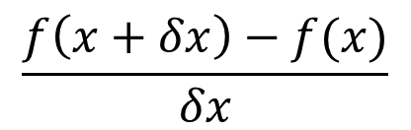





Differentiation
y
Algebraic version
$$y=f(x)$$
Original coordinate
New coordinate
$$x+δx, f\left(x+δx\right)$$
$$(x,f\left(x\right))$$
$$(x+δx,f\left(x+δx\right))$$
$$\frac{δy}{δx}=$$
$$\frac{f\left(x+δx\right)−f(x)}{δx}$$
$$f\left(x+δx\right)−f(x)$$
$$x,f\left(x\right)$$
$$δx$$
This means the change in y divided by the change in x
x

Slide 7
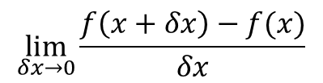
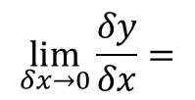
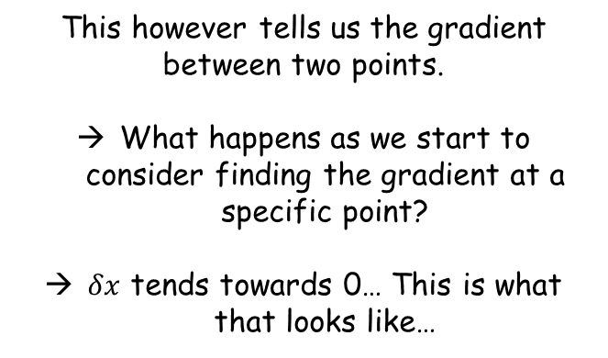
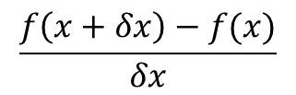
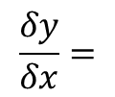

Differentiation
y
$$\frac{δy}{δx}=$$
$$\frac{f\left(x+δx\right)−f(x)}{δx}$$
$$y=f(x)$$
This however tells us the gradient between two points.
What happens as we start to consider finding the gradient at a specific point?
$δx$ tends towards 0… This is what that looks like…
$$x+δx, f\left(x+δx\right)$$
$$f\left(x+δx\right)−f(x)$$
$$\lim_{δx→0}{\frac{δy}{δx}}=$$
$$\lim_{δx→0}{\frac{f\left(x+δx\right)−f(x)}{δx}}$$
$$x,f\left(x\right)$$
$$δx$$
The limit as $δx$ tends towards 0
x

Slide 8
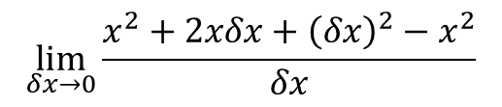

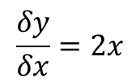

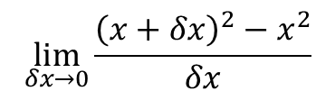

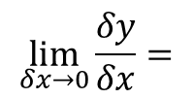

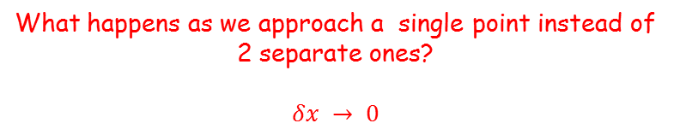
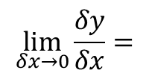

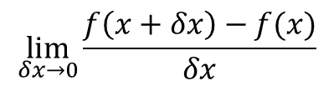
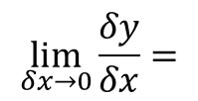


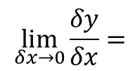
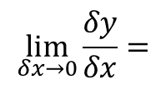
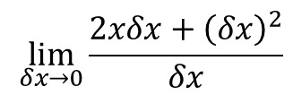
Differentiation
y
$$\lim_{δx→0}{\frac{δy}{δx}}=$$
$$\lim_{δx→0}{\frac{f\left(x+δx\right)−f(x)}{δx}}$$
$$y=x^{2}$$
Replace the functions
$$x+δx, {\left(x+δx\right)}^{2}$$
$$\lim_{δx→0}{\frac{δy}{δx}}=$$
$$\lim_{δx→0}{\frac{{\left(x+δx\right)}^{2}−x^{2}}{δx}}$$
Expand the bracket
$$\lim_{δx→0}{\frac{δy}{δx}}=$$
$$\lim_{δx→0}{\frac{x^{2}+2xδx+{\left(δx\right)}^{2}−x^{2}}{δx}}$$
$${\left(x+δx\right)}^{2}−x^{2}$$
The x² terms cancel each other
$$\lim_{δx→0}{\frac{δy}{δx}}=$$
$$\lim_{δx→0}{\frac{2xδx+{\left(δx\right)}^{2}}{δx}}$$
$$x,x^{2}$$
$$δx$$
Divide all by $δx$
$$\lim_{δx→0}{\frac{δy}{δx}}=$$
x
$$\lim_{δx→0}{2x+δx}$$
What happens as we approach a single point instead of 2 separate ones?
$$δx → 0$$
$$\frac{δy}{δx}=2x$$

Slide 9
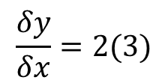
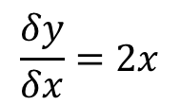
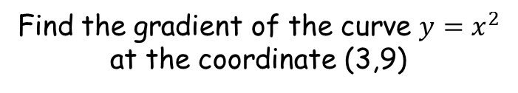
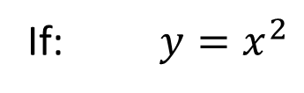



Differentiation
y
If: $y=x^{2}$
The function
$$y=x^{2}$$
The gradient function (formula for the gradient, in terms of x)
Then: $\frac{δy}{δx}=2x$
Find the gradient of the curve $y=x^{2}$ at the coordinate (3,9)
The gradient at this exact point is 6
$$\frac{δy}{δx}=2x$$
The x-coordinate at this point is 4
$$\frac{δy}{δx}=2(3)$$
x
$$3$$
Calculate it!
$$=6$$

Slide 10
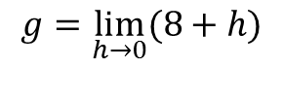
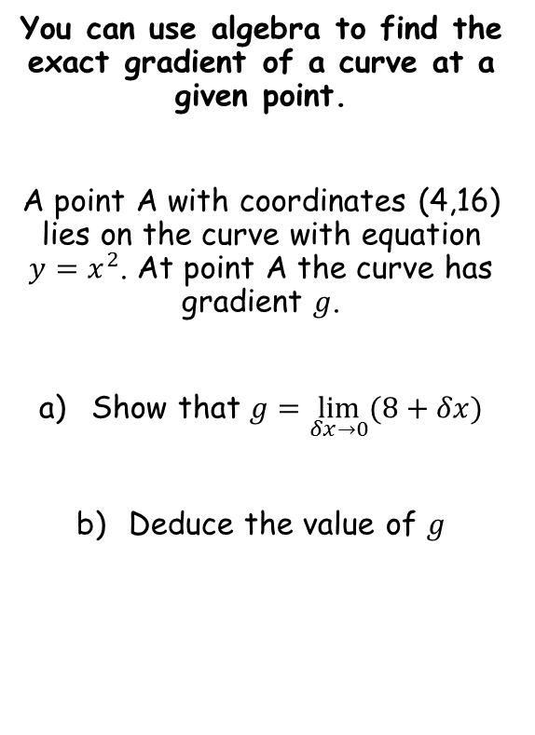
Differentiation
You can use algebra to find the exact gradient of a curve at a given point.
A point A with coordinates (4,16) lies on the curve with equation $y=x^{2}$. At point A the curve has gradient $g$.
Show that $g=\lim_{δx→0}(8+δx)$
Deduce the value of $g$
$$g=\lim_{h→0}(8+h)$$
Be aware that sometimes the letter h is used to represent the change in x
12B

Slide 11







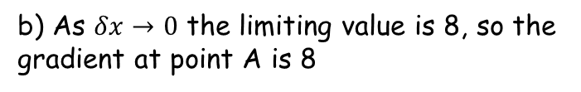
Differentiation
$$\lim_{δx→0}{\frac{δy}{δx}}=\lim_{δx→0}{\frac{f\left(x+δx\right)−f(x)}{δx}}$$
We can use g to represent the gradient here
You can use algebra to find the exact gradient of a curve at a given point.
A point A with coordinates (4,16) lies on the curve with equation $y=x^{2}$. At point A the curve has gradient $g$.
Show that $g=\lim_{δx→0}(8+δx)$
Deduce the value of $g$
$$g=\lim_{δx→0}{\frac{f\left(x+δx\right)−f(x)}{δx}}$$
Replace the value of x, and use the function given in the question
$$g=\lim_{δx→0}{\frac{{\left(4+δx\right)}^{2}−{(4)}^{2}}{δx}}$$
Expand brackets
$$g=\lim_{δx→0}{\frac{16+8δx+{(δx)}^{2}−16}{δx}}$$
Group like terms
$$g=\lim_{δx→0}{\frac{8δx+{(δx)}^{2}}{δx}}$$
Divide all by $δx$
$$g=\lim_{δx→0}{(8+δx)}$$
b) As $δx→0$ the limiting value is 8, so the gradient at point A is 8
12B

Slide 12

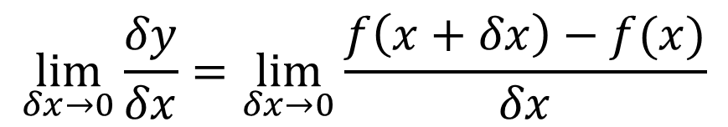




Differentiation
$$\lim_{δx→0}{\frac{δy}{δx}}=\lim_{δx→0}{\frac{f\left(x+δx\right)−f(x)}{δx}}$$
Can you find a formula for the gradient for each of these curves using the method shown? Use it to find the gradient where x = 2 for each!
a) $y=x^{3}$
b) $y=x^{2}+4$
c) $y=x^{2}+4x$
d) $y={2x}^{3}$
e) $y=x^{4}$

Slide 13
Teachings for
Exercise 12C

Slide 14

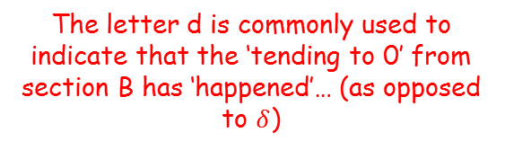




Differentiation
You can use the definition of the derivative to find an expression for the derivative of $x^{n}$ where $n$ is any number.
As a general rule, to differentiate a function…
The function
If $y={ax}^{n}$
If $f\left(x\right)=ax^{n}$
Its derivative (formula for the gradient, in terms of x)
Then $\frac{dy}{dx}={nax}^{n−1}$
Then $f^{′}\left(x\right)={nax}^{n−1}$
The letter d is commonly used to indicate that the ‘tending to 0’ from section B has ‘happened’… (as opposed to $δ$)
Gottfried Leibniz’s notation
Joseph Lagrange’s notation
Both types of notation are still used so you need to be familiar with both
12C

Slide 15










Differentiation
You can use the definition of the derivative to find an expression for the derivative of $x^{n}$ where $n$ is any number.
Find $f^{′}\left(x\right)$ for each of the expressions for $f(x)$ to the right.
a) $f\left(x\right)=x^{6}$
Multiply by the power and reduce it by 1
$$f′\left(x\right)={6x}^{5}$$
b) $f\left(x\right)=x^{\frac{1}{2}}$
Multiply by the power and reduce it by 1
$$f′\left(x\right)={\frac{1}{2}x}^{−\frac{1}{2}}$$
If $f\left(x\right)=ax^{n}$
You need to be able to rewrite this. This of it as two fractions multiplied together
$${=\frac{1}{2}×x}^{−\frac{1}{2}}$$
Then $f^{′}\left(x\right)={nax}^{n−1}$
Rewrite the second using index rules
$$=\frac{1}{2}×\frac{1}{\sqrt{x}}$$
Group together
$$=\frac{1}{2\sqrt{x}}$$
12C

Slide 16





Differentiation
You can use the definition of the derivative to find an expression for the derivative of $x^{n}$ where $n$ is any number.
Find $f^{′}\left(x\right)$ for each of the expressions for $f(x)$ to the right.
c) $f\left(x\right)=x^{−2}$
Multiply by the power and reduce it by 1
$$f′\left(x\right)={−2x}^{−3}$$
Think of it as 2 terms multiplied together
$$={−2×x}^{−3}$$
$$=−2×\frac{1}{x^{3}}$$
Rewrite the second
Group together
$$=−\frac{2}{x^{3}}$$
If $f\left(x\right)=ax^{n}$
Then $f^{′}\left(x\right)={nax}^{n−1}$
12C

Slide 17



Differentiation
You can use the definition of the derivative to find an expression for the derivative of $x^{n}$ where $n$ is any number.
Find $f^{′}\left(x\right)$ for each of the expressions for $f(x)$ to the right.
d) $f\left(x\right)=x^{2}×x^{3}$
Multiply terms together first
$$f\left(x\right)=x^{5}$$
Multiply by the power and reduce it by 1
$$f^{′}(x)=5x^{4}$$
If $f\left(x\right)=ax^{n}$
Then $f^{′}\left(x\right)={nax}^{n−1}$
12C

Slide 18






Differentiation
You can use the definition of the derivative to find an expression for the derivative of $x^{n}$ where $n$ is any number.
Find $f^{′}\left(x\right)$ for each of the expressions for $f(x)$ to the right.
e) $f\left(x\right)=\frac{x}{x^{5}}$
Rewrite
$$f\left(x\right)=x^{−4}$$
Differentiate
$$f′\left(x\right)={−4x}^{−5}$$
Think of it as 2 terms multiplied together
$$={−4×x}^{−5}$$
$$=−4×\frac{1}{x^{5}}$$
Rewrite the second term
If $f\left(x\right)=ax^{n}$
Group together
Then $f^{′}\left(x\right)={nax}^{n−1}$
$$=−\frac{4}{x^{5}}$$
12C

Slide 19


Differentiation
You can use the definition of the derivative to find an expression for the derivative of $x^{n}$ where $n$ is any number.
Find $f^{′}\left(x\right)$ for each of the expressions for $f(x)$ to the right.
f) $f\left(x\right)=7x^{3}$
Differentiate
$$f′\left(x\right)={21x}^{2}$$
If $f\left(x\right)=ax^{n}$
Then $f^{′}\left(x\right)={nax}^{n−1}$
12C

Slide 20
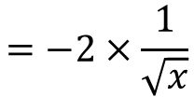



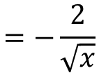
Differentiation
You can use the definition of the derivative to find an expression for the derivative of $x^{n}$ where $n$ is any number.
Find $f^{′}\left(x\right)$ for each of the expressions for $f(x)$ to the right.
g) $f\left(x\right)=−4x^{\frac{1}{2}}$
Differentiate
$$f′\left(x\right)={−2x}^{−\frac{1}{2}}$$
This of it as 2 terms multiplied together
$$={−2×x}^{−\frac{1}{2}}$$
Rewrite the second term
$$=−2×\frac{1}{\sqrt{x}}$$
If $f\left(x\right)=ax^{n}$
Group together
Then $f^{′}\left(x\right)={nax}^{n−1}$
$$=−\frac{2}{\sqrt{x}}$$
12C

Slide 21





Differentiation
You can use the definition of the derivative to find an expression for the derivative of $x^{n}$ where $n$ is any number.
Find $f^{′}\left(x\right)$ for each of the expressions for $f(x)$ to the right.
h) $f\left(x\right)=\sqrt{36x^{3}}$
Rewrite
$$f\left(x\right)=\sqrt{36}\sqrt{x^{3}}$$
Square root each part / rewrite using indices
$$f\left(x\right)=6x^{\frac{3}{2}}$$
Differentiate
$$f′\left(x\right)=9x^{\frac{1}{2}}$$
If $f\left(x\right)=ax^{n}$
Rewrite
$$=9\sqrt{x}$$
Then $f^{′}\left(x\right)={nax}^{n−1}$
12C

Slide 22
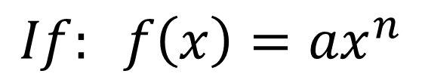
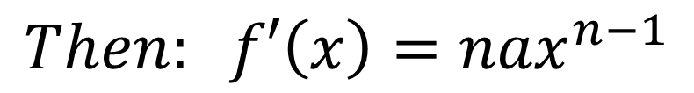
Differentiation
As you have also learnt about the binomial expansion, we can prove the differentiation rule for any power of x…
$$If: f\left(x\right)={ax}^{n}$$
$$Then: f′\left(x\right)={nax}^{n−1}$$
12C

Slide 23

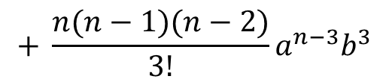



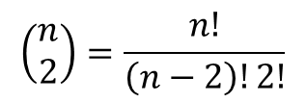


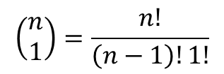
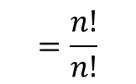



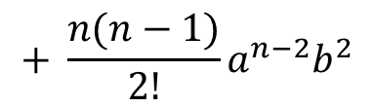
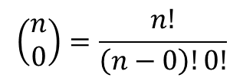


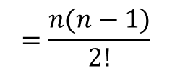

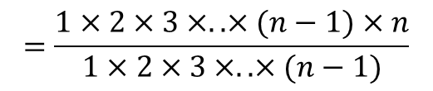



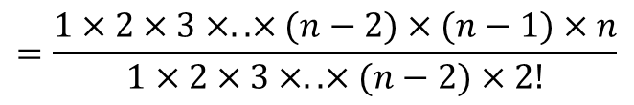
Differentiation
$$\left(\begin{matrix}n \\ r\end{matrix}\right)=\frac{n!}{\left(n−r\right)!r!}$$
Binomial Expansion reminder!
$${(a+b)}^{n}$$
$$=\left(\begin{matrix}n \\ 0\end{matrix}\right)a^{n}$$
$$+ \left(\begin{matrix}n \\ 1\end{matrix}\right)a^{n−1}b$$
$$+ \left(\begin{matrix}n \\ 2\end{matrix}\right)a^{n−2}b^{2}$$
$$+ \left(\begin{matrix}n \\ 3\end{matrix}\right)a^{n−3}b^{3}$$
$$+ ………$$
$$+ \left(\begin{matrix}n \\ n\end{matrix}\right)b^{n}$$
$$\left(\begin{matrix}n \\ 1\end{matrix}\right)=\frac{n!}{\left(n−1\right)!1!}$$
$$\left(\begin{matrix}n \\ 2\end{matrix}\right)=\frac{n!}{\left(n−2\right)!2!}$$
$$\left(\begin{matrix}n \\ 0\end{matrix}\right)=\frac{n!}{\left(n−0\right)!0!}$$
$$+ \frac{n(n−1)}{2!}a^{n−2}b^{2}$$
$$+ \frac{n(n−1)(n−2)}{3!}a^{n−3}b^{3}$$
$$+ \left(\begin{matrix}n \\ n\end{matrix}\right)b^{n}$$
$$=a^{n}$$
$$+ na^{n−1}b$$
0! is defined as 1
$$+ ………$$
$$=\frac{n!}{\left(n−1\right)!}$$
$$=\frac{1×2×3×..×(n−2)×(n−1)×n}{1×2×3×..×(n−2)×2!}$$
$$=\frac{n!}{n!}$$
$$=\frac{1×2×3×..×(n−1)×n}{1×2×3×..×(n−1)}$$
$$=\frac{n(n−1)}{2!}$$
$$=1$$
$$=n$$
12C

Slide 24




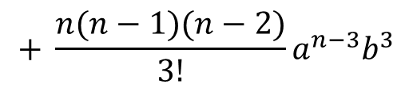





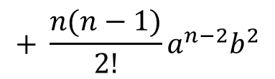





Differentiation
$${(a+b)}^{n}$$
$$+ \frac{n(n−1)}{2!}a^{n−2}b^{2}$$
$$+ \frac{n(n−1)(n−2)}{3!}a^{n−3}b^{3}$$
$$+ \left(\begin{matrix}n \\ n\end{matrix}\right)b^{n}$$
$$=a^{n}$$
$$+ na^{n−1}b$$
$$+ ………$$
→ Calculate the first 4 terms in the expansion of:
$${\left(x+y\right)}^{8}$$
$$+ \frac{8(7)}{2}x^{6}y^{2}$$
$$+ \frac{8(7)(6)}{6}x^{5}y^{3}$$
$$=x^{8}$$
$$+ 8x^{7}y$$
$$=x^{8}$$
$$+ 8x^{7}y$$
$$+ 28x^{6}y^{2}$$
$$+ 56x^{5}y^{3}$$
12C

Slide 25








Differentiation
y
If: $f(x)={ax}^{n}$
$$f(x)={ax}^{n}$$
$$x+δx, a{\left(x+δx\right)}^{n}$$
$$\lim_{δx→0}{\frac{δy}{δx}}=$$
$$\lim_{δx→0}{\frac{{a\left(x+δx\right)}^{n}−{ax}^{n}}{δx}}$$
Now we need the binomial expansion…
$$a{\left(x+δx\right)}^{n}−{ax}^{n}$$
$$x,{ax}^{n}$$
$$δx$$
x
12C

Slide 26










Differentiation
If: $f(x)={ax}^{n}$
Let’s rewrite the bracket using the binomial expansion
$$\lim_{δx→0}{\frac{δy}{δx}}=$$
$$\lim_{δx→0}{\frac{{a\left(x+δx\right)}^{n}−{ax}^{n}}{δx}}$$
$${\left(x+δx\right)}^{n}$$
$$=x^{n}$$
$$+{\left(\begin{matrix}n \\ 1\end{matrix}\right) x}^{n−1}(δx)$$
$$+{\left(\begin{matrix}n \\ 2\end{matrix}\right) x}^{n−2}{(δx)}^{2}$$
$$+{\left(\begin{matrix}n \\ 3\end{matrix}\right) x}^{n−3}{(δx)}^{3}$$
$$+ ………+{(δx)}^{n}$$
$$+ { \frac{n(n−1)}{2}x}^{n−2}{\left(δx\right)}^{2}$$
$$+ { \frac{n(n−1)(n−2)}{6}x}^{n−3}{\left(δx\right)}^{3}$$
$$=x^{n}$$
$$+ { nx}^{n−1}(δx)$$
$$+ ………+{(δx)}^{n}$$
12C

Slide 27



Differentiation
If: $f(x)={ax}^{n}$
$$\lim_{δx→0}{\frac{δy}{δx}}=$$
$$\lim_{δx→0}{\frac{{a\left(x+δx\right)}^{n}−{ax}^{n}}{δx}}$$
Replace the bracket with the expansion
$$=\lim_{δx→0}{\frac{a(x^{n}+{ nx}^{n−1}\left(δx\right)+{ \frac{n\left(n−1\right)}{2}x}^{n−2}{\left(δx\right)}^{2}+.. .. .. +{(δx)}^{n})−{ax}^{n}}{δx}}$$
Multiply out
$$=\lim_{δx→0}{\frac{ax^{n}+{ anx}^{n−1}\left(δx\right)+{ \frac{an\left(n−1\right)}{2}x}^{n−2}{\left(δx\right)}^{2}+.. .. .. +a{(δx)}^{n}−{ax}^{n}}{δx}}$$
Group terms
$$=\lim_{δx→0}{\frac{{ anx}^{n−1}\left(δx\right)+{ \frac{an\left(n−1\right)}{2}x}^{n−2}{\left(δx\right)}^{2}+.. .. .. +a{(δx)}^{n}}{δx}}$$
12C

Slide 28







Differentiation
If: $f(x)={ax}^{n}$
1
n-1
$$\lim_{δx→0}{\frac{{ anx}^{n−1}\left(δx\right)+{ \frac{an\left(n−1\right)}{2}x}^{n−2}{\left(δx\right)}^{2}+.. .. .. +a{(δx)}^{n}}{δx}}$$
$$\lim_{δx→0}{\frac{δy}{δx}}=$$
Divide all by $δx$
$$=\lim_{δx→0}{{ anx}^{n−1}+{ \frac{an\left(n−1\right)}{2}x}^{n−2}\left(δx\right)+.. .. .. +a{(δx)}^{n−1}}$$
$$\lim_{δx→0}{\frac{δy}{δx}}$$
As $δx$ tends towards, 0, any terms including it will do as well!
$$\frac{δy}{δx}$$
$$={ anx}^{n−1}$$
Everything in-between will also contain a $δx$ term
12C

Slide 29
Teachings for
Exercise 12D and 12E

Slide 30

Differentiation
Find $\frac{dy}{dx}$ when $y=x^{2}−6x−4$
You can differentiate a function with several terms by differentiating each term separately.
If you have several terms, differentiate them all separately.
→ You should do any re-writing you need to before differentiating anything…
Differentiate each term separately.
A number on its own disappears
12D/E

Slide 31





Differentiation
Find $\frac{dy}{dx}$ when $y=x^{2}−6x−4$
You can differentiate a function with several terms by differentiating each term separately.
If you have several terms, differentiate them all separately.
→ You should do any re-writing you need to before differentiating anything…
$$=−6x^{1}$$
Multiply by power, reduce power by 1
$$=−4x^{0}$$
Multiply by power, reduce power by 1
$$=−6x^{0}$$
$$=0$$
x⁰ = 1
$$=−6$$
So terms that are just a number will cancel out!
12D/E

Slide 32








Differentiation
You can differentiate a function with several terms by differentiating each term separately.
If you have several terms, differentiate them all separately.
→ You should do any re-writing you need to before differentiating anything…
Find the gradient of the curve $y=x^{3}+x^{2}$ when $x=2$
$$y=x^{3}+x^{2}$$
Differentiate each term to find the gradient function
$$\frac{dy}{dx}=$$
$${3x}^{2}$$
$$+ 2x$$
Sub in x = 2
$${=3(2)}^{2}$$
$$+ 2(2)$$
Calculate
$$=16$$
12D/E

Slide 33








Differentiation
Find the gradient of the curve $y={\frac{1}{3}x}^{\frac{1}{2}}+4x^{2}$ at the point $\left(1,\frac{13}{3}\right)$
You can differentiate a function with several terms by differentiating each term separately.
If you have several terms, differentiate them all separately.
→ You should do any re-writing you need to before differentiating anything…
$$y={\frac{1}{3}x}^{\frac{1}{2}}+4x^{2}$$
Differentiate each term to find the gradient function
$$\frac{dy}{dx}=$$
$${\frac{1}{6}x}^{−\frac{1}{2}}$$
$$+ 8x$$
$${=\frac{1}{6}(1)}^{−\frac{1}{2}}$$
Sub in x = 1
$$+ 8(1)$$
Calculate
$$=8\frac{1}{6}$$
12D/E

Slide 34









Differentiation
Find $\frac{dy}{dx}$ when $y=\frac{1}{4\sqrt{x}}$
You can differentiate a function with several terms by differentiating each term separately.
If you have several terms, differentiate them all separately.
→ You should do any re-writing you need to before differentiating anything…
$$y=\frac{1}{4\sqrt{x}}$$
We need to rewrite this first – you can think of it as being 2 fractions multiplied together
$$y=\frac{1}{4}×\frac{1}{\sqrt{x}}$$
Group together
$$y=\frac{1}{4}x^{−\frac{1}{2}}$$
$$\frac{dy}{dx}=$$
Differentiate
$$−\frac{1}{8}x^{−\frac{3}{2}}$$
Think of them as 2 terms multiplied
$$=−\frac{1}{8}×x^{−\frac{3}{2}}$$
Rewrite the second
$$=−\frac{1}{8}×\frac{1}{{\left(\sqrt{x}\right)}^{3}}$$
Group together again
$$=−\frac{1}{8{\left(\sqrt{x}\right)}^{3}}$$
12D/E

Slide 35










Differentiation
Find the gradient of the curve $y=\frac{x−2}{x^{2}}$ at the point (2,0)
You can differentiate a function with several terms by differentiating each term separately.
If you have several terms, differentiate them all separately.
→ You should do any re-writing you need to before differentiating anything…
$$y=\frac{x−2}{x^{2}}$$
This can be written as 2 separate fractions with the same denominator
$$y=\frac{x}{x^{2}}−\frac{2}{x^{2}}$$
Rewrite for differentiation
$$y=x^{−1}−{2x}^{−2}$$
Differentiate to find the gradient function
$$\frac{dy}{dx}=$$
$$−x^{−2}$$
$$+ 4x^{−3}$$
Sub in x = 2
$$=−{(2)}^{−2}$$
$$+ 4{(2)}^{−3}$$
$$=\frac{1}{4}$$
Calculate
12D/E

Slide 36
Teachings for
Exercise 12F

Slide 37
Differentiation
You can use the derivative to find the equations of tangents and normal to a curve at a given point.
The tangent is a straight line that intersects the curve at on point only.
The gradient of the tangent is the same as the gradient of the curve at the point given (so you can differentiate to get it)
The normal is a straight line perpendicular to the tangent where it touches the curve.
Normal
Curve
Tangent
12F

Slide 38


Differentiation
You can use the derivative to find the equations of tangents and normal to a curve at a given point.
Find the equation of the tangent to the curve y = x³ – 3x² + 2x - 1, at the point (3,5).
So we need the gradient of the tangent. It will be the same as the gradient of the curve at the point given (x = 3)
Differentiate to get the gradient function
Substitute the x value in to find the gradient
$$=3{\left(3\right)}^{2}−6\left(3\right)+2$$
The gradient at (3,5) is 11
$$=11$$
Use the formula for a straight line!
Substitute the co-ordinate and gradient in
Expand bracket
Add 5
Tangent
12F

Slide 39



Differentiation
You can use the derivative to find the equations of tangents and normal to a curve at a given point.
Find the equation of the normal to the curve y = 8 - 3√x at the point where x = 4.
Start by finding the gradient of the curve at that point.
Gradient = -³/₄ (this is of the tangent)
The Normal is perpendicular to the tangent
Gradient of the Normal = ⁴/₃
Rewrite
Differentiate
Rewrite for substitution
$$\frac{dy}{dx}=−\frac{3}{2}×\frac{1}{\sqrt{x}}$$
$$=−\frac{3}{2}×\frac{1}{\sqrt{4}}$$
Sub in x = 4
The Gradient where x = 4 is -³/₄
$$=−\frac{3}{4}$$
12F

Slide 40
Differentiation
You can use the derivative to find the equations of tangents and normal to a curve at a given point.
Find the equation of the normal to the curve y = 8 - 3√x at the point where x = 4.
Gradient of the Normal = ⁴/₃
Now we need the co-ordinates at that point. We already have x = 4.
Co-ordinates at the intersection = (4,2)
Substitute in x = 4
3 times 2 = 6!
Use the formula for a straight line!
Substitute the co-ordinate and gradient in
Multiply by 3
Expand bracket
Rearrange
12F

Slide 41
Teachings for
Exercise 12G

Slide 42
Differentiation
You can use the derivative to determine whether a function is increasing or decreasing in a given interval.
An increasing function is one with a positive gradient.
A decreasing function is one with a negative gradient.
y
This function is increasing for all values of x
x
y
This function is decreasing for all values of x
x
12G

Slide 43
Differentiation
You can use the derivative to determine whether a function is increasing or decreasing in a given interval.
An increasing function is one with a positive gradient.
A decreasing function is one with a negative gradient.
Some functions are increasing in one interval and decreasing in another.
y
x
This function is decreasing for x > 0, and increasing for x < 0
At x = 0, the gradient is 0. This is known as a stationary point.
12G

Slide 44
Differentiation
You can use the derivative to determine whether a function is increasing or decreasing in a given interval.
An increasing function is one with a positive gradient.
A decreasing function is one with a negative gradient.
Some functions are increasing in one interval and decreasing in another.
You need to be able to work out ranges of values where a function is increasing or decreasing..
Example Question
Show that the function ;
is an increasing function.
Differentiate to get the gradient function
→ Since x² has to be positive, 3x² + 24 will be as well
→ So the gradient will always be positive, hence an increasing function
12G

Slide 45
Differentiation
You can use the derivative to determine whether a function is increasing or decreasing in a given interval.
An increasing function is one with a positive gradient.
A decreasing function is one with a negative gradient.
Some functions are increasing in one interval and decreasing in another.
You need to be able to work out ranges of values where a function is increasing or decreasing..
Example Question
Find the range of values where:
is a decreasing function.
Differentiate for the gradient function
We want the gradient to be below 0
Factorise
Factorise again
Roots are x = -3 and 1
BUT, we want values that will make the function negative (you can sketch the graph to help with this)
12G

Slide 46
Differentiation
You can use the derivative to determine whether a function is increasing or decreasing in a given interval.
Example Question
Find the range of values where:
y
f(x)
is a decreasing function.
Differentiate for the gradient function
We want the gradient to be below 0
x
Factorise
Factorise again
Roots are x = -3 and 1
BUT, we want values that will make the function negative (you can sketch the graph to help with this)
-3
1
Decreasing Function range
12G

Slide 47
Teachings for
Exercise 12H

Slide 48





Differentiation
You can find the rate of change of the gradient function by differentiating a second time.
Examples
or $y$
Original Equation
Differentiate once (first order derivative)
$$y={3x}^{5}+\frac{4}{x^{2}}$$
or
Rewrite in the form ax^{n}
$$y={3x}^{5}+4x^{−2}$$
Differentiate
$$\frac{dy}{dx}=15x^{4}−8x^{−3}$$
or
Differentiate twice (second order derivative)
Differentiate again
$$\frac{d^{2}y}{dx^{2}}=60x^{3}+24x^{−4}$$
12H

Slide 49


Differentiation
You can find the rate of change of the gradient function by differentiating a second time.
Examples
Find $f^{′}(x)$ and $f^{′′}(x)$ of the following:
$$f\left(x\right)=3\sqrt{x}+\frac{1}{2x}$$
or $y$
Original Equation
Differentiate once (first order derivative)
Rewrite in the form ax^{n}
or
Differentiate
Differentiate again
or
Differentiate twice (second order derivative)
12H

Slide 50
Teachings for
Exercise 12I

Slide 51
Differentiation
You can determine the nature of stationary points by considering gradients.
A point where f(x) stops increasing and starts decreasing is called a maximum point
A point where f(x) stops decreasing and starts increasing is called a minimum point
A point of inflexion is where the gradient is locally a maximum or minimum (the gradient does not have to change from positive to negative, for example)
These are all known as turning points, and occur where f’(x) = 0
y
Local maximum
x
Point of inflexion
Local minimum
12I

Slide 52
Differentiation
You can determine the nature of stationary points by considering gradients.
To find the coordinates of these points, you need to:
1) Differentiate f(x) to get the Gradient Function
2) Solve f’(x) by setting it equal to 0 (as this represents the gradient being 0)
3) Substitute the value(s) of x into the original equation to find the corresponding y-coordinate
y
Local maximum
x
Point of inflexion
Local minimum
12I

Slide 53


Differentiation
The second derivative will tell us if the stationary point is a maximum or minimum
Notice how the diagram's gradient is always getting smaller
It starts very positive (and steep), gets less positive, equals 0, then becomes slightly negative, before becoming more negative
The gradient's gradient is negative
We describe this as $\frac{d}{dx}\frac{dy}{dx}<0$
Or $\frac{d^{2}y}{{dx}^{2}}<0$
y
x
When $\frac{d^{2}y}{{dx}^{2}}<0$
we have a local maximum.
12I

Slide 54


Differentiation
The second derivative will tell us if the stationary point is a maximum or minimum
Notice how the diagram's gradient is always getting bigger
It starts very negative (and steep), gets less negative, equals 0, then becomes slightly positive, before becoming more positive
The gradient's gradient is positive
We describe this as $\frac{d}{dx}\frac{dy}{dx}>0$
Or $\frac{d^{2}y}{{dx}^{2}}>0$
y
x
When $\frac{d^{2}y}{{dx}^{2}}>0$
we have a local minimum.
12I

Slide 55






Differentiation
All three points happen when $\frac{dy}{dx}=0$
y
$$\frac{d^{2}y}{{dx}^{2}}<0$$
Local maximum
x
Point of inflexion
This does not mean that whenever $\frac{d^{2}y}{{dx}^{2}}=0$
there is a point of inflexion, it could also be a local max or min, but every point of inflexion has $\frac{d^{2}y}{{dx}^{2}}=0$.
A little more work is required here, but I will discuss this later
$$\frac{d^{2}y}{{dx}^{2}}=0$$
Local minimum
$$\frac{d^{2}y}{{dx}^{2}}>0$$
If point of inflexion $→\frac{d^{2}y}{{dx}^{2}}=0$
But
If $\frac{d^{2}y}{{dx}^{2}}=0→$ Point of inflexion
(it does suggest we should look into it though)
12I

Slide 56




Differentiation
y
Local maximum
x
Point of inflexion
Local minimum
$$\frac{dy}{dx}>0$$
$$\frac{dy}{dx}<0$$
$$\frac{dy}{dx}>0$$
Apart from at point of inflexion where $\frac{dy}{dx}=0$
12I

Slide 57
Differentiation
You can determine the nature of stationary points by considering gradients.
To find the coordinates of these points, you need to:
1) Differentiate f(x) to get the Gradient Function
2) Solve f’(x) by setting it equal to 0 (as this represents the gradient being 0)
3) Substitute the value(s) of x into the original equation to find the corresponding y-coordinate
Example Question
Find the coordinates of the turning point on the curve y = x⁴ – 32x, and state whether it is a minimum or maximum.
Differentiate
Set equal to 0
Add 32
Divide by 4, then cube root
Sub 2 into the original equation
The stationary point is at (2, -48)
Work out the y-coordinate
12I

Slide 58
Differentiation
You can determine the nature of stationary points by considering gradients.
To find the coordinates of these points, you need to:
1) Differentiate f(x) to get the Gradient Function
2) Solve f’(x) by setting it equal to 0 (as this represents the gradient being 0)
3) Substitute the value(s) of x into the original equation to find the corresponding y-coordinate
Example Question
Find the coordinates of the turning point on the curve y = x⁴ – 32x, and state whether it is a minimum or maximum.
The stationary point is at (2, -48)
Differentiate again
So the stationary point is a MINIMUM in this case!
Sub in the x coordinate
Positive = Minimum
Negative = Maximum
The rate of change of the rate of change is positive
→ This means the rate of change (gradient) is about to increase!
12I

Slide 59
Differentiation
You can determine the nature of stationary points by considering gradients.
To find the coordinates of these points, you need to:
1) Differentiate f(x) to get the Gradient Function
2) Solve f’(x) by setting it equal to 0 (as this represents the gradient being 0)
3) Substitute the value(s) of x into the original equation to find the corresponding y-coordinate
Example Question
Find the stationary points on the curve: y = 2x³ – 15x² + 24x + 6, and state whether they are minima, maxima or points of inflexion
Differentiate
Set equal to 0
Factorise
Factorise again
Write the solutions
Substituting into the original formula will give the following coordinates as stationary points:
(1, 17) and (4, -10)
12I

Slide 60
Differentiation
Stationary points at: (1, 17) and (4, -10)
You can determine the nature of stationary points by considering gradients.
To find the coordinates of these points, you need to:
1) Differentiate f(x) to get the Gradient Function
2) Solve f’(x) by setting it equal to 0 (as this represents the gradient being 0)
3) Substitute the value(s) of x into the original equation to find the corresponding y-coordinate
Example Question
Find the stationary points on the curve: y = 2x³ – 15x² + 24x + 6, and state whether they are minima, maxima or points of inflexion
Differentiate again
Sub in x = 1
Sub in x = 4
So (1,17) is a Maximum
So (4,-10) is a Minimum
12I

Slide 61

Differentiation
You can determine the nature of stationary points by considering gradients.
Please note that if $f^{′′}\left(x\right)=0$, the stationary point could be a minimum, maximum or a point of inflexion.
In this case, find the gradient just before and just after the coordinate, this will then tell you the nature of the point.
12I

Slide 62
Teachings for
Exercise 12J

Slide 63




Differentiation
Gradient is positive, increases, then decreases
Gradient is negative, decreases, then increases
$$y$$
Function
You can use the features of a function to sketch its corresponding gradient function.
You need to consider the gradient at various sections of the graph…
Dividing the graph up helps, and plot any stationary points first
After that, consider the way the gradient changes…
Gradient is positive, but decreasing
Gradient is negative, and decreasing
$$x$$
$$y$$
Gradient Function
Gradient is zero at each of these points
$$x$$
12J

Slide 64








Differentiation
$$y$$
Function
You can use the features of a function to sketch its corresponding gradient function.
The diagram shows the curve with equation $y=f(x)$. It has an asymptote at $y=−2$, a turning point at $(−3,−8)$and it cuts the x-axis at $(−10,0)$
Sketch the graph of $y=f′(x)$
State the equation of the asymptote of $y=f′(x)$
Gradient is negative, but increasing
$$(−10,0)$$
$$x$$
$$y=−2$$
Gradient is positive, increases briefly, but then decreases towards 0
$$(−3,−8)$$
$$y$$
Gradient Function
$$−3$$
$$y=0$$
$$x$$
Gradient is zero at this point
12J

Slide 65
Teachings for
Exercise 12K

Slide 66

Differentiation
You can use derivatives to model many real-life relationships.
Remember that you can think of $\frac{dy}{dx}$ as $\frac{small change in y}{small change in x}$
The differential therefore represents the rate of change of $y$, with respect to $x$
It is possible to replace $y$ and $x$ with real-life quantities that are changing, in order to model the situation mathematically
12K

Slide 67



Differentiation
You can use derivatives to model many real-life relationships.
To the right is a water tank, and the volume is constantly changing over time
If $V$ represents the volume of water in litres, and $t$ represents the time in seconds, then the Volume is a function of time. $V=f(t)$
$$V=f(t)$$
If the volume is a function of time, then the differential will represent the rate at which the volume is changing over time..
$$\frac{dV}{dt}=f′(t)$$
12K

Slide 68





Differentiation
You can use derivatives to model many real-life relationships.
Given that the volume, $V {cm}^{3}$, of an expanding sphere is related to its radius, $r cm$, by the formula $V=\frac{4}{3}πr^{3}$, find the rate of change of volume with respect to radius at the instant when the radius is 5cm.
$$V=\frac{4}{3}πr^{3}$$
Differentiate to find the rate of change of Volume with respect to the radius
$$\frac{dV}{dr}=4πr^{2}$$
Sub in the value of r = 5
$$=4π{\left(5\right)}^{2}$$
Calculate
$$=314 {cm}^{3}$$
So at the moment when the radius of the expanding sphere is 5cm, the Volume is increasing at 314cm³ per cm.
12K

Slide 69







Differentiation
You can use derivatives to model many real-life relationships.
x
x
A large tank (shown) is to be made from 54m² of sheet metal. It has no top.
a) Show that the Volume of the tank will be given by:
y
$$SA={2x}^{2}+3xy$$
The Surface Area is 54
$$V=18x−\frac{2}{3}x^{3}$$
$$54={2x}^{2}+3xy$$
Subtract 2x²
With the information you have, you can set up equations for the Volume and Surface Area of the tank…
We want a formula for the Volume in terms of x only, so we will need to eliminate y
This can be done using the SA equation…
$$54−{2x}^{2}=3xy$$
Divide by 3x
$$V=x^{2}y$$
$$SA={2x}^{2}+3xy$$
$$\frac{54−{2x}^{2}}{3x}=y$$
12K

Slide 70






Differentiation
You can use derivatives to model many real-life relationships.
x
$$y=\frac{54−{2x}^{2}}{3x}$$
x
A large tank (shown) is to be made from 54m² of sheet metal. It has no top.
a) Show that the Volume of the tank will be given by:
y
$$V=x^{2}y$$
Replace y with the expression above
$$V=18x−\frac{2}{3}x^{3}$$
$$V=x^{2}\left(\frac{54−{2x}^{2}}{3x}\right)$$
Multiply the fraction by x²
With the information you have, you can set up equations for the Volume and Surface Area of the tank…
We want a formula for the Volume in terms of x only, so we will need to eliminate y
This can be done using the SA equation…
3
$$V=\frac{54x^{2}−{2x}^{4}}{3x}$$
Divide all terms by x
$$V=x^{2}y$$
$$SA={2x}^{2}+3xy$$
$$V=\frac{54x−{2x}^{3}}{3}$$
Write as 2 separate terms
$$V=18x−\frac{2}{3}x^{3}$$
12K

Slide 71


Differentiation
You can use derivatives to model many real-life relationships.
x
x
A large tank (shown) is to be made from 54m² of sheet metal. It has no top.
a) Show that the Volume of the tank will be given by:
b) Find the Maximum volume of the tank
So we want to find the value of x for which the Volume is a maximum
The graph to the right shows the equation for the volume…
Differentiate the function and set it equal to 0…
y
The Volume will be maximised here (x has to be greater than 0)
$$V=18x−\frac{2}{3}x^{3}$$
V
$$V=18x−\frac{2}{3}x^{3}$$
x
The maximum Volume is at the stationary point
→ Hence, the gradient will equal 0
12K

Slide 72







Differentiation
You can use derivatives to model many real-life relationships.
x
x
A large tank (shown) is to be made from 54m² of sheet metal. It has no top.
a) Show that the Volume of the tank will be given by:
b) Find the Maximum volume of the tank
Differentiate the function and set it equal to 0…
So the greatest Volume will occur when x = 3…
y
$$V=18x−\frac{2}{3}x^{3}$$
Differentiate
$$V=18x−\frac{2}{3}x^{3}$$
$$\frac{dV}{dx}=18−2x^{2}$$
Set the gradient function equal to 0
$$0=18−2x^{2}$$
Add 2x²
$${2x}^{2}=18$$
Divide by 2
$$x^{2}=9$$
Square root
$$x=±3$$
x must be positive
$$x=3$$
12K

Slide 73


Differentiation
You can use derivatives to model many real-life relationships.
x
x
A large tank (shown) is to be made from 54m² of sheet metal. It has no top.
a) Show that the Volume of the tank will be given by:
b) Find the Maximum volume of the tank
Differentiate the function and set it equal to 0…
So the greatest Volume will occur when x = 3…
y
$$V=18x−\frac{2}{3}x^{3}$$
Let x = 3
$$V=18x−\frac{2}{3}x^{3}$$
$$V=18(3)−\frac{2}{3}{(3)}^{3}$$
Calculate V
$$V=36m^{3}$$
12K

