Slide 1
Teachings For
Exercise 10D

Slide 2

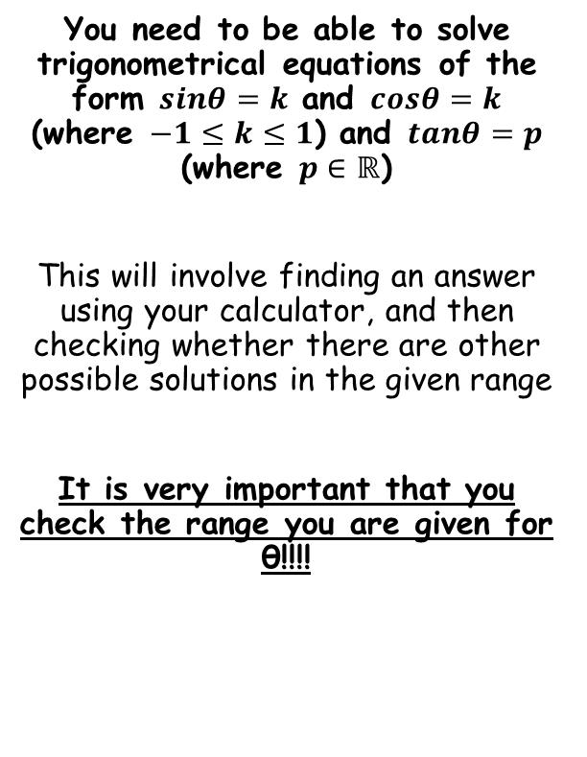


Trig Identities and Equations
$$sinθ=sin(180−θ)$$
$$cosθ=cos(360−θ)$$
$$tanθ=tan(θ±180)$$
You need to be able to solve trigonometrical equations of the form $sinθ=k$ and $cosθ=k$ (where $−1≤k≤1$) and $tanθ=p$ (where $p∈ℝ$)
This will involve finding an answer using your calculator, and then checking whether there are other possible solutions in the given range
It is very important that you check the range you are given for θ!!!!
Use Sin⁻¹
This will give you one answer
0.5
y = Sinθ
90
180
270
360
30
150
10D

Slide 3
Trig Identities and Equations
$$sinθ=sin(180−θ)$$
$$cosθ=cos(360−θ)$$
$$tanθ=tan(θ±180)$$
You need to be able to solve trigonometrical equations of the form $sinθ=k$ and $cosθ=k$ (where $−1≤k≤1$) and $tanθ=p$ (where $p∈ℝ$)
This will involve finding an answer using your calculator, and then checking whether there are other possible solutions in the given range
It is very important that you check the range you are given for θ!!!!
Divide by 5
Use Sin⁻¹
Not within the range. You can add 360° to obtain an equivalent value
203.6
336.4
90
180
270
360
y = Sinθ
-0.4
10D

Slide 4
Trig Identities and Equations
$$sinθ=sin(180−θ)$$
$$cosθ=cos(360−θ)$$
$$tanθ=tan(θ±180)$$
You need to be able to solve trigonometrical equations of the form $sinθ=k$ and $cosθ=k$ (where $−1≤k≤1$) and $tanθ=p$ (where $p∈ℝ$)
This will involve finding an answer using your calculator, and then checking whether there are other possible solutions in the given range
It is very important that you check the range you are given for θ!!!!
Divide by Cosθ
Use Trig Identities
Use Tan⁻¹
2
y = Tanθ
90
180
270
360
63.4
243.4
10D

