Slide 1
Teachings For
Exercise 10C

Slide 2



Trig Identities and Equations
1
You can use sin, cos and tan along with Pythagoras’ Theorem to find two useful identities.
To the right is a ‘unit circle’, a circle with a radius of 1 and a centre at (0,0)
We can draw a right-angled triangle and label sides using GCSE trigonometry
H
1
Sinθ
$$θ$$
O
-1
Cosθ
1
A
-1
O
A
O
S
H
C
H
T
A
$$O=HSinθ$$
$$A=HCosθ$$
10C

Slide 3


Trig Identities and Equations
1
You can use sin, cos and tan along with Pythagoras’ Theorem to find two useful identities.
Given that:
We can see from the triangle in the unit circle that:
H
1
Sinθ
$$θ$$
O
-1
Cosθ
1
$$Tanθ=\frac{O}{A}$$
A
-1
$$Tanθ=\frac{Sinθ}{Cosθ}$$
O
A
O
S
H
C
H
T
A
10C

Slide 4




Trig Identities and Equations
$$Tanθ≡\frac{Sinθ}{Cosθ}$$
1
You can use sin, cos and tan along with Pythagoras’ Theorem to find two useful identities.
Given that:
We can see from the triangle in the unit circle that:
H
1
Sinθ
$$θ$$
O
-1
Cosθ
1
$$a^{2}+b^{2}=c^{2}$$
A
-1
$${(Sinθ)}^{2}+{(Cosθ)}^{2}=1^{2}$$
$${Sin}^{2}θ+{Cos}^{2}θ=1$$
O
A
O
S
H
C
H
T
A
10C

Slide 5

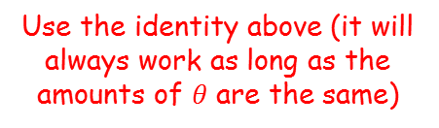



Trig Identities and Equations
$$Tanθ≡\frac{Sinθ}{Cosθ}$$
$${Sin}^{2}θ+{Cos}^{2}θ≡1$$
You can use sin, cos and tan along with Pythagoras’ Theorem to find two useful identities.
Simplify the following expression:
$$\sin^{2}3θ+\cos^{2}3θ$$
Use the identity above (it will always work as long as the amounts of $θ$ are the same)
$$=1$$
$$\sin^{2}3θ+\cos^{2}3θ$$
10C

Slide 6









Trig Identities and Equations
$$Tanθ≡\frac{Sinθ}{Cosθ}$$
$${Sin}^{2}θ+{Cos}^{2}θ≡1$$
You can use sin, cos and tan along with Pythagoras’ Theorem to find two useful identities.
Simplify the following expression:
$$5−5\sin^{2}θ$$
Factorise
$$=5(1−\sin^{2}θ)$$
You can use a rearranged version of the identity above to replace the bracket
$$=5\cos^{2}θ$$
$$5−5\sin^{2}θ$$
$${Sin}^{2}θ+{Cos}^{2}θ \text{≡} 1$$
Subtract ${Cos}^{2}θ$
Subtract ${Sin}^{2}θ$
$${Sin}^{2}θ≡1−{Cos}^{2}θ$$
$${Cos}^{2}θ≡1−{Sin}^{2}θ$$
10C

Slide 7




Trig Identities and Equations
$$Tanθ≡\frac{Sinθ}{Cosθ}$$
$${Sin}^{2}θ+{Cos}^{2}θ≡1$$
You can use sin, cos and tan along with Pythagoras’ Theorem to find two useful identities.
Simplify the following expression:
$$\frac{sin2θ}{\sqrt{1−sin^{2}2θ}}$$
Replace the rooted part as in the previous example
$$=\frac{sin2θ}{\sqrt{\cos^{2}2θ}}$$
You can work out the square root
$$\frac{sin2θ}{\sqrt{1−sin^{2}2θ}}$$
$$=\frac{sin2θ}{cos2θ}$$
This is equal to the other identity!
$$=tan2θ$$
10C

Slide 8






Trig Identities and Equations
$$Tanθ≡\frac{Sinθ}{Cosθ}$$
$${Sin}^{2}θ+{Cos}^{2}θ≡1$$
You can use sin, cos and tan along with Pythagoras’ Theorem to find two useful identities.
Prove that:
You should choose one side to begin with…
$$\frac{\cos^{4}θ−\sin^{4}θ}{cos^{2}θ}$$
You can factorise the top (similar to the difference of 2 squares)
$$=\frac{(\cos^{2}θ+\sin^{2}θ)(\cos^{2}θ−\sin^{2}θ)}{cos^{2}θ}$$
$$\frac{\cos^{4}θ−\sin^{4}θ}{cos^{2}θ}≡1−\tan^{2}θ$$
The left of the brackets is equal to 1
$$=\frac{(\cos^{2}θ−\sin^{2}θ)}{cos^{2}θ}$$
You can write this as 2 separate fractions
$$=\frac{\cos^{2}θ}{cos^{2}θ}−\frac{\sin^{2}θ}{cos^{2}θ}$$
These fractions can then be simplified
$$=1−tan^{2}θ$$
10C

Slide 9



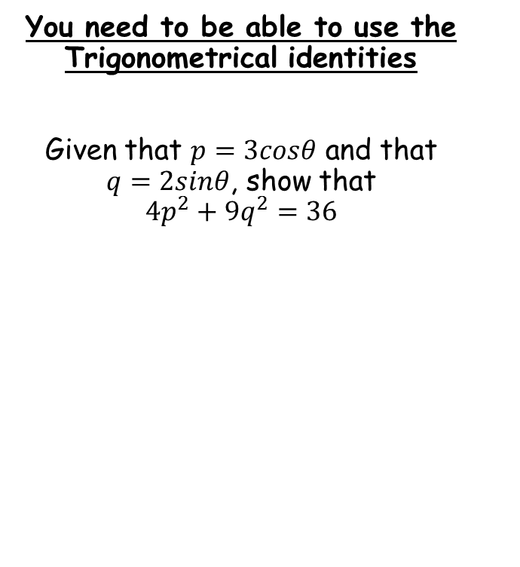





Trig Identities and Equations
$$Tanθ≡\frac{Sinθ}{Cosθ}$$
$${Sin}^{2}θ+{Cos}^{2}θ≡1$$
You need to be able to use the Trigonometrical identities
Given that $p=3cosθ$ and that $q=2sinθ$, show that ${4p}^{2}+{9q}^{2}=36$
$$p=3cosθ$$
$$q=2sinθ$$
Divide by 3
Divide by 2
$$\frac{p}{3}=cosθ$$
$$\frac{q}{2}=sinθ$$
You will need to start with one of the identities, and replace the cos and sin parts!
$${Sin}^{2}θ+{Cos}^{2}θ=1$$
Replace sin and cos using the above relationships
$${\left(\frac{q}{2}\right)}^{2}+{\left(\frac{p}{3}\right)}^{2}=1$$
Square each fraction
$$\frac{q^{2}}{4}+\frac{p^{2}}{9}=1$$
Multiply by 36
$$9q^{2}+4q^{2}=36$$
10C

