Slide 1
Old Spec Q’s
Trigonometry
Practice A (i)
SAM 1
(i)
2018 1
(iv)
Practice A (ii)
SAM 1
(ii)
2018 2
(i)
Practice B
SAM 2
(i)
2018 2
(ii)
Practice C
SAM 2
(ii)
Practice D
SAM 2
(iii)
Practice E (i)
2018 1
(i)
Practice E (ii)
2018 1
(ii)
Practice F
2018 1
(iii)

Slide 2
Practice A

Slide 3
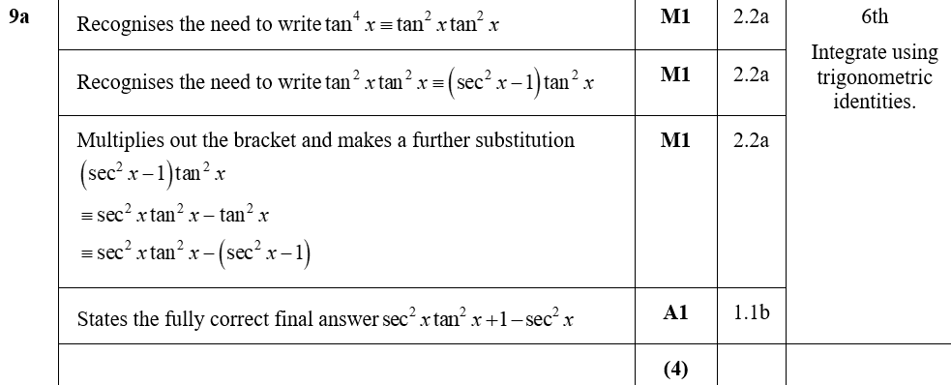
Practice A
A

Slide 4
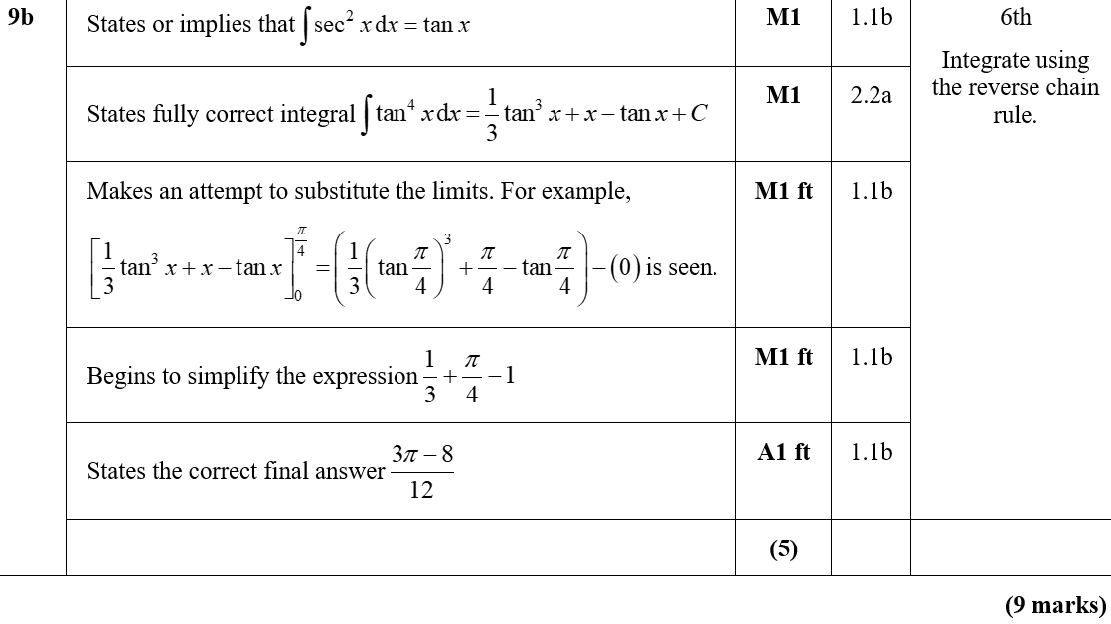
Practice A
B
B notes

Slide 5
Practice A

Slide 6
Practice A
A

Slide 7
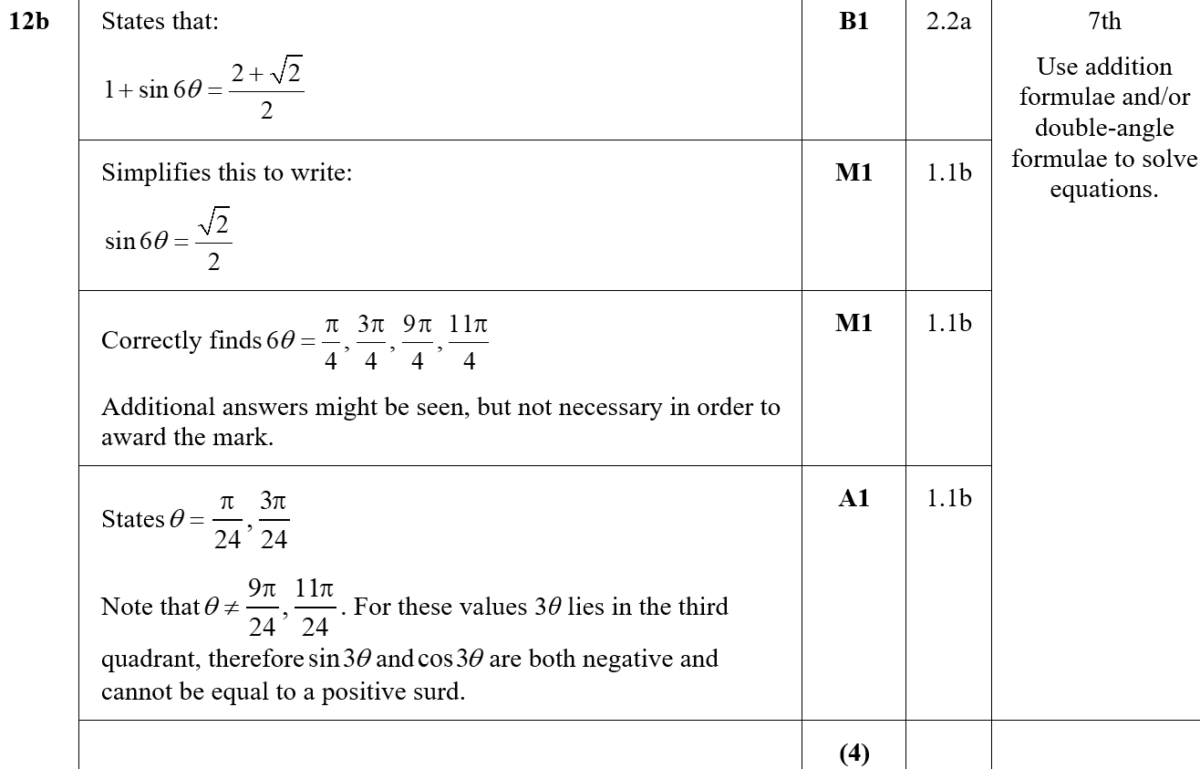
Practice A
B
B notes

Slide 8
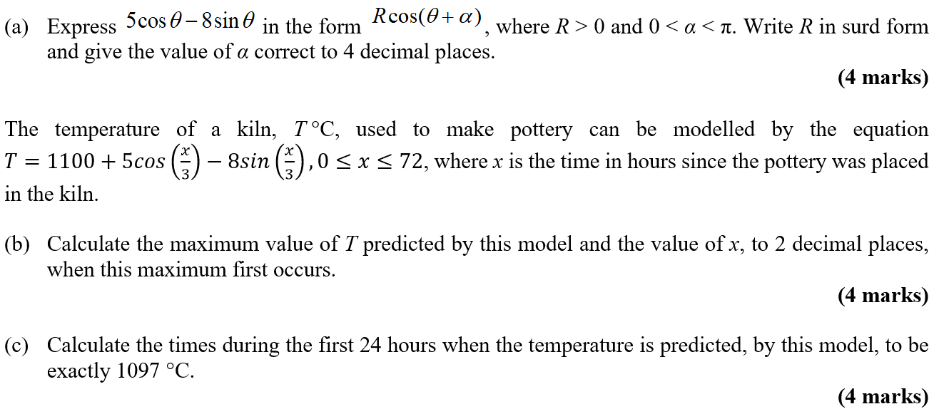
Practice B

Slide 9
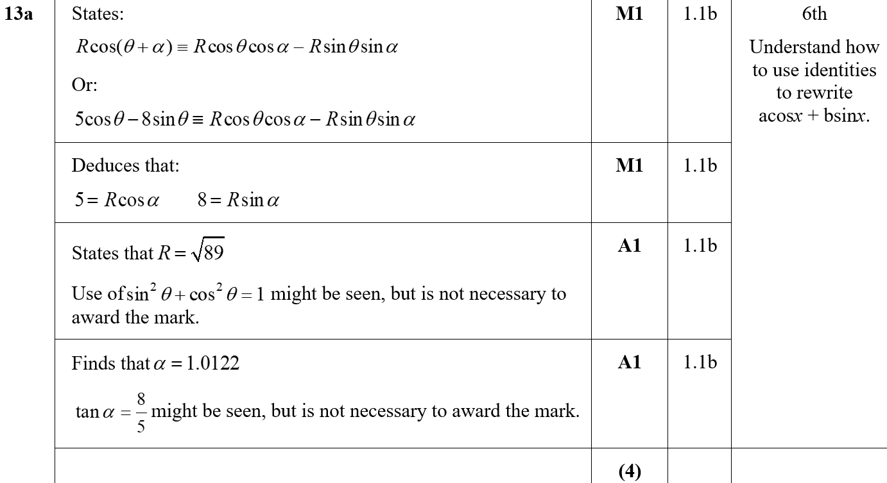
Practice B
A

Slide 10
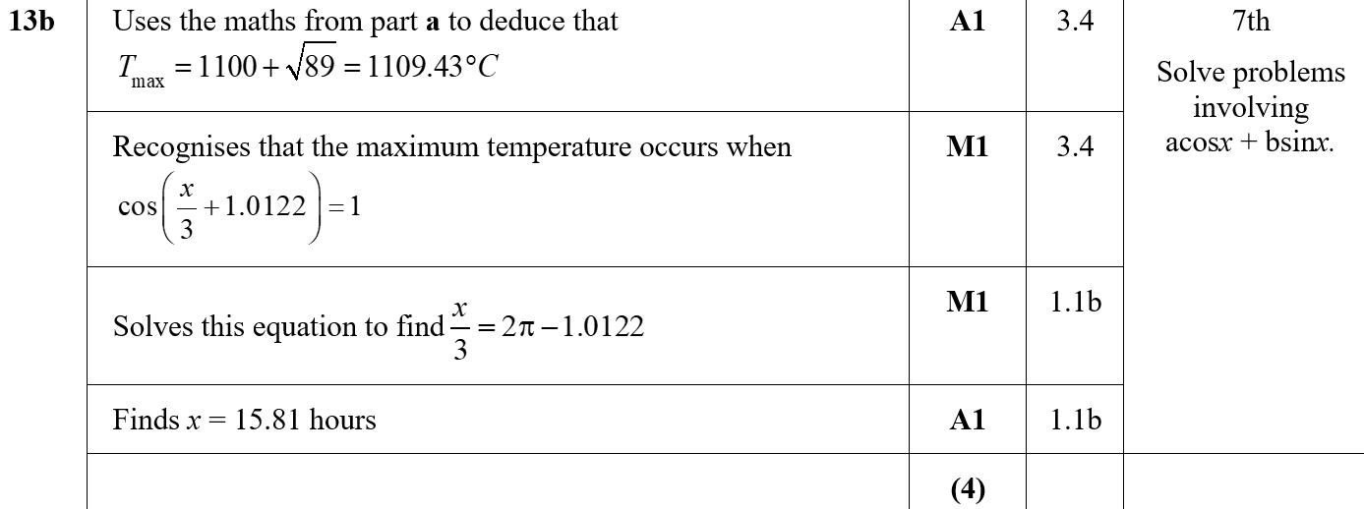
Practice B
B

Slide 11
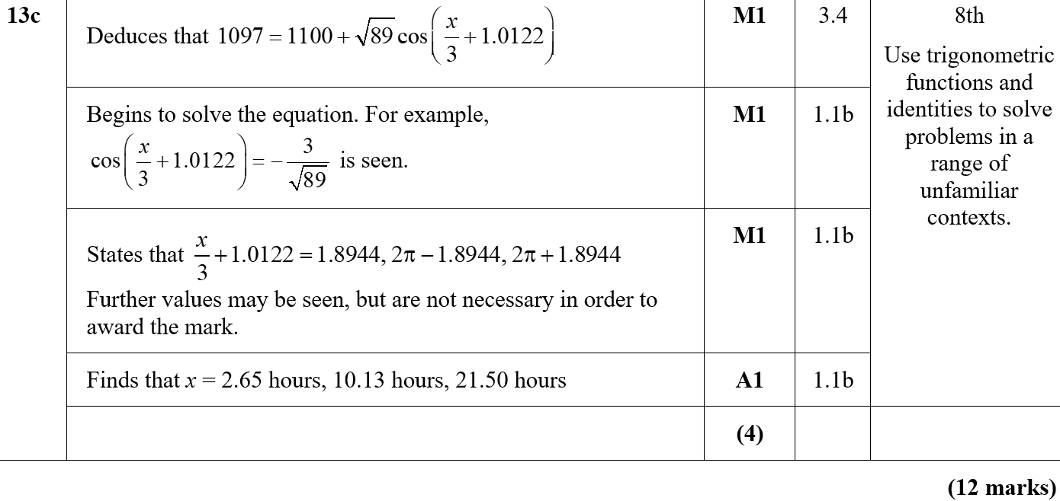
Practice B
C

Slide 12
Practice C

Slide 13
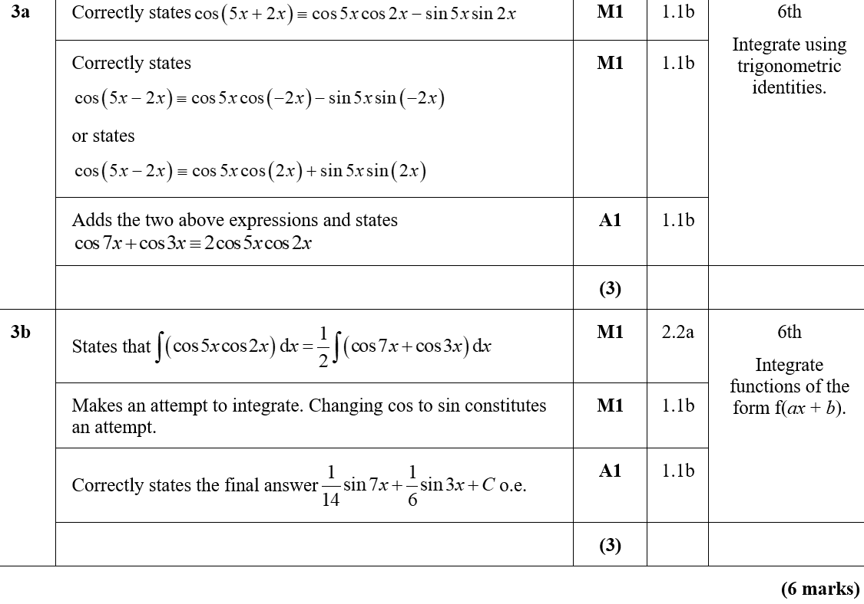
Practice C
A
B
B notes

Slide 14
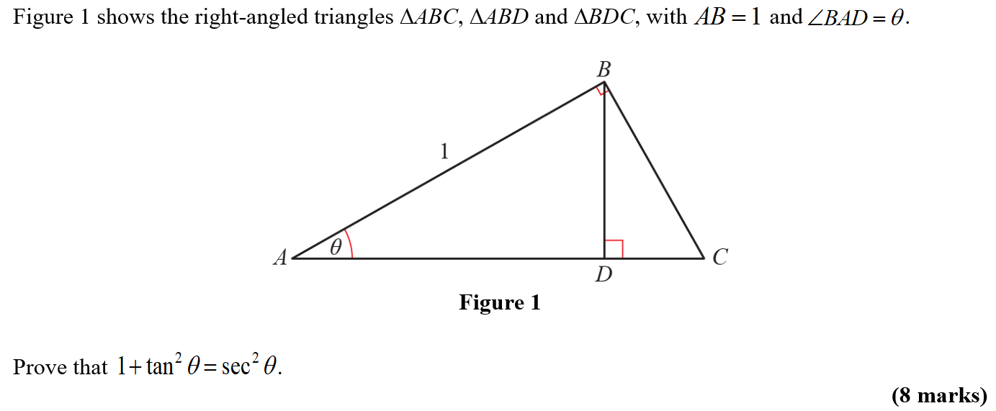
Practice D

Slide 15
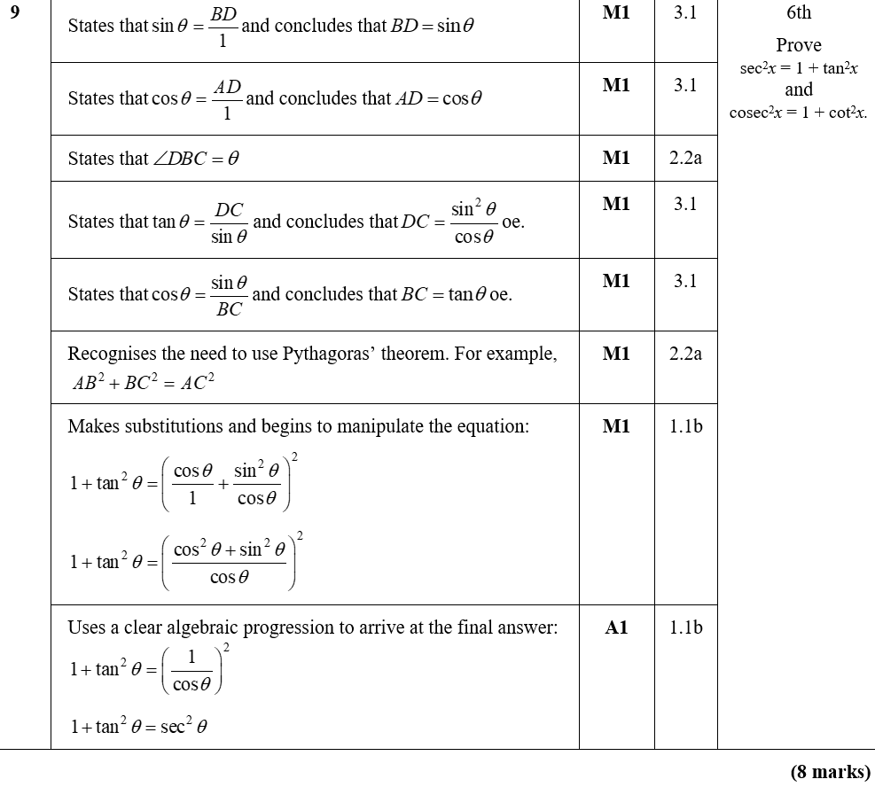
Practice D
A

Slide 16
Practice E

Slide 17
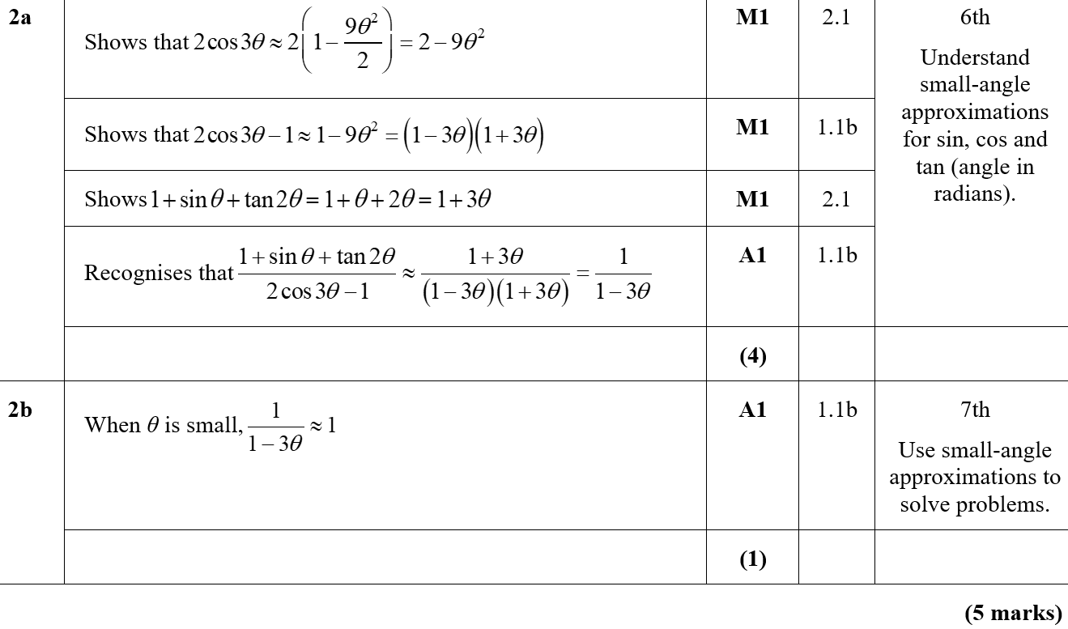
Practice E
A
B

Slide 18
Practice E

Slide 19
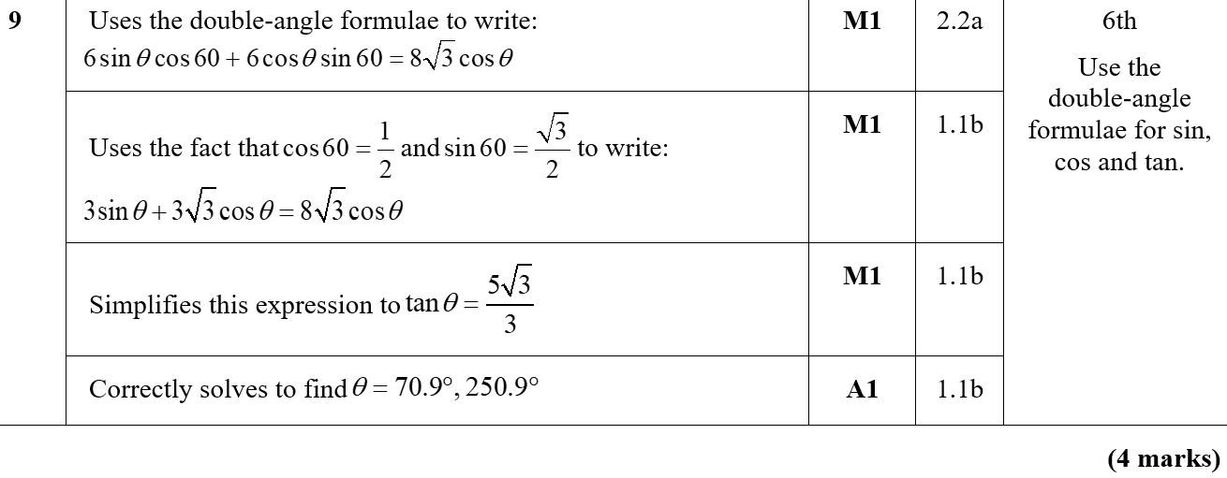
Practice E
A

Slide 20
Practice F

Slide 21
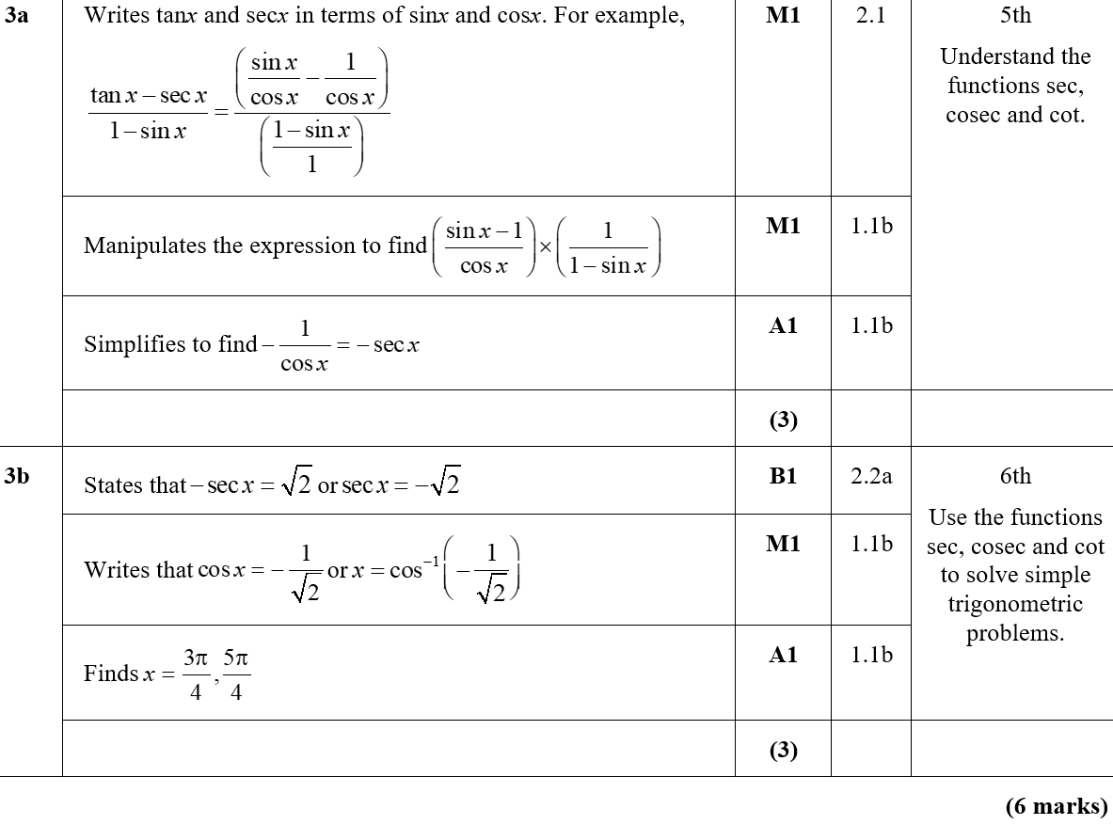
Practice F
A
B

Slide 22
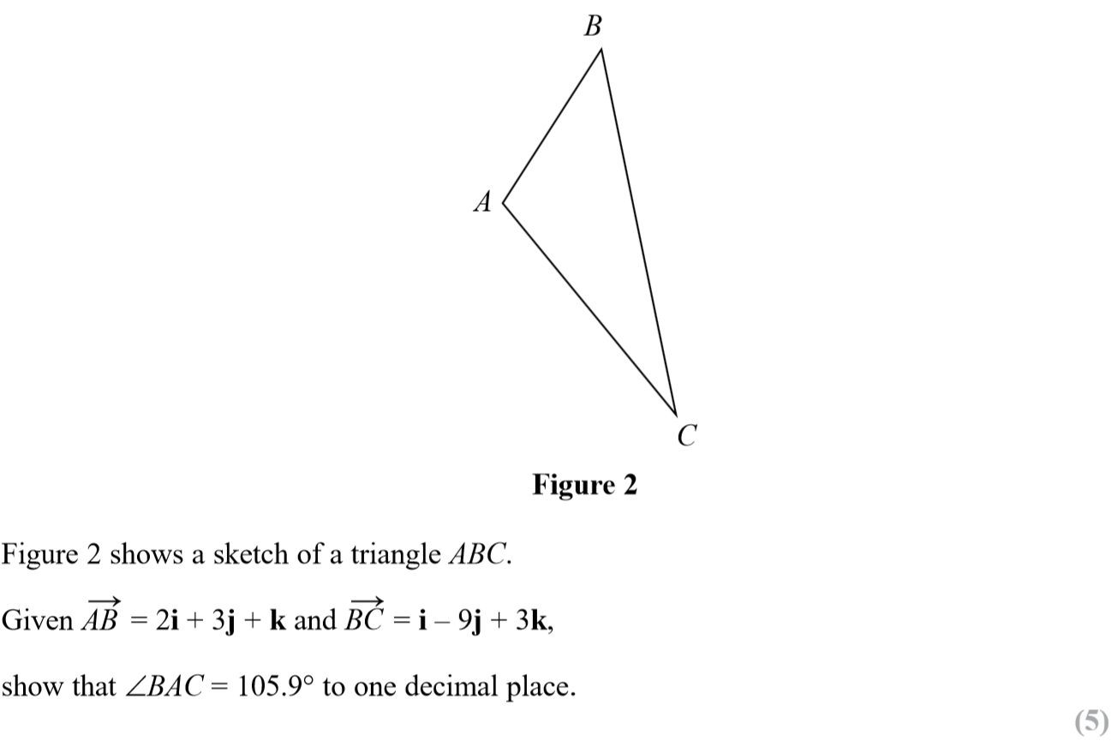
SAM Paper 1

Slide 23
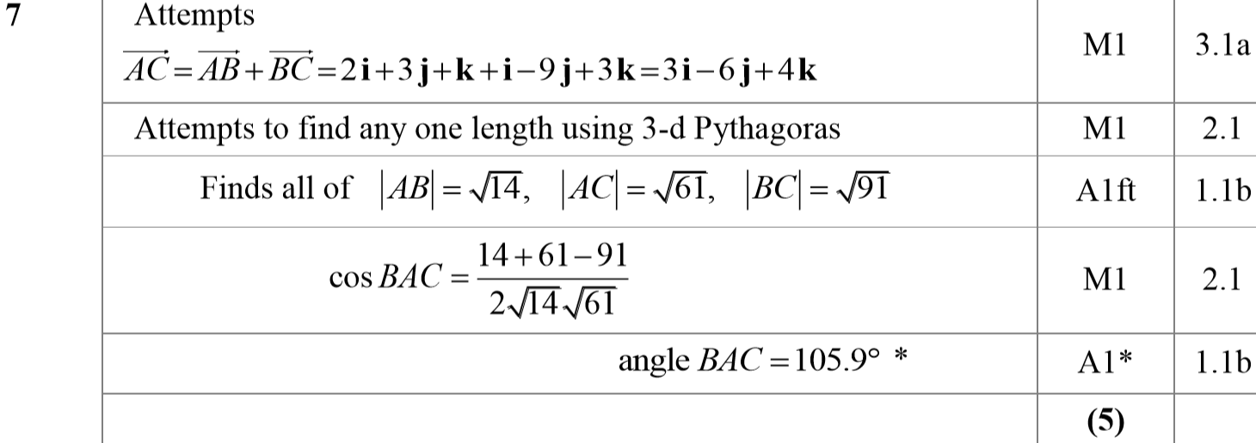
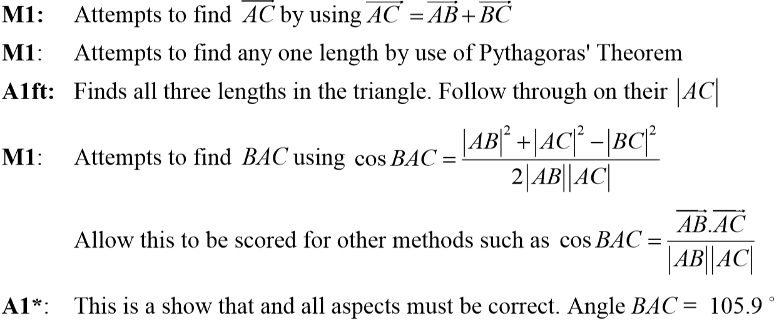
SAM Paper 1
A
A notes

Slide 24
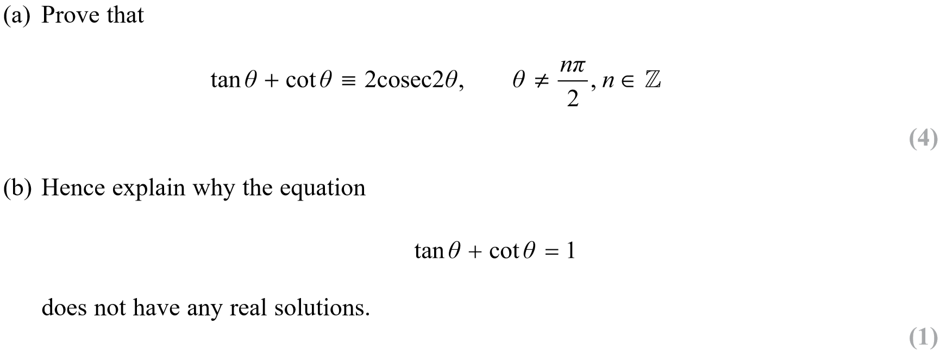
SAM Paper 1

Slide 25
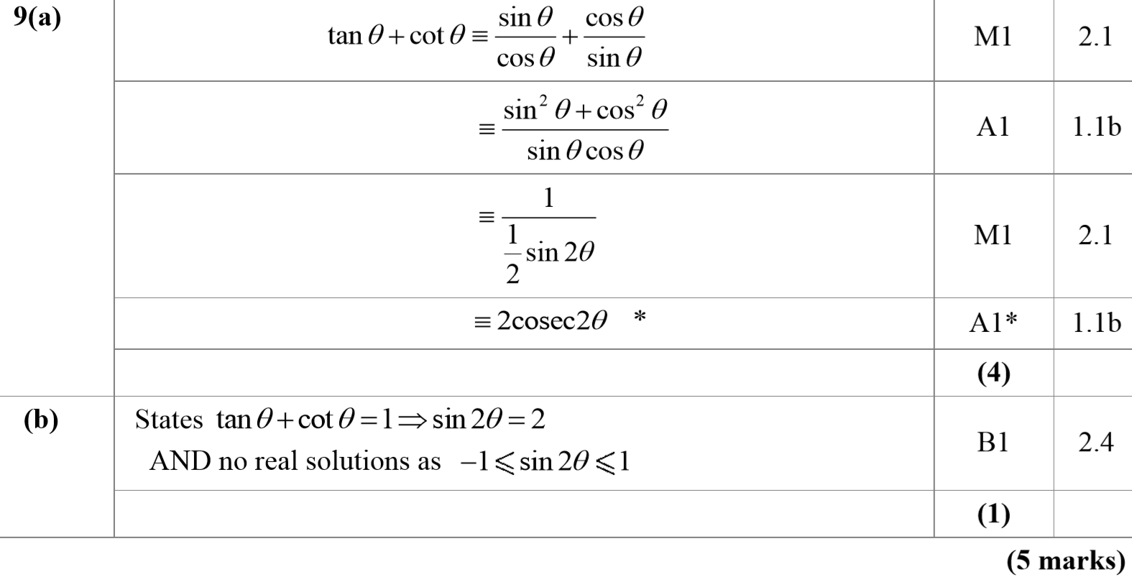
SAM Paper 1
A
B

Slide 26
SAM Paper 1
A notes
B notes

Slide 27
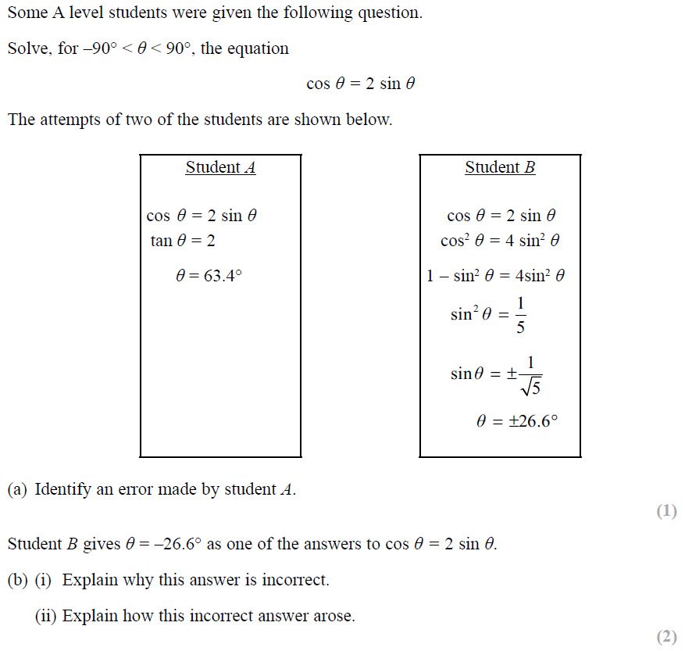
SAM Paper 2

Slide 28
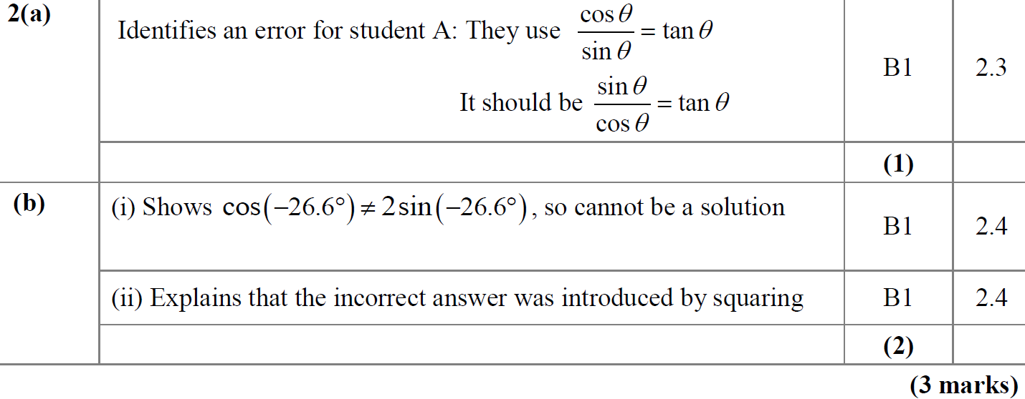
SAM Paper 2
A
B

Slide 29
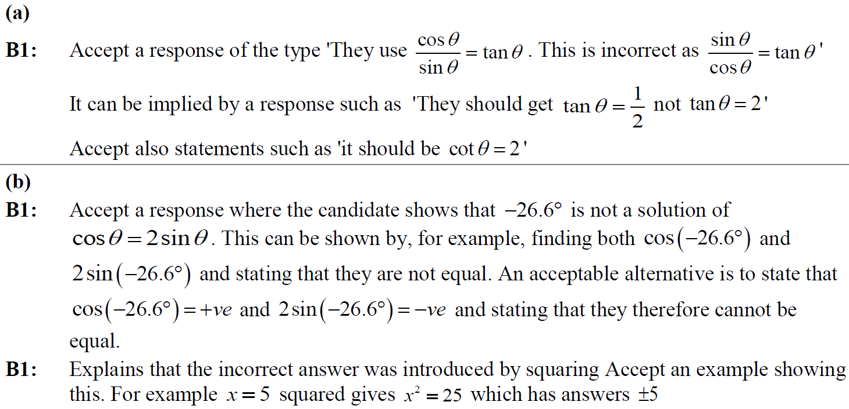
SAM Paper 2
A notes
B notes

Slide 30
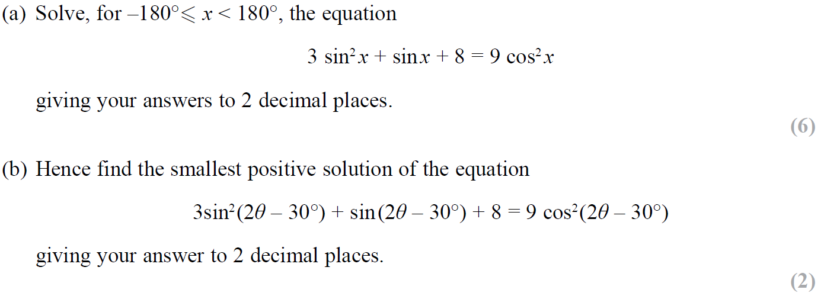
SAM Paper 2

Slide 31
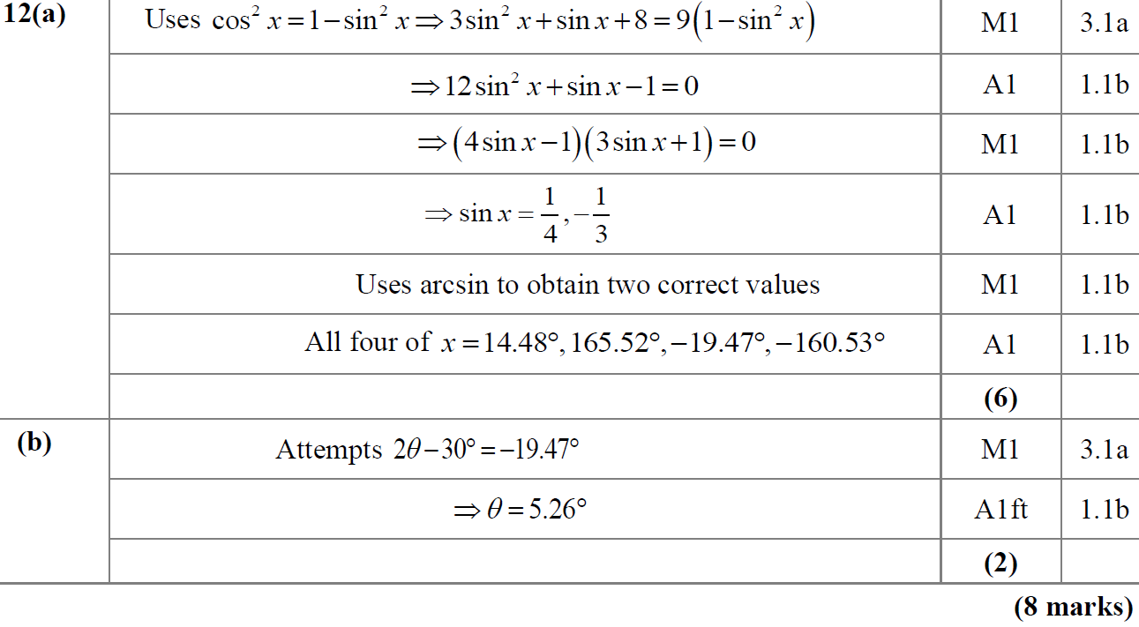
SAM Paper 2
A
B

Slide 32
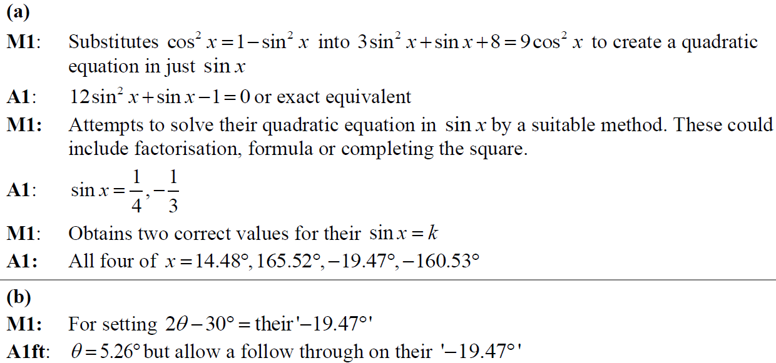
SAM Paper 2
A notes
B notes

Slide 33
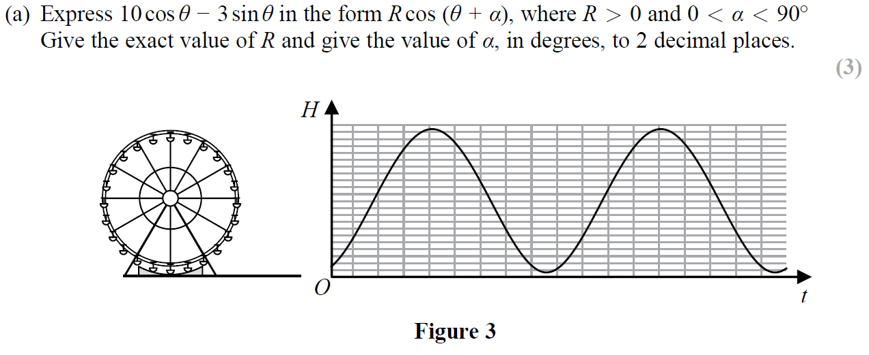
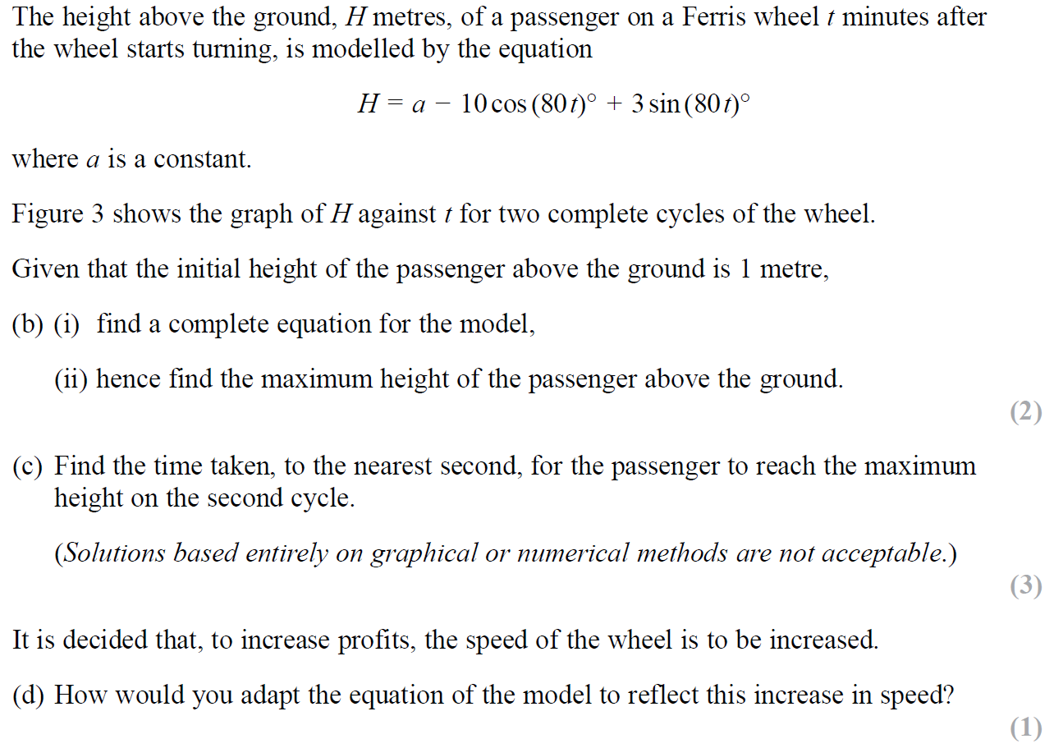
SAM Paper 2

Slide 34
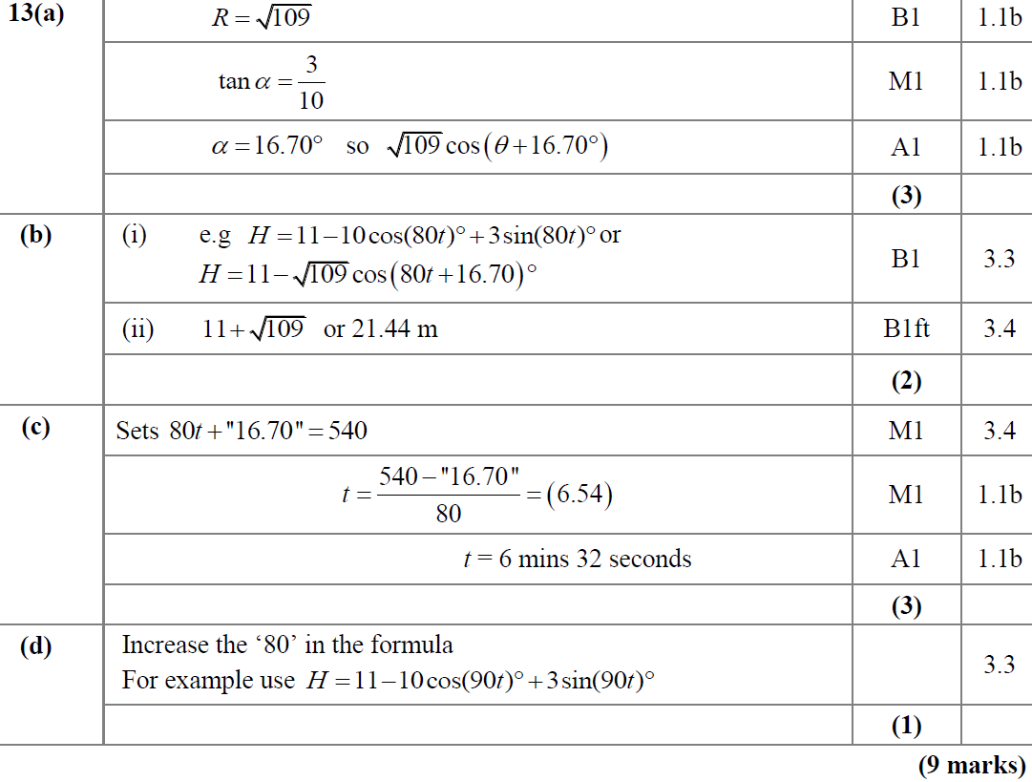
SAM Paper 2
A
B
C
D

Slide 35
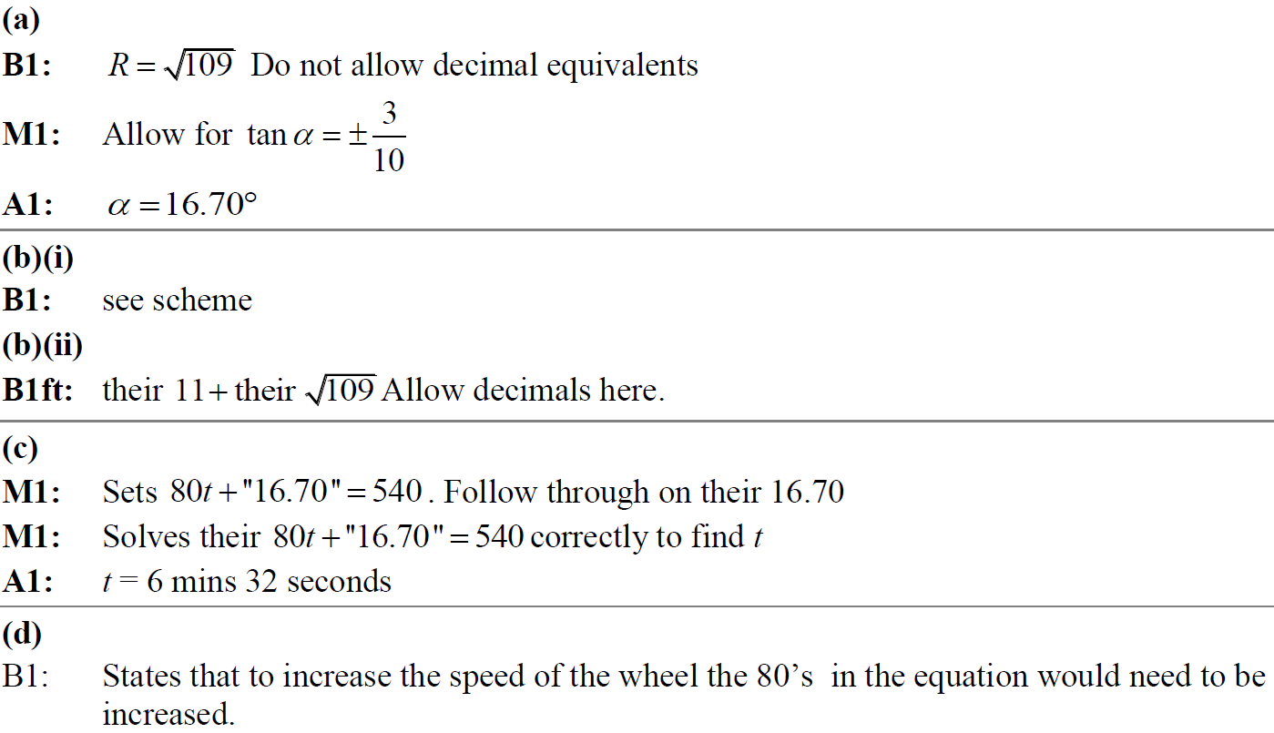
SAM Paper 2
A notes
B notes
C notes
D notes

Slide 36
2018 Paper 1

Slide 37
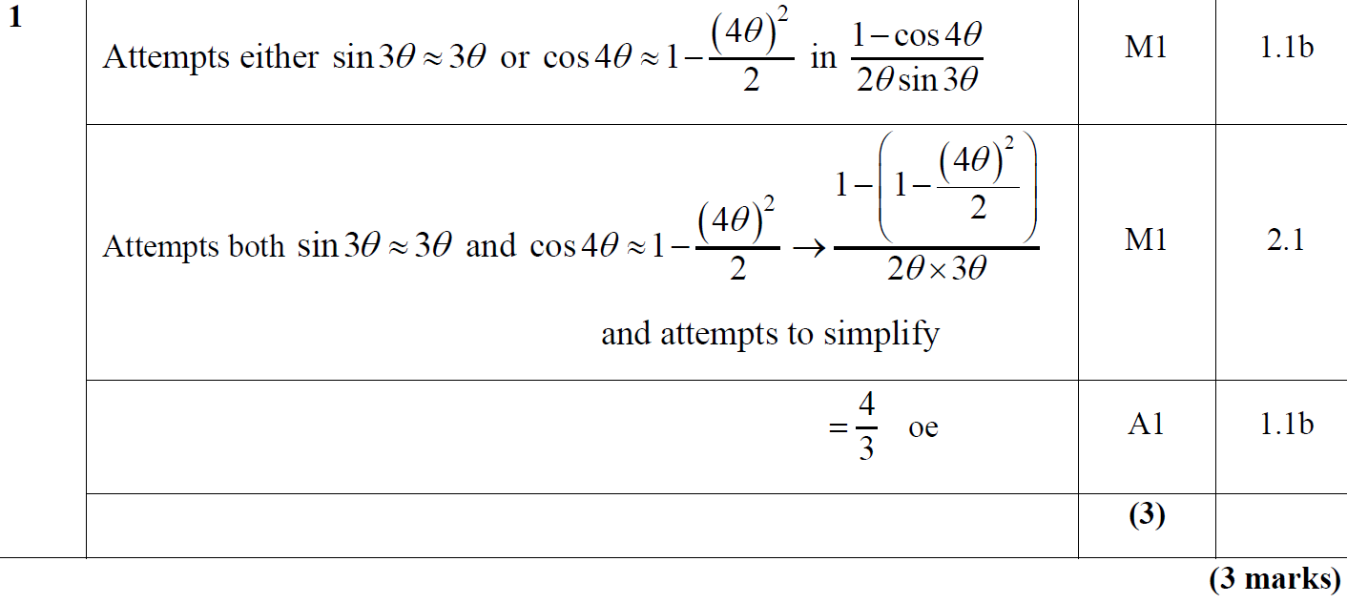
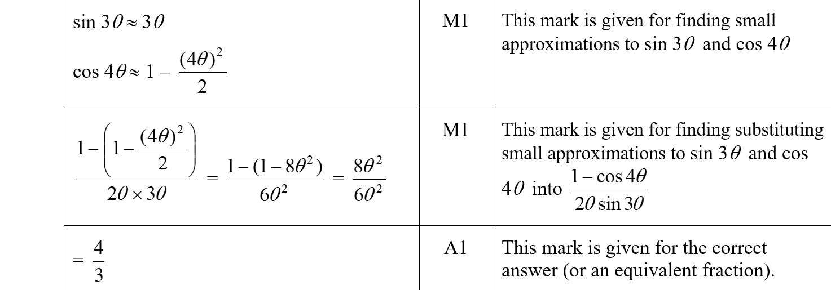
2018 Paper 1
A
A (SF)

Slide 38
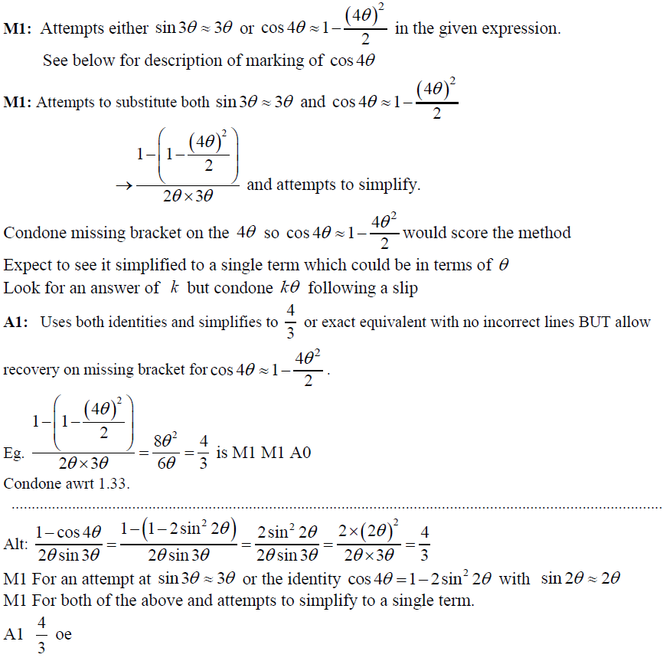
2018 Paper 1
A notes

Slide 39
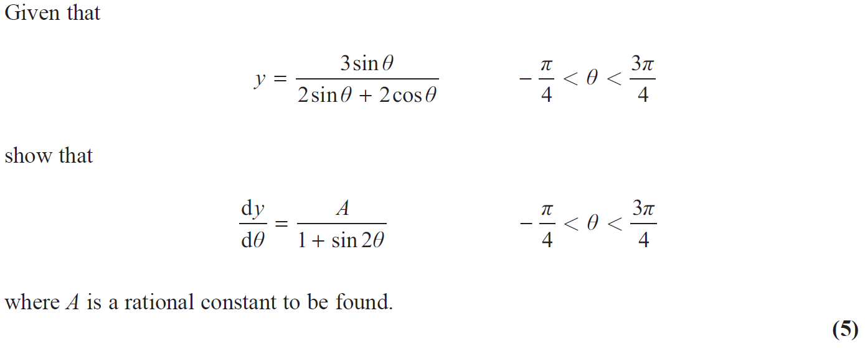
2018 Paper 1

Slide 40
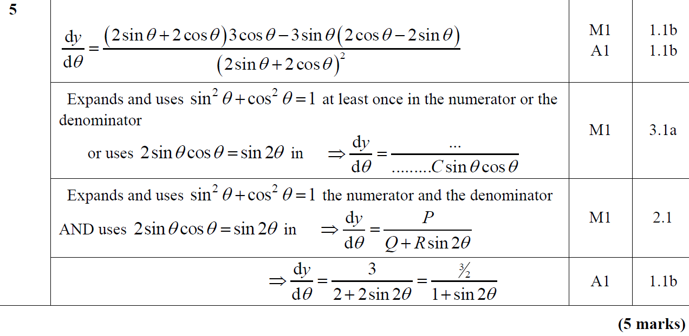
2018 Paper 1
A

Slide 41
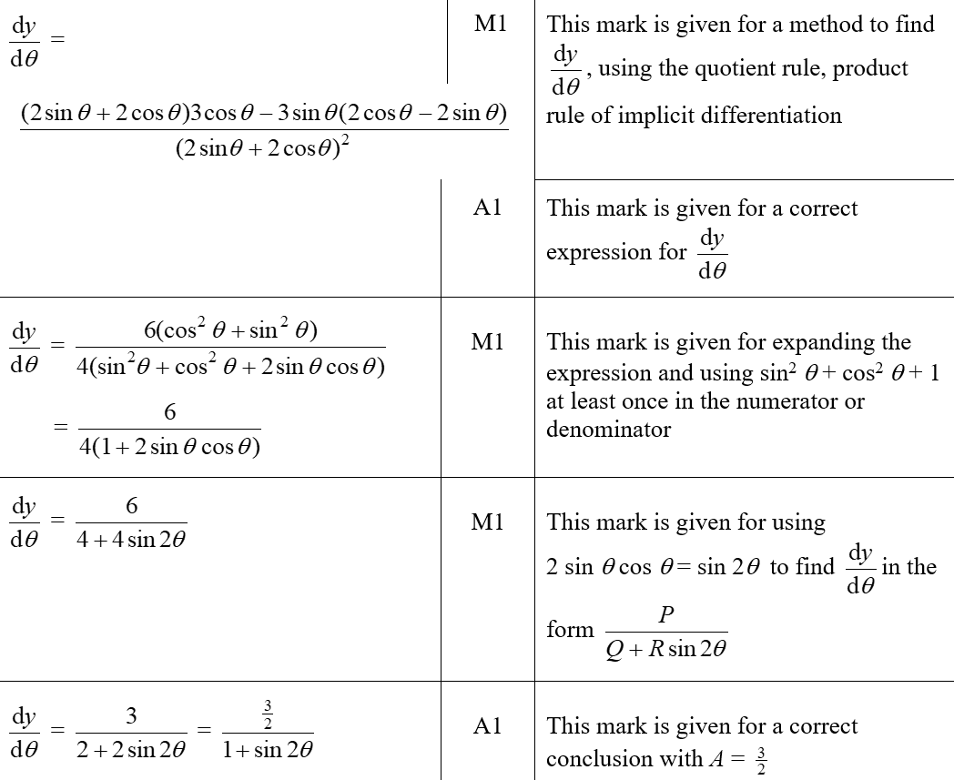
2018 Paper 1
A (SF)

Slide 42
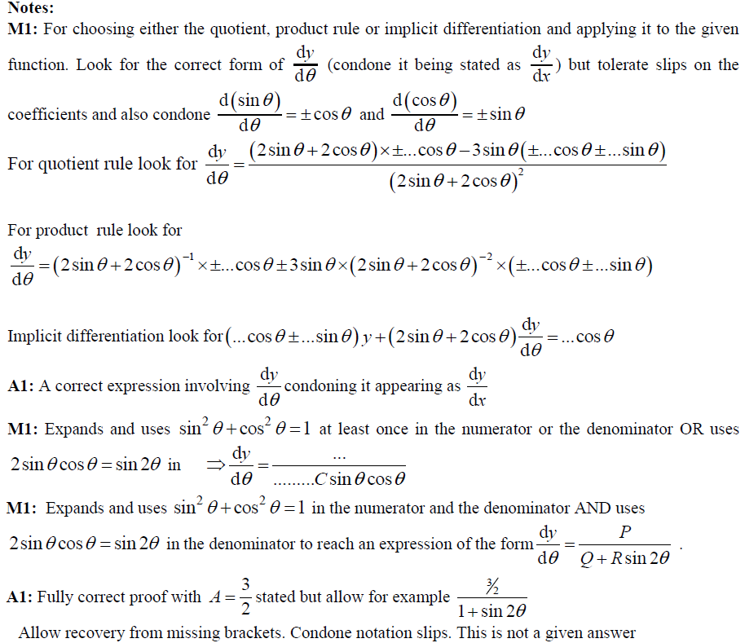
2018 Paper 1
A notes

Slide 43
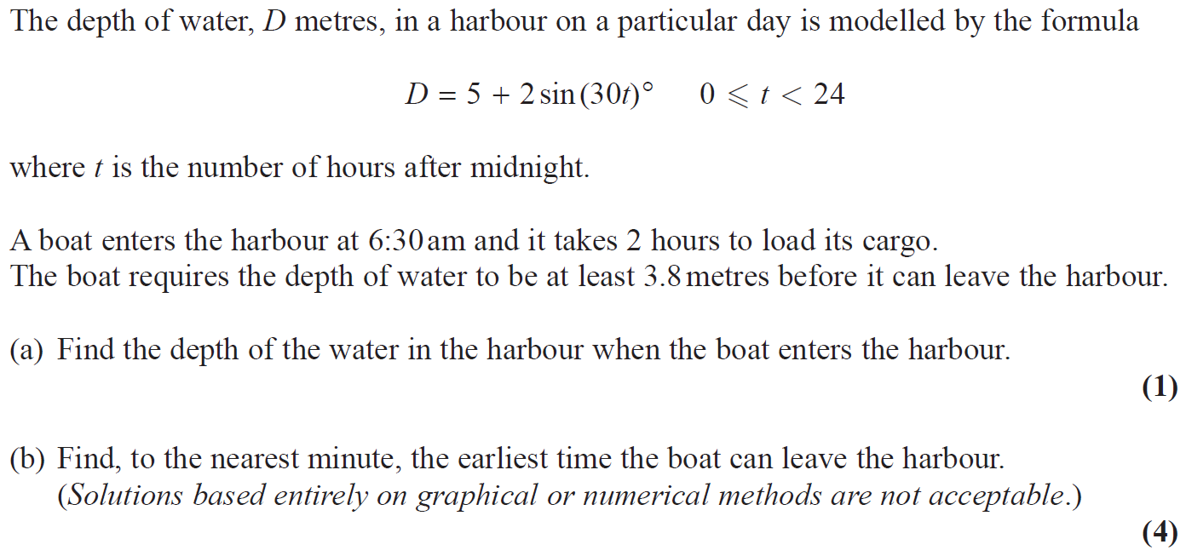
2018 Paper 1

Slide 44
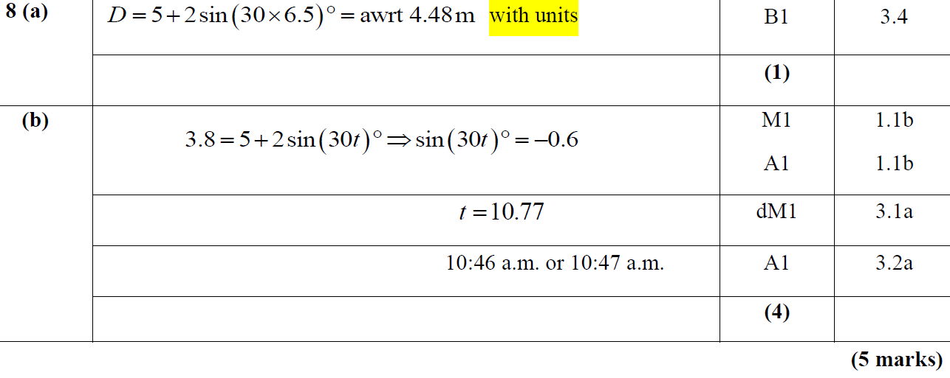
2018 Paper 1
A
B

Slide 45
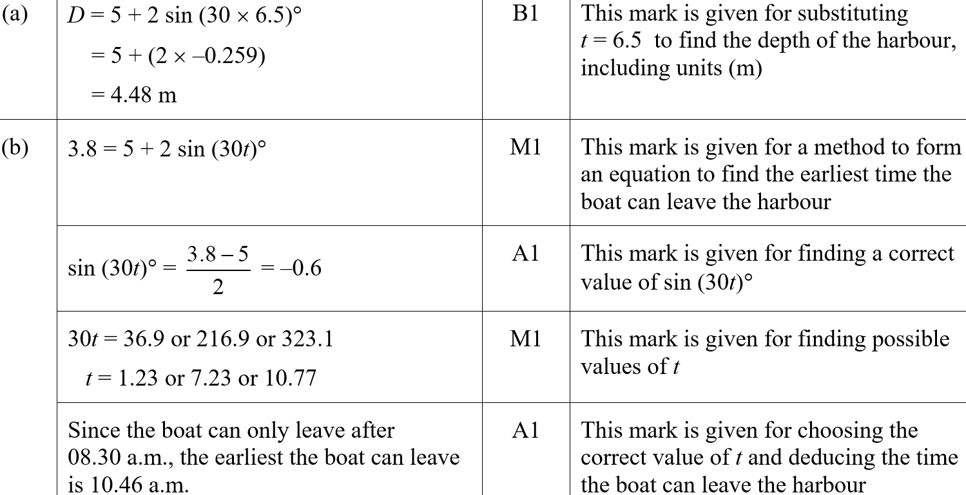
2018 Paper 1
A (SF)
B (SF)

Slide 46
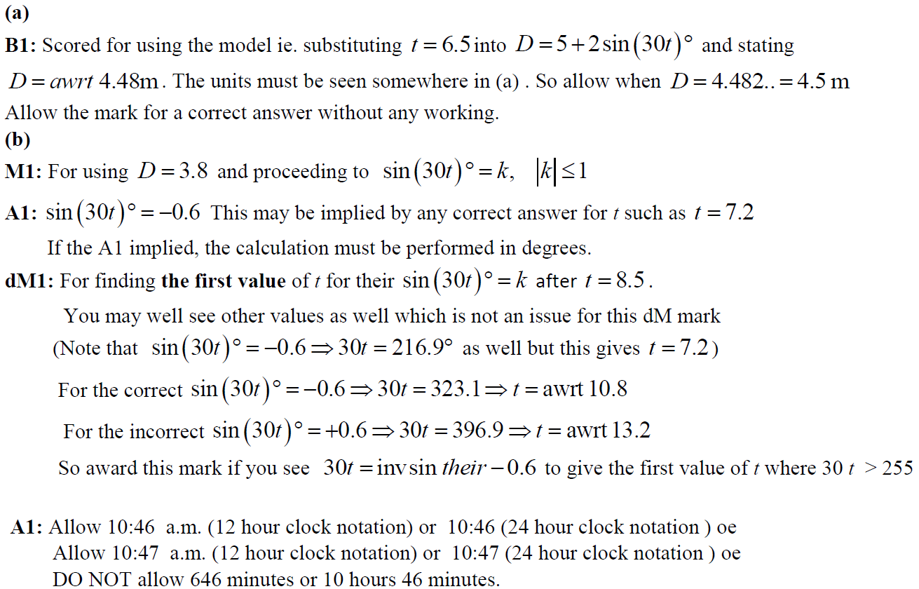
2018 Paper 1
A notes
B notes

Slide 47
2018 Paper 1

Slide 48
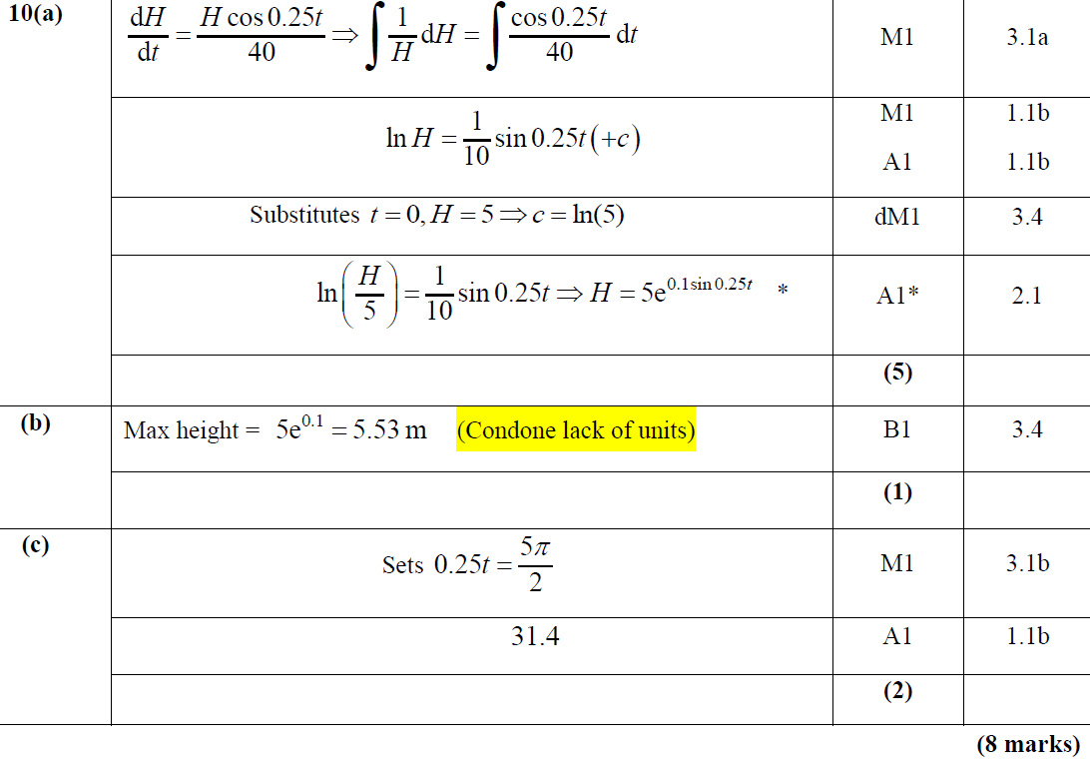
2018 Paper 1
A
B
C

Slide 49
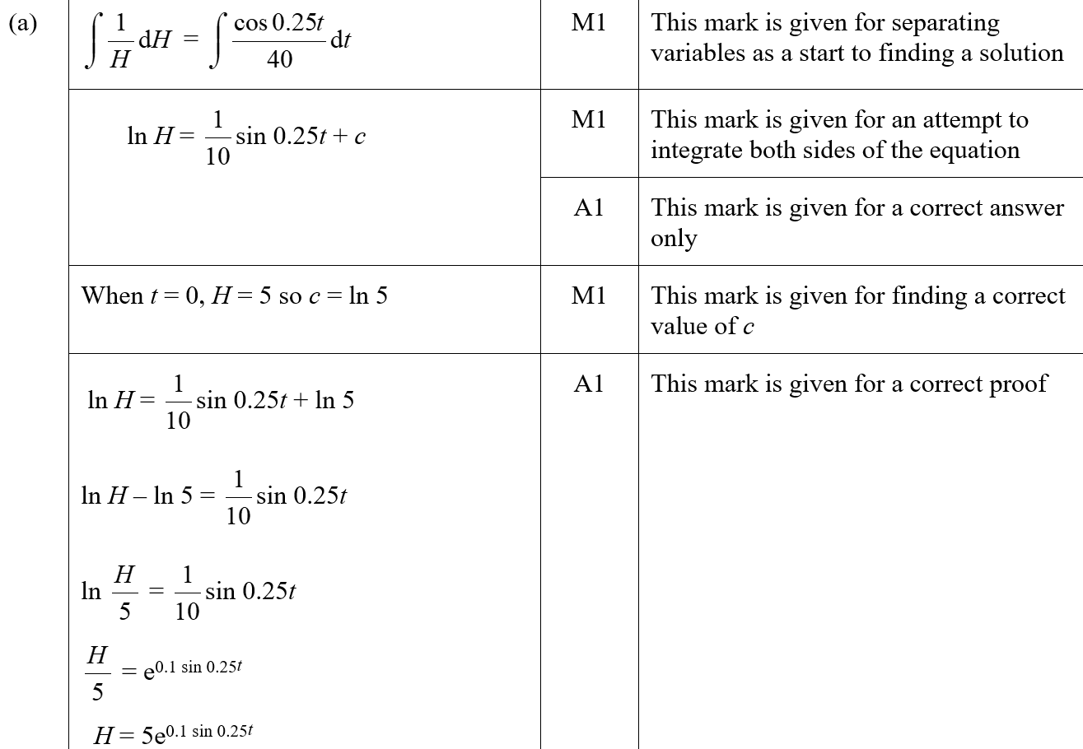
2018 Paper 1
A (SF)

Slide 50
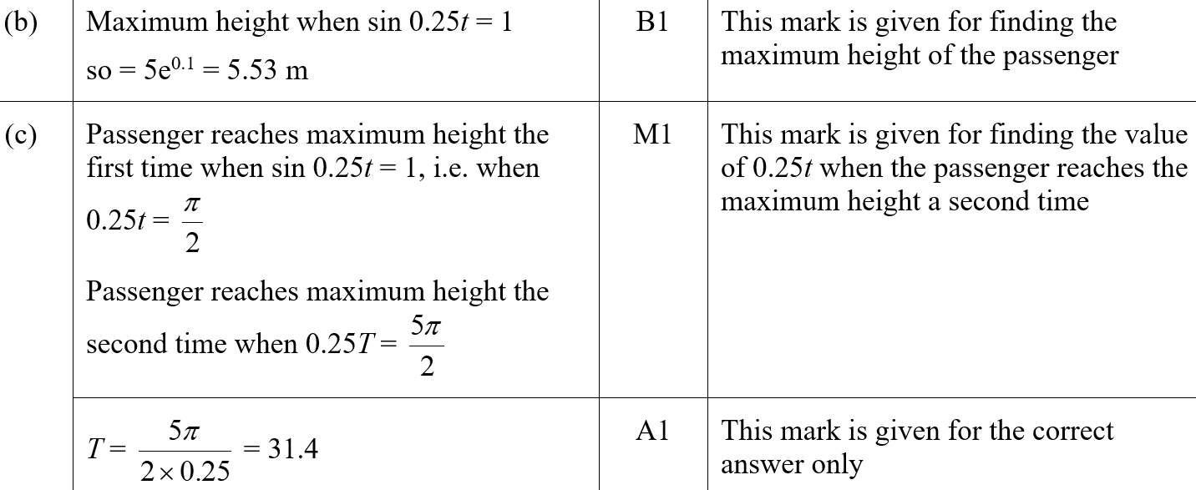
2018 Paper 1
B (SF)
C (SF)

Slide 51
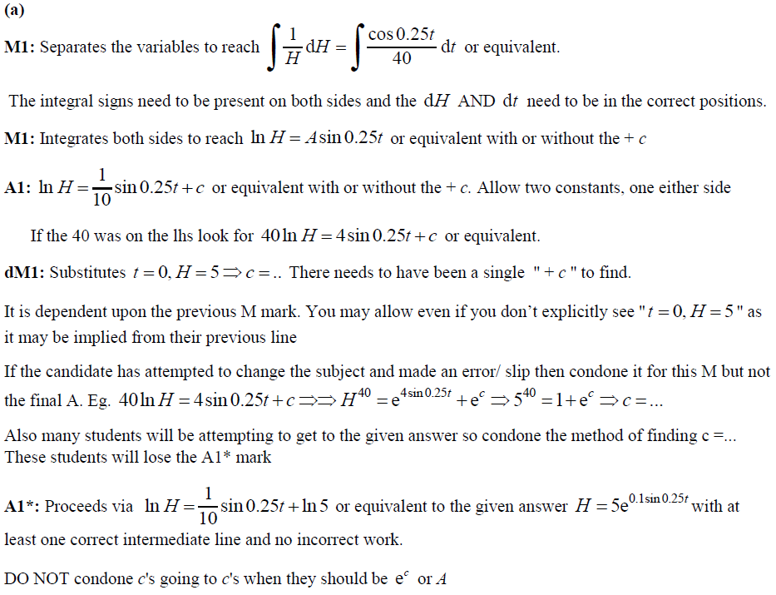
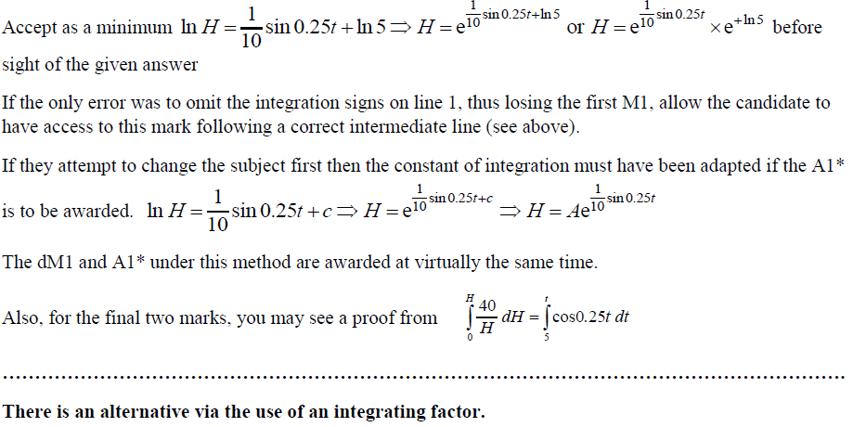
2018 Paper 1
A notes

Slide 52
2018 Paper 1
B notes
C notes

Slide 53
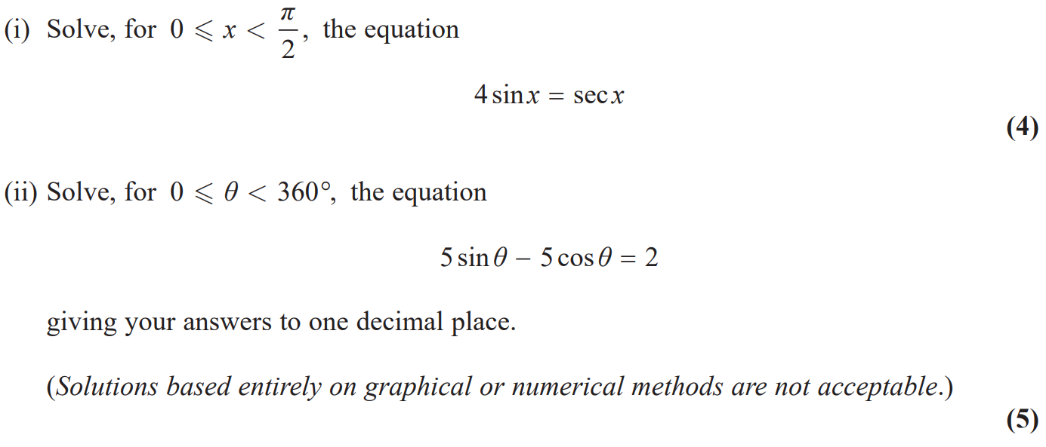
2018 Paper 2

Slide 54
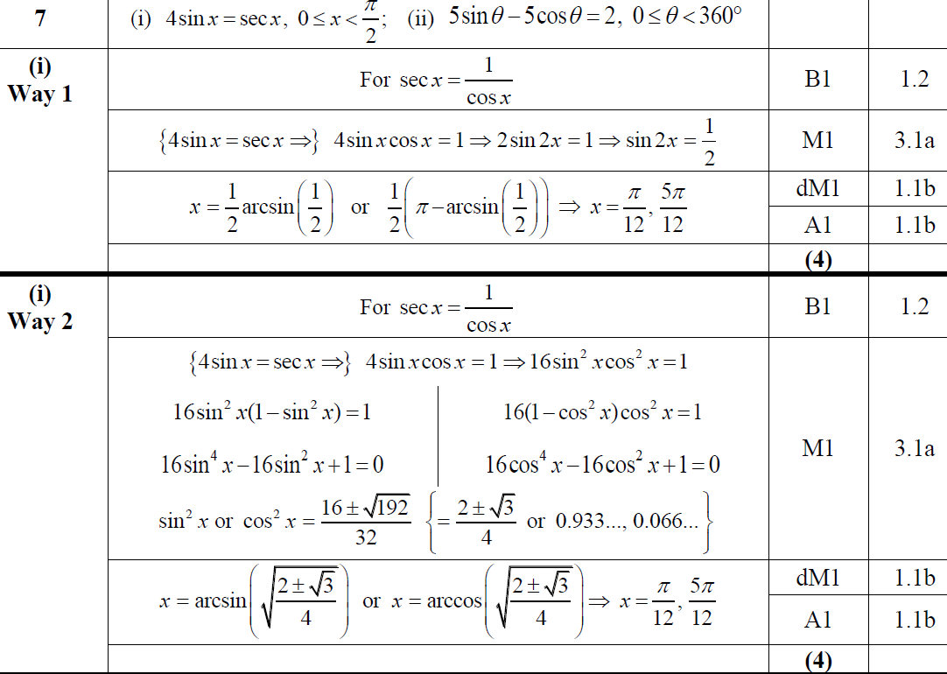
2018 Paper 2
(i)
(i) Alternative

Slide 55
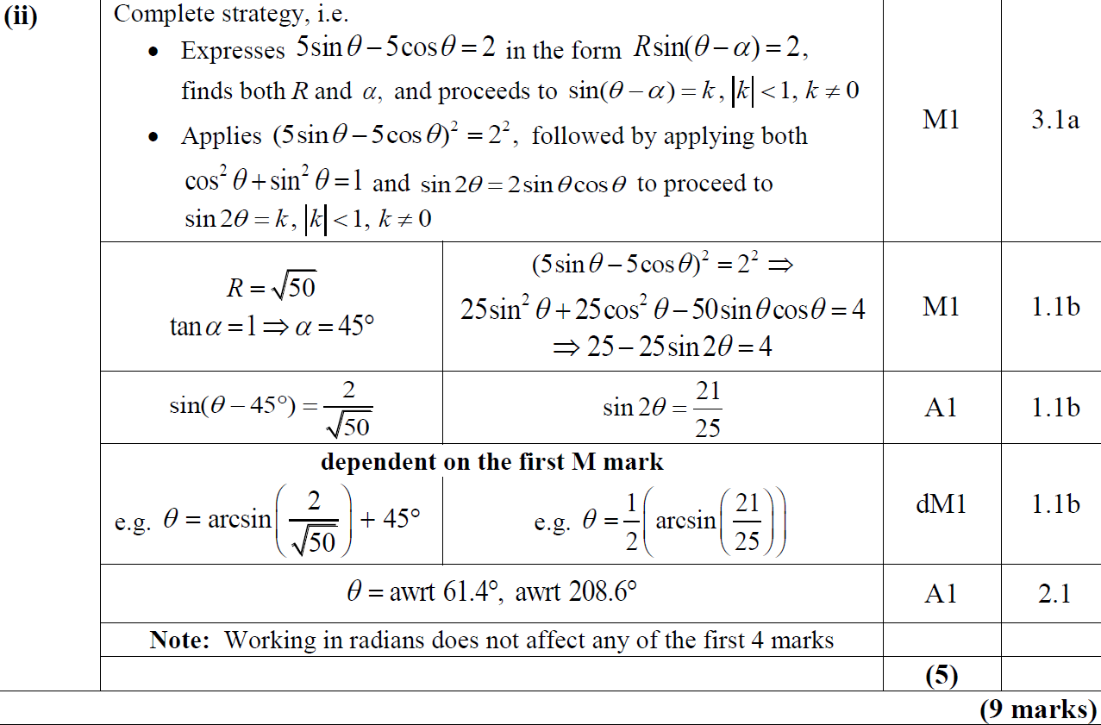
2018 Paper 2
(ii)

Slide 56
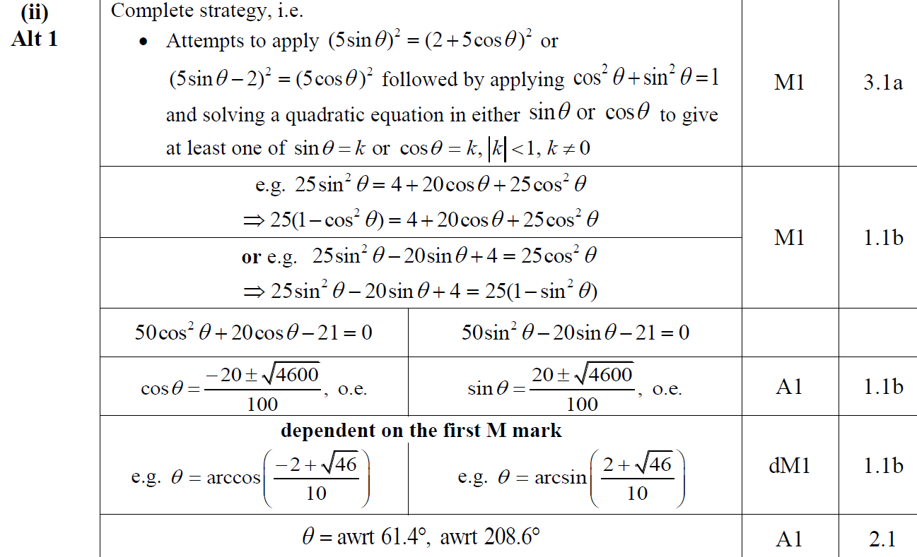
2018 Paper 2
(ii) Alternative

Slide 57
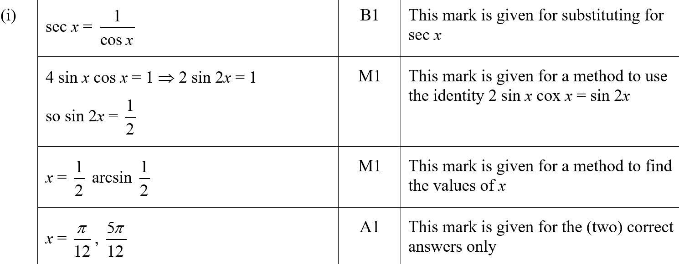
2018 Paper 2
(i) (SF)

Slide 58
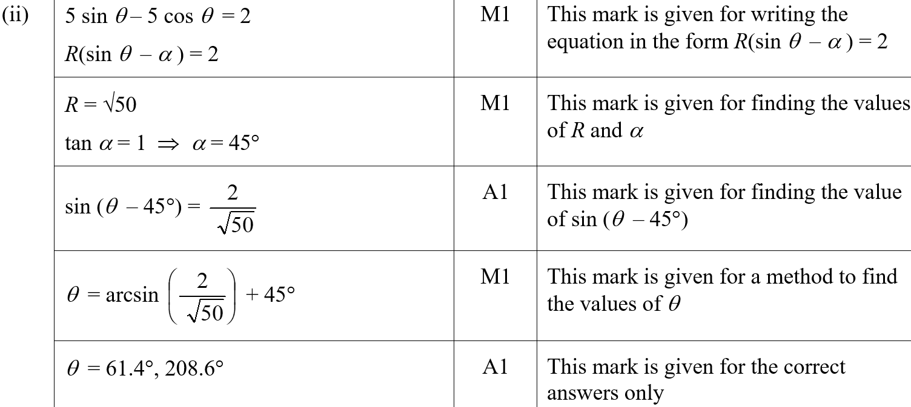
2018 Paper 2
(ii) (SF)

Slide 59
2018 Paper 2
(i) notes

Slide 60
2018 Paper 2
(ii) notes

Slide 61
2018 Paper 2

Slide 62
2018 Paper 2
A
A Alternative

Slide 63
2018 Paper 2
B

Slide 64
2018 Paper 2
B Alternative

Slide 65
2018 Paper 2
A (SF)

Slide 66
2018 Paper 2
B (SF)

Slide 67
2018 Paper 2
A notes

Slide 68
2018 Paper 2
B notes

Slide 69
New Spec Q’s
Old SpecTrigonometry
Jan 2006 (i)
June 2007 (ii)
June 2009 (ii)
Jan 2011 (ii)
Jan 2013 (ii)
June 2016 (i)
Jan 2006 (ii)
Jan 2008 (i)
June 2009 (iii)
June 2011 (i)
June 2013 (i)
June 2016 (ii)
June 2006 (i)
Jan 2008 (ii)
Jan 2010 (i)
June 2011 (ii)
June 2013 (ii)
June 2016 (iii)
June 2006 (ii)
June 2008 (i)
Jan 2010 (ii)
Jan 2012 (i)
June 2014 (i)
June 2017 (i)
Jan 2007 (i)
June 2008 (ii)
Jan 2010 (iii)
Jan 2012 (ii)
June 2014 (ii)
June 2017 (ii)
Jan 2007 (ii)
Jan 2009 (i)
June 2010 (i)
June 2012 (i)
June 2015 (i)
June 2018 (i)
Jan 2007 (iii)
Jan 2009 (ii)
June 2010 (ii)
June 2012 (ii)
June 2015 (ii)
June 2018 (ii)
June 2007 (i)
June 2009 (i)
Jan 2011 (i)
Jan 2013 (i)
June 2015 (iii)

Slide 70
Jan 2006

Slide 71
Jan 2006
A
B
C (i)
C (ii)

Slide 72
Jan 2006

Slide 73
Jan 2006
A (i)
A (ii)
B
C

Slide 74
June 2006

Slide 75
June 2006
A
B
C

Slide 76
June 2006

Slide 77
June 2006
A
B (i)

Slide 78
June 2006
B (ii)

Slide 79
Jan 2007

Slide 80
Jan 2007
A
B

Slide 81
Jan 2007

Slide 82
Jan 2007
A
B

Slide 83
Jan 2007

Slide 84
Jan 2007
i
ii (A)
ii (B)
Alternative i

Slide 85
June 2007

Slide 86
June 2007
A
B
C
A notes
B notes

Slide 87
June 2007
C notes
Alternative Methods for C

Slide 88
June 2007

Slide 89
June 2007
A
Alternative A

Slide 90
B
June 2007
C
Alternative C

Slide 91
Jan 2008

Slide 92
Jan 2008
A
B (i)
B (ii)

Slide 93
Jan 2008

Slide 94
Jan 2008
A
B
C

Slide 95
June 2008

Slide 96
June 2008
A
B
C (i)
C (ii)

Slide 97
June 2008

Slide 98
June 2008
A
B

Slide 99
Jan 2009

Slide 100
Jan 2009
A (i)
A (ii)
B

Slide 101
Jan 2009
Alternative (1) for B
Alternative (2) for B

Slide 102
Jan 2009

Slide 103
Jan 2009
A
B
C
D

Slide 104
June 2009

Slide 105
June 2009
A

Slide 106
June 2009
B

Slide 107
June 2009

Slide 108
June 2009
A
B

Slide 109
June 2009
C
D

Slide 110
June 2009

Slide 111
June 2009
A
B

Slide 112
Jan 2010

Slide 113
Jan 2010
A

Slide 114
Jan 2010
B

Slide 115
Jan 2010

Slide 116
Jan 2010
A
B

Slide 117
Jan 2010
C

Slide 118
Jan 2010

Slide 119
Jan 2010
A

Slide 120
June 2010

Slide 121
June 2010
A
B

Slide 122
June 2010

Slide 123
June 2010
A
B (i)
B (ii)
C
D

Slide 124
Jan 2011

Slide 125
Jan 2011
A
B

Slide 126
Jan 2011
C

Slide 127
Jan 2011

Slide 128
Jan 2011
A

Slide 129
June 2011

Slide 130
June 2011
A
B (i)

Slide 131
June 2011
Alternative B (i)
B (ii)

Slide 132
June 2011

Slide 133
June 2011
A
B

Slide 134
June 2011
C

Slide 135
Jan 2012

Slide 136
Jan 2012
A

Slide 137
Jan 2012
A Notes

Slide 138
Jan 2012

Slide 139
A
Jan 2012
B
C

Slide 140
Jan 2012
A Notes
A Alternative

Slide 141
Jan 2012
A Alternative
B Notes

Slide 142
Jan 2012
B Alternative
C Notes

Slide 143
Jan 2012
C Alternative

Slide 144
June 2012

Slide 145
June 2012
A
B
C

Slide 146
June 2012

Slide 147
June 2012
A
B
C
D

Slide 148
Jan 2013

Slide 149
Jan 2013
A
B (i)
B (ii)

Slide 150
Jan 2013

Slide 151
Jan 2013
(i)
(ii) A
(ii) B

Slide 152
June 2013

Slide 153
June 2013
A
B

Slide 154
June 2013
A Alternative (i)
A Alternative (ii)

Slide 155
June 2013
A Notes

Slide 156
June 2013
B Notes

Slide 157
June 2013

Slide 158
June 2013
A
B
C
D

Slide 159
June 2013
A Notes
B Notes

Slide 160
June 2013
C Notes
D Notes

Slide 161
June 2014

Slide 162
June 2014
A
B

Slide 163
June 2014

Slide 164
June 2014
A
B (i)
B (ii)
C (i)
C (ii)

Slide 165
June 2015

Slide 166
June 2015
A
B
C

Slide 167
June 2015
A notes

Slide 168
June 2015
B notes

Slide 169
June 2015
C notes

Slide 170
June 2015

Slide 171
June 2015
A
B
C

Slide 172
June 2015
A notes

Slide 173
June 2015
B notes

Slide 174
June 2015
C notes

Slide 175
June 2015

Slide 176
June 2015
A

Slide 177
June 2015
B

Slide 178
June 2015
A Alternative 1
A Alternative 2

Slide 179
June 2015
A Alternative 3

Slide 180
June 2015
A notes

Slide 181
June 2015
B notes

Slide 182
June 2016

Slide 183
June 2016
A
B
C

Slide 184
June 2016
A notes
B notes

Slide 185
June 2016
C notes

Slide 186
June 2016

Slide 187
June 2016
A
B

Slide 188
June 2016
A notes

Slide 189
June 2016
B notes

Slide 190
June 2016

Slide 191
June 2016
A
B

Slide 192
June 2016
A Alternative 1
A Alternative 2

Slide 193
June 2016
B Alternative

Slide 194
June 2016
A notes

Slide 195
June 2016
B notes

Slide 196
June 2017

Slide 197
June 2017
A
B
C

Slide 198
June 2017
C Alternative 1
C Alternative 2

Slide 199
June 2017
A notes
B notes

Slide 200
June 2017
C notes

Slide 201
June 2017

Slide 202
June 2017
A
B

Slide 203
June 2017
A notes

Slide 204
June 2017
B notes

Slide 205
June 2017
A Alternative 1
A Alternative 1 notes

Slide 206
June 2017
A Alternative 2
A Alternative 2 notes

Slide 207
June 2017
B Alternative notes

Slide 208
June 2018

Slide 209
June 2018
(i)
(ii) A
(ii) B

Slide 210
June 2018
(i) Alternative 1
(i) Alternative 2

Slide 211
June 2018
(i) notes
(ii) A notes

Slide 212
June 2018
(ii) B notes

Slide 213
June 2018

Slide 214
June 2018
A
B (i)
B (ii)
C (i)
C (ii)

Slide 215
June 2018
A notes
B (i) notes
B (ii) notes

Slide 216
June 2018
C (i) notes
C (ii) notes

