Slide 1
There are no old past paper questions on proof (new to spec)
Proof
Practice A
(i)
Practice F
(i)
Practice A
(ii)
Practice F
(ii)
Practice B
SAM 2
(i)
Practice C
(i)
SAM 2
(ii)
Practice C
(ii)
2018 2
Practice D
Practice E
(i)
Practice E
(ii)

Slide 2
Practice A

Slide 3
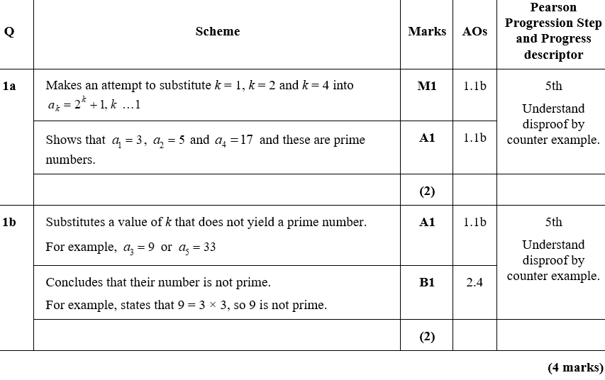
Practice A
A
B

Slide 4
Practice A

Slide 5
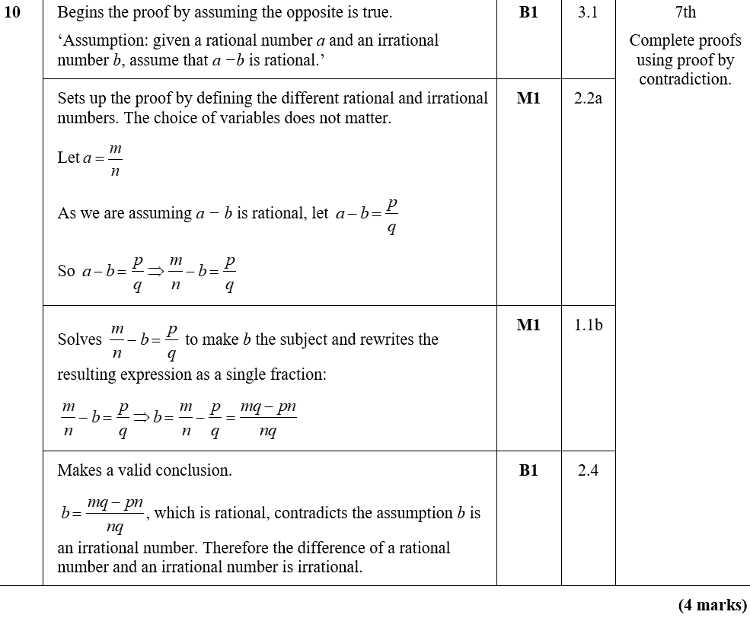
Practice A
A

Slide 6
Practice B

Slide 7
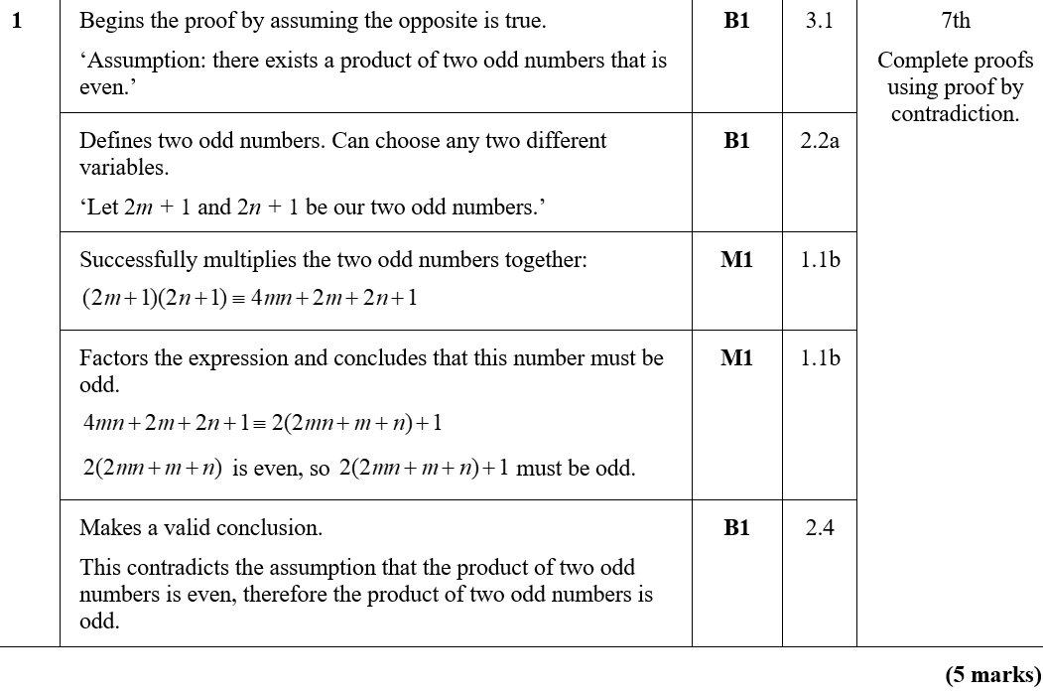
Practice B
A

Slide 8
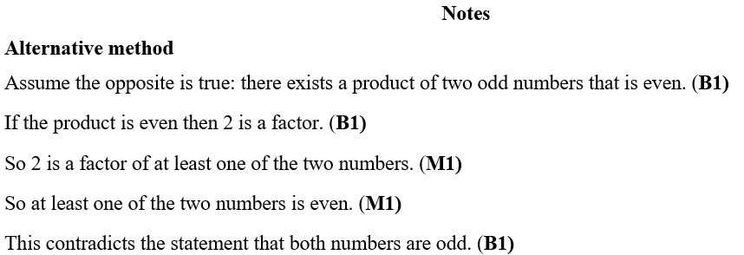
Practice B
Notes

Slide 9
Practice C

Slide 10
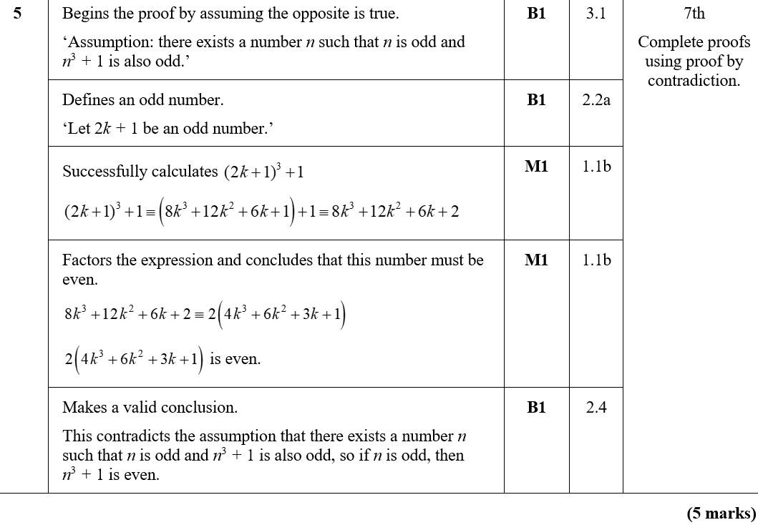
Practice C
A

Slide 11
Practice C
A

Slide 12
Practice C

Slide 13
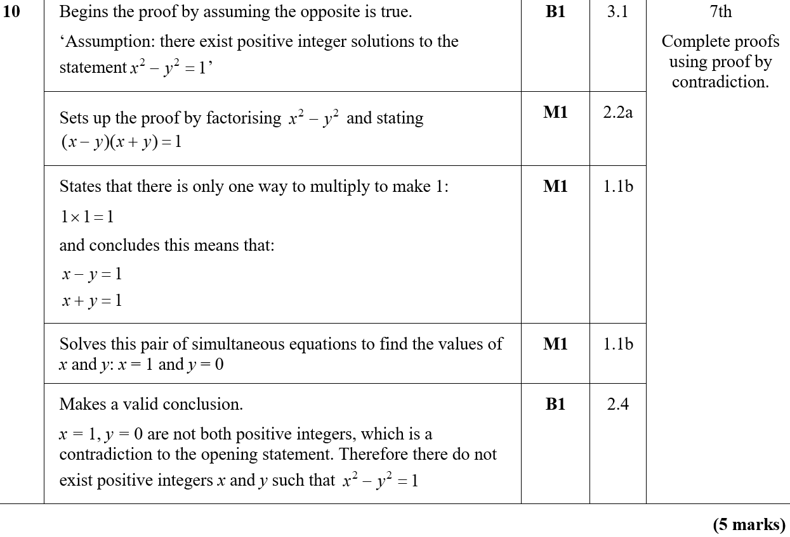
Practice C
A

Slide 14
Practice D

Slide 15
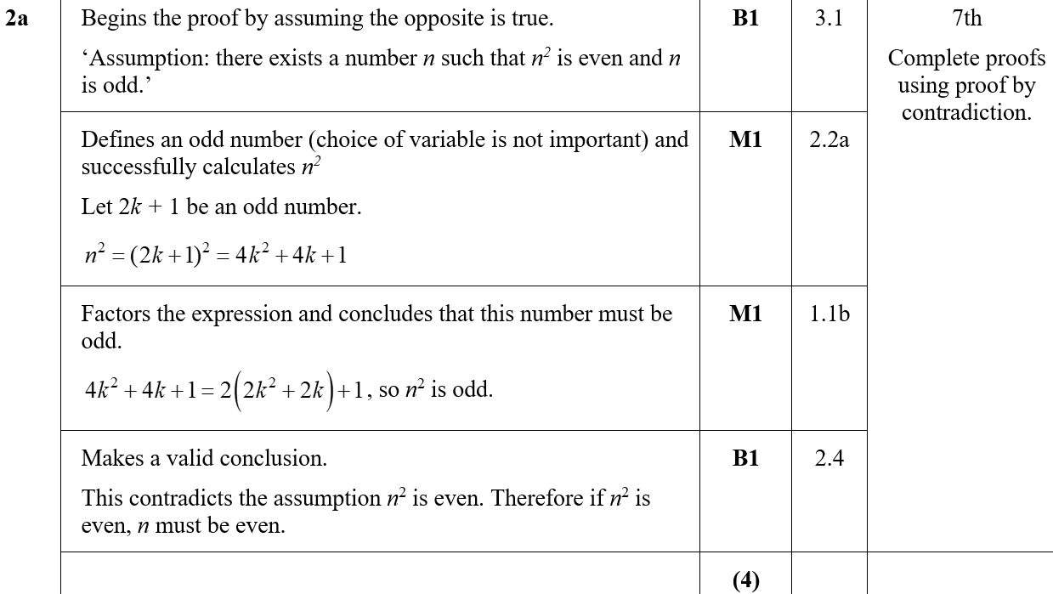
Practice D
A

Slide 16
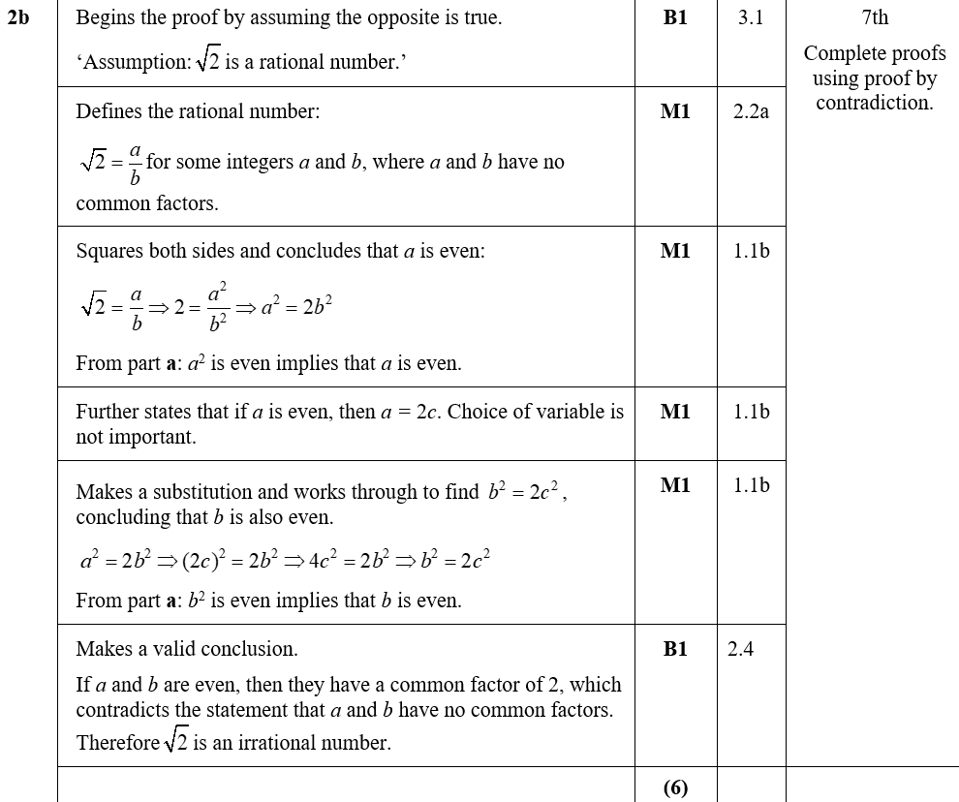
Practice D
B

Slide 17
Practice E

Slide 18
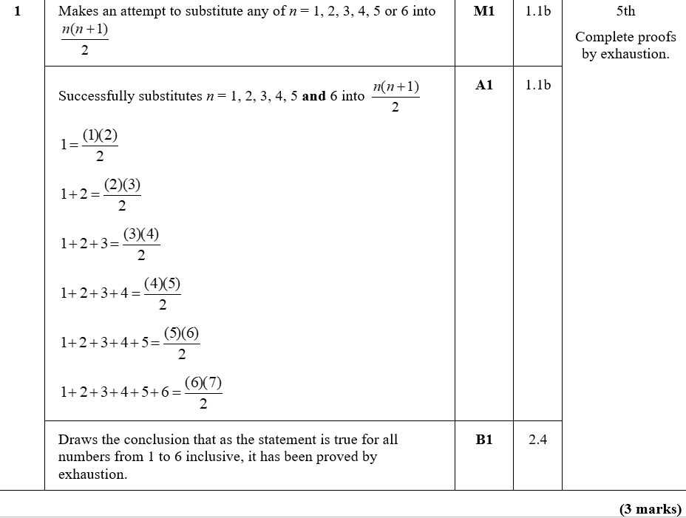
Practice E
A

Slide 19
Practice E

Slide 20
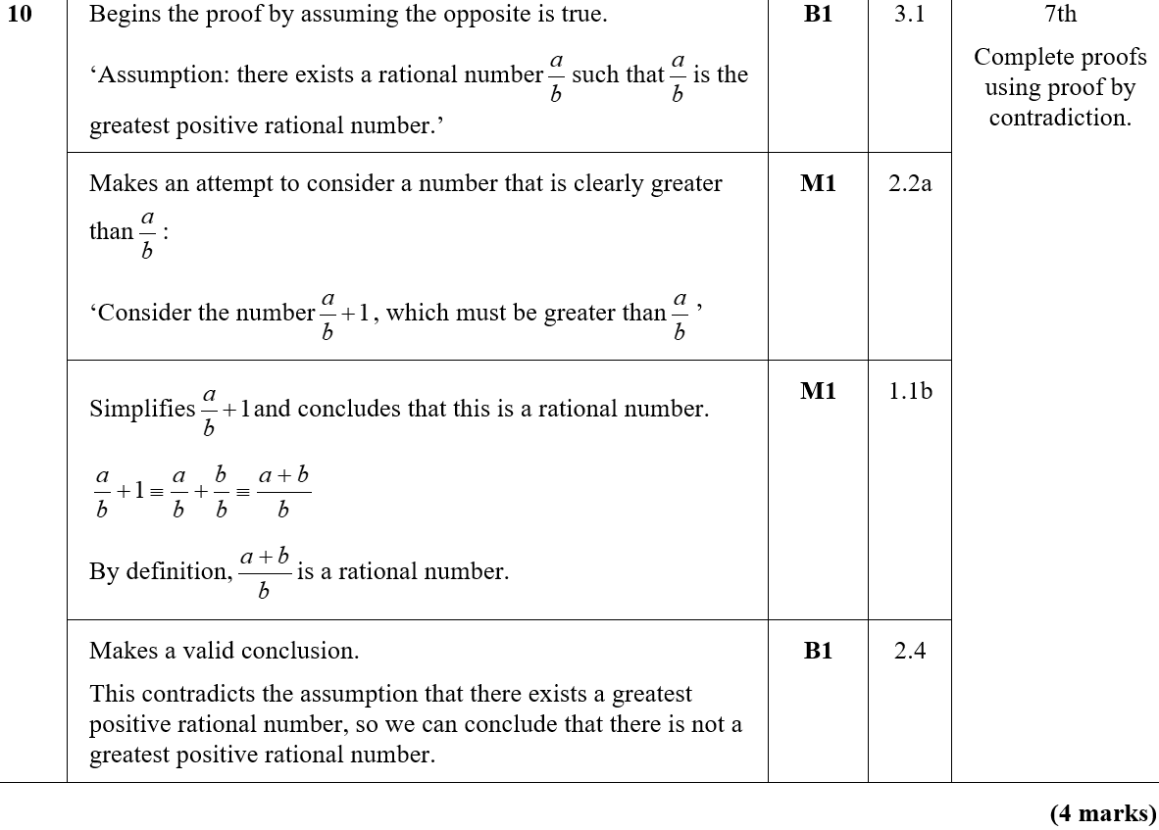
Practice E
A

Slide 21
Practice F

Slide 22
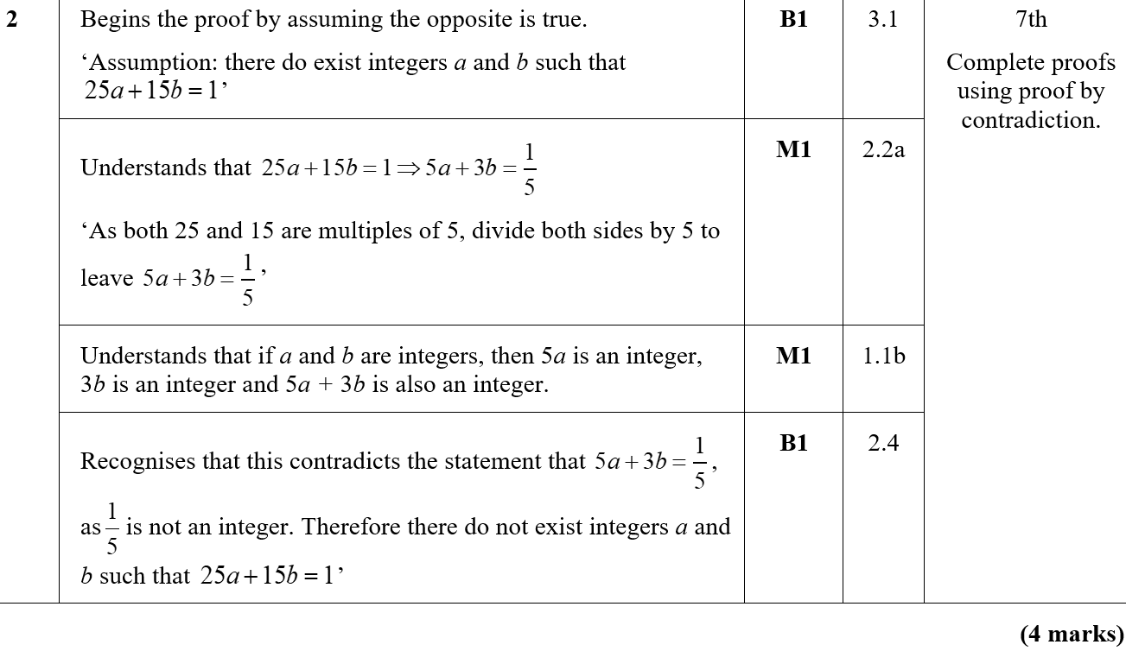
Practice F
A

Slide 23
Practice F

Slide 24
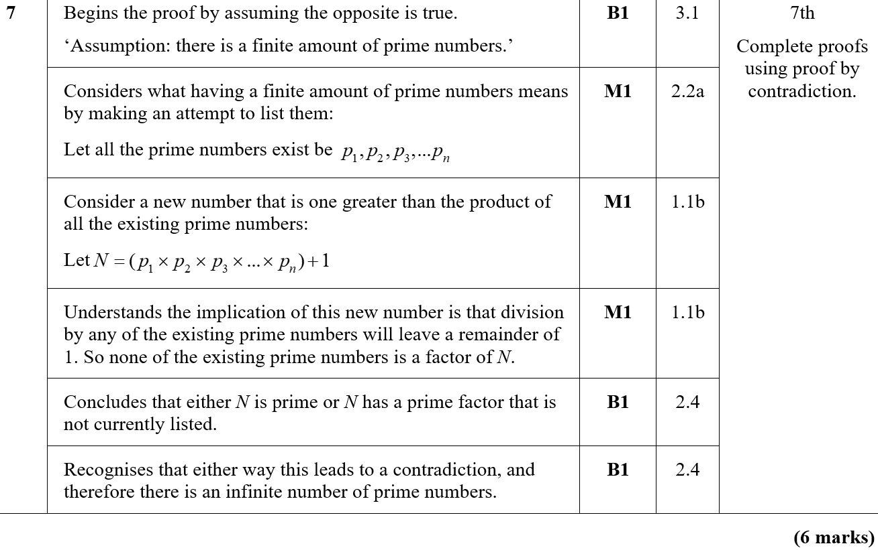
Practice F
A

Slide 25
Practice F
Notes

Slide 26
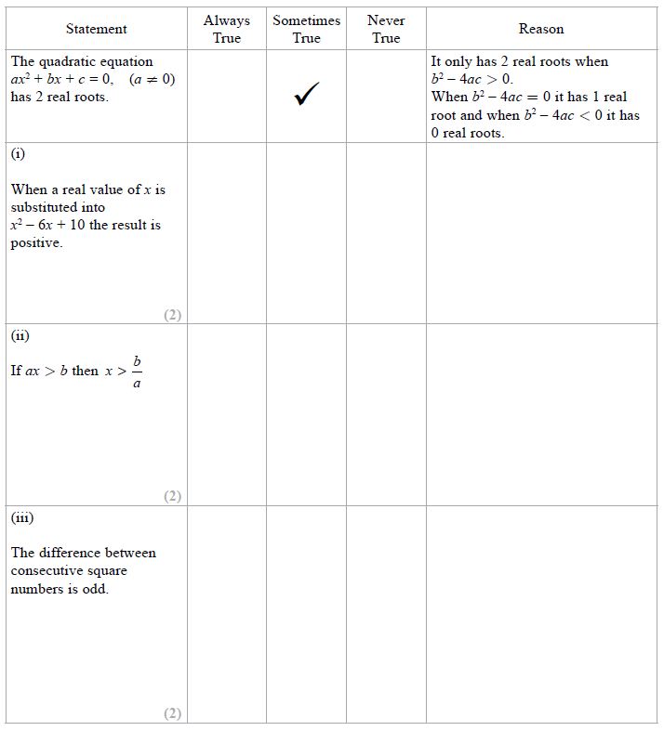
SAM Paper 2

Slide 27
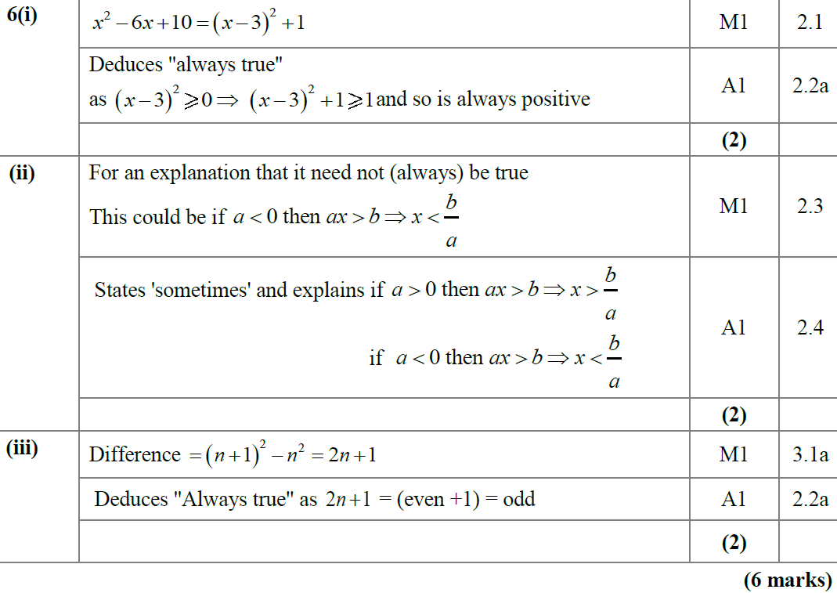
SAM Paper 2
i
ii
iii

Slide 28
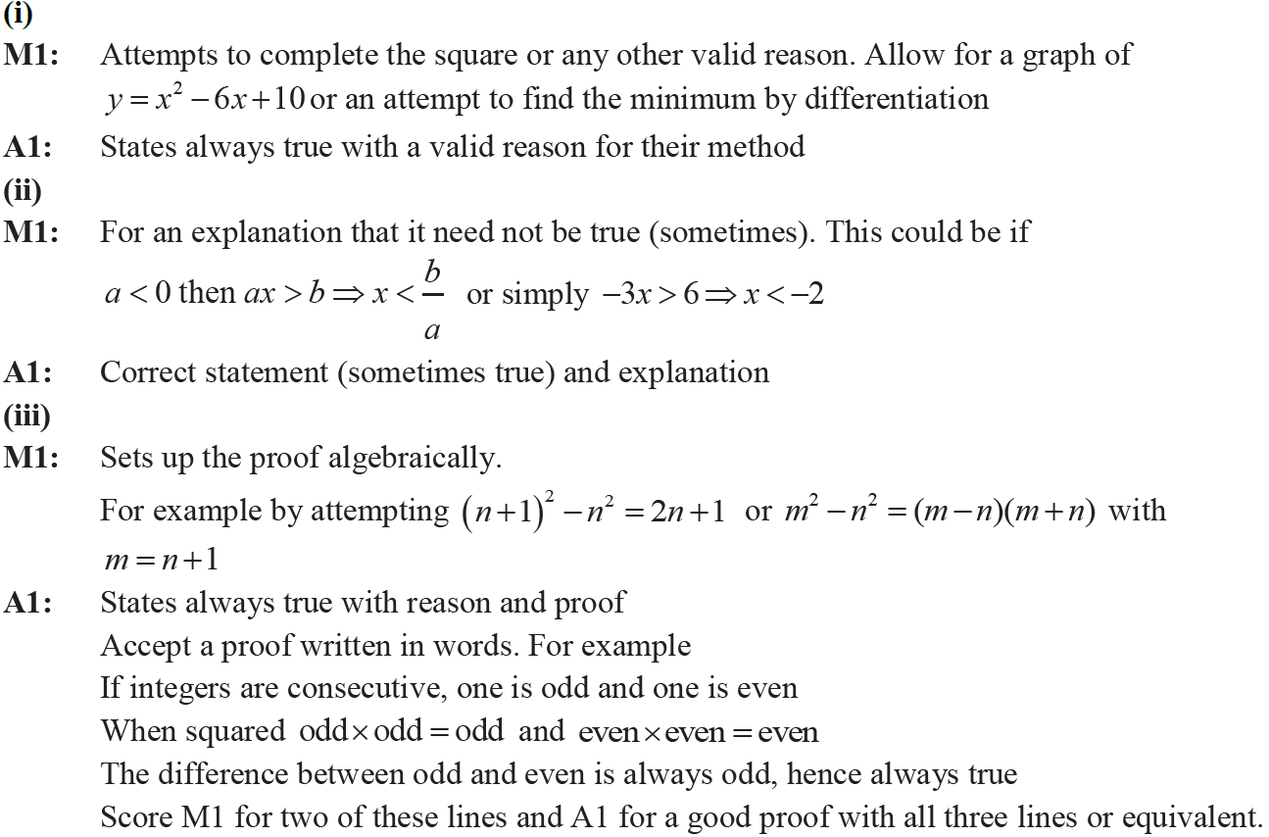
SAM Paper 2
i notes
ii notes
iii notes

Slide 29
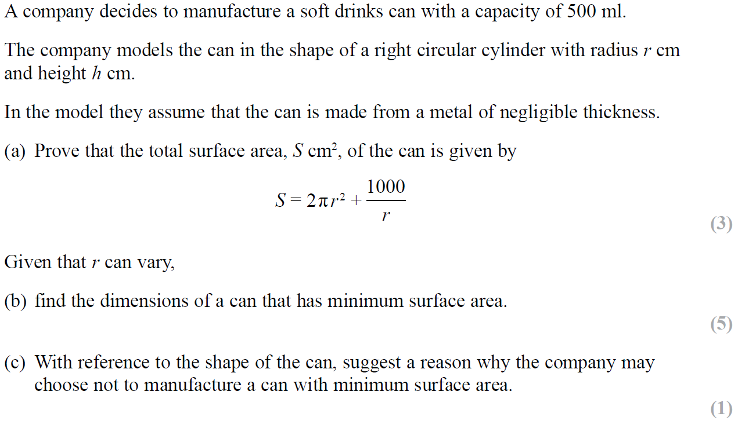
SAM Paper 2

Slide 30
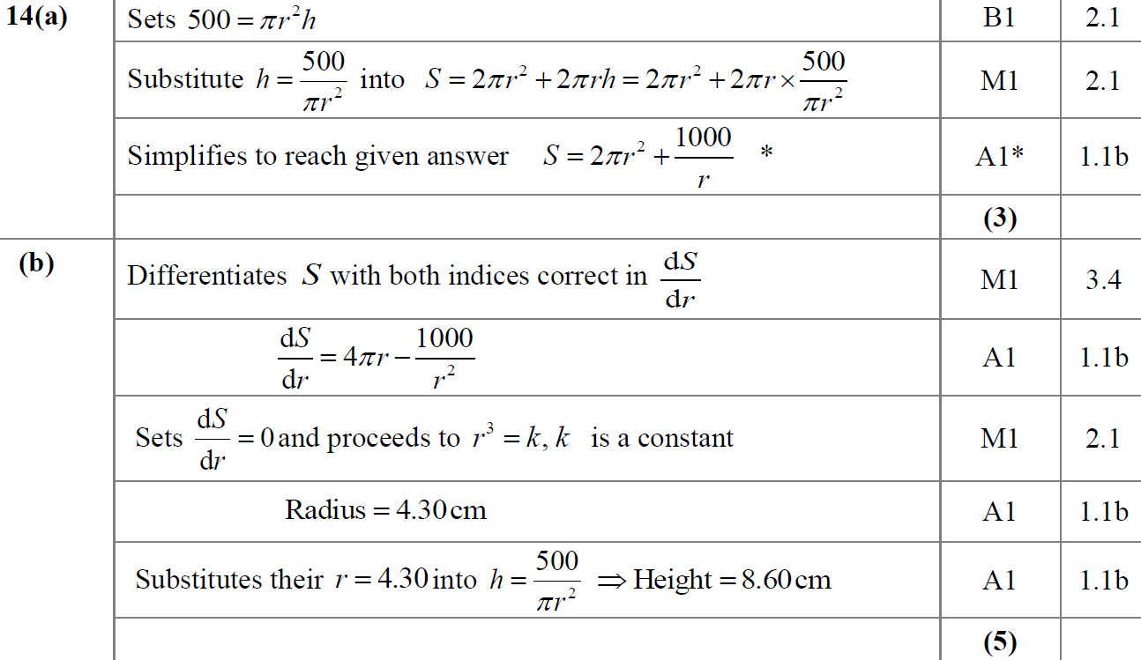
SAM Paper 2
A
B

Slide 31
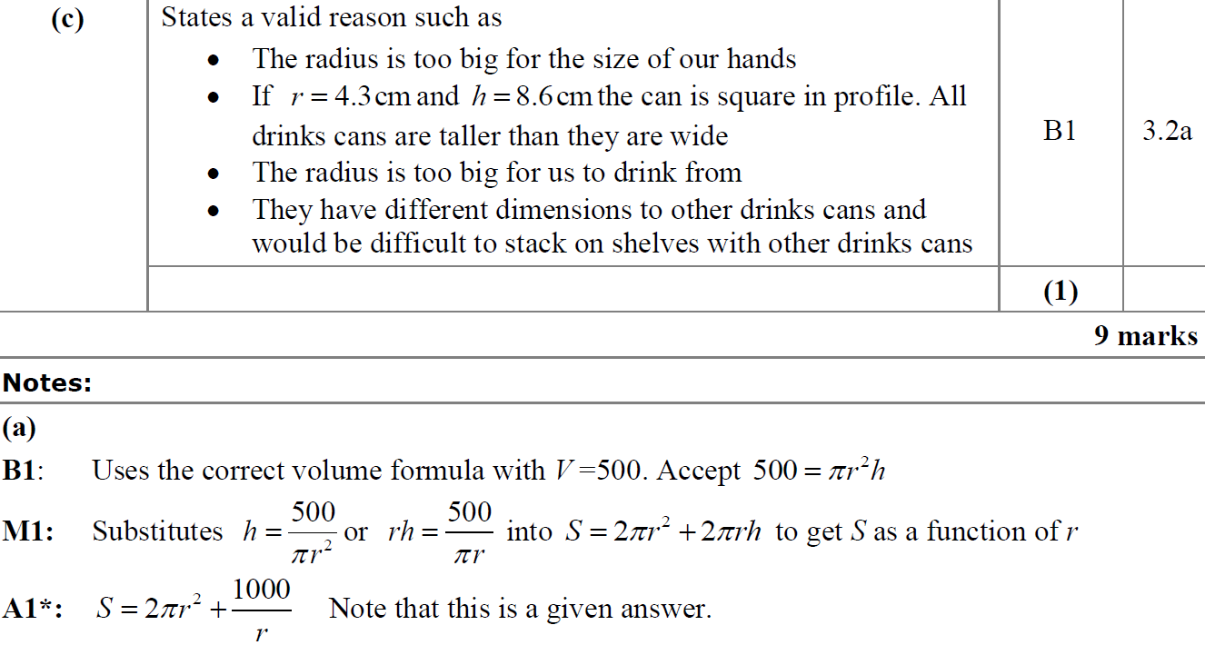
SAM Paper 2
C
A notes

Slide 32
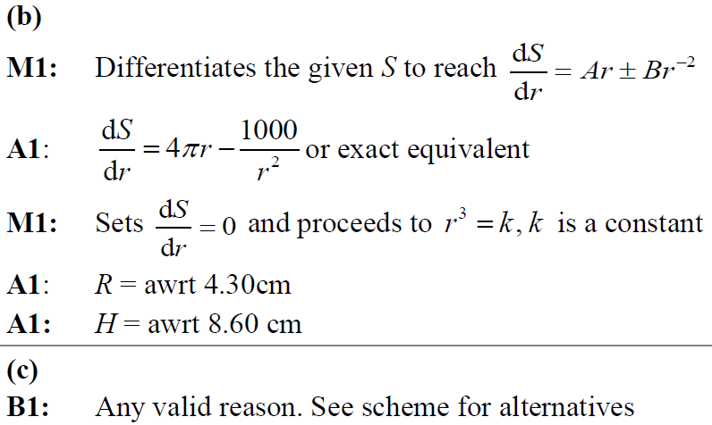
SAM Paper 2
B notes
C notes

Slide 33
2018 Paper 2

Slide 34
2018 Paper 2
A
A (SF)

Slide 35
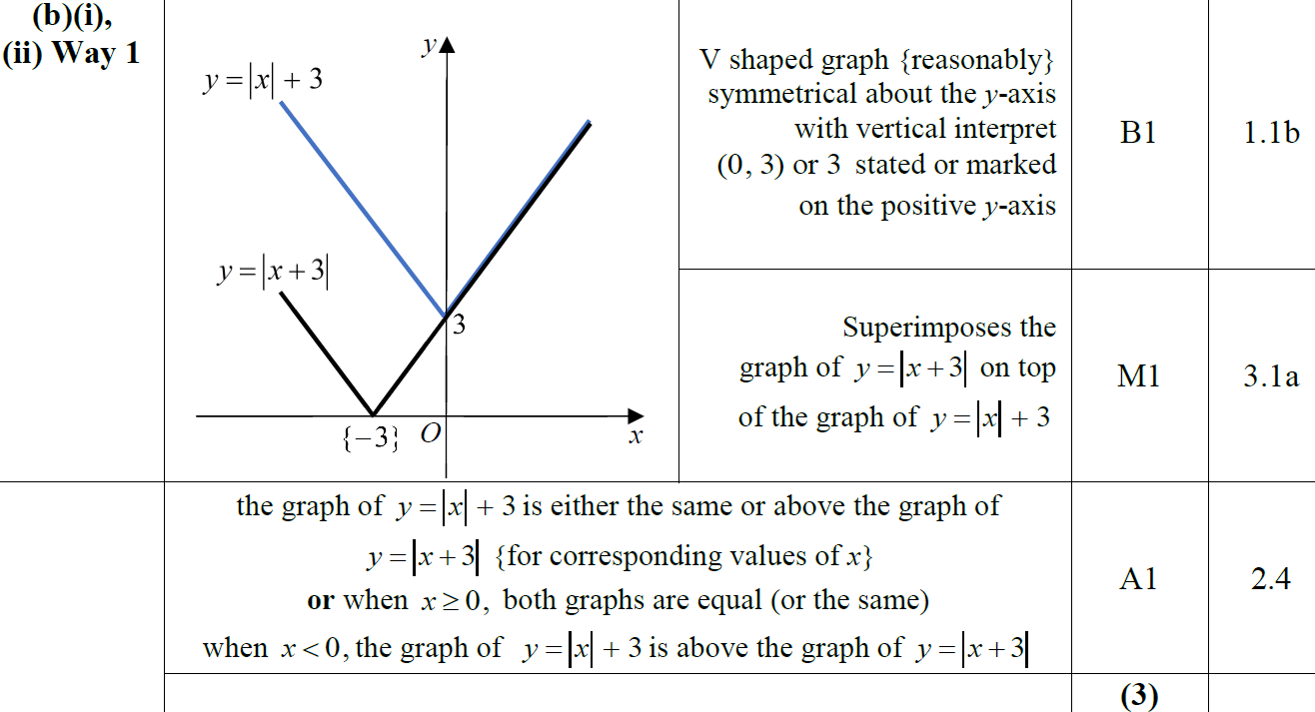
2018 Paper 2
B
B (ii) Alternatives

Slide 36
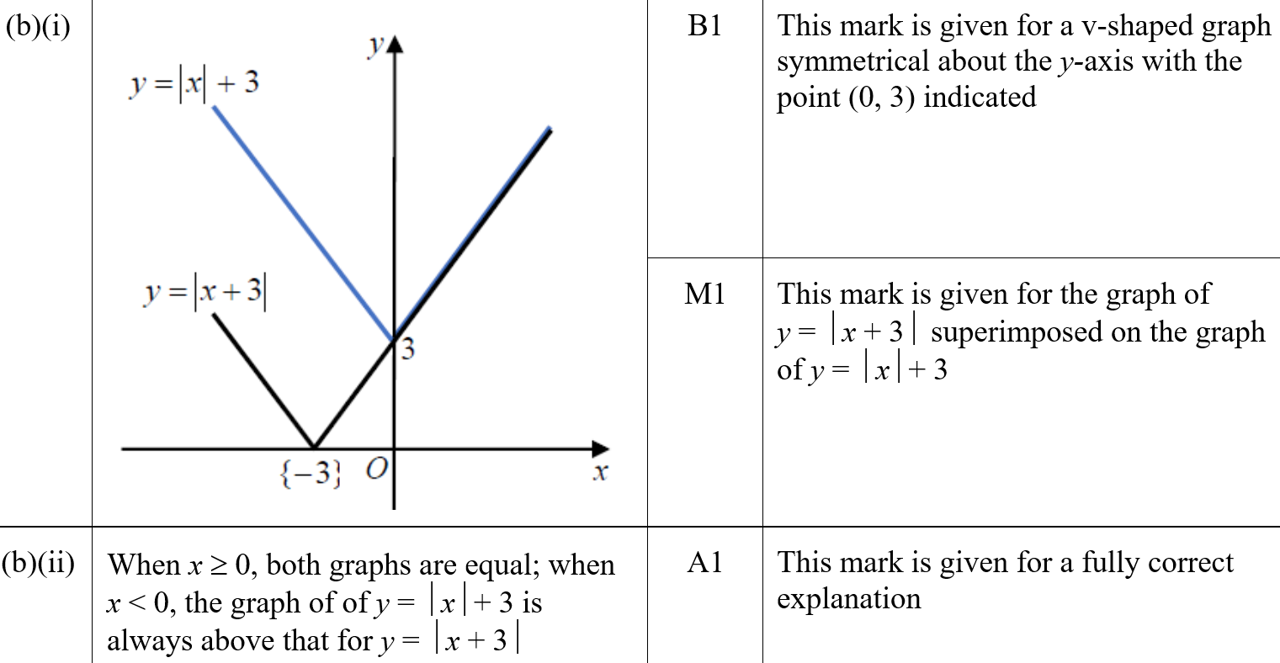
2018 Paper 2
B (i) (SF)
B (ii) (SF)

Slide 37
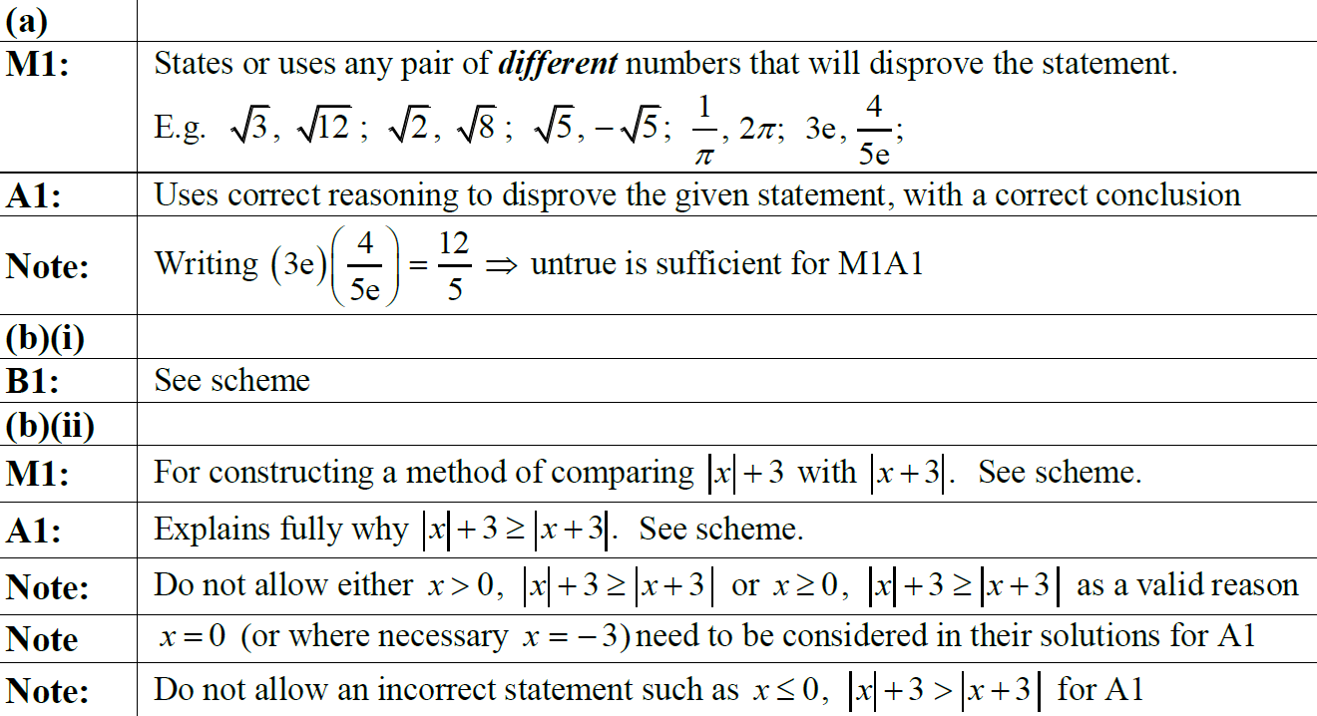
2018 Paper 2
A notes
B (i) notes
B (ii) notes

Slide 38
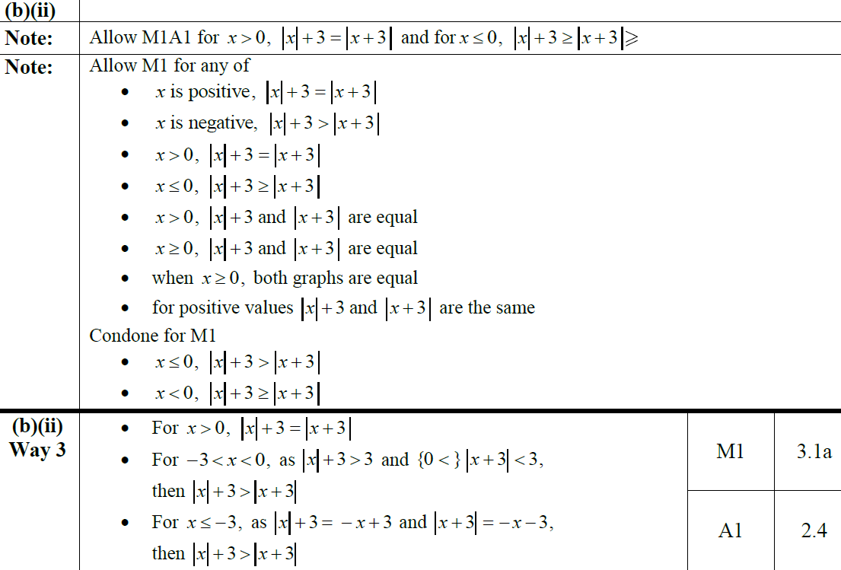
2018 Paper 2
B (ii) Alternatives notes

